Slide 1

SMART INDIA HACKATHON 2026
Problem Statement ID – 26092
Problem Statement Title – AI-Driven Scheme Matching for Marginalized Entrepreneurs
Theme- Smart Automation
PS Category- Software
Team ID -
Team Name - TechBizz

Slide 2


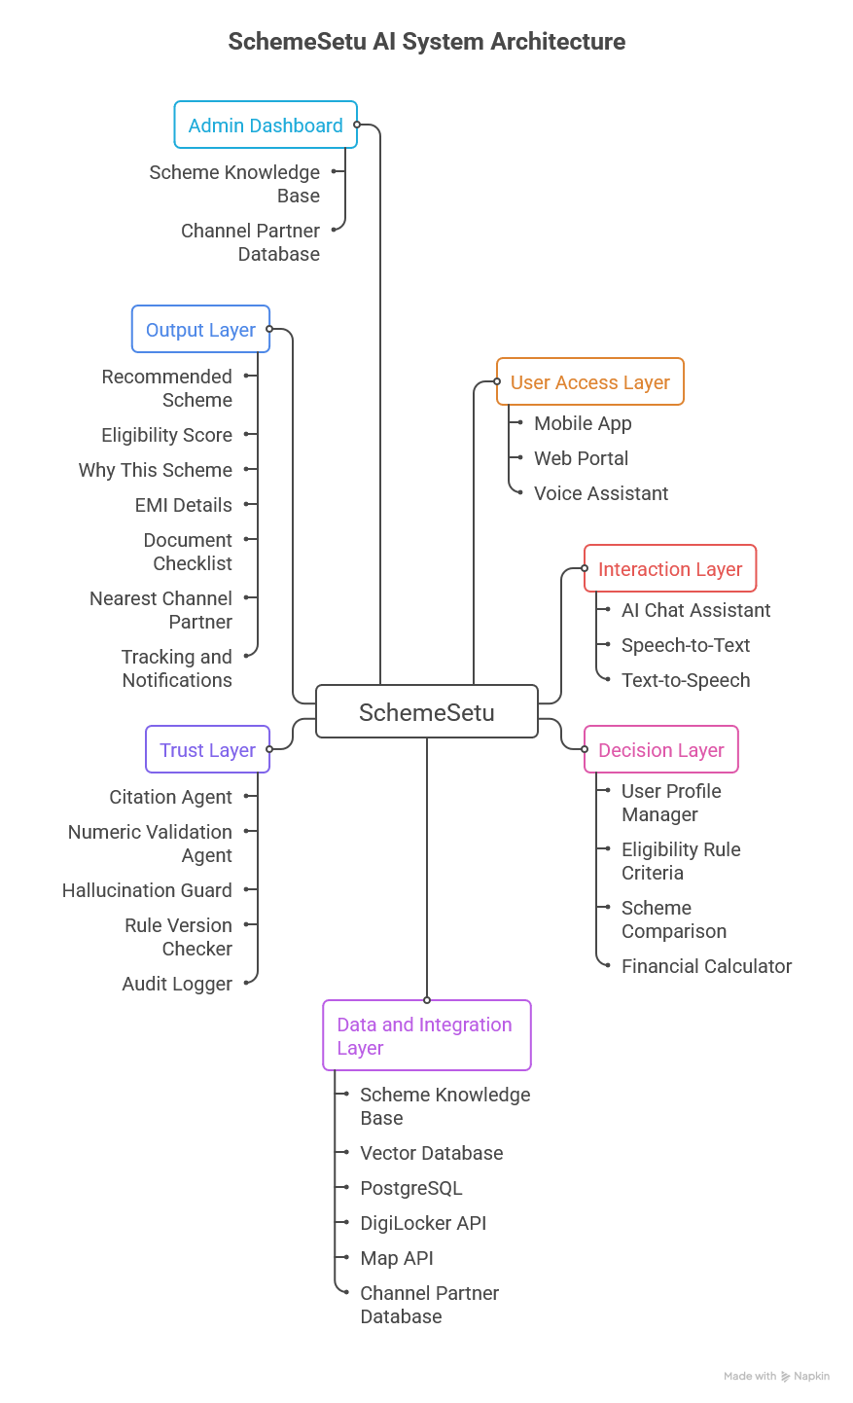
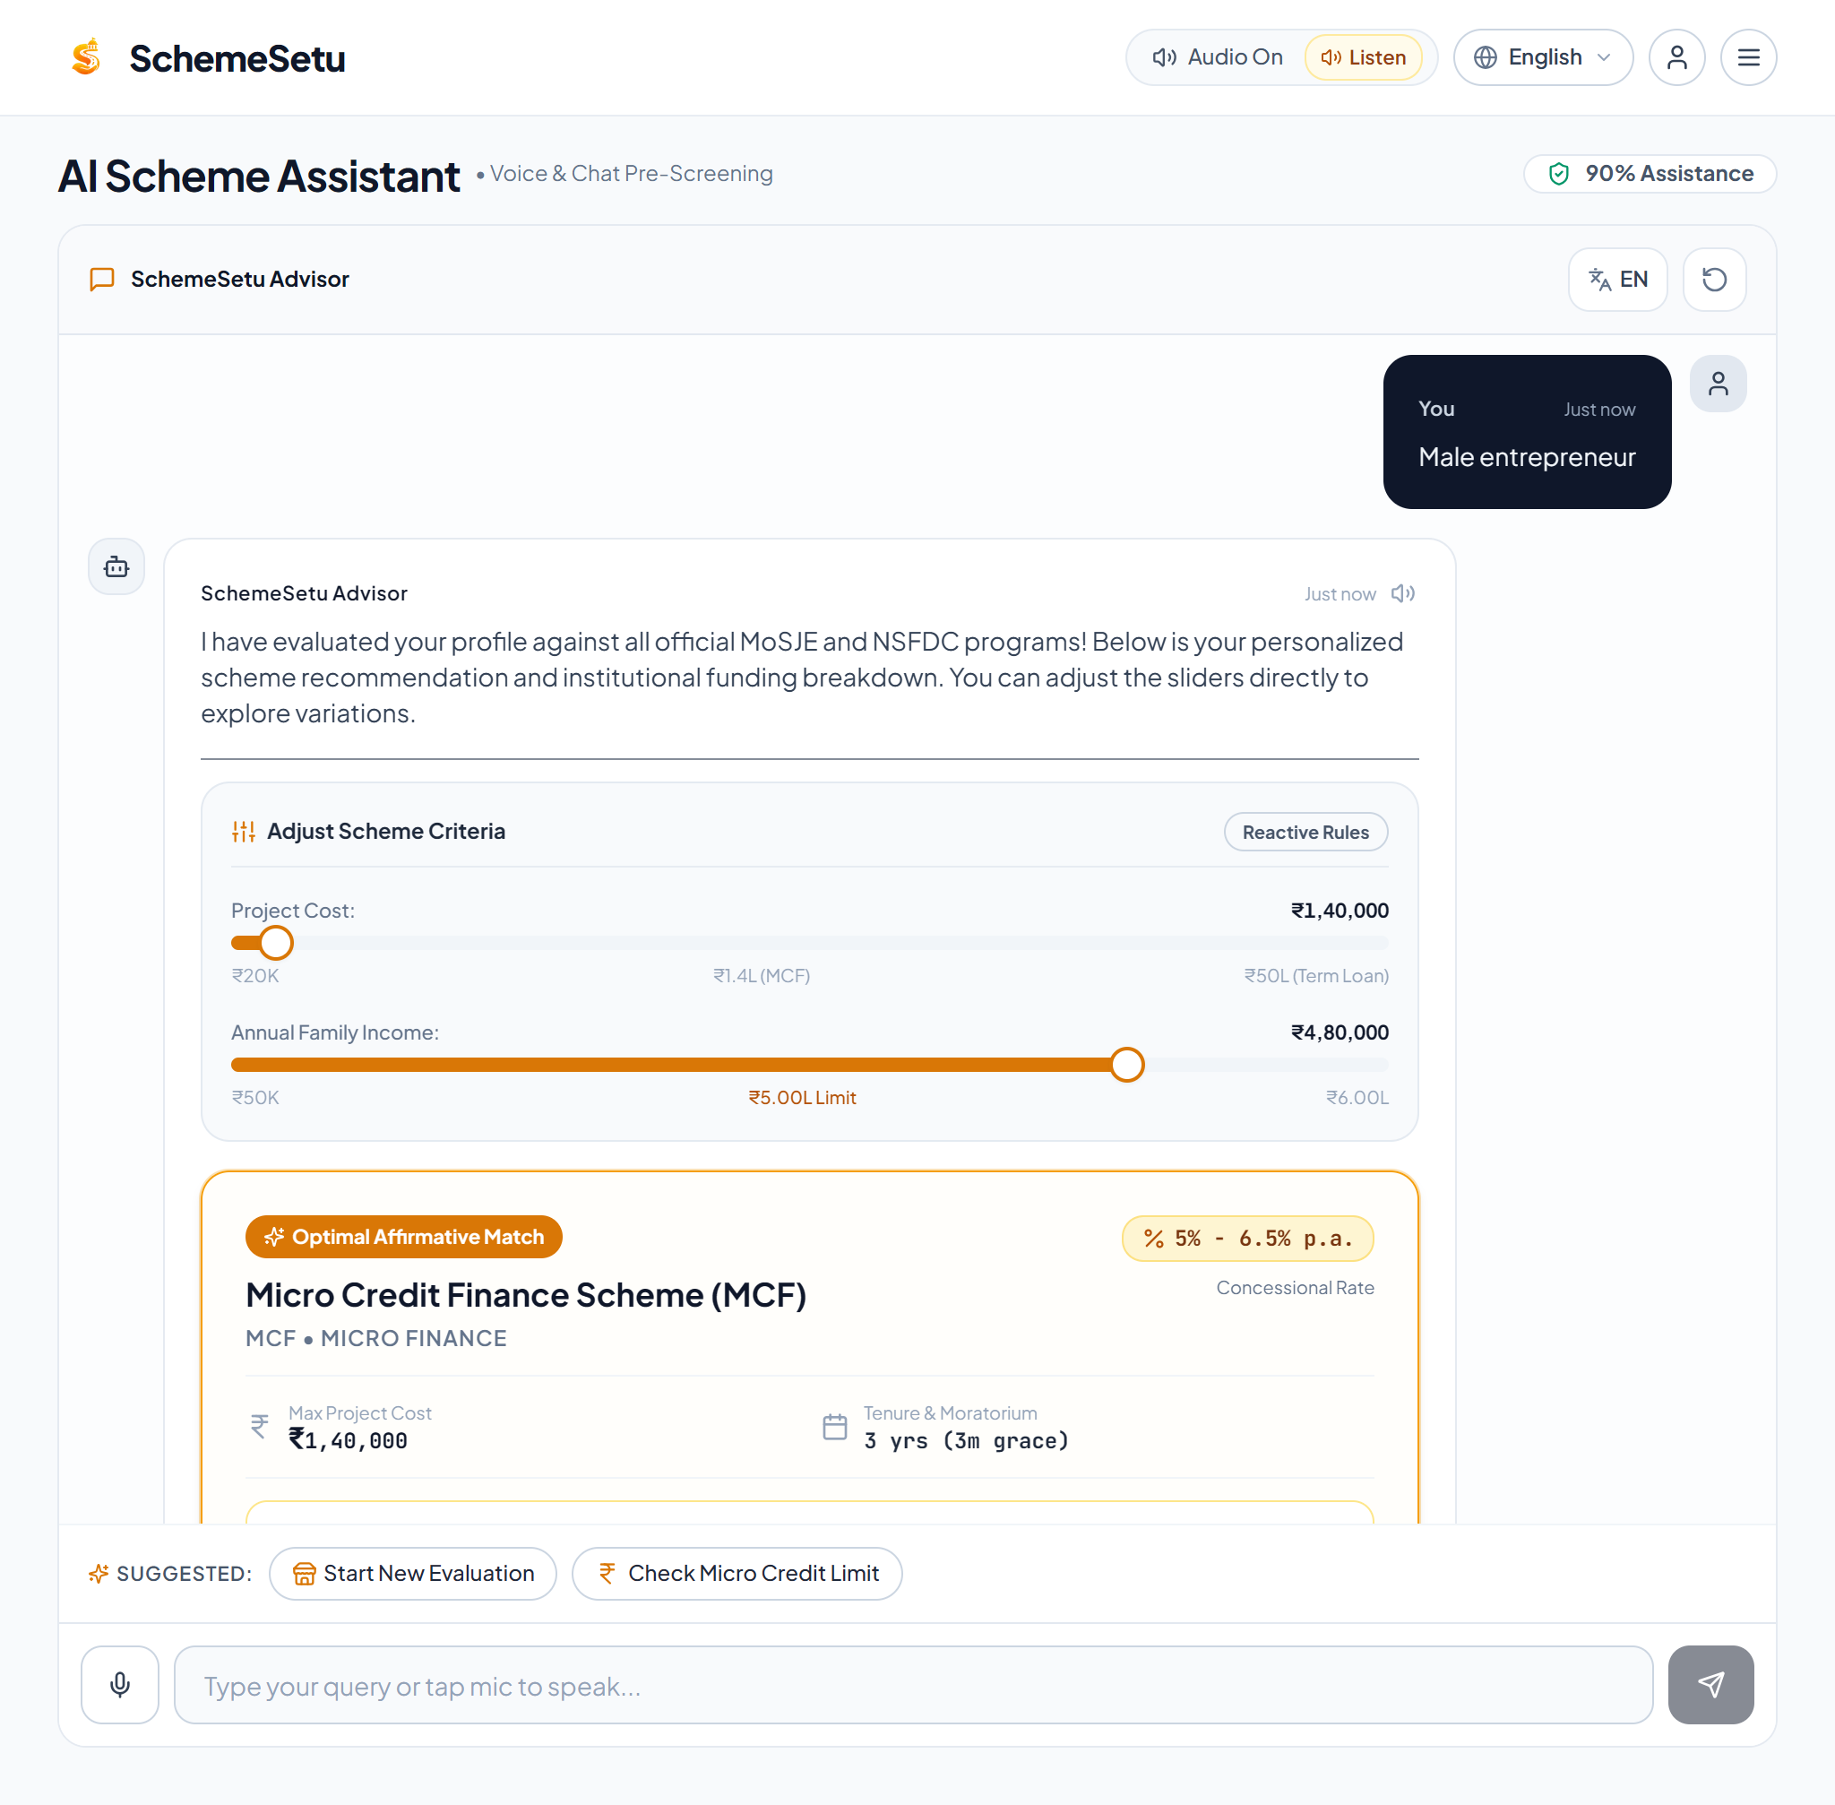
SchemeSetu
TechBizz
Proposed Solution
SchemeSetu is a multilingual, voice-enabled AI platform guiding beneficiaries from discovery to verified Channel Partners using official knowledge sources.
Key Features & USPs
✓ AI voice multilingual chat
✓ Smart scheme recommender with match score
✓ EMI & financial calculator
✓ Nearest partner locator (map-based)
✓ Local LLM for gov. data privacy
✓ Hallucination-proof, citation-backed AI
✓ DigiLocker document sync & tracking
Prototype Interface
SchemeSetu Architecture

Slide 3
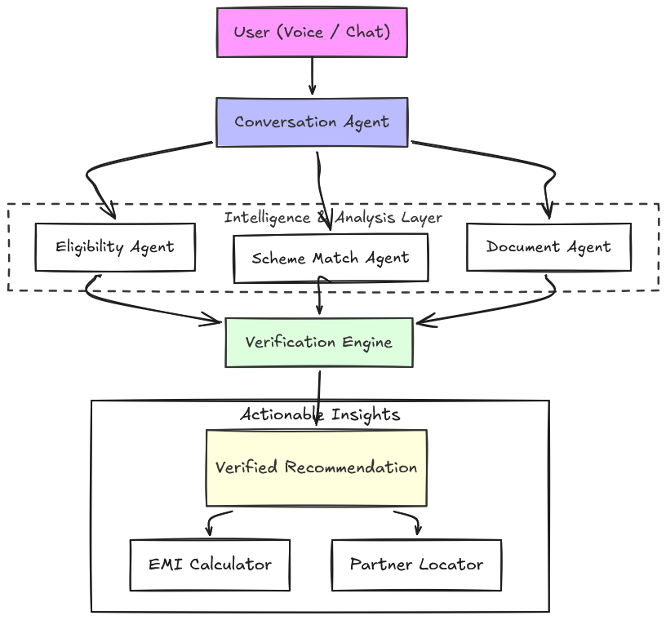
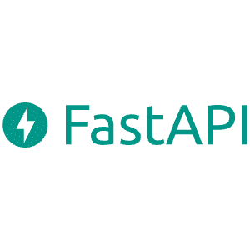











TECHNICAL APPROACH
Your Team Name
TechBizz
Component | Proposed Stack
Frontend | Flutter
Backend | FastAPI
Voice / Speech | Bhashini SDK / Whisper-Indic
AI | Local LLM (Ollama) + RAG
Embeddings | Sentence Transformers
Database | PostgreSQL + PostGIS
Maps | MapMyIndia API
Integration | DigiLocker / API Gateway
Security | Sovereign Local Inference, DigiLocker PKI Sync, JWT Session Auth
Deployment | Docker

Slide 4
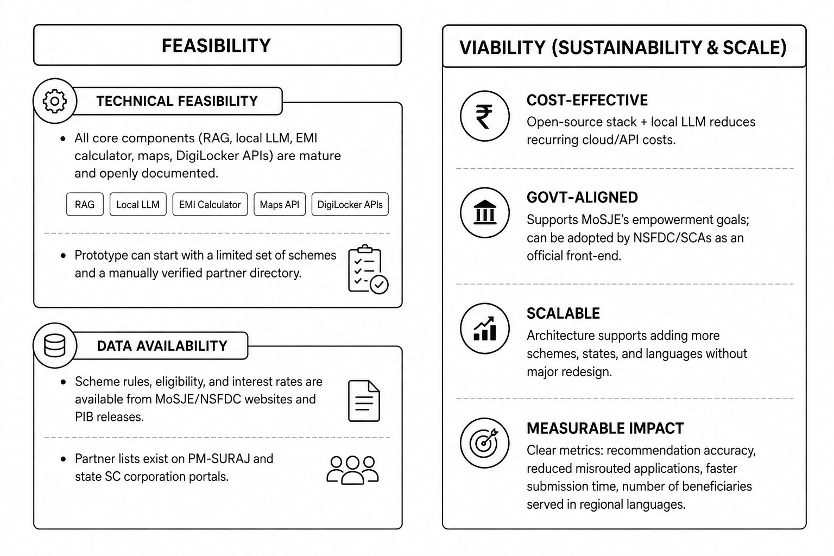
FEASIBILITY AND VIABILITY
Your Team Name
TechBizz
Challenge | Mitigation
Scheme rules change periodically | Versioned scheme database with effective dates
AI may provide incorrect information | Rule engine + grounded RAG + citations
Sensitive government data | Local LLM, encryption, consent, data minimization
Partner eligibility changes | Admin dashboard and periodic partner-data updates
Low digital literacy | Voice-first interface and assisted-service mode
Limited internet connectivity | Lightweight app, SMS alerts, and offline form saving
Language ambiguity | Human review option and multilingual validation
Note:
Zero Cloud Inference Overhead: Deploying quantized 4-bit local weights eliminates recurring token API expenses, keeping ongoing cloud infrastructure costs minimal for state agencies.
Low-Bandwidth Resilient: The progressive web interface caches essential rules and form schemas locally, ensuring high operational viability in low-connectivity 2G rural regions.
Non-Invasive Core Integration: Connects seamlessly with the existing PM-SURAJ portal and DigiLocker APIs without demanding costly retrofits to legacy banking or state agency databases.
Institutional Risk Safeguard: Programmatically filters out channel partners with high default or overdue rates, ensuring sustainable fund utilization and viable disbursal channels.
@SIH Idea submission- Template
4

Slide 5
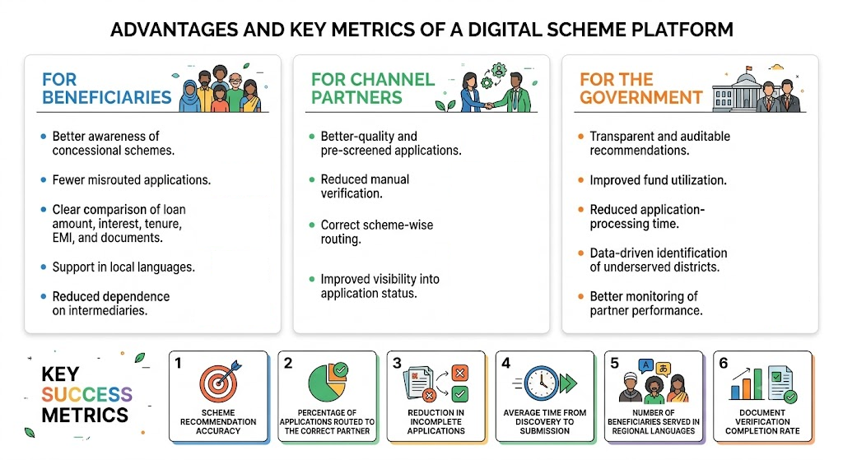
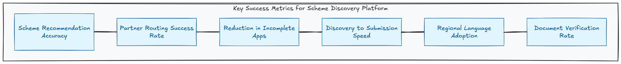
IMPACT AND BENEFITS
Your Team Name
TechBizz
Target Performance Indicators:
90% Reduction in Cycle Time: Drastically compresses the scheme-to-submission pipeline from a 45-day offline ordeal to under 5 minutes.
Zero Document Leakage: Ensures 100% data integrity and pre-verification via digital credential synchronization, dropping manual processing errors.
Dramatically Lower Rejection Rates: Delivers highly aligned, pre-screened application dossiers, increasing bank confidence and approval speeds.
Optimized Fund Utilization: Ensures government welfare funds are directed rapidly to active, credit-healthy channel partners with available limits.
Better awareness of preferential schemes.
Fewer misrouted applications.
Clear comparison of loan amount, interest, tenure, EMI, and documents.
Support in local languages.
Reduced dependence on intermediaries.
Better-quality and pre-screened applications.
Reduced manual verification.
Correct scheme-wise routing.
Improved visibility into application status.
Transparent and auditable recommendations.
Improved fund utilization.
Reduced application-processing time.
Data-driven identification of under-served districts.
Better monitoring of partner performance.

Slide 6

RESEARCH AND REFERENCES
Your Team Name
TechBizz
Primary Government Sources
Ministry of Social Justice & Empowerment (MoSJE) - Scheme policies and guidelines
NSFDC Official Website - Scheme details, eligibility and Channel Partners
PM-SURAJ Portal - Official application ecosystem
DigiLocker - Consent-based document access
PIB - Government announcements and policy updates
Privacy & Compliance
Digital Personal Data Protection Act, 2023 - Data privacy considerations
Feature / Capability | SchemeSetu (Ours) | PM-SURAJ Portal | myScheme | JanSamarth Portal | Haqdarshak
Voice-Enabled Multilingual Chat | ✓ 12+ Languages | ✗ | ✗ | ✗ | ✗
Local-AI Data Privacy (DPDP) | ✓ Local LLM | ✗ | ✗ | ✗ | ✗
Grounded Citations / Explanations | ✓ RAG-backed | ✗ | ✗ | ✗ | ✗
Interactive EMI & Grace Calculator | ✓ Dynamic Rules | ✗ | ✗ | ✗ Commercial Only | ✗
Real-Time Partner NPA Health Routing | ✓ PostGIS-based | ✗ | ✗ | ✗ | ✗
Requires Human Intermediary | ✗ Self-Service | ✗ | ✗ | ✗ | ✓ Field Agents
Note: SchemeSetu solves specific problem of MoSJE, which does not have any current implemented private or government competitors.
Github: SchemeSetu Github
Live: SchemeSetu

