Slide 1
DEPARTMENT OF COMPUTER SCIENCE & ENGINEERING
CST463 - WEB PROGRAMMING
10 November 2025
Notes:
Welcome the participants to the program.
Introduce yourself and briefly summarize your experience at EY and your interest in presenting at Welcome to EY.
Have co-facilitators, if present, introduce themselves and provide background information.
State the following to help participants understand the context of Welcome to EY:
This course was designed for all ranks around the globe. It provides you with foundational knowledge that will help to explain our culture, our processes and how we go to market.
However, your service line will provide the specifics about your role and your job.
As an organization, we want to invest in you, give you consistent content globally, let you meet other new hires across service lines and meet some of our leaders.

Slide 2

CST463 - WEB PROGRAMMING

Slide 3
Module 4 (CO3, Cognitive Knowledge Level: Apply)
Form processing and Business Logic
Cookies- Sessions
MySQL Integration-Connecting to MySQL with PHP
Performing CREATE, DELETE, INSERT, SELECT and UPDATE operations on MySQL table
Working with MySQL data
Reading from Database-Dynamic Content.

Slide 4
Form processing and Business Logic

Slide 5
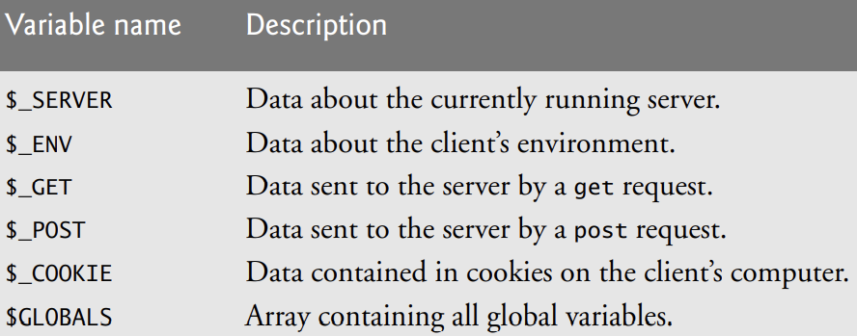
Form processing
Superglobal arrays are associative arrays predefined by PHP that hold variables acquired from user input, the environment or the web server, and are accessible in any variable scope. Some of PHP’s superglobal arrays
The arrays $_GET and $_POST retrieve information sent to the server by HTTP get and post requests, respectively, making it possible for a script to have access to this data when it loads another page

Slide 6
Form processing
when PHP is used for form handling, the PHP script is embedded in an XHTML document, like other uses of PHP.
The recommended approach is to use the implicit arrays for form values, $_POST and $_GET.
These arrays have keys that match the form element names and values that were input by the client.
For example, if a form has a text box named phone and the form method is POST, the value of that element is available in the PHP script as follows:
$_POST["phone"]
The built-in $_GET function is used to collect values from a form sent with method="get".
Information sent from a form with the GET method is visible to everyone and has limits on the amount of information to send (max. 100 characters).

Slide 7
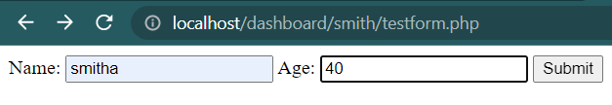
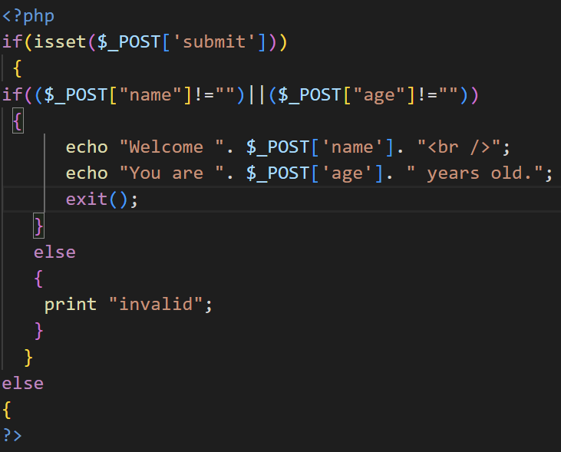
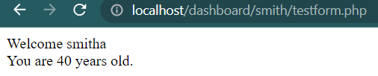

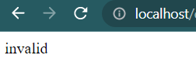
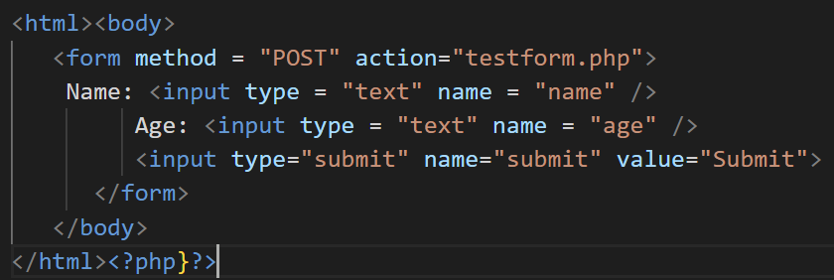
Form processing $_POST Function

Slide 8
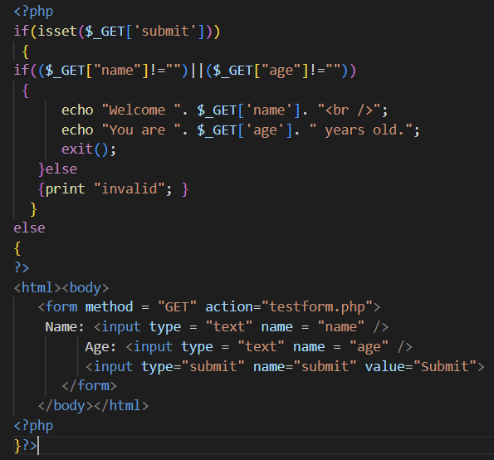
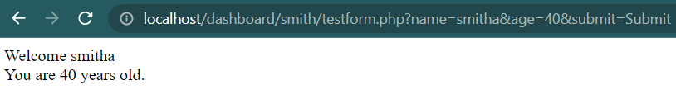
Form processing $_GET Function

Slide 9
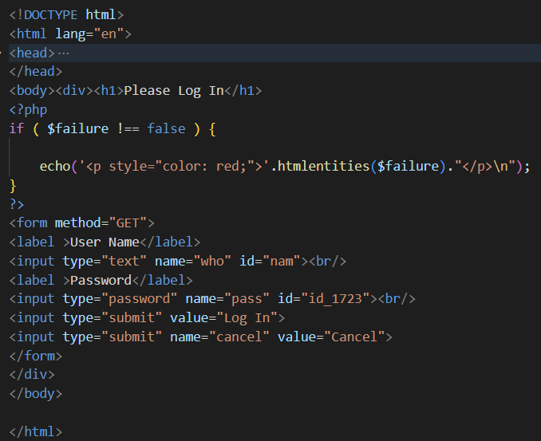
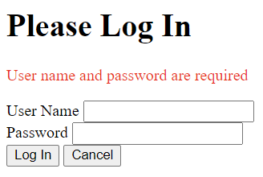
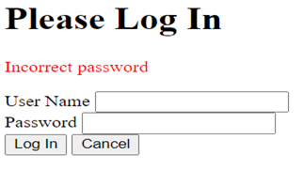

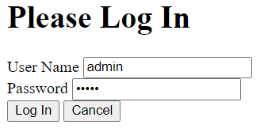
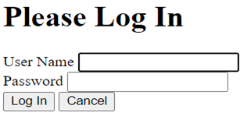
Form processing

Slide 10
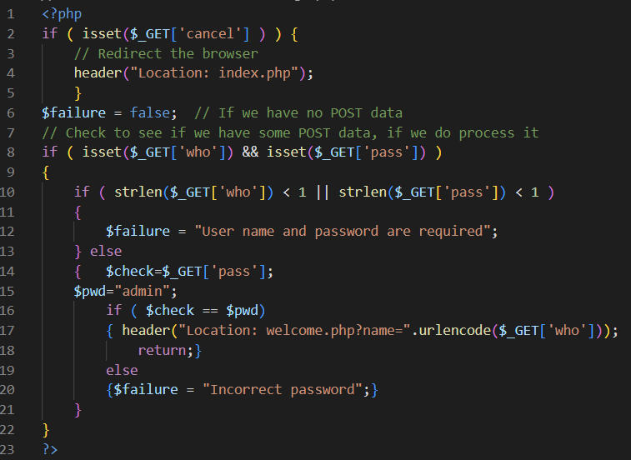
Form processing

Slide 11
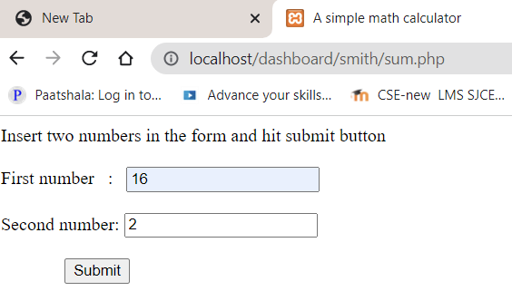
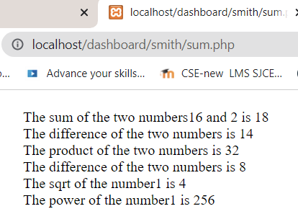
Simple PHP Program to generate a simple calculator
To find basic mathematical operations on two numbers

Slide 12
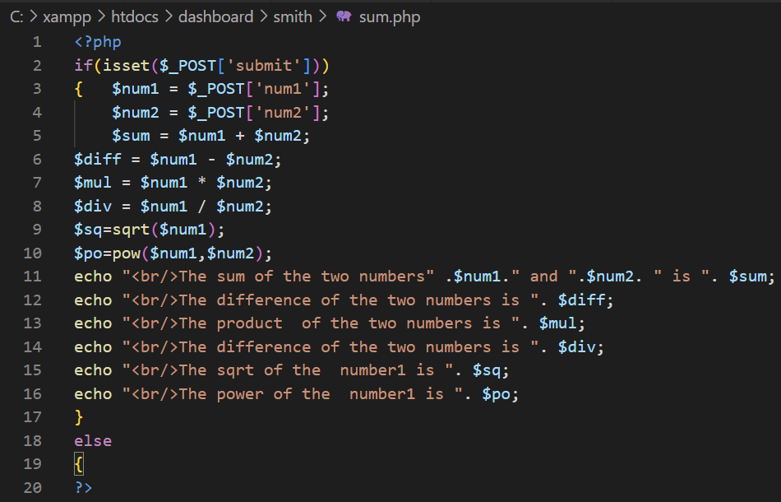
Simple PHP Program to generate a simple calculator
To find basic mathematical operations on two numbers

Slide 13
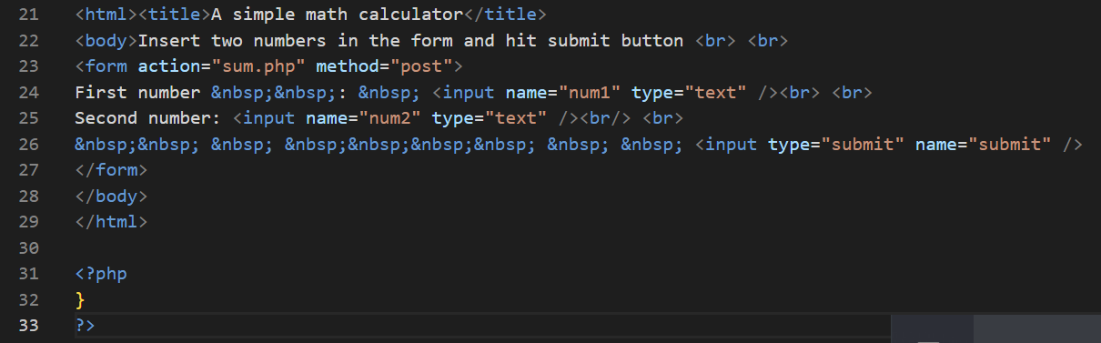
Simple PHP Program to generate a simple calculator
To find basic mathematical operations on two numbers

Slide 14
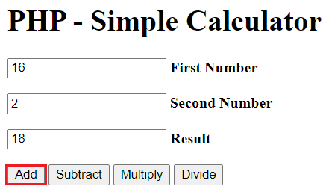
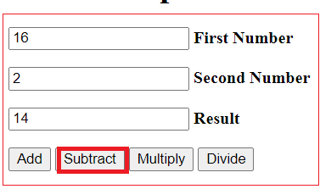
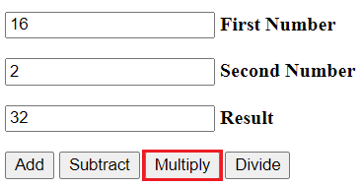
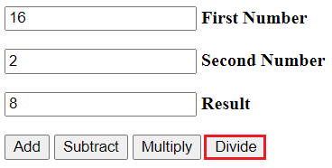
Modified PHP Program to generate a simple calculator
To find basic mathematical operations on two numbers

Slide 15
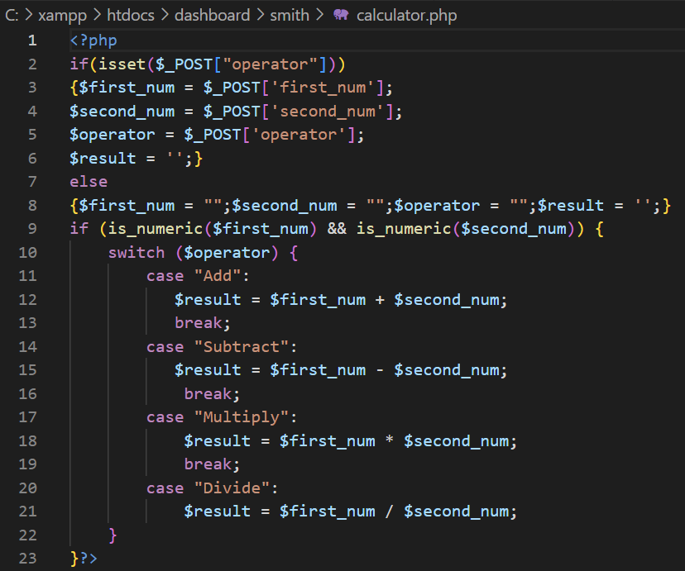
Modified PHP Program to generate a simple calculator

Slide 16
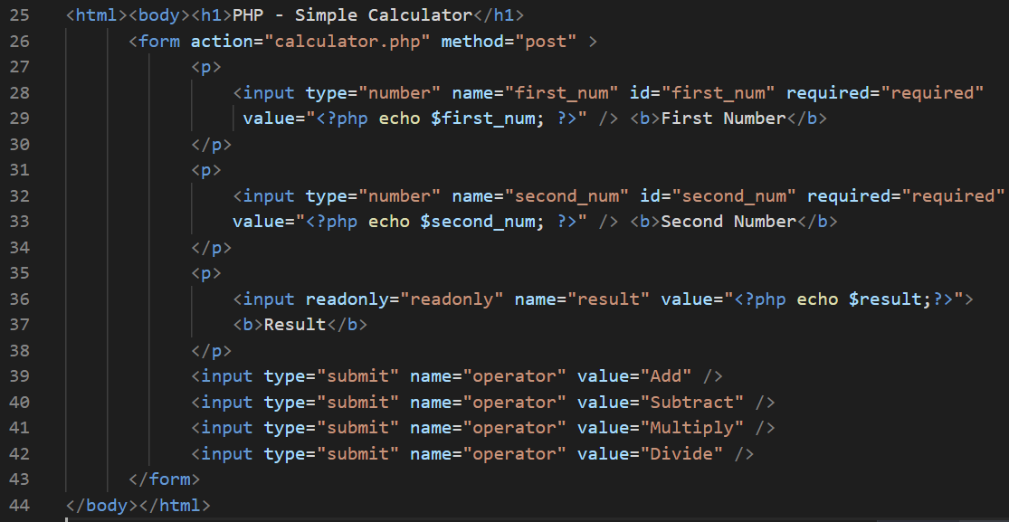
Modified PHP Program to generate a simple calculator

Slide 17
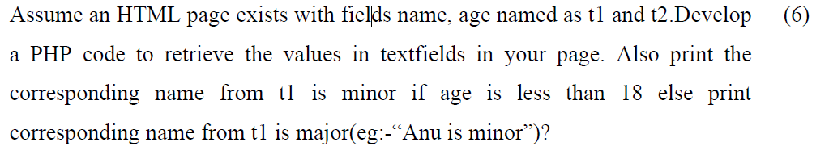
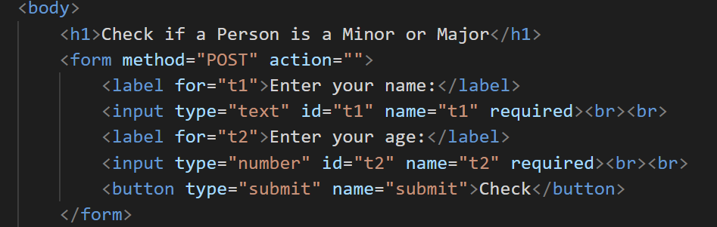
University Question

Slide 18
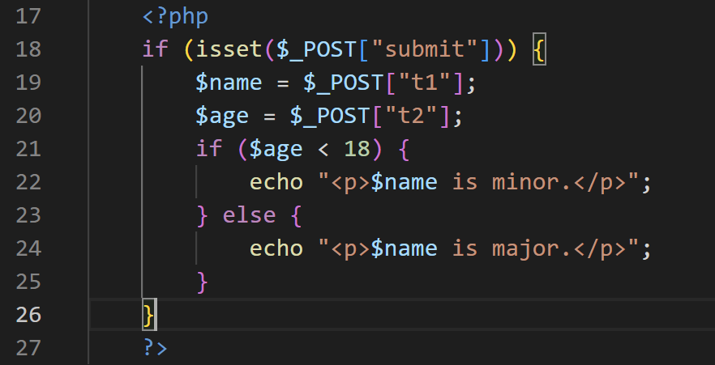
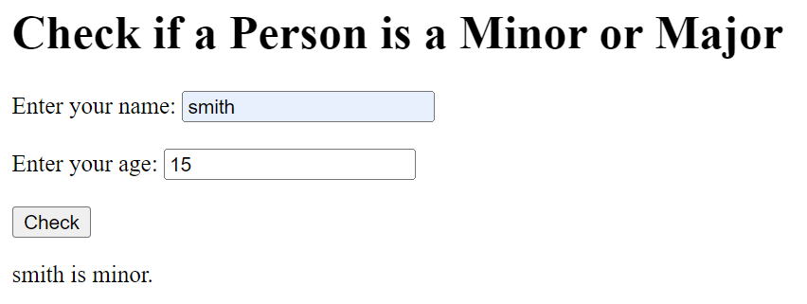
University Question

Slide 19
Cookies and Session

Slide 20
Cookies
A cookie is often used to identify a user.
A cookie is a small file that the server embeds on the user's computer.
Each time the same computer requests a page with a browser, it will send the cookie too.
With PHP, you can both create and retrieve cookie values.
Cookies provide a general approach to storing information about sessions on the browser system itself.
The server is given this information when the browser makes subsequent requests for Web resources from the server.
Cookies allow the server to present a customized interface to the client.
They also allow the server to connect requests from a particular client to previous requests, thereby connecting sequences of requests into a session.

Slide 21
Cookies
A cookie is a small object of information that consists of a name and a textual value.
A cookie is created by some software system on the server.
A message from a browser to a server is a request; a message from a server to a browser is a response. The header part of an HTTP communication can include cookies. So, every request sent from a browser to a server, and every response from a server to a browser, can include one or more cookies.
At the time it is created, a cookie is assigned a lifetime. When the time a cookie has existed reaches its associated lifetime, the cookie is deleted from the browser's host machine.
a particular cookie is information that is exchanged exclusively between one specific browser and one specific server.

Slide 22
Cookies- setcookie function
A cookie is set in PHP with the setcookie function. This function takes one or more parameters.
setcookie(name, value, expire, path)
The first parameter, which is mandatory, is the cookie's name given as a string. The second, if present, is the new value for the cookie, also a string. If the value is absent, setcookie undefines the cookie. The third parameter, when present, is the expiration time in seconds for the cookie, given as an integer.
The default value for the expiration time is zero, which specifies that the cookie is destroyed at the end of the current session
setcookie(“valid", "true", time() + 86400);
This call creates a cookie named "valid" whose value is "true" and whose lifetime is one day (86,400 is the number of seconds in a day).

Slide 23
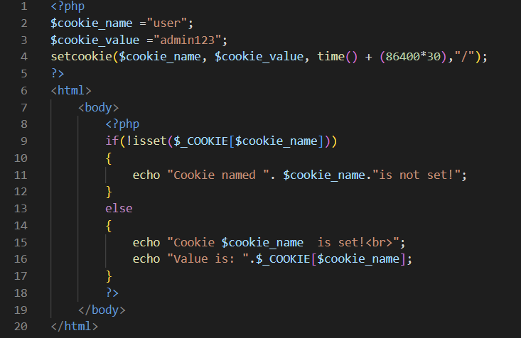
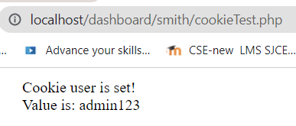
Cookies- setcookie function

Slide 24
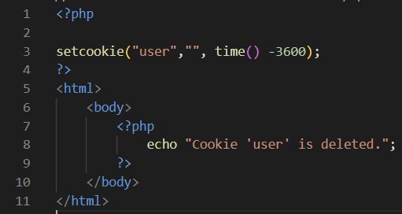
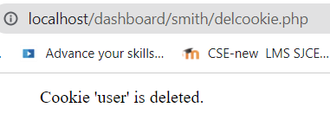
Cookies- setcookie-delete function
The example creates a cookie named "user" with the value “admin123".
The cookie will expire after 30 days (86400 * 30).
The "/" means that the cookie is available in entire website (otherwise, select the directory you prefer).
retrieve the value of the cookie "user" (using the global variable $_COOKIE).
use the isset() function to find out if the cookie is set:
To delete a cookie, use setcookie() function with an expiration date in the past:
Example

Slide 25
Cookies- setcookie function
In PHP, cookie values are treated much like form values.
All cookies that arrive with a request are placed in the implicit $_COOKIES array, which has the cookie names as keys and the cookie values as values.
most browsers have a limit on the number of cookies that will be accepted from a particular server site.
In many cases, information about a session is needed only during the session
Rather than using one or more cookies, a single session array can be used to store information about the previous requests of a client during a session.
In particular, session arrays often store a unique session ID for a session.

Slide 26
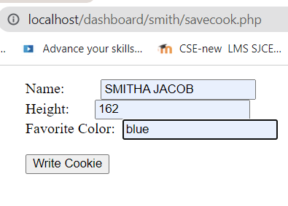
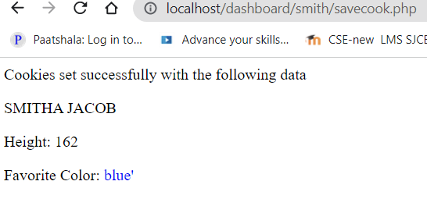
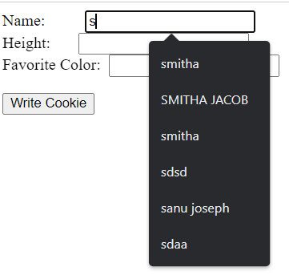
Cookies- setcookie function

Slide 27
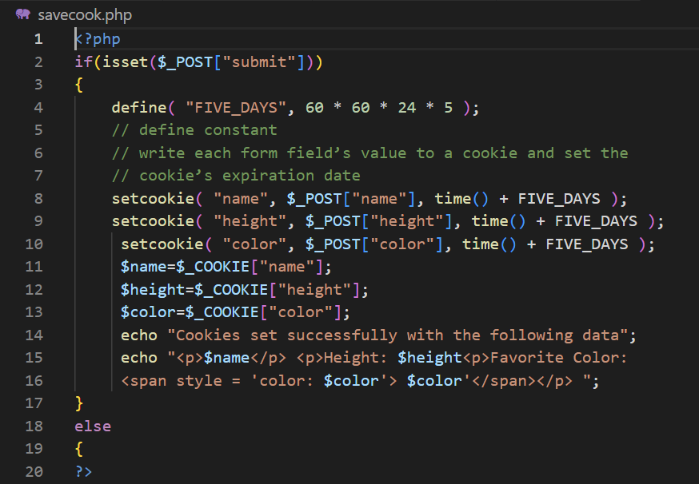
Cookies- setcookie function

Slide 28
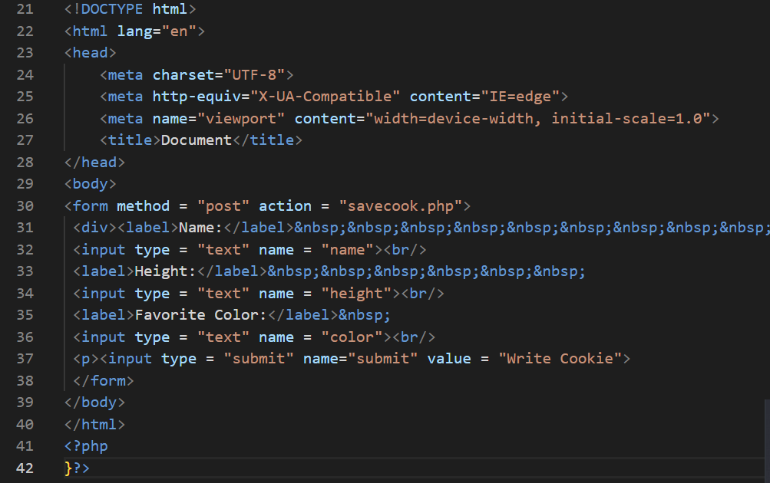
Cookies- setcookie function

Slide 29
Session
When you work with an application, you open it, do some changes, and then you close it. This is much like a Session.
The computer knows who you are. It knows when you start the application and when you end.
But on the internet the web server does not know who you are or what you do, because the HTTP address doesn't maintain state.
Session variables solve this problem by storing user information to be used across multiple pages (e.g. username ,pwd etc). By default, session variables last until the user closes the browser.
So; Session variables hold information about one single user, and are available to all pages in one application.

Slide 30
Session
One significant way that session arrays differ from cookies is that they can be stored on the server, whereas cookies are stored on the client.
In PHP, a session ID is an internal value that identifies a session.
Session IDs need not be known or handled in any way by PHP scripts.
PHP is made aware that a script is interested in session tracking by calling the session_start function, which takes no parameters. The first call to session_start in a session causes a session ID to be created and recorded.
On subsequent calls to session_start in the same session, the function retrieves the $_SESSION array, which stores any session variables and their values that were registered in previously executed scripts in this session.
A session is started with the session_start() function.
Session variables are set with the PHP global variable: $_SESSION

Slide 31
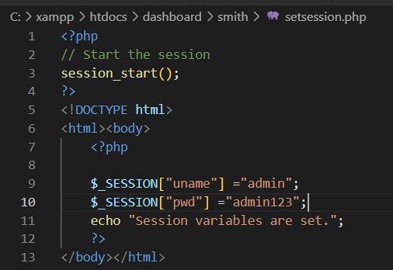
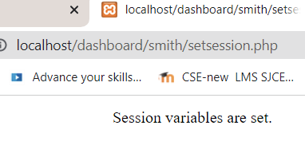
Set Session variables

Slide 32
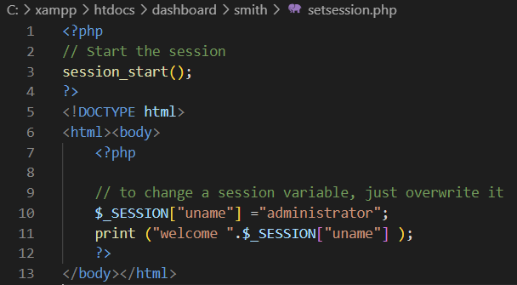
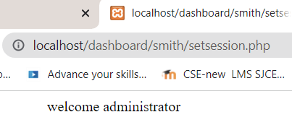
Modify Session variables

Slide 33
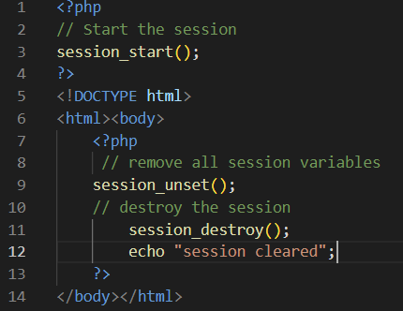
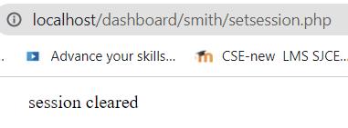
Destroy a Session
To remove all global session variables and destroy the session, use session_unset() and session_destroy():
Example

Slide 34
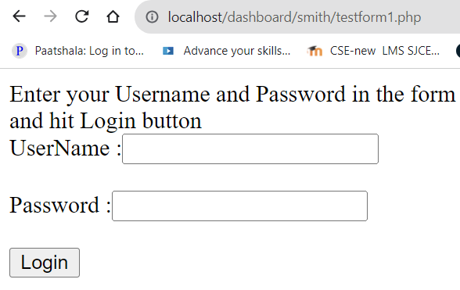
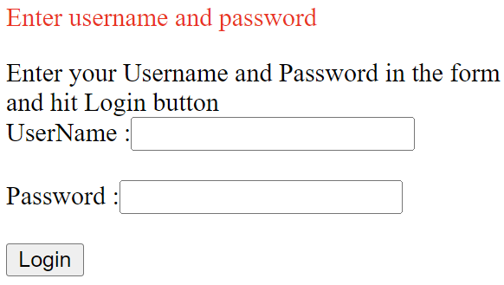
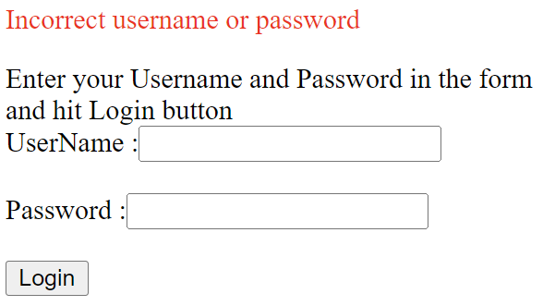
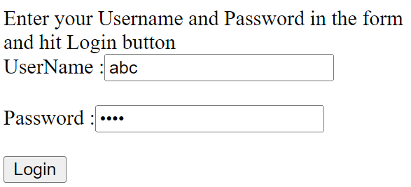
EXAMPLE Session

Slide 35
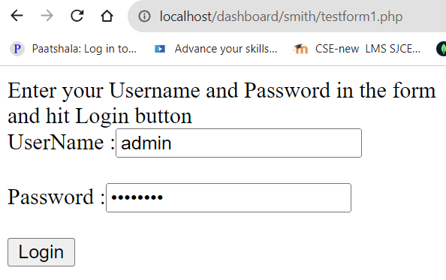
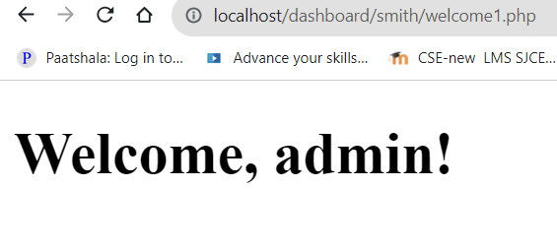
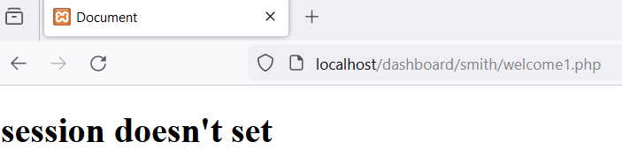
EXAMPLE Session

Slide 36


EXAMPLE Session

Slide 37


Slide 38

Welcome1.php

Slide 39

University Question

Slide 40

University Question

Slide 41
MySQL Integration-Connecting to MySQL with PHP

Slide 42

Connecting PHP to MySQL
When users enter any data into the fields of your forms, you need to collect that information and add it to the database.To do that, you want to know how to connect PHP with MySQL.
In order to connect a MySQL database to PHP, you require MySQL on your computer, a tool to create and manage databases, and PHP installed. The most popular ways to connect a PHP script to MySQL are MySQli and PDO

Slide 43
PHP and MySQL
What is MySQL?
MySQL is an open-source relational database management system (RDBMS). It is the most popular database system used with PHP.
Structured Query Language (SQL).
The data in a MySQL database are stored in tables that consist of columns and rows.
MySQL is a database system that runs on a server.
MySQL is ideal for both small and large applications.
MySQL is a very fast, reliable, and easy-to-use database system. It uses standard SQL. MySQL compiles on a number of platforms.
How we can connect PHP to MySQL?
PHP 5 and later can work with a MySQL database using: MySQLi extension (the ‘i’ is abbreviation for improved)
PDO (PHP Data Objects)

Slide 44
Connecting PHP to MySQL
To connect PHP to MySQL, you can use the MySQLi extension or PDO (PHP Data Objects).
MySQLi (MySQL Improved) is a PHP extension that provides both procedural and object-oriented styles for interacting with MySQL databases.
In the object-oriented style, MySQLi is used as an object-oriented extension.
$conn = new mysqli($servername, $username, $password, $dbname);
if ($conn->connect_error) {
die("Connection failed: " . $conn->connect_error);
}
In the procedural style, MySQLi functions are called using a procedural approach
$conn = mysqli_connect($servername, $username, $password, $dbname);
if (!$conn)
{ die("Connection failed: " . mysqli_connect_error()); }

Slide 45
Connecting PHP to MySQL
Connection to MySQL using MySQLi
We can use procedural and object-oriented styles of MySQLi in our code. Mixing these styles might lead to confusion.
object-oriented approach to check the connection is ($conn->connect_error) and using a procedural approach (mysqli_connect()).
PHP provides mysqli_connect() function to open a database connection.
This function takes a single parameter, which is a connection returned by the mysql_connect() function.
You can disconnect from the MySQL database anytime using another PHP function mysqli_close().
There is also a procedural approach of MySQLi to establish a connection to MySQL database from a PHP script.

Slide 46
Form processing with DB- Making a Connection
The basic syntax for a connection to MySQL is as follows:
$mysqli = mysqli_connect("hostname", "username", "password", "database");
The value of $mysqli is the result of the function and is used in later functions for communicating with MySQL.
With sample values inserted, the connection code looks like this:
$mysqli = mysqli_connect("localhost", “root", “ ", "test");
It creates a new connection and then tests to see whether an error occurred.
If an error occurred, an error message and uses the mysqli_connect_error() function to print the message.

Slide 47

Form processing with DB- Making a Connection

Slide 48



Procedural Style: making connection with test database
MySQL_i_Connect_error

Slide 49
Form processing with DB- Making a Connection
if ($conn) checks if the variable $conn contains a truthy value.
This condition checks if the connection was successful.
if block echoes a message indicating that the connection to the specified database was established successfully.
If the condition is false (meaning the connection failed), the code inside the else block is executed.
The die() function terminates the script and prints an error message.
Using die() is a more severe way to handle connection errors because it stops the script execution immediately.
The error message includes details about the connection failure obtained from mysqli_connect_error().

Slide 50

Making a Connection –Object oriented Style

Slide 51
MySQL Integration-Inserting records

Slide 52



Form processing with DB-Executing Queries-Insert records
PHP to MySQL connection is required to inserts information into our database.
Also we should use INSERT INTO … VALUES syntax for that:

Slide 53

Form processing with DB-Executing Queries-Insert records
PHP to MySQL connection is required to inserts information into our database.
Also we should use INSERT INTO … VALUES syntax for that:

Slide 54

Form processing with DB-Executing Queries-Insert records
PHP to MySQL connection is required to inserts information into our database.
Also we should use INSERT INTO … VALUES syntax for that:

Slide 55




Slide 56


Form processing-Registration form

Slide 57
Form processing with DB- Executing Queries
The mysqli_ query() function in PHP is used to send your SQL query to MySQL
the mysqli_error() function returns a helpful error message when you make a mistake
$conn = new mysqli($servername, $username, $password, $dbname);
$sql = "INSERT INTO ttest(name,address,gender) VALUES ('$_POST[name]', '$_POST[address]', '$_POST[gender]')";
if ($conn->query($sql) === TRUE)
{
echo "Data Inserted successfully!";
}

Slide 58

Form processing-Registration form

Slide 59

Form processing-Registration form

Slide 60
MySQL Integration-Create Table

Slide 61



Form processing with DB- Creating Tables

Slide 62

Form processing with DB- Creating Tables

Slide 63

Form processing with DB- Creating Tables

Slide 64
MySQL Integration-Select

Slide 65
Select Data From a MySQL Database
The SELECT statement is used to select data from one or more tables:
SELECT column_name(s) FROM table_name
or we can use the * character to select ALL columns from a table:
SELECT * FROM table_name
Select Data With MySQLi can also be done in two ways
MySQLi Object-oriented
MySQLi Procedural

Slide 66


Select Data From a MySQL Database-MySQLi Procedural

Slide 67

Select Data From a MySQL Database
First, we set up an SQL query that selects the id, testField columns from the testTable. The next line of code runs the query and puts the resulting data into a variable called $result.
Then, the function num_rows() checks if there are more than zero rows returned.
If there are more than zero rows returned, the function fetch_assoc() puts all the results into an associative array that we can loop through. The while() loop loops through the result set and outputs the data from the id, testField columns.

Slide 68

Select Data From a MySQL Database-MySQLi Object-oriented

Slide 69
MySQL Integration-Update

Slide 70
Update Data In a MySQL Table Using MySQLi
The UPDATE statement is used to update existing records in a table:
UPDATE table_name SET column1=value, column2=value2,...
WHERE some_column=some_value
The WHERE clause specifies which record or records that should be updated. If you omit the WHERE clause, all records will be updated!

Slide 71

Update Data In a MySQL Table Using MySQLi-ObjectOriented

Slide 72



Update Data In a MySQL Table Using MySQLi contd….

Slide 73


Update Data In a MySQL Table Using MySQLi-procedural contd….

Slide 74

Update Data In a MySQL Table Using MySQLi-Procedural

Slide 75

Update Data In a MySQL Table Using MySQLi-procedural contd….

Slide 76


Update Data In a MySQL Table Using MySQLi-procedural Example 2

Slide 77


Update Data In a MySQL Table Using MySQLi-procedural contd….

Slide 78

Update Data In a MySQL Table Using MySQLi-procedural contd….
action→upTestPro1.php

Slide 79

Update Data In a MySQL Table Using MySQLi-procedural contd….

Slide 80
Working with sql Data

Slide 81
Working with Mysql Data
WARNING
There is no more support for mysql_* functions, they are officially deprecated, no longer maintained and will be removed in the future.
You should update your code with PDO or MySQLi to ensure the functionality of your project in the future

Slide 82

Working with Mysql Data

Slide 83

Working with Mysql Data

Slide 84

Working with Mysql Data

Slide 85
Reading from Database Dynamically

Slide 86







Accessing Mysql Data-through dynamic Form data

Slide 87

Working with Mysql Data-through Form data

Slide 88

Working with Mysql Data-through Form data

Slide 89
Dynamic Contents

Slide 90
Dynamic Content
PHP can dynamically change the HTML5 it outputs based on a user’s input.
We can combine the HTML5 form & PHP script into one dynamic document.
The form is created using a series of loops, arrays and conditionals.
We add error checking to each of the text input fields and inform the user of invalid entries on the form itself, rather than on an error page.
If an error exists, the script maintains the previously submitted values in each form element.
Finally, after the form has been successfully completed, we store the input from the user in a MySQL database.

Slide 91

Dynamic Content-Creation of mailinglist Table

Slide 92




Slide 93


Slide 94

Dynamic Content-Variables & Arrays
Lines 18–24 create variables that are used throughout the script to fill in form fields and check for errors.
Line 25 creates an array for formerrors
Lines 27,29,30 create three arrays, $booklist, $systemlist and $inputlist, that are used to dynamically create the form’s input fields.

Slide 95


Dynamic Content-Variables & Arrays

Slide 96

Dynamic Content-Variables & Arrays

Slide 97
Dynamic Content-Variables & Arrays
We specify that the form created in this document is self-submitting (i.e., it posts to itself) by setting the action to the script 'dynamicForm.php' in line 94.
Lines 32-72 use the isset function to determine whether the $_POST array contains keys representing the various form fields.
These keys exist only after the form is submitted.
If function isset returns true, then the form has been submitted and we assign the value for each key to a variable. Otherwise, we assign the empty string to each variable.
Line 53 determines whether any errors were detected, while Dynamically Creating the Form
If $iserror is false (i.e., there were no input errors), lines 54–88 display the page indicating that the form was submitted successfully

Slide 98

Dynamic Content- Dynamically Creating the Form
If $iserror is true, lines 54–88 are skipped, and the code from lines 92-128 executes.
These lines include a series of print statements and conditionals to output the form, as seen in Fig.

Slide 99


Slide 100


Slide 101
Dynamically Creating the Form
Lines 96–102 iterate through each element in the $inputlist array.
In line 98 the value of $$inputname is assigned to the text field’s value attribute. If the form has not yet been submitted, this will be the empty string "".
The notation $$variable specifies a variable ‘variable’ , which allows the code to reference variables dynamically.
You can use this expression to obtain the value of the variable whose name is equal to the value of $variable.
PHP first determines the value of $variable, then appends this value to the leading $ to form the identifier of the variable you wish to reference dynamically.

Slide 102
Dynamically Creating the Form
we use $$inputname to reference the value of each form-field variable.
During the iteration of the loop, $inputname contains the name of one of the text input elements, such as "email".
PHP replaces $inputname in the expression $$inputname with the string representing that element’s name forming the expression ${"email"}.
The entire expression then evaluates to the value of the variable $email. Thus, the variable $email, which stores the value of the e-mail text field after the form has been submitted, is dynamically referenced.
This dynamic variable reference is added to the string as the value of the input field (using the concatenation operator) to maintain data over multiple submissions of the form.

Slide 103
Dynamic Content- Dynamically Creating the Form
Lines 99-101 add a red asterisk next to the text input fields that were filled out incorrectly.
Lines 103-104 display the phone number format instructions in red if the user entered an invalid phone number.
Lines 105-112 and 113-125 generate options for the book drop-down list and operating-system radio buttons, respectively.
Lines 120–123 select an operating system radio button under two conditions. If the form is begin displayed for the first time, the first radio button is selected. Otherwise, if the $currsystem variable’s value matches what’s stored in the $os variable, that specific radio button is selected

Slide 104
Dynamic Content- Inserting Data into the Database
If the form has been filled out correctly, lines 56-71 place the form information in the MySQL database MailingList using an INSERT statement.
Lines 81 generate the web page indicating a successful form submission, which also provides a link to formDatabase.php (Fig.).

Slide 105



Slide 106


Full program

Slide 107
Thank You

