Slide 1
DEPARTMENT OF COMPUTER SCIENCE & ENGINEERING
CST463 - WEB PROGRAMMING
10 November 2025
Notes:
Welcome the participants to the program.
Introduce yourself and briefly summarize your experience at EY and your interest in presenting at Welcome to EY.
Have co-facilitators, if present, introduce themselves and provide background information.
State the following to help participants understand the context of Welcome to EY:
This course was designed for all ranks around the globe. It provides you with foundational knowledge that will help to explain our culture, our processes and how we go to market.
However, your service line will provide the specifics about your role and your job.
As an organization, we want to invest in you, give you consistent content globally, let you meet other new hires across service lines and meet some of our leaders.

Slide 2

CST463 - WEB PROGRAMMING

Slide 3
Module 5 (CO3, Cognitive Knowledge Level: Apply)
Module- 5 (JSON, Laravel)
JSON Data Interchange Format: Syntax, Data Types, Object, JSON Schema, Manipulating JSON data with PHP Web
Development Frameworks: Laravel Overview-Features of Laravel-Setting up a Laravel Development Environment-Application structure of Laravel-Routing -Middleware- Controllers Route Model Binding-Views-Redirections-Request and Responses.

Slide 4
JSON Data Interchange Format

Slide 5
JSON
JSON or JavaScript Object Notation is a lightweight text-based open standard for human-readable data interchange.
Conventions used by JSON are known to programmers, which include C, C++, Java, Python, Perl, etc.
JSON stands for JavaScript Object Notation.
Douglas Crockford specified the format.
It was designed for human-readable data interchange.
It has been extended from the JavaScript scripting language.
The filename extension is .json.
JSON Internet Media type is application/json. The Uniform Type Identifier is public.json.

Slide 6
JSON-OVERVIEW
JSON: JavaScript Object Notation.
JSON is a syntax for storing and exchanging data.
JSON is text, written with JavaScript object notation.
JSON is a lightweight data-interchange format
JSON is "self-describing" and easy to understand
JSON is language independent
JSON uses JavaScript syntax, but the JSON format is text only.
Text can be read and used as a data format by any programming language.
JavaScript has a built-in function to convert a string, written in JSON format, into native JavaScript objects: JSON.parse()

Slide 7
JSON-Syntax
The JSON syntax is a subset of the JavaScript syntax.
JSON syntax is derived from JavaScript object syntax:
Data is in name/value pairs. Data is separated by commas
Curly braces hold objects and each name is followed by ':'(colon), the name/value pairs are separated by, (comma).
Square brackets hold arrays and values are separated by,(comma).
JSON supports the following two data structures:
Collection of name/value pairs:
This Data Structure is supported by different programming languages.
Ordered list of values
It includes array, list, vector or sequence etc.

Slide 8
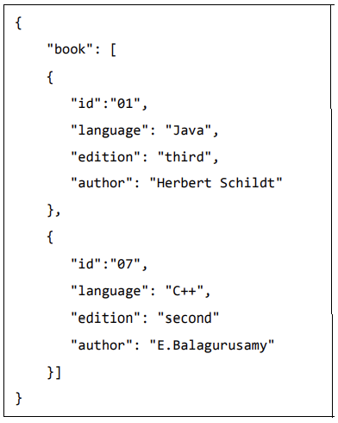
JSON-Syntax
The JSON format is almost identical to JavaScript objects.
In JSON, keys must be strings, written with double quotes:
The following example shows how to use JSON to store information related to books based on their topic and edition.
Book array stores information about two books.
Each book is having id, language, edition and author fields

Slide 9
JSON-Data
JSON Data - A Name and a Value
JSON data is written as name/value pairs.
A name/value pair consists of a field name (in double quotes), followed by a colon, followed by a value:
Example "name":"John“
JSON names require double quotes. JavaScript names don’t.
In JSON, keys must be strings, written with double quotes:
JSON { "name":"John" }
In JavaScript, keys can be strings, numbers, or identifier names:
JavaScript { name:"John" }

Slide 10
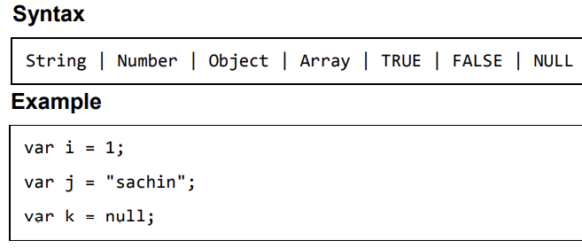
JSON-Values
In JSON,values must be one of the following data types: string,number,object (JSON object),array,Boolean,null
In JavaScript values can be all of the above, plus any other valid JavaScript expression, including: a function, a date , undefined
In JSON,string values must be written with double quotes { "name":"John" }
In JavaScript, you can write string values with double or single quotes:
{ name:'John' }

Slide 11
JSON-Values
With JavaScript you can create an object and assign data to it:
var person = { "name":"John", "age":31, "city":"NewYork" };
You can access a JavaScript object like this:
person.name; // returns John
OR
person["name"];
Data can be modified like this:
person.name = "Gilbert";
Or
person["name"] = "Gilbert";
The file type for JSON files is ".json"
The MIME type for JSON text is "application/json"

Slide 12
JSON Data Types

Slide 13
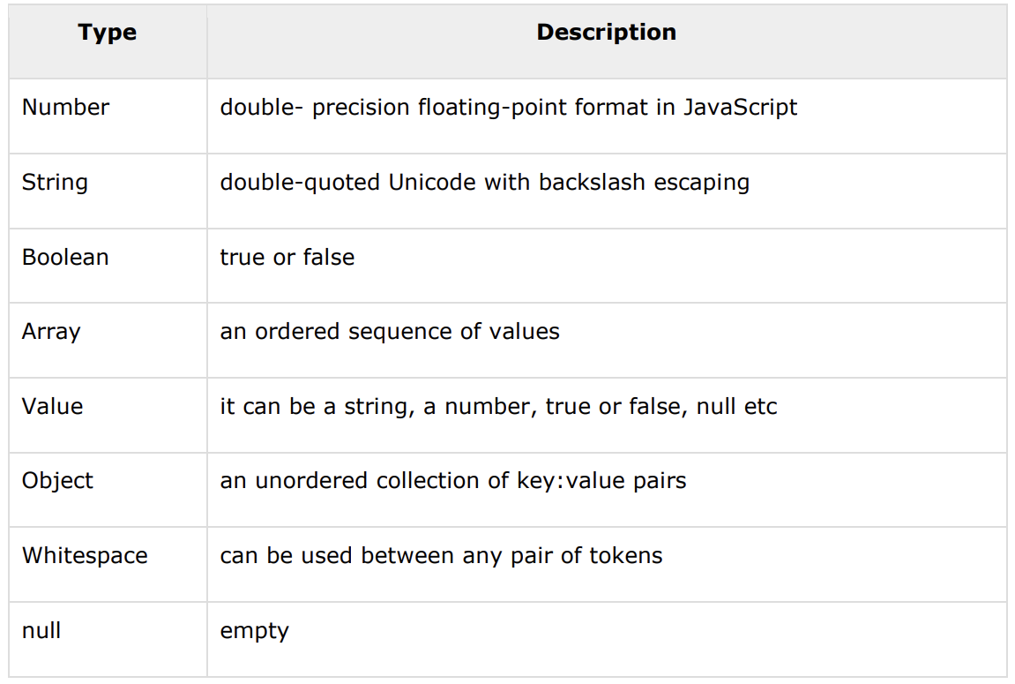
JSON-Data Types
In JSON, values must be one of the following data types:
a string
a number
an object (JSON object)
an array
a boolean
null
JSON values cannot be one of the following data types:
a function
a date
undefined

Slide 14
JSON-Data Types
In JSON, values must be one of the following data types:
a string
a number
an object (JSON object)
an array
a boolean
null
JSON values cannot be one of the following data types:
a function
a date
undefined

Slide 15
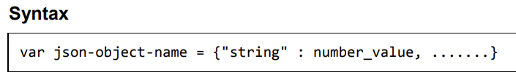
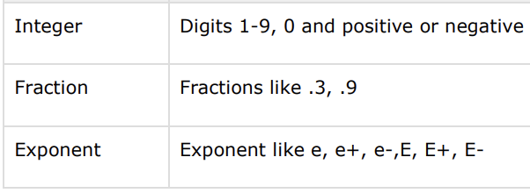

JSON-Data Types
JSON Numbers
Numbers in JSON must be an integer or a floating point.
It is a double precision floating-point format in JavaScript and it depends on implementation.
Octal and hexadecimal formats are not used. No NaN or Infinity is used in Number. { "age":30 }

Slide 16
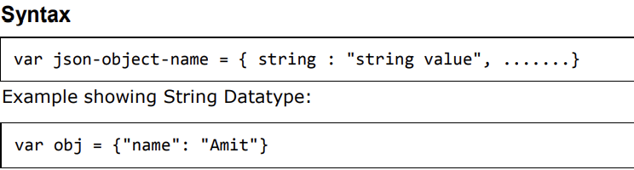
JSON-Data Types
JSON Strings
Strings in JSON must be written in double quotes. { "name":"John" }
It is a sequence of zero or more double quoted Unicode characters with backslash escaping.
Character is a single character string i.e. a string with length 1.

Slide 17
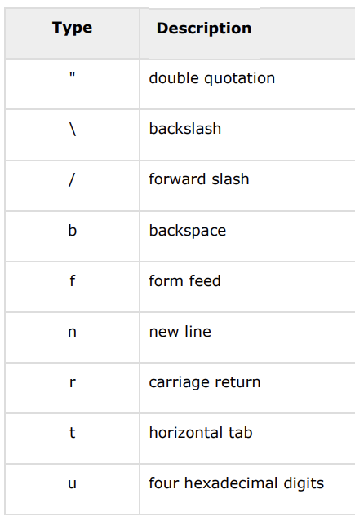
JSON-Data Types
JSON Strings
The table shows various special characters that you can use in strings of a JSON document
A string is a sequence of zero or more Unicode characters, wrapped in double quotes, using backslash escapes.
A character is represented as a single character string.
A string is very much like a C or Java string.

Slide 18
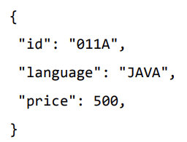
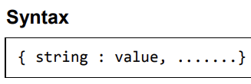
JSON-Data Types
JSON Objects Values in JSON can be objects.
{ "employee":{ "name":"John", "age":30, "city":"NewYork" } }
Objects as values in JSON must follow the same rules as JSON objects.
It is an unordered set of name/value pairs. Objects are enclosed in curly braces that is, it starts with '{' and ends with '}’.
Each name is followed by ':'(colon) and the key/value pairs are separated by , (comma).
The keys must be strings and should be different from each other. Objects should be used when the key names are arbitrary strings.

Slide 19
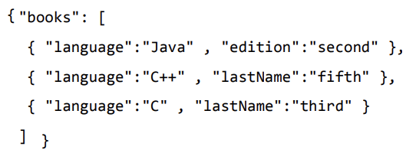
JSON-Data Types
JSON Arrays
It is an ordered collection of values.
These are enclosed in square brackets which means that array begins with .[. and ends with .]..
The values are separated by , (comma).
Array indexing can be started at 0 or 1.
Arrays should be used when the key names are sequential integers.
Values in JSON can be arrays.
{ "employees":[ "John", "Anna", "Peter" ] }

Slide 20
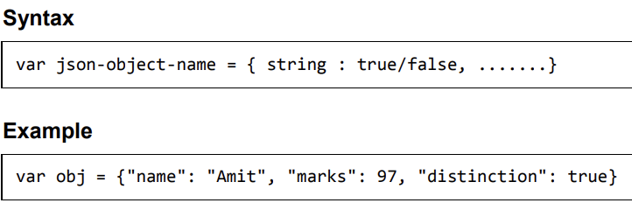
JSON-Data Types
JSON Booleans Values in JSON can be true/false.
{ "sale":true }
JSON null Values in JSON can be null. It means empty type.
{ "middlename":null }
Whitespace:It can be inserted between any pair of tokens. It can be added to make a code more readable. Example shows declaration with and without whitespace:

Slide 21
JSON OBJECT

Slide 22
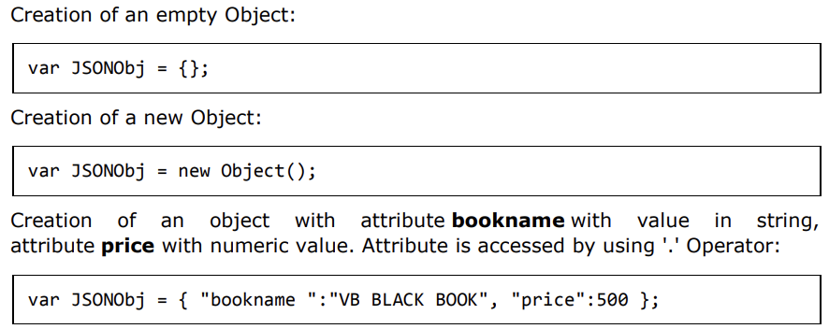
JSON-Objects
Creating Simple Objects
JSON objects can be created with JavaScript.

Slide 23
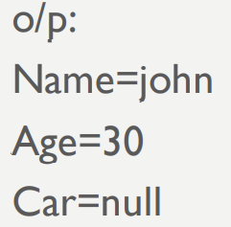
Accessing JSON Objects
You can access the object values by using dot (.) notation:
myObj = { "name":"John", "age":30, "car":null };
x = myObj.name;
You can also access the object values by using bracket ([]) notation:
myObj = { "name":"John", "age":30, "car":null };
x = myObj["name"];
You can loop through object properties by using the for-in loop:
person = { "name":"John", "age":30, "car":null };
for (x in person)
{
alert(x+"="+person[x])
}

Slide 24
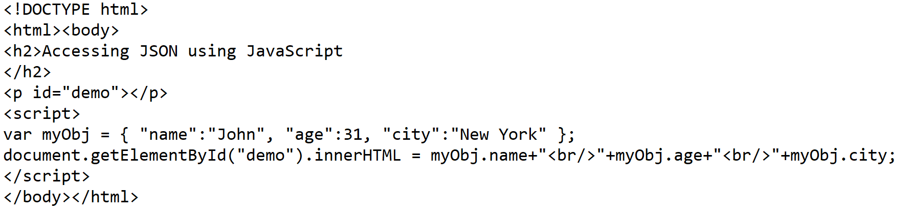
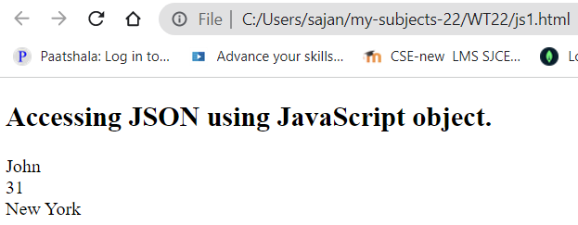
Accessing JSON Object in JavaScript

Slide 25
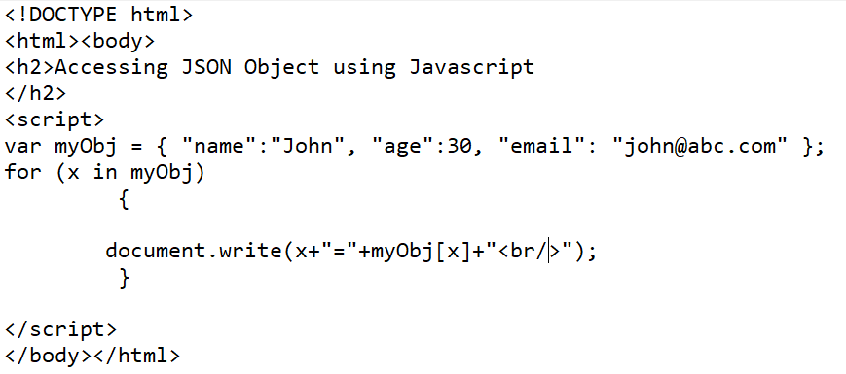
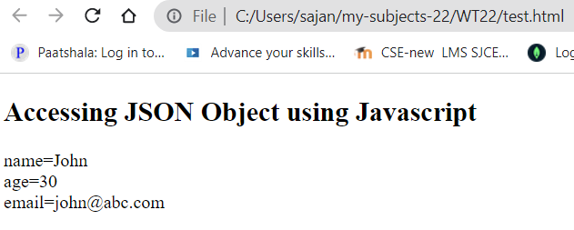
Accessing JSON Object in JavaScript

Slide 26
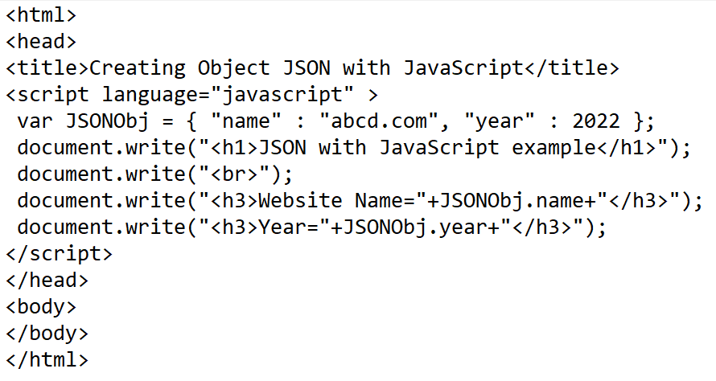
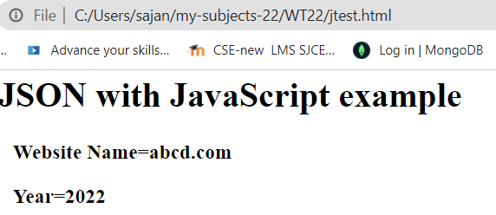
creation of an object in JavaScript using JSON,

Slide 27
Nested JSON Objects
Values in a JSON object can be another JSON object.
myObj = { "name":"John”, "age":30,
"cars": { "car1":"Ford", "car2":"BMW", "car3":"Fiat" }
}
You can access nested JSON objects by using the dot notation or bracket notation: Example
x = myObj.cars.car2;
or
x = myObj.cars["car2"];

Slide 28
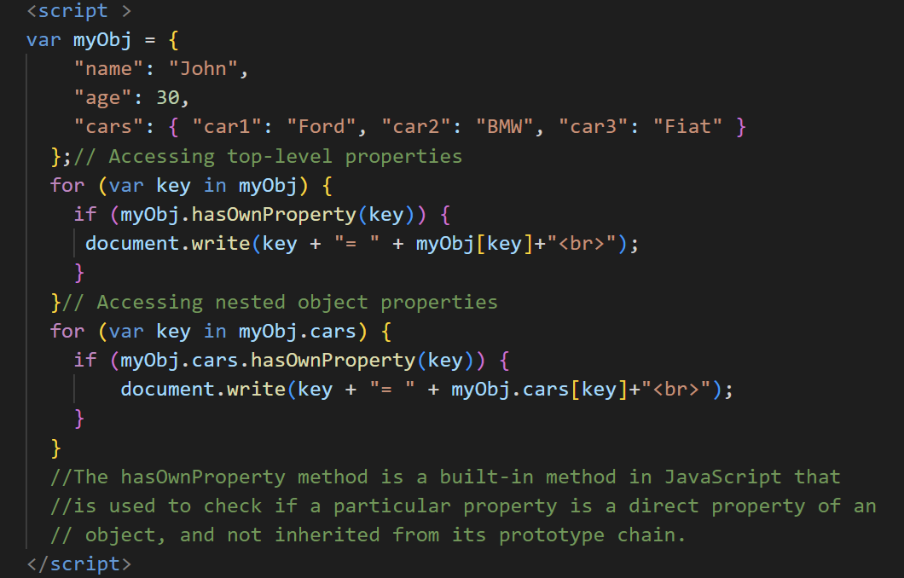
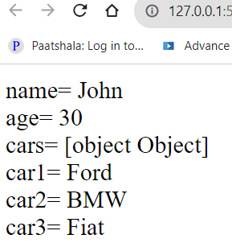
creation of an object in JavaScript using JSON,

Slide 29
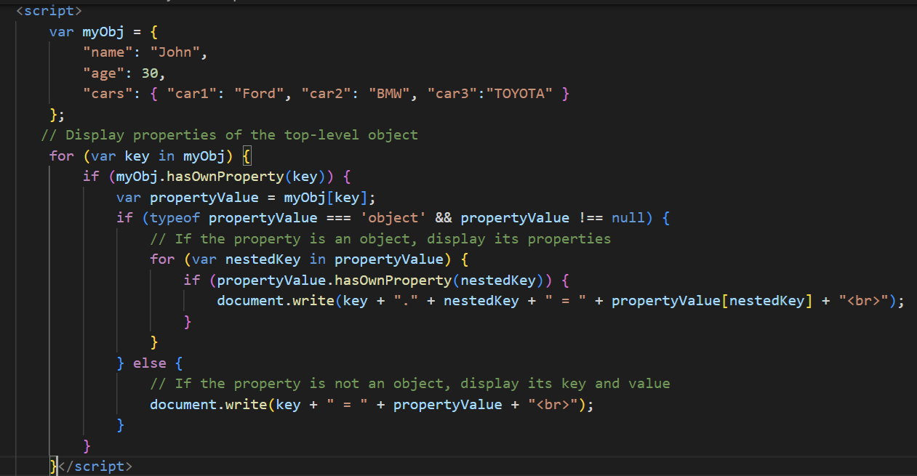
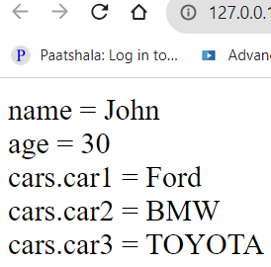
creation of an object in JavaScript using JSON,

Slide 30
JSON SCHEMA

Slide 31
JSON Schema
JSON Schema is a specification for JSON-based format for defining the structure of JSON data.
It was written under IETF draft which expired in 2011.
JSON Schema, describes your existing data format.
JSON Schema is a powerful tool for validating the structure of JSON data.
Complete structural validation, useful for automated testing, and validating client-submitted data.
There are several JSON Schema Validation Libraries and validators currently available for different programming languages.
JSON Schema itself is written in JSON.
It is data itself, not a computer program. It’s just a declarative format for “describing the structure of other data”.

Slide 32
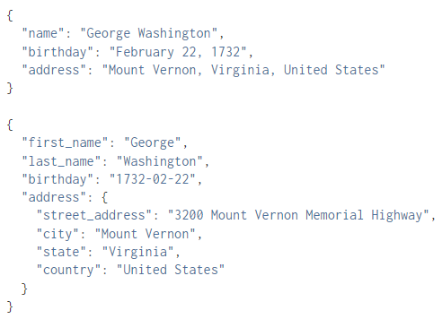
JSON Schema
For example, you could imagine representing information about a person in JSON in different ways:
Both representations are equally valid, though one is clearly more formal than the other
Suppose we need to know what fields are expected, and how the values are represented. Means we want to validate the data
That’s where JSON Schema comes in.

Slide 33
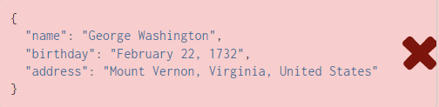
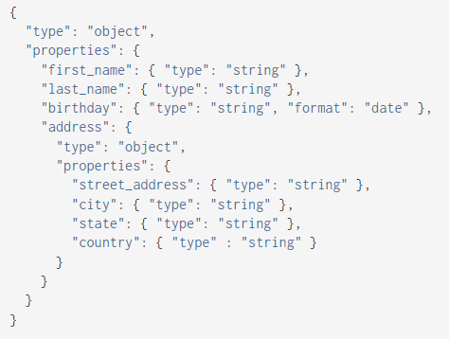
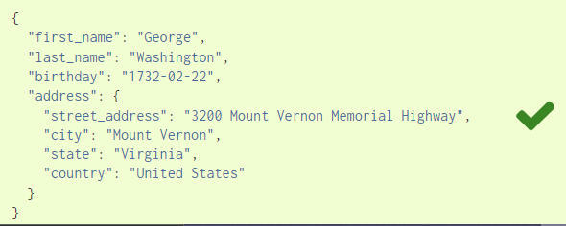
JSON Schema
By “validating” the first example against this schema, you can see that it fails. However, the second example passes:

Slide 34
JSON Schema
Structure of a JSON Schema: Since JSON format contains an object, array, and name-value pair elements.
Name-value pairs are used for providing schema processing elements as well as validating the JSON content.
$schema: To specify the version of JSON schema.
title and description: To provide information about the schema.
required: It’s an array of elements that indicates which elements should be present.
additionalProperties: To indicate whether existence of specified elements are allowed or not.
JSON content definition:
When a JSON object is defined, JSON schema uses name-value pair “type”:”object”
When arrays are defined, JSON schema uses the name-value pair “type”:”array”

Slide 35
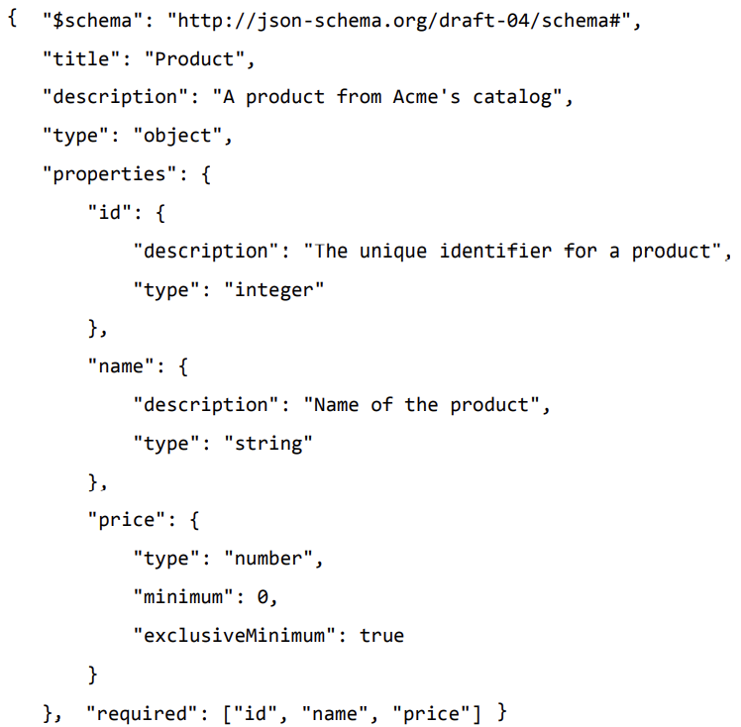

Slide 36
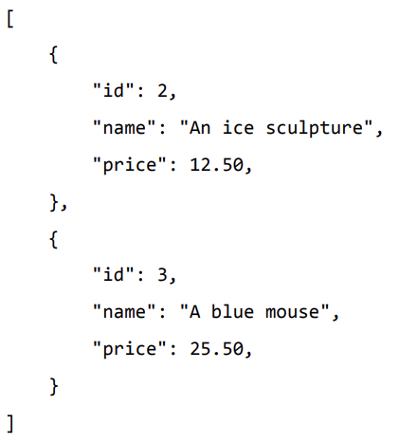
JSON Schema data to validate the schema
Check the http://json-schema.org for the complete list of keywords that can be used in defining a JSON schema.
The above schema can be used to test the validity of the following JSON code:

Slide 37
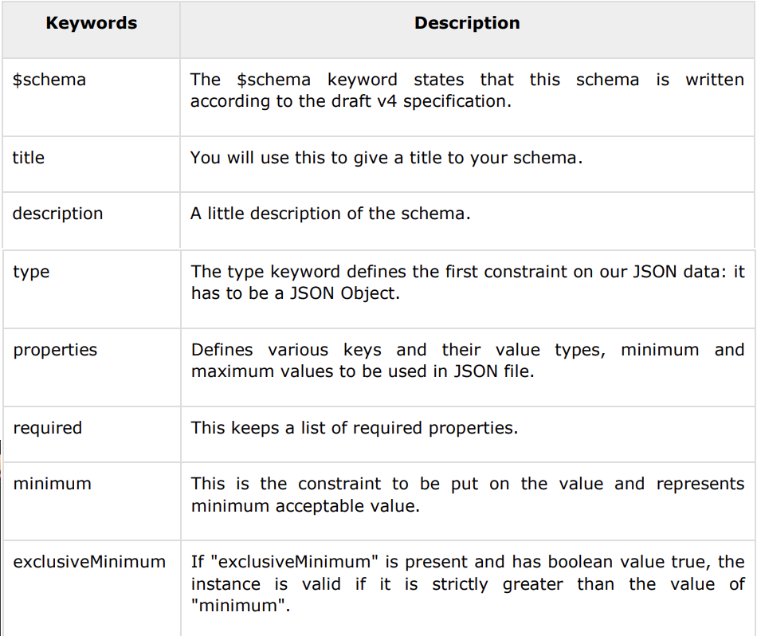

Slide 38
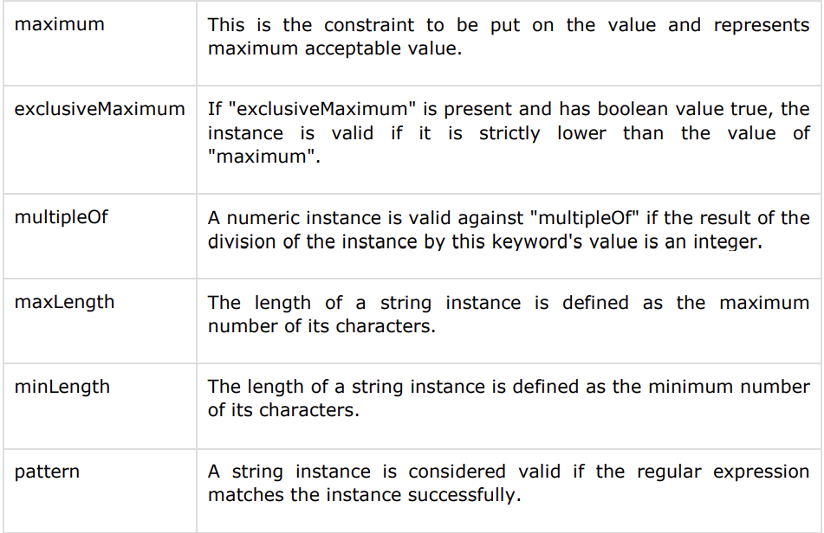

Slide 39
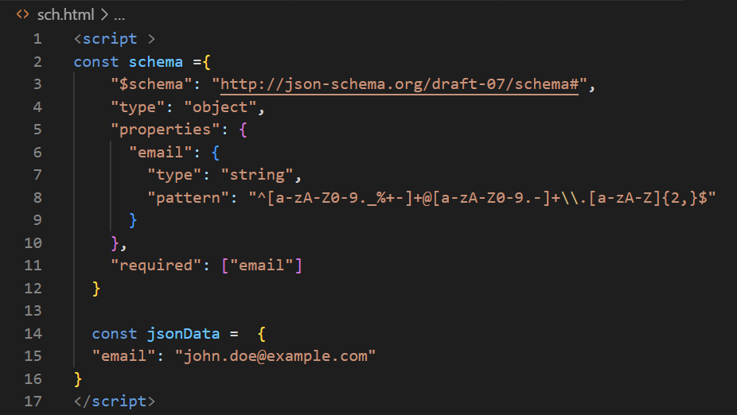
JSON Schema-email pattern example

Slide 40
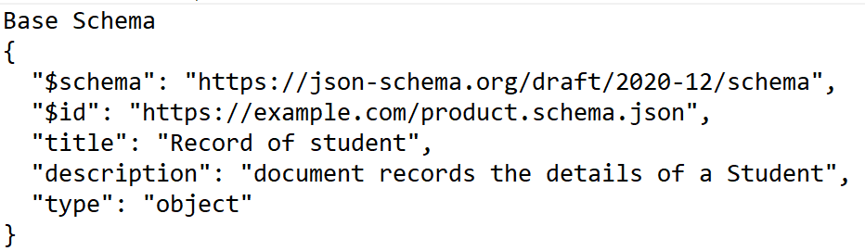
document definition of a ‘Student document ‘using JSON Schema
$schema links to the resource that identifies the valid schemas
$id keyword identifies the schema resource.
The URI in this keyword is an identifier and not necessarily a network locator.
It must represent a valid URI reference that is normalized and resolves absolute URI.
It must not contain a non empty fragment . It should not contain an empty fragment.
title keyword gives a short description of the schema
description keyword to explain more about the schema

Slide 41
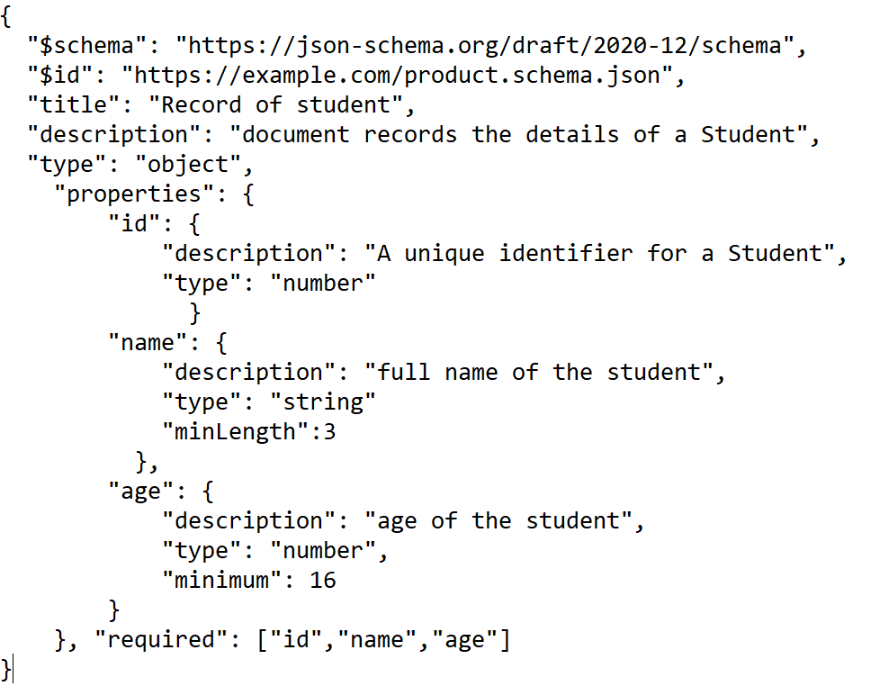

Slide 42
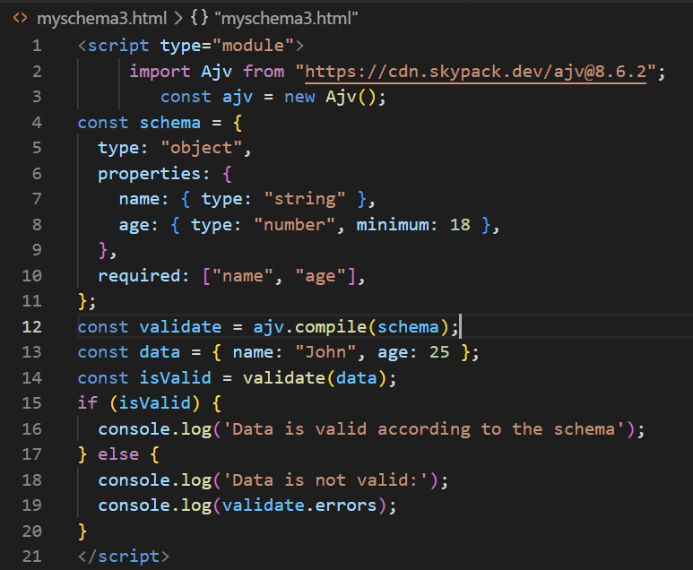
Ajv is a JSON Schema validator for JavaScript. It's a widely used library that allows you to validate JSON data against a JSON Schema. Validation of Ajv supports JSON Schema draft-04, draft-06, draft-07, and draft-2019-09. It provides a comprehensive set of features to validate JSON data based on a predefined schema.

Slide 43
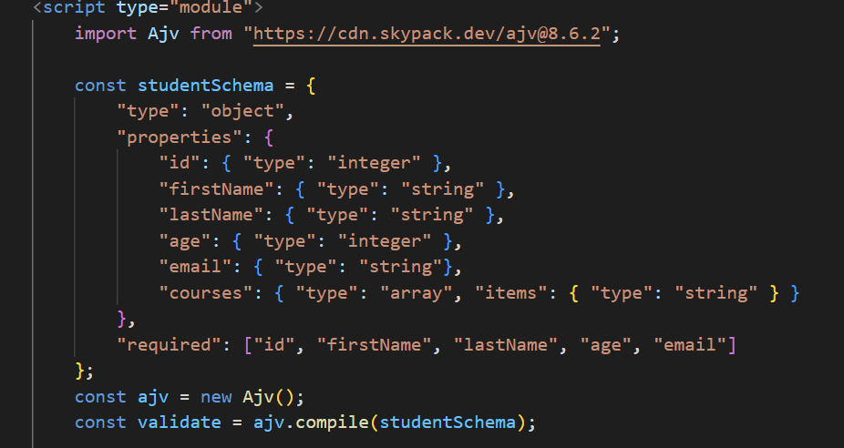
JSON-STUDENTSCHEMA ----University Question

Slide 44
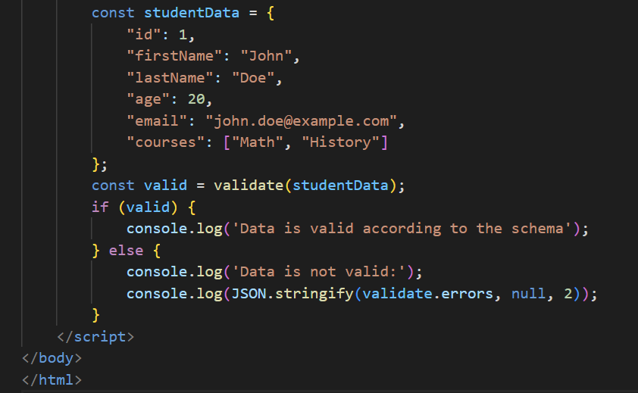
JSON-STUDENTSCHEMA

Slide 45
Manipulating JSON data with PHP Web

Slide 46
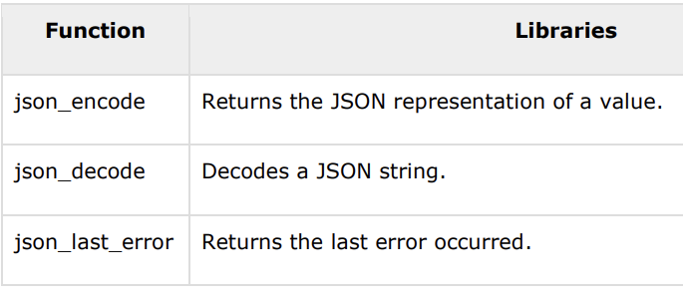
JSON ─ JSON with PHP
As of PHP 5.2.0, the JSON extension is bundled and compiled into PHP by default.
JSON Functions
PHP json_encode() function is used for encoding JSON in PHP. This function returns the JSON representation of a value on success or FALSE on failure.
PHP json_decode() function is used for decoding JSON in PHP. This function returns the value decoded from json to appropriate PHP type.

Slide 47
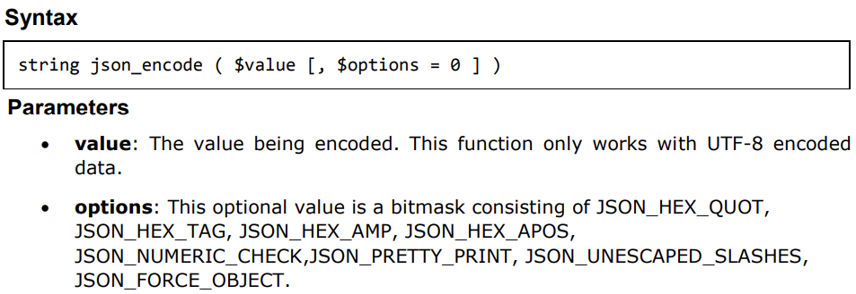
Encoding JSON in PHP (json_encode)
As of PHP 5.2.0, the JSON extension is bundled and compiled into PHP by default.
JSON Functions
PHP json_encode() function is used for encoding JSON in PHP. This function returns the JSON representation of a value on success or FALSE on failure.
PHP json_decode() function is used for decoding JSON in PHP. This function returns the value decoded from json to appropriate PHP type.

Slide 48
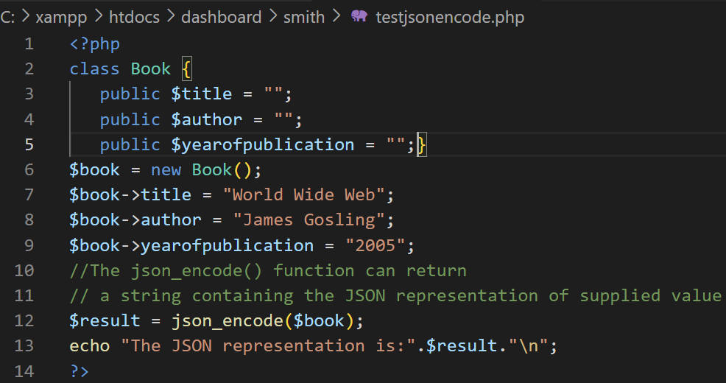
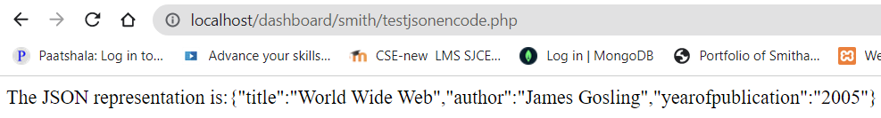
How the PHP objects can be converted into JSON?(json_encode)

Slide 49
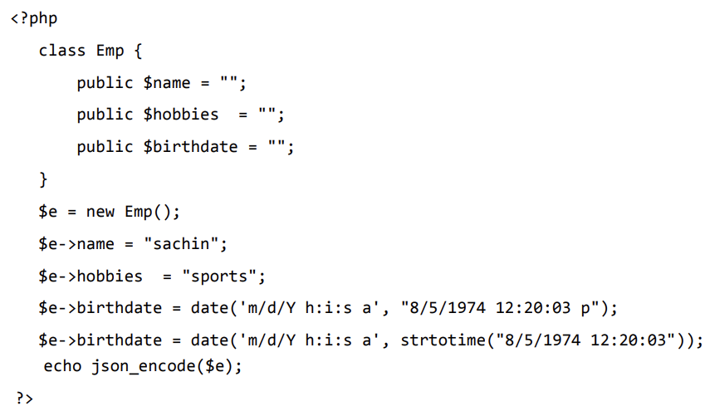
how the PHP objects can be converted into JSON?(json_encode)

Slide 50
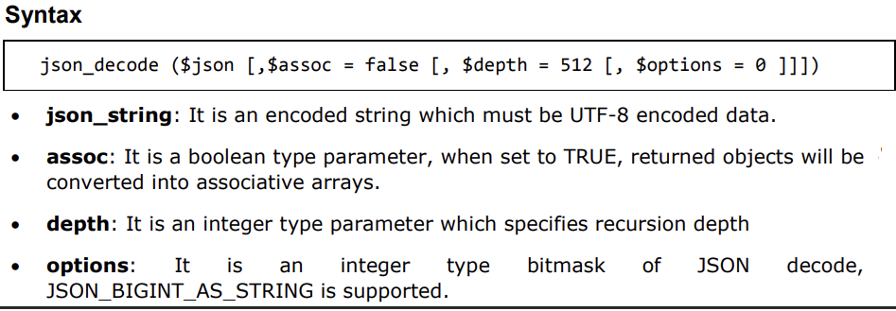
Decoding JSON in PHP (json_decode)
PHP json_decode() function is used for decoding JSON in PHP. This function returns the value decoded from json to appropriate PHP type.

Slide 51
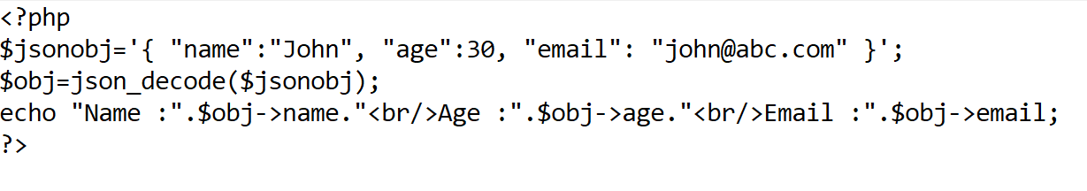
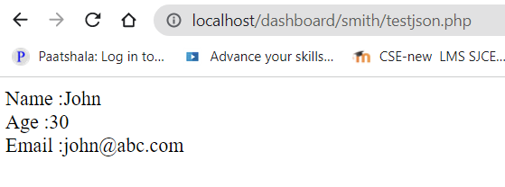
Decoding JSON in PHP (json_decode)
PHP json_decode() function is used for decoding JSON in PHP. This function returns the value decoded from json to appropriate PHP type.

Slide 52
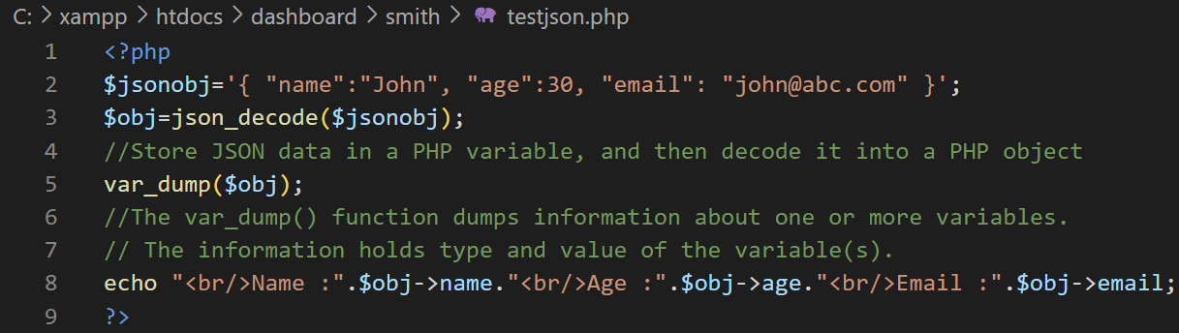
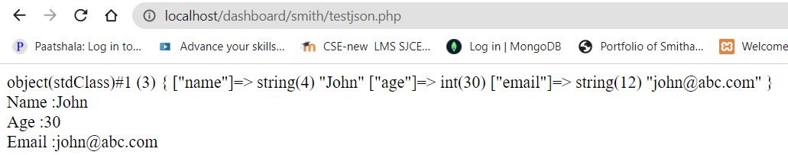
Decoding JSON in PHP (json_decode)
PHP json_decode() function is used for decoding JSON in PHP. This function returns the value decoded from json to appropriate PHP type.

Slide 53
Development Framework , Laravel

Slide 54
Web Development Frameworks:
Laravel Overview
Features of Laravel
Setting up a Laravel Development Environment
Application structure of Laravel
Routing
Middleware
Controllers
Route Model Binding
Views
Redirections
Request and Responses.

Slide 55
Web Development Frameworks:Laravel
Frameworks like Laravel , Symfony, Silex, Lumen, and Slim — prepackage a collection of third-party components together with custom framework “glue” like configuration files, service providers, prescribed directory structures, and application bootstraps.
Laravel’s architecture is different from other PHP frameworks. This framework works on an MVC-based design.
Laravel uses one of the powerful default template engines i.e. Blade template engine. It allows Laravel developers to use plain PHP code.
Using this template engine ,we can create an app without additional costs.
Laravel supports only these database languages
MySQL
PostgreSQL
SQLite, and
SQLServer

Slide 56
Web Development Frameworks : Laravel
Laravel is a web application framework with expressive, elegant syntax.
Laravel is the best choice for building modern, full-stack web applications.
A Progressive Framework
Laravel grows with you. Laravel gives you robust tools for dependency injection, unit testing, queues, real-time events, and more.
A Scalable Framework
Laravel is incredibly scalable . Laravel's built-in support for fast, distributed cache systems , horizontal scaling with easily scaled to handle hundreds of millions of requests per month.
A Community Framework
Laravel combines the best packages in the PHP ecosystem to offer the most robust and developer friendly framework available.

Slide 57
Features of Laravel

Slide 58
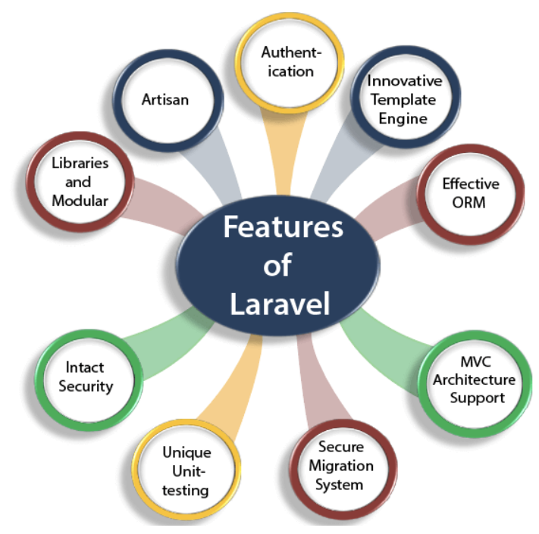

Slide 59
Features of Laravel
Authentication
Laravel contains an inbuilt authentication system, you only need to configure models, views, and controllers to make the application work.
Innovative Template Engine
Laravel provides an innovative template engine which allows the developers to create solid structures for an application.
Effective ORM
Laravel contains an inbuilt ORM (Object Relational Mapper), known as Eloquent which allows the developers to query the database tables by using the simple PHP syntax without writing any SQL code.
MVC Architecture Support
Laravel supports MVC architecture. It provides faster development process as in MVC, and it separates the business logic from the presentation logic.
Secure Migration System
Laravel framework can expand the database and the migration process of Laravel is very secure and full-proof. In the whole process, php code is used rather than SQL code.

Slide 60
Features of Laravel
Unique Unit-testing
Laravel provides a unique unit-testing. In Laravel, developers can also write the test cases in their own code.
Intact Security
Laravel has an inbuilt web application security, i.e., it itself takes care of the security of an application. It uses "Bcrypt Hashing Algorithm" to generate the salted password
Libraries and Modular
Laravel is very popular as some Object-oriented libraries, and pre-installed libraries are added in this framework, these pre-installed libraries are not added in other php frameworks. This framework is divided into several modules that follow the php principles allowing the developers to build responsive and modular apps.
Artisan
Laravel framework provides a built-in tool for a command-line known as Artisan that performs the repetitive programming tasks that do not allow the php developers to perform manually.

Slide 61
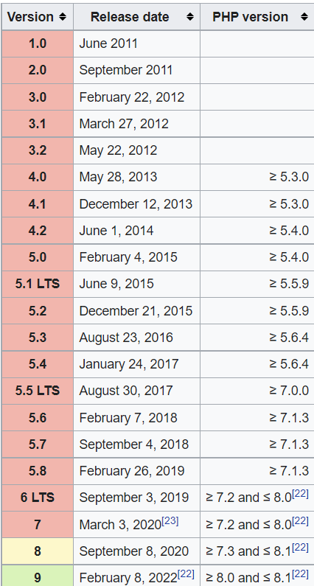
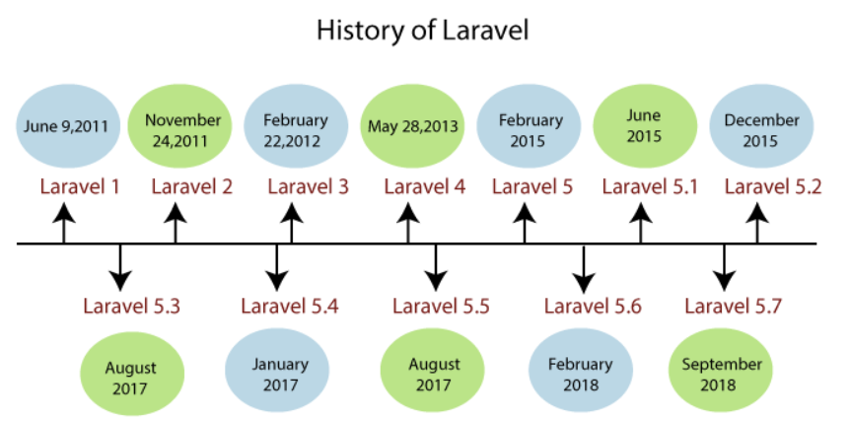

Slide 62
MVC Architecture Of Laravel

Slide 63
MVC Architecture Of Laravel
The Laravel Framework follows MVC architecture. MVC is an architectural design pattern that helps to develop web applications faster.
MVC stands for Model-View-Controller.
Model (M)–A model handles data used by the web application.
View (V)–A view helps to display data to the user.
Controller (C)–A controller interacts with the model to create data for the view.
The following figure shows the interactions between Model, View, and Controller.

Slide 64

MVC Architecture Of Laravel

Slide 65
Setting up a Laravel Development Environment

Slide 66

Laravel 9.x

Slide 67

composer installation
Before creating your first Laravel project, you should ensure that your local machine has PHP and Composer installed.
The installer - which requires that you have PHP already installed - will download Composer for you and set up your PATH environment variable so you can simply call composer from any directory.
Download and run Composer-Setup.exe - it will install the latest composer version whenever it is executed.

Slide 68


Installation of Composer and laravel
Composer is a dependency manager for PHP. Laravel uses the Composer to manage its dependencies.
You need to install the composer before installing Laravel
Install Composer-setup.exe
Composer doesn’t know how to install Laravel.so install Laravel installer using the command

Slide 69


Check the installation using the command ‘laravel’
Laravel installation is completed
Create New project –go to command prompt
laravel new example-smith

Slide 70


Installation of Composer and laravel
Open command prompt and type
laravel new example-smith

Slide 71

installation of Laravel
After the project has been created, start Laravel's local development server using the Laravel's Artisan CLI serve command:
Once you have started the Artisan development server, your application will be accessible in your web browser at [http://127.0.0.1:8000]
Laravel web server is ready at this URL.
As Laravel supports MVC ,it is the “web.php” file of routes directory ,displays the welcome page contents from “ views/welcome.blade.php”

Slide 72


Slide 73


Slide 74


Slide 75


Slide 76


Route Definitions
In a Laravel application, you will define your “web” routes in routes/web.php and your “API” routes in routes/api.php. Web routes are those that will be visited by your end users; API routes are those for your API, if you have one

Slide 77


Route Definitions-using view
In a Laravel application, you will define your “web” routes in routes/web.php

Slide 78

Route Definitions-using view
Define your “webpage ” contents in views/hello.blade.php

Slide 79


Route Definitions-using view
Define your “webpage ” contents in views/hello1.blade.php
web.php

Slide 80

Route Definitions-using view
Define your “webpage ” contents in views/hello1.blade.php

Slide 81
Application structure of Laravel

Slide 82

Laravel PHP Project Structure
Open your project from the File Explorer to see the root directory structure of the Laravel project.
app/Http directory: This directory contains sub-directories for Controllers & Middleware.
app/User.php file: This is the default Model provided by Laravel.
resources/views directory: This directory contains HTML files or templates which help to display data to the user.
routes directory: This directory contains all the routes definitions for the Laravel PHP application.
The bootstrap directory contains the app.php file which bootstraps the framework.

Slide 83
Laravel PHP Project Structure
The config directory, as the name implies, contains all of your application's configuration files.
The database directory contains your database migrations, model factories, and seeds.
The lang directory houses all of your application's language files.
The public directory contains the index.php file, which is the entry point for all requests entering your application and configures autoloading. This directory also houses your assets such as images, JavaScript, and CSS.
The resources directory contains your views as well as your raw, un-compiled assets such as CSS or JavaScript.

Slide 85
Laravel routes

Slide 86
Introduction To Laravel Routes
Routing accepts the request and redirects it to the relevant controller function.
There are two main route files in the Laravel Framework:
routes/web.php: This file is used to register web routes.
routes/api.php: This file is used to register API routes.
The following code segment shows the default web route registered by Laravel to display the welcome page from views/welcome.blade.php.
Route::get('/', function () {
return view('welcome’);
});
In the above route, Route is the class used to define the function get().
The function get() has a parameter “/” which indicates the root URL of the Laravel application.

Slide 87


Introduction To Laravel Routes
Creating a Route
Step 1:
Add the following code segment in routes/web.php file to register a new route.
Step 2: Visit the URL: http://127.0.0.1:8000/example to see the output.
Step 3: The following screenshot shows the output.

Slide 88




Introduction To Laravel Routes
Routing Parameters
The Laravel Framework uses two types of route parameters.
#1) Required parameters
The required parameters are the parameters that pass to the URL as shown below.
#2) Optional parameters
Place “?” after the router parameter to make it optional as shown below.

Slide 89

Route verbs
Routing accepts the request and redirects it to the relevant controller function.
Route::get is used in our route definitions.
This means we’re telling Laravel to only match for these routes when the HTTP request uses the GET action
The most common are GET and POST, followed by PUT, DELETE, and PATCH.
Each method communicates a different thing to the server, and to your code, about the intentions of the caller

Slide 90
Route verbs
Route::get method is used to define routes that respond to HTTP GET requests specifically
Route::post- route is intended to handle HTTP POST requests to the /example URL.
Route::put-route is designed to handle HTTP PUT requests, often used for updating resources.
Route::delete- route is meant for handling HTTP DELETE requests, typically used for resource deletion
Route::any- any method allows a route to respond to any HTTP request method (GET, POST, PUT, DELETE, etc.).
Route::match- match method allows you to specify an array of HTTP methods that a route should respond to.

Slide 91


Laravel's routing mechanisms:
Basic Routing:In Laravel, the basic routing is defined in the routes/web.php file for web routes
Route Parameters:
Routes can have parameters that capture parts of the URI. These parameters are passed to the route's closure or controller method.
Controller Routing:
Instead of handling logic directly in the closure, you can direct a route to a controller method.
Controllers are typically stored in the app/Http/Controllers directory.

Slide 92
Laravel Views

Slide 93

Introduction To Views
In MVC architecture, the character ‘V’ stands for View. Views contain HTML, CSS and JavaScript.
The Views represent the frontend of the Laravel application, and it is used to display the content for the user.
All the views are stored in the resources/views directory. By default, the Laravel Framework provides the welcome.blade.php file.
Creating a View
Step 1: Create a view named index.php in the resources/views directory and save the following code

Slide 94


introduction To Views
Step 2: Add the following code segment in the routes/web.php file to register a new route.
Step 3: Visit the URL: http://127.0.0.1:8000/index to see the output.
Step 4: The following screenshot shows the output.

Slide 95



Passing Data to Views
Step 1: Create a view named user.php in the resources/views directory and save the following code.
Step 2: Add the following code segment in the routes/web.php file to register a new route.
Step 3: Visit the URL: http://127.0.0.1:8000/user to see the output.
Step 4: The following screenshot shows the output.

Slide 96

Introduction to blade template
Blade templates use .blade.php extension. The blade templates stored in the resources/views directory.
Usage of Blade Templates
Usage 1: variable values
In blade templates, we can use {{ $variable }} to print the value of a variable instead of <?php echo $variable ?> As you see, there is no need to write PHP tags or the echo keyword.
Step 1: Rename the file user.php to user.blade.php (in the resources/views directory) and modify the existing code as shown below.
Step 2: Visit the URL: http://127.0.0.1:8000/user.

Slide 97



Example Laravel Routes-with parameter
Web.php

Slide 98

Introduction to blade template
Usage 2: ternary operators
In blade templates, we can use {{ $variable or ‘default_value’ }} instead of <?phpisset($variable) ? $variable : ?default_value? ?> to write ternary operators.

Slide 99
Laravel controllers

Slide 100

Laravel Controllers
In MVC architecture, the character ‘C’ stands for Controller.
A controller communicates with the relevant model if necessary and loads the view to display the content for the user.
All the controllers are stored in the app/Http/Controllers directory.
Creating a Controller
Run the following command in the command prompt to create a controller named testController. php artisan make:controller testController
This command will create a file named testController.php in the app/Http/Controllers directory. By default, the Controller.php file is included with the Laravel Framework.
Calling Controllers from Routes
The following syntax can be used to call controllers from routes in web.php file.

Slide 101



Simple Example using Laravel Controllers
Step 1:Run the command prompt and make the controller named AuthController
Step 2: Add the following code segment in the http/AuthController.php and web.php

Slide 102
Laravel Controllers-Second example HelloWorld
Step 1: Run the following command in the command prompt to create a controller named HelloWorldController
This command will create a file named HelloWorldController.php in the app/Http/Controllers directory.
Step 2: Add the following code segment in the routes/web.php file to register a new route.
Step 3: Create the index function in the HelloWorldController as shown below

Slide 103



Laravel Controllers- Second example HelloWorld
Step 4: Create a view named hello.blade.php in the resources/views directory and save the following code.
Step 5: Visit the URL: http://127.0.0.1:8000/hellocon
to see the output.
Step 6: The following screenshot shows the output.

Slide 104

Laravel Controllers-Third example Sum of two number
Step 1: Run the following command in the command prompt to create a controller named MathController
This command will create a file named MathController.php in the app/Http/Controllers directory.
Step 2: Add the following code segment in the routes/web.php file to register a new route.
Step 3: Create the showForm and calculateSum function in the MathController as shown below

Slide 105

Laravel Controllers-Third example Sum of two number
Step 3: Create the showForm and calculateSum function in the MathController as shown below

Slide 106

Laravel Controllers-Third example Add 2 numbers
Step 4: Create a view named add.blade.php in the resources/views directory and save the following code
Step 5: Visit the URL: http://127.0.0.1:8000/add to see the output.

Slide 107


Laravel Controllers-Third example Add 2 numbers

Slide 108



Login Example using Laravel Controllers
Step 3:Add the following code segment in the routes/web.php file to register a new route.
Step 4:create a view named login.blade.php in resources/views/login.blade.php
Step5:Visit the URL: http://127.0.0.1:8000/login to see the output.
Step 6: The following screenshot shows the output

Slide 109


Login Example using Laravel Controllers
Modify the Login Page

Slide 110



Login Example using Laravel Controllers
Modify the UserController Page

Slide 111

Login Example using Laravel Controllers
Modify the Login Page for Validation

Slide 112



Login Example using Laravel Controllers
Modify the UserController Page

Slide 113
Redirection

Slide 114




Redirection
Creating Redirects
Redirect responses are instances of the Illuminate\Http\RedirectResponse class, and contain the proper headers needed to redirect the user to another URL.
There are several ways to generate a Redirect Response instance.
The simplest method is to use the global redirect helper
To redirect the user to their previous location, such as when a submitted form is invalid. You may use the global back helper function.

Slide 115
Redirection
Redirecting To Named Routes
When you call the redirect helper with no parameters, an instance of Illuminate\Routing\Redirector is returned, allowing you to call any method on the Redirector instance.
For example, to generate a RedirectResponse to a named route, you may use the route method:
If your route has parameters, you may pass them as the second argument to the route method:
// For a route with the following URI: profile/{id}

Slide 116


Redirection
Redirecting To Named Routes

Slide 117
Request & Response

Slide 118


Response
A web application responds to a user’s request in many ways depending on many parameters
Laravel provides several different ways to return response.
Response can be sent either from route or from controller.
The basic response that can be sent is simple string
Creating Responses
Strings & Arrays
All routes and controllers should return a response to be sent back to the user's browser.
Laravel framework will automatically convert the string into a full HTTP response:

Slide 119


Response
Response Objects
Typically, instead of returning simple strings or arrays from your route actions., we will be returning full Illuminate\Http\Response instances or views.
Returning a full Response instance allows you to customize the response's HTTP status code and headers.
A Response instance inherits from the Symfony\Component\HttpFoundation\Response class, which provides a variety of methods for building HTTP responses:

Slide 120

Request
Laravel's Illuminate\Http\Request class provides an object-oriented way to interact with the current HTTP request being handled by your application as well as retrieve the input, cookies, and files that were submitted with the request.
The Laravel service container will automatically inject the incoming request instance:
Retrieving The Request Path:The path method returns the request's path information. So, if the incoming request is targeted at http://abc.com/foo/bar, the path method will return foo/bar:

Slide 121

Request
Retrieving The Request Method
The method ‘method’ will return the HTTP verb for the request. You may use the isMethod method to verify that the HTTP verb matches a given string:
Retrieving All Input Data
You may retrieve all of the incoming request's input data as an array using the all method. This method may be used regardless of whether the incoming request is from an HTML form or is an XHR request:

Slide 122

Student Data Request and Response

Slide 123

Student Data Request and Response

Slide 124



Student Data Request and Response

Slide 125
Laravel Middleware

Slide 126
Middleware
What Is Middleware
In simple words, middleware is a bridge between a request and a response.
It provides a mechanism to filter HTTP requests.
All the middleware files are stored in the app/Http/Middleware directory.
The Laravel Framework has a middleware to check whether the user of the Laravel application is authenticated or not.
If the user is authenticated, it directs to the home page and if the user is not authenticated, it redirects to the login page.
There are a lot of wrappers around Laravel’s request and response cycle, including something called middleware.
When your route closure or controller method is done , it’s not time to send the output to the browser yet; returning the content allows it to continue flowing through the response stack and the middleware before it is returned back to the user.

Slide 127

Middleware
Creating a Middleware
Step 1: Run the following command in the command prompt to create a middleware called CheckUser.
This command will create a file named CheckUser.php in the app/Http/Middleware directory.
Step 2: Open the CheckUser.php file and modify the existing code as shown below in class CheckUser.

Slide 128

Middleware
Step 3: Open the Kernel.php file in the app/Http directory and add the path of the CheckUser middleware as shown below.
Step 4: Add the following code segment in the routes/web.php file to register a new route.

Slide 129


Middleware
Step 5: We have already created the User Controller. Open the UserController.php file and modify the existing code as shown below.
Step 4: Visit the following URL: http://127.0.0.1:8000/test to see the output.
Step 5: The following screenshot shows the output.

Slide 130
Route Model Binding in Laravel

Slide 131
Route Model Binding in Laravel
Route Model Binding in Laravel is a feature that allows you to bind a model instance to a route parameter.
Instead of manually retrieving the model from the database based on the route parameter, Laravel automatically does this for you, making it more convenient and expressive.
There are two types of Route Model Binding in Laravel:
Implicit Route Model Binding:
Implicit binding is the default type of model binding in Laravel.
Explicit Route Model Binding:
Explicit binding allows you to define your own resolution logic for route model binding.
You explicitly tell Laravel which class should be used to retrieve a model for a given identifier.

Slide 132
Route Model Binding in Laravel
Benefits of Route Model Binding:
Cleaner Controller Code: The controller method signatures become cleaner and more expressive.
Automatic Retrieval: Laravel automatically retrieves the model instance from the database based on the route parameter, reducing the need for manual retrieval.

Slide 133
Thank You my dear students

