Slide 1


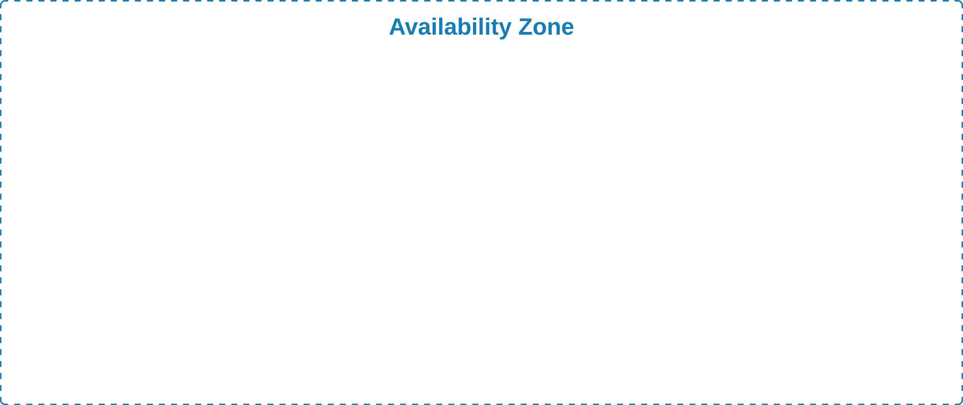

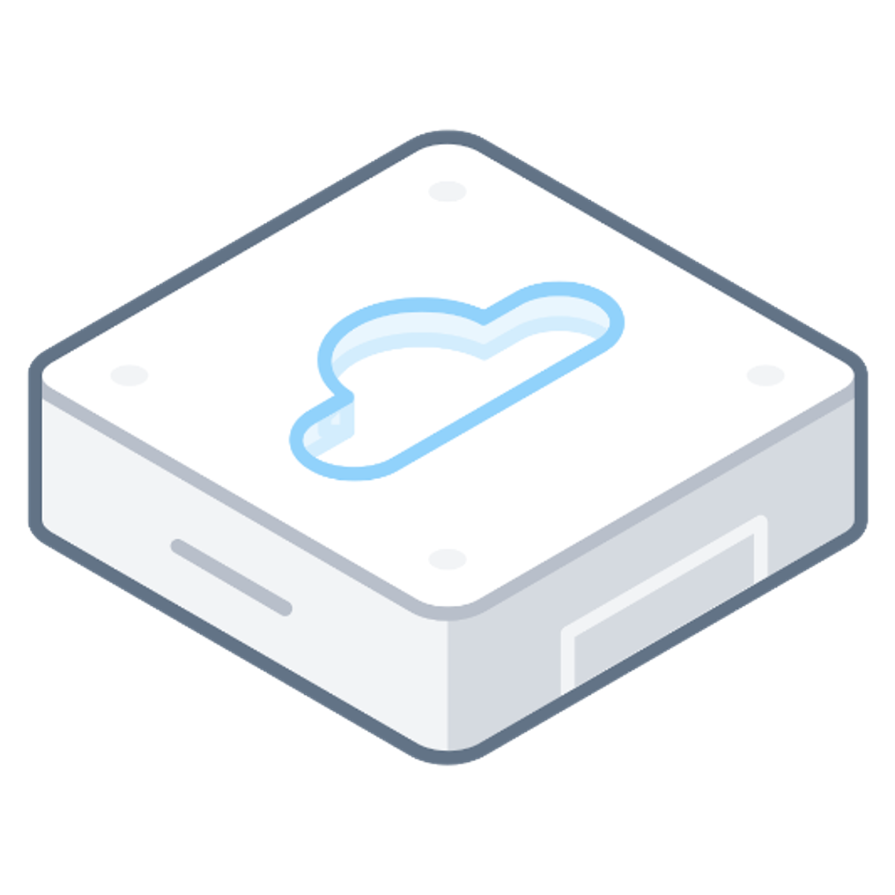
Bare Metal EC2
Bare Metal EC2
Bare Metal EC2
Nutanix Cloud Cluster (NC2) on AWS

