Slide 1

Hello It’s Tuxx!

Slide 2
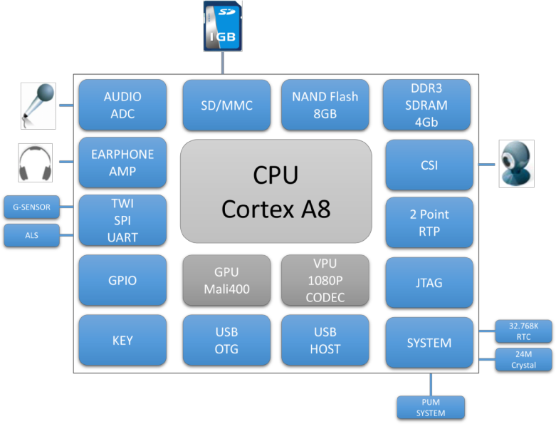

Slide 3
Odroid XU4: | NanoPi NEO4: | BeagleBone Black:
Processor: Samsung Exynos 5422, Quad-core Cortex-A15 and Quad-core Cortex-A7. | Processor: Rockchip RK3399 Dual-core Cortex-A72 up to 1.8GHz and Quad-core Cortex-A53 up to 1.5GHz. | Processor: Single-core ARM Cortex-A8.
RAM: 2GB LPDDR3. | RAM: 1GB LPDDR3. | RAM: 512MB DDR3.
Connectivity: Gigabit Ethernet, HDMI, USB 3.0, USB 2.0, GPIO pins. | Connectivity: HDMI, USB 3.0, Gigabit Ethernet, Wi-Fi, Bluetooth. | Connectivity: Ethernet, HDMI, USB 2.0, GPIO pins.
Form Factor: Compact and powerful | Compact Design: Small form. | Form Factor: Similar to Raspberry Pi.

Slide 4

Raspberry Pi 1 Model B
Raspberry Pi 3 Model B
Raspberry Pi 2 Model B
Raspberry Pi 3 Model B+
Raspberry Pi ZERO W
Raspberry Pi 4 Model B
Raspberry Pi 1 Model B

