Slide 1
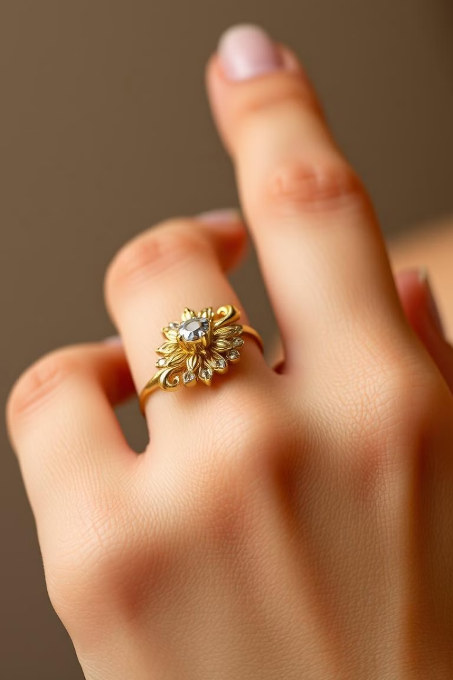

The Allure of Gold Jewelry
Gold jewelry has captivated humanity for millennia, symbolizing wealth, status, and the eternal beauty of the natural world. From the intricate filigree of ancient Egyptian ornaments to the sleek sophistication of modern designs, gold's timeless appeal transcends cultures and eras. Join us as we explore the history, craftsmanship, and enduring symbolism behind this precious metal and the exquisite pieces it inspires.
by Payal Nanda

Slide 2
The History of Gold Jewelry
Ancient Civilizations
Gold jewelry has been prized since the dawn of human civilization, with the earliest known examples dating back to the Neolithic period. Ancient Egyptians, Mesopotamians, and other early cultures adorned themselves and their deities with intricate gold pieces, showcasing their technical mastery and reverence for the precious metal.
The Modern Era
In the 20th century, gold jewelry evolved to reflect changing styles and cultural trends. From the art deco elegance of the 1920s to the minimalist chic of the present day, gold remains a timeless symbol of luxury and refined taste.
1
2
3
The Renaissance
During the Renaissance, European monarchs and nobility commissioned extravagant gold jewelry to display their wealth and power. Goldsmiths of the era pushed the boundaries of craftsmanship, creating elaborate pieces that combined gold with precious gems and enamels.

Slide 3
Varieties of Gold Jewelry
Karats
Styles
Colors
Settings
Gold jewelry is measured in karats, a unit that indicates the purity of the metal. Pure gold is 24 karats, while lower karats like 14K and 18K are alloyed with other metals to increase durability and adjust the color.
Gold jewelry encompasses a wide range of styles, from classic chains and pendants to bold statement pieces. Popular styles include hoop earrings, delicate filigree, and sleek modern designs that showcase the metal's innate beauty.
In addition to the warm, yellow hue of traditional gold, the metal can be found in a variety of colors. Rose gold, white gold, and even black gold offer unique takes on this timeless material, allowing wearers to express their personal style.
Gold jewelry often features precious gemstones set in a variety of settings, from the simple prong to the intricate pavé. The setting can significantly impact the overall look and feel of the piece, from the understated elegance of a solitaire to the dazzling brilliance of a diamond-encrusted design.

Slide 4
The Craftsmanship of Gold Jewelry
Meticulous Techniques
Artisanal Expertise
Sustainable Sourcing
The creation of gold jewelry involves a multitude of intricate techniques, from lost-wax casting and hand-engraving to granulation and filigree work. These specialized skills require years of training and attention to detail to execute flawlessly.
Master goldsmiths and jewelers are true artisans, combining technical proficiency with an innate sense of design and an eye for proportion. Their expertise allows them to transform the malleable gold into captivating pieces that showcase the metal's natural beauty.
Responsible gold mining and ethical sourcing practices are becoming increasingly important in the jewelry industry. Many leading brands now prioritize transparency and sustainability, ensuring their gold is extracted and processed in a way that minimizes environmental impact and respects human rights.

Slide 5
The Symbolism of Gold Jewelry
Wealth and Status
Spirituality and Tradition
Gold's rarity and value have long made it a symbol of wealth, power, and social status. Wearing gold jewelry has historically been a way for individuals to display their affluence and social standing.
In many cultures, gold is imbued with spiritual significance, representing the divine, the sun, and the connection between the earthly and the divine. Gold jewelry is often used in religious ceremonies and rituals, as well as to mark important life events.
Beauty and Timelessness
Personal Expression
The warm, lustrous glow of gold is universally associated with elegance, sophistication, and the enduring nature of human creativity. Gold jewelry is prized for its ability to enhance the wearer's natural beauty and radiance.
Beyond its traditional associations, gold jewelry has become a means of personal expression, allowing wearers to showcase their individual style, personality, and self-confidence. The versatility of gold allows it to be interpreted in countless ways.

Slide 6




Caring for Gold Jewelry
Clean Regularly
Proper Storage
Polish with Care
Periodic Inspection
To maintain the luster and brilliance of your gold jewelry, clean it regularly with a mild soap and water solution. Avoid harsh chemicals or abrasives that can damage the metal.
Store your gold jewelry in a soft, padded jewelry box or pouch to prevent scratches and tarnish. Keep pieces separate to avoid tangling or damaging delicate chains and settings.
Use a soft, lint-free cloth to gently polish your gold jewelry, removing any built-up dirt or grime. Avoid vigorous rubbing, which can wear down the metal over time.
For pieces with gemstones or intricate settings, have your gold jewelry inspected and professionally cleaned by a jeweler every few years to ensure the integrity of the design.

Slide 7





Trends in Gold Jewelry
Minimalism
1
In recent years, there has been a shift towards sleek, understated gold jewelry that emphasizes the natural beauty of the metal. Simple chains, stud earrings, and delicate rings have become increasingly popular.
Mixed Metals
2
The pairing of gold with other metals like silver or rose gold has become a trendy way to create visual interest and contrast in jewelry designs.
Personalization
3
Customized and personalized gold jewelry, such as engraved pieces or those featuring birthstones, has gained popularity as a way for wearers to express their individuality.
Sustainability
4
As consumers become more conscious of the environmental and ethical impact of their purchasing decisions, the demand for responsibly sourced and recycled gold has increased.
Statement Pieces
5
Bold, oversized gold jewelry that makes a dramatic statement has also seen a resurgence in popularity, as wearers seek to showcase their style and confidence.

Slide 8
The Future of Gold Jewelry
$400B
40%
Global Market
Sustainability Focus
The global gold jewelry market is projected to reach $400 billion by 2027, driven by growing consumer demand and a rising middle class in emerging markets.
Industry experts estimate that up to 40% of gold jewelry sales will come from sustainable and ethically sourced gold by 2030, as consumers prioritize responsible production practices.
75%
5%
E-Commerce Growth
Technological Innovation
Online jewelry sales are expected to account for 75% of total gold jewelry sales by 2025, as consumers increasingly turn to digital platforms to research, browse, and purchase gold jewelry.
Advancements in 3D printing, lab-grown diamonds, and other emerging technologies are poised to disrupt the traditional gold jewelry industry, with an estimated 5% of the market shifting towards these innovative solutions by 2030.

Slide 9
Conclusions
Timeless Beauty
1
Gold jewelry's enduring appeal lies in its timeless beauty, symbolism, and ability to enhance the wearer's natural radiance.
Evolving Trends
2
The gold jewelry industry continues to evolve, with emerging trends in sustainability, personalization, and technological innovation shaping the future of this dynamic market.
Craftsmanship and Care
3
The exceptional craftsmanship and attention to detail that goes into creating gold jewelry, as well as the proper care and maintenance required, contribute to its lasting value and appeal.
A Lasting Legacy
4
As gold jewelry continues to captivate and inspire, it remains a cherished symbol of wealth, status, and the enduring human appreciation for beauty and artistry.

