Slide 1
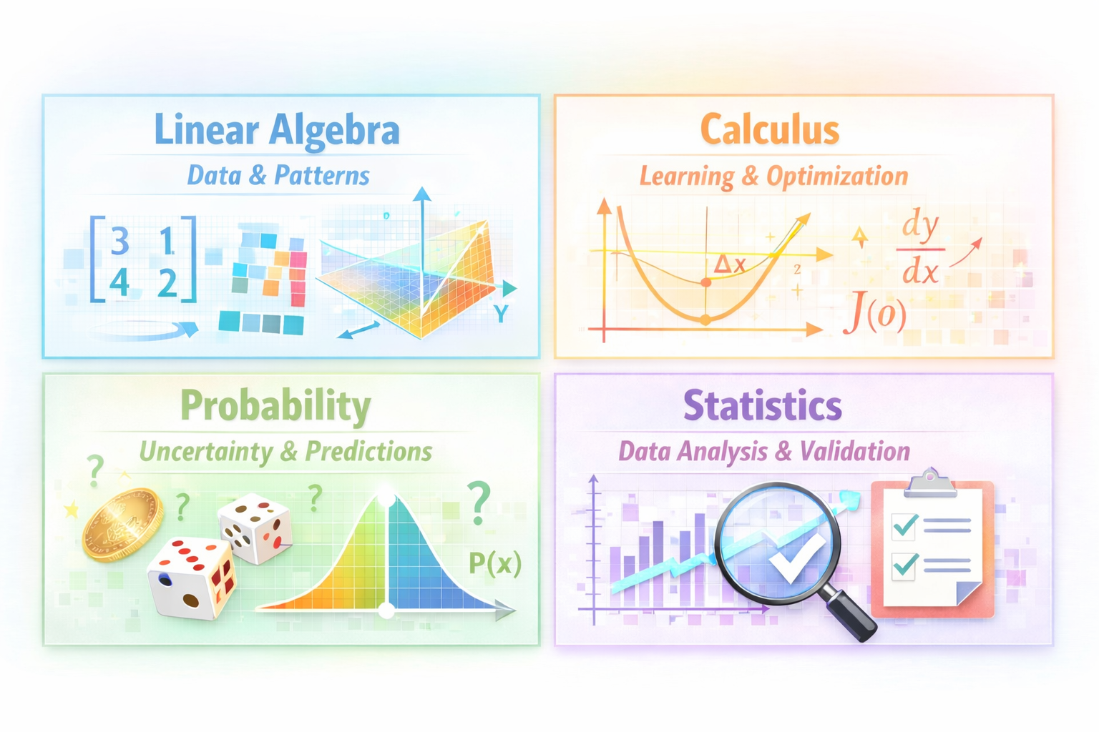

Mathematics for Machine Learning
Notes:
Linear Algebra helps machines represent data and find patterns.”
Calculus helps models to learn and improve step by step.”
Probability helps models to handle uncertainty and make predictions.”
Statistics helps us to understand data and check if models work.
“If you really want to understand machine learning,

Slide 2

Mathematics for Machine Learning
Notes:
Hello everyone
“Do you know where the real intelligence in machine learning comes from?”
“It’s not just code… It’s mathematics.”
“Machine learning stands on four mathematical pillars.”
“Linear Algebra. Calculus. Probability And Statistics.
“Think of them as tools. Different tools for different problems.”
Linear Algebra helps machines represent data and find patterns.”

Slide 3

Mathematics for Machine Learning
Notes:
Linear Algebra helps machines represent data and find patterns.”
Calculus helps models to learn and improve step by step.”
Probability helps models to handle uncertainty and make predictions.”
Statistics helps us to understand data and check if models work.
“If you really want to understand machine learning,

Slide 4

Mathematics for Machine Learning
Notes:
“If you really want to understand machine learning, you need to understand its mathematics.”
“See you in the session. Training details are in the description below.”

Slide 5

Mathematics for Machine Learning
Notes:
Linear Algebra helps machines represent data and find patterns.”
Calculus helps models to learn and improve step by step.”
Probability helps models to handle uncertainty and make predictions.”
Statistics helps us to understand data and check if models work.
“If you really want to understand machine learning,

