Slide 1
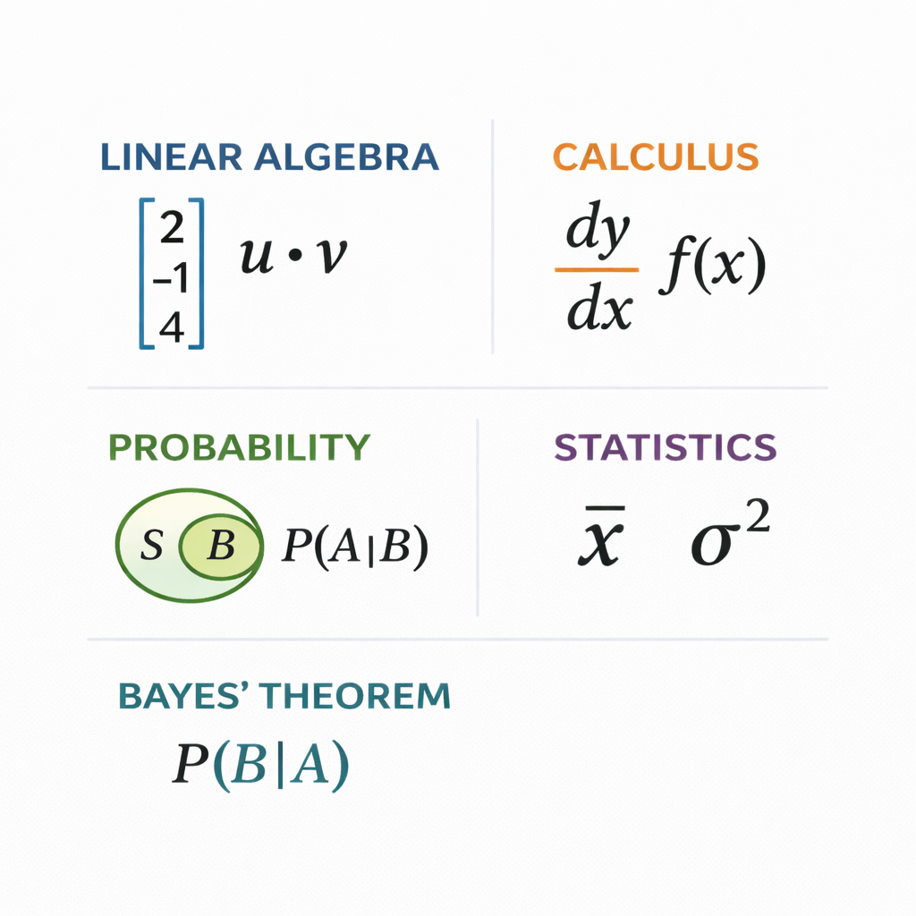
Mathematics for Machine Learning
Linear Algebra
Calculus
Probability
Statistics
Notes:
Hello everyone,
Today, we are starting a journey into mathematics for machine learning.
When we hear machine learning, we often think it is all about coding and algorithms.
But The real intelligence behind machine learning comes from mathematics
In these, I will not use complex formulas. Instead,
More focus on understanding
why mathematics matters,
and how it helps machines learn.
Machine learning is built on four mathematical pillars.
Linear Algebra.
Calculus.
Probability.
And Statistics.
Each one plays a different role. Think of them as tools. Different tools for different problems.
In the next few minutes, I will give you high overview of each one.
Prerequisites : none. We will be starting from basics so prior knowledge of maths is not required.
This learning is series of 4 sessions around 30-40 mins each.
Today we will be covering introduction and Liner algebra
And then separate session Calculus, Probability, and Statistics
https://github.com/sj8511/mathsforml is my github repo which has some jupyter notebook and python code examples
So Let’s begin our journey..

Slide 2
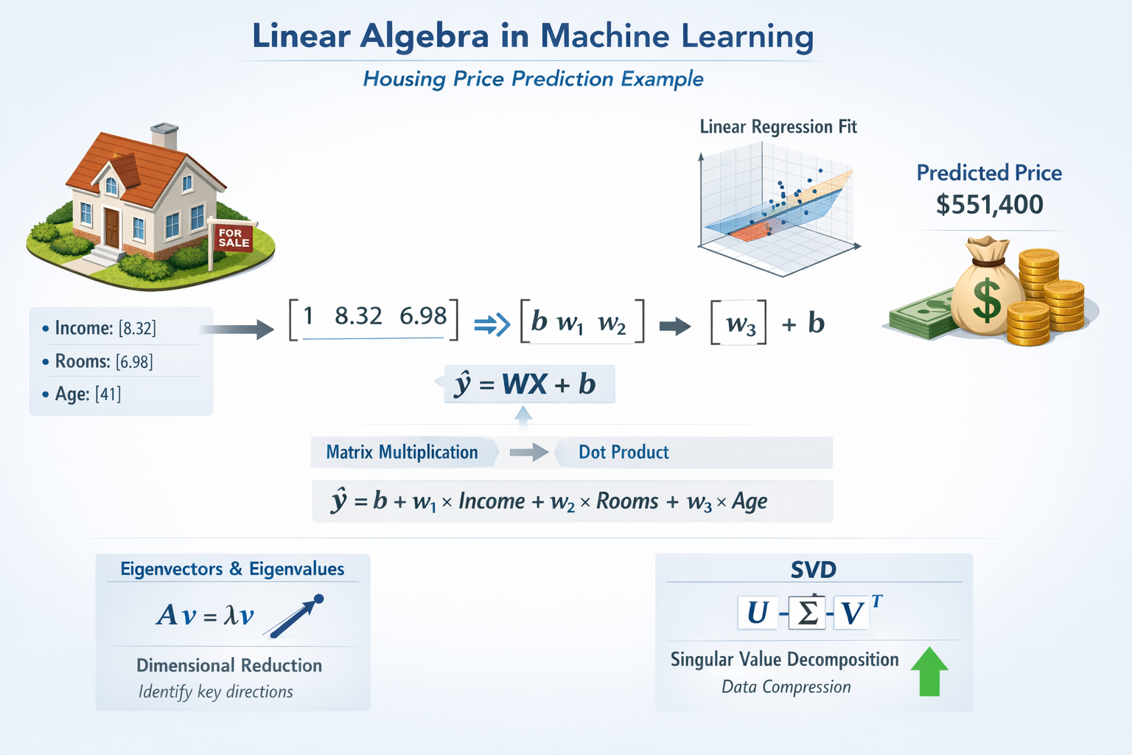
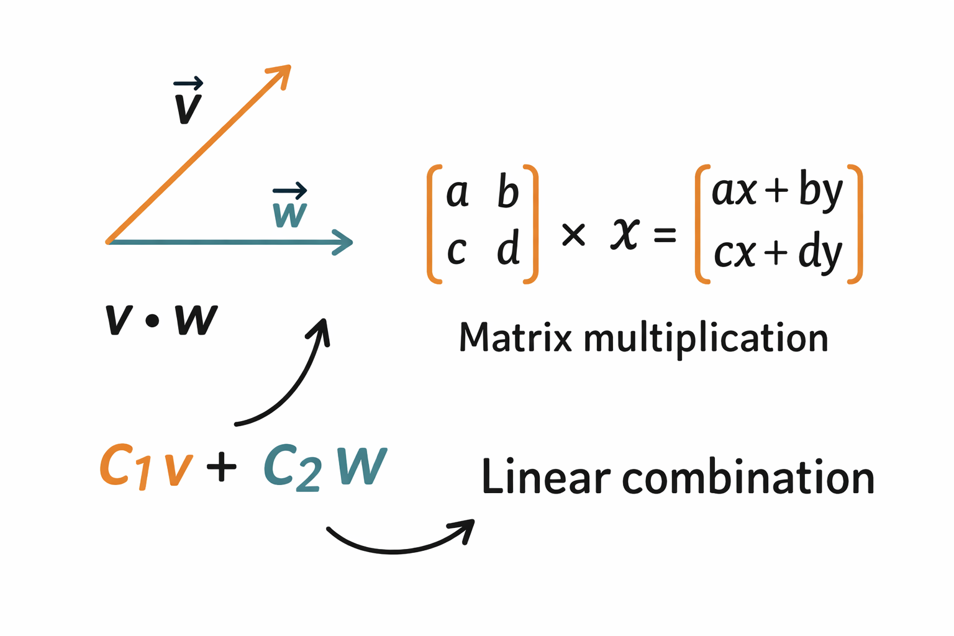
Linear Algebra
MedInc | House Age | Ave Rooms | MedHouse Val
8.3252 | 41 | 6.9841 | 4.526
8.3014 | 21 | 6.2381 | 3.585
Every data point becomes a vector, and an entire dataset becomes a matrix,
dot products measure similarity
matrix multiplication combines information across features
linear combinations help models build new features
Notes:
Let us begin
with Linear Algebra.
Linear algebra is all about scalers, Vectors, Matrices .. their transformation and combination.
In machine learning,
Every data point like Median income, House Age and avg rooms becomes a vector, and an entire dataset becomes a matrix
First image shows building blocks like Vectors, matrix and their operation
And second image shows how we can use these building blocks to predict the house price.
We will learn all these concepts today.
So, linear algebra helps machines represent data and work with it.

Slide 3
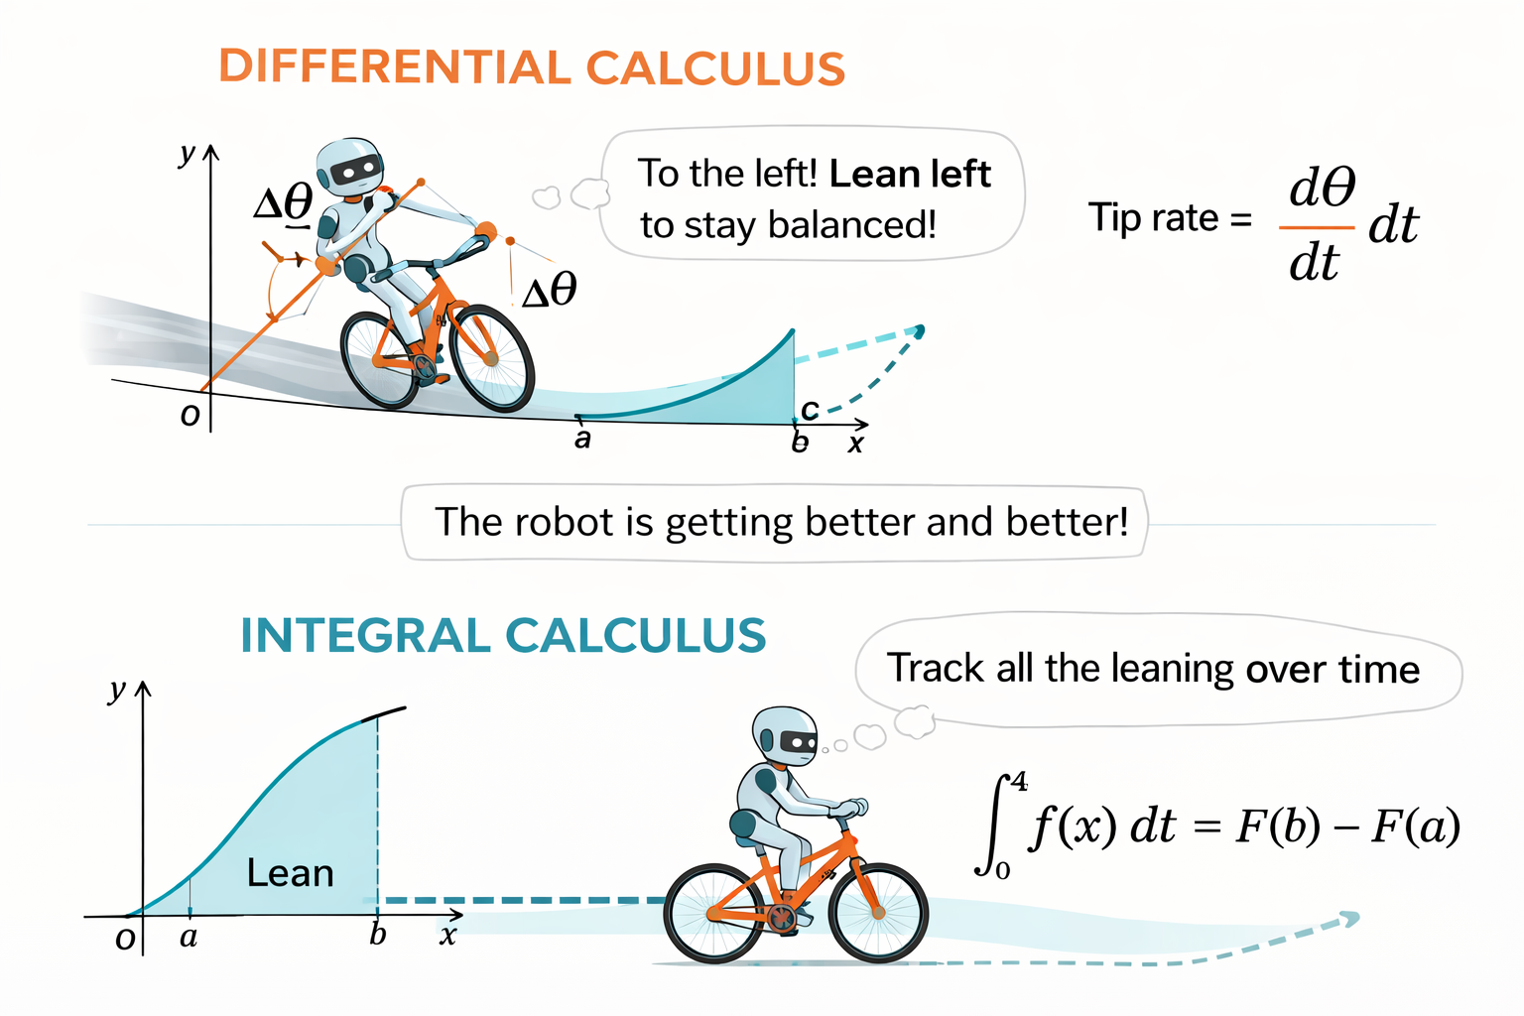
Calculus
Imagine a robot learning to ride a bicycle. Differential calculus tells the robot how fast it’s tipping and which way to lean to stay balanced. Integral calculus helps it remember how much it has leaned over time so it can ride smoothly.
Notes:
Now,
let us talk about Calculus.
Imagine a robot learning to ride a bicycle.
Differential calculus tells the robot how fast it is tipping,
and which way to lean to stay balanced , what to do to take left turn or right turn ..its all about learning.
Integral calculus helps it remember how much it has leaned over time
In the same way, calculus helps machine learning models learn from mistakes, and improve step by step.
We will learn both Differential calculus and Integral calculus in next session
Calculus is important session don’t miss it.

Slide 4
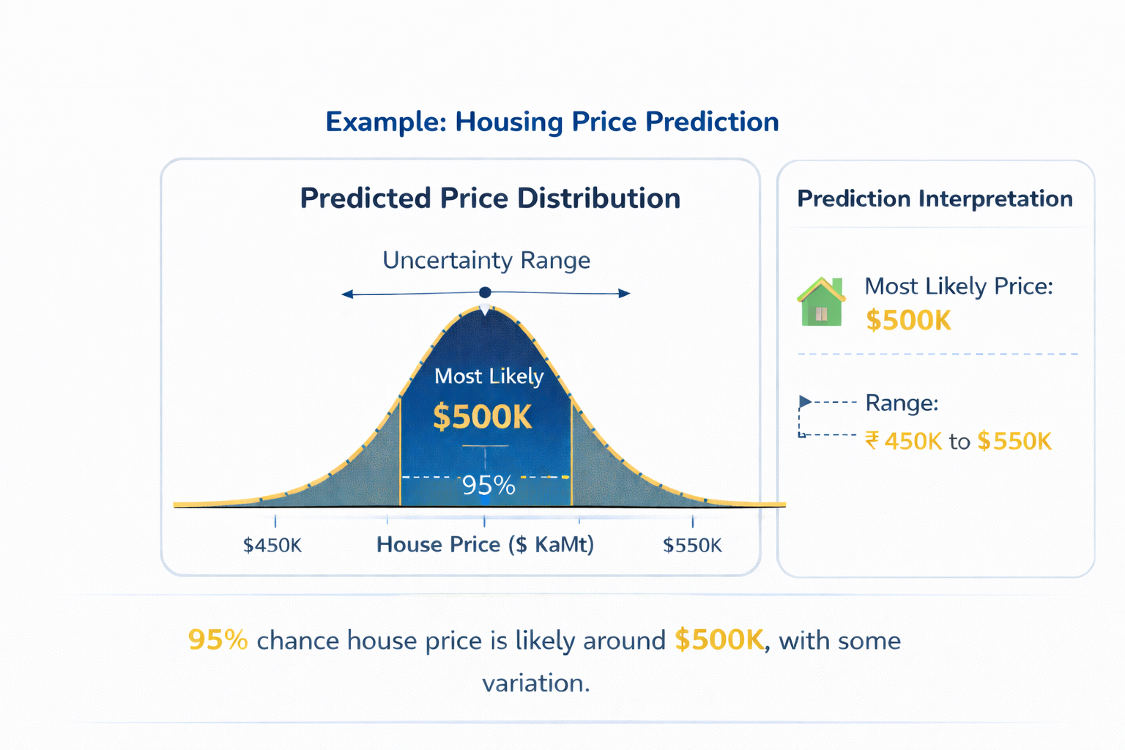
Probability
Models uncertainty
sample space represents all the possibilities, while events are the specific outcomes.
Conditional probability helps models make better guesses
Bayes’ Theorem lets models continually update their predictions
Notes:
Next,
we have Probability.
Real-world data is uncertain.
Probability helps models handle uncertainty.
If you look at the attached image which is related to housing price prediction .. it says 95% chance that this price of house approx $500K. This is 95% is the probability.
In this section we will be learning
Sample Space and Events
Joint Probability
Conditional Probability
Bayes Theorem

Slide 5
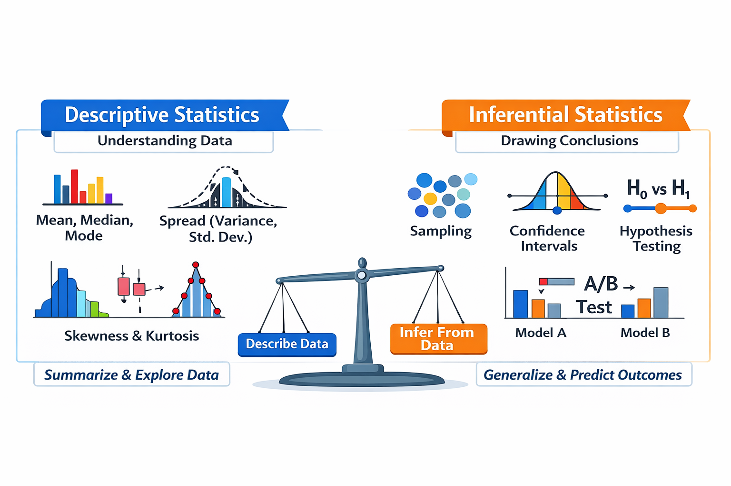
Statistics
Data understanding & summarization
Mean, variance, standard deviation
Sampling & hypothesis testing
Notes:
Finally,
we have Statistics.
In Statistics we will be learning descriptive statistics and Inferential statistics
descriptive statistics is to understand the data
Inferential statistics is to predict prices for unseen data
As you see in this image Concepts such as mean, variance, and standard deviation summarize patterns in a dataset. Statistical tests like hypothesis and A/B testing are used check assumptions, and validate the model

Slide 6
THANK YOU

