Slide 1
Linear Algebra in Machine Learning
Scalars, Vectors, Matrices
Coordinate Systems
Vector addition
Dot Product
Matrix Multiplication
Housing price prediction
Notes:
Now we're going to explore how linear algebra serves as the mathematical backbone of machine learning.
We'll start with fundamental concepts and build up to a practical example of predicting housing prices in California.

Slide 2
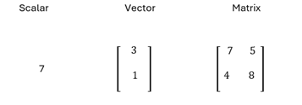
Scalar, Vector, Matrix
Scalar is a single numerical value that has only magnitude
Vector is an ordered array(or list) of numbers that has both magnitude and direction
A matrix is a rectangular array of numbers arranged in rows and columns
Scalars are 0D, vectors are 1D and matrices are 2D arrays
A tensor is a mathematical object that generalizes Scalars, Vector, Matrices to higher dimensions
Notes:
Let’s begin with the basic building blocks. A scalar is simply a single number — just a magnitude, nothing more. A vector is an ordered list of numbers; you can think of it as an arrow with both magnitude and direction. A matrix is a rectangular grid of numbers arranged in rows and columns. While scalars are zero-dimensional, vectors are one-dimensional, and matrices are two-dimensional. Finally, we have tensors, which generalize all of these into higher dimensions. These objects are the vocabulary of machine learning, and models express data, weights, and transformations using them.

Slide 3
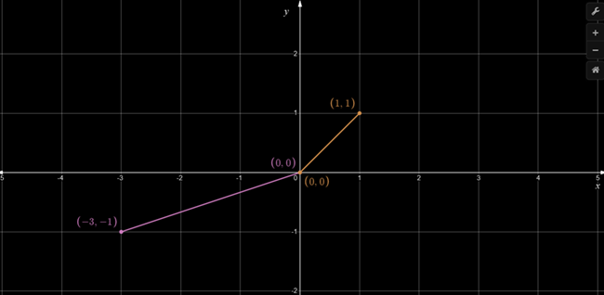
Coordinate System
From two dimensions perspective, you have a horizontal line, called the x-axis, and a vertical line, called the y-axis.
The place where they intersect is the origin.
In three dimensions, we have 3rd axis called z-axis which is perpendicular to both x and y axis.
https://www.desmos.com/calculator/nfle2zawsk
Notes:
Before we do operations, it’s important to understand the stage they exist on: coordinate systems. In two dimensions, we have an x-axis and a y-axis intersecting at the origin. In three dimensions, we introduce a z-axis, which is perpendicular to both x and y. These coordinate systems allow us to locate points, describe vectors, and visualize geometric relationships. Machine learning models—especially those involving images, 3-D sensing, or geometry—rely heavily on structured coordinate systems.
https://www.desmos.com/calculator/nfle2zawsk
3D
https://www.desmos.com/3d/aetsx8jcea

Slide 4
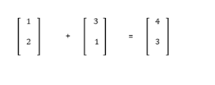
Vector addition
If vectors are represented by their components, then add the corresponding components.
For example, add x-component of first vector to x-component of second vector
https://www.desmos.com/calculator/nfle2zawsk
Notes:
Now let’s talk about vector operations. Vector addition is intuitive: If two vectors are represented by components, we add each component individually — x with x, y with y, and so on. Geometrically, this looks like placing one vector at the tip of another, creating a new vector. This simple idea becomes powerful when working with embeddings, gradients, and transformations in machine learning
https://www.desmos.com/calculator/nfle2zawsk

Slide 5
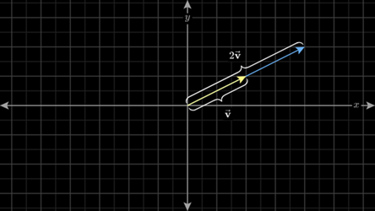
Scalar Multiplication
Multiplying a vector by a scalar, changes its magnitude but not its direction (unless the scalar is negative, which reverse the direction)
Notes:
Scalar multiplication stretches or shrinks a vector. If you multiply a vector by a positive scalar, you change its magnitude but not its direction. A negative scalar flips the direction. This is crucial in optimization, where step sizes—controlled by scalars—determine how the model moves toward a minimum during training.

Slide 6
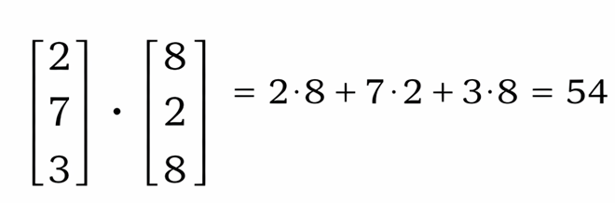
Dot Product
 | Movie1(like) | Movie2
Action | 2 | 8 | 2*8 | 16
Commedy | 7 | 2 | 7*2 | 14
Drama | 3 | 8 | 3*8 | 24
 |  |  |  | 16 + 14 +24 = 54
 | Movie1 (like) | Movie3
Action | 2 | 8 | 2*8 | 16
Commedy | 7 | 1 | 7*1 | 7
Drama | 3 | 4 | 3*4 | 12
 |  |  |  | 16 + 7 + 12 = 35
This operation takes two vectors and results in a scalar value. It represents the extent to which the vectors are parallel.
Result is maximized when vectors point in the same direction, is zero when they are perpendicular, and is minimized (most negative) when they point in opposite directions.
Notes:
Next, the dot product, one of the most important tools in machine learning. The dot product multiplies corresponding components of two vectors and sums the results. What’s special is what it represents: The dot product measures similarity. If two vectors point in similar directions, they have a high dot product; if perpendicular, the dot product is zero; if opposite, it becomes negative. This is the reason dot products power recommendation systems, attention mechanisms, and neural network layers.

Slide 7
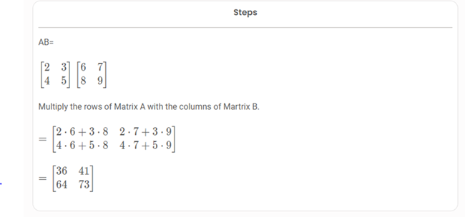
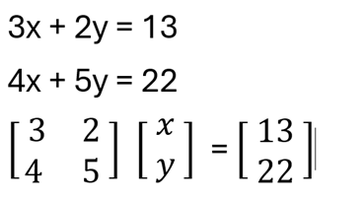
Matrix Multiplication
Transforms vectors
Core of neural network computation
Notes:
Now let’s move to matrix multiplication — the engine of neural networks. Matrix multiplication transforms vectors. When you multiply a matrix by a vector, you're applying a transformation such as stretching, rotating, or projecting. In neural networks, each layer is a matrix that transforms its input vector into another space. This is why matrix multiplication is at the core of all deep learning computations. Behind every forward pass or backward pass in a model is a massive amount of matrix math happening millions of times per second.
https://www.desmos.com/calculator/mw1pz860jk

Slide 8
🏠 Can we predict house prices?
California housing data
SR# | MedInc | House Age | Ave Rooms | Ave Bedrms | Population | AveOccup | Latitude | Longitude | MedHouse Val
0 | 8.3252 | 41 | 6.9841 | 1.0238 | 322 | 2.5556 | 37.88 | -122.23 | 4.526
1 | 8.3014 | 21 | 6.2381 | 0.9719 | 2401 | 2.1098 | 37.86 | -122.22 | 3.585
2 | 7.2574 | 52 | 8.2881 | 1.0734 | 496 | 2.8023 | 37.85 | -122.24 | 3.521
3 | 5.6431 | 52 | 5.8174 | 1.0731 | 558 | 2.5479 | 37.85 | -122.25 | 3.413
4 | 3.8462 | 52 | 6.2819 | 1.0811 | 565 | 2.1815 | 37.85 | -122.25 | 3.422
5 | 4.0368 | 52 | 4.7619 | 1.1036 | 413 | 2.1399 | 37.85 | -122.25 | 2.697
6 | 3.6591 | 52 | 4.9317 | 1.1128 | 1094 | 2.1284 | 37.84 | -122.25 | 2.992
7 | 3.12 | 52 | 4.7975 | 1.0869 | 1157 | 2.0269 | 37.84 | -122.25 | 2.414
8 | 2.0804 | 42 | 4.2941 | 1.049 | 1206 | 1.9913 | 37.84 | -122.26 | 2.267
9 | 3.6912 | 52 | 4.9706 | 1.0663 | 1551 | 2.4513 | 37.84 | -122.25 | 2.611
Notes:
https://inria.github.io/scikit-learn-mooc/python_scripts/datasets_california_housing.html
Challenge: Estimate home values based on key features
Above data is first 10 rows from California housing dataset. Target house price is the last column “Med House value” * 100000

Slide 9
Feature selection
Median Income (x $10000) | Average Rooms | House Age | House prices (x $100000)
8.3252 | 6.9841 | 41 | 4.526
8.3014 | 6.2381 | 21 | 3.585
7.2574 | 8.2881 | 52 | 3.521
5.6431 | 5.8174 | 52 | 3.413
1 8.3252 6.9841 41
1 8.3014 6.2381 21
1 7.2574 8.2881 52
1 5.6431 5.8174 52
b
W1
W2
W3
452600
358500
352100
341300
X
=
Price₁ = b + w₁×Income₁ + w₂×Rooms₁ + w3 × House age₁
Price₂ = b + w₁×Income₂ + w₂×Rooms₂ + w3 × House age₂
Price₃ = b+ w₁×Income₃ + w₂×Rooms₃ + w3 × House age₃
Notes:
Challenge: Estimate home values based on key features
Available data: Median income, Avg Rooms, house prices
Goal: Find pattern: Features → Price
Let’s bring everything together with a real example from the dataset included in the PowerPoint. Suppose we have income levels and average room counts for different neighbourhoods.
We also have a simple model: Price=𝑏+𝑤_1× Income + 𝑤_2×Rooms
We can rewrite these values into a matrix form, where each row represents a house and each column represents a feature. Then we multiply this matrix by a weight vector and add a bias term. This is classic linear algebra: a matrix–vector multiplication that produces predicted prices.

Slide 10
Standardization
Step 1 : Standardize the data
Fair Comparisons
Remove the influence of high values
Standardized Values:
MedInc : mean = 3.8707, std = 1.8998
HouseAge : mean = 28.6395, std = 12.5856
AveRooms : mean = 5.4290, std = 2.4742
To standardize: z = (x - mean) / std
MedInc_std = (8.3252 - 3.8707) / 1.8998 = 2.345
HouseAge_std = (41.0 - 28.6395) / 12.5856 = 0.982
AveRooms_std = (6.9841 - 5.4290) / 2.4742 = 0.628
Notes:
All features contribute equally to the learning process.
Standardization scales data to have a mean of zero and a standard deviation of one

Slide 11
Standardization
1 8.3252 6.9841 41
1 8.3014 6.2381 21
1 7.2574 8.2881 52
1 5.6431 5.8174 52
b
W1
W2
W3
452600
358500
352100
341300
X
=
Bias Inc_std Rooms_std Age_std
1 2.345 0.628 0.982
1 2.334 -0.481 -0.607
1 1.784 1.155 1.855
1 0.933 0.157 1.855
b
W1
W2
W3
452600
358500
352100
341300
X
=
Notes:
Matrix × Vector = Predictions Vector

Slide 12
The Normal Equation
Step 1: Feature Matrix (X)
Organize standardized features + bias
Step 2: Transpose (Xᵀ)
Swap rows and columns
Standardised matrix
 | Bias | Inc_std | Rooms_std | Age_std
House 1 | 1 | 2.345 | 0.628 | 0.982
House 2 | 1 | 2.334 | -0.481 | -0.607
House 3 | 1 | 1.784 | 1.155 | 1.855
House 4 | 1 | 0.933 | 0.157 | 1.855
Transposed Matrix
 | House 1 | House 2 | House 3 | House 4
Bias | 1 | 1 | 1 | 1
Inc_std | 2.345 | 2.334 | 1.784 | 0.933
Rooms_std | 0.628 | -0.481 | 1.155 | 0.157
Age_std | 0.982 | -0.607 | 1.855 | 1.855
Xᵀ = [1.000, 1.000, 1.000, 1.000] # Bias column
[2.345, 2.334, 1.784, 0.933] # MedInc_std
[0.628,-0.481, 1.155, 0.157] # AveRooms_std
[0.982,-0.607, 1.855, 1.855] # HouseAge_std
Notes:
The Inverse Matrix: Mathematical "Undo" Operation
If multiplication is like applying a transformation, then the inverse is like reversing that transformation.
3 × 4 = 12 (Transformation: multiply by 4)
12 × ¼ = 3 (Inverse: multiply by 1/4)

Slide 13
The Normal Equation
Step 3: Multiply (XᵀX)
Capture feature relationships
XᵀX = Xᵀ × X =
[4.000, 7.396, 1.459, 4.085] # Bias row
[7.396, 16.815, 2.646, 6.936] # MedInc row
[1.459, 2.646, 2.463, 2.743] # Rooms row
[4.085, 6.936, 2.743, 8.408] # Age row
Step 4: Inverse (XᵀX)⁻¹
Solve linear system
(XᵀX)⁻¹ =
[ 0.902,-0.461, 0.052,-0.336]
[-0.461, 0.298,-0.099, 0.149]
[ 0.052,-0.099, 0.615,-0.142]
[-0.336, 0.149,-0.142, 0.333]
Notes:
The Inverse Matrix: Mathematical "Undo" Operation
If multiplication is like applying a transformation, then the inverse is like reversing that transformation.
3 × 4 = 12 (Transformation: multiply by 4)
12 × ¼ = 3 (Inverse: multiply by 1/4)

Slide 14
The Normal Equation
Step 5: Multiply Xᵀy
Xᵀy = Xᵀ × y =
[1.000×4.526 + 1.000×3.585 + 1.000×3.521 + 1.000×3.413] = [15.045]
[2.345×4.526 + 2.334×3.585 + 1.784×3.521 + 0.933×3.413] = [27.546]
[0.628×4.526 + (-0.481)×3.585 + 1.155×3.521 + 0.157×3.413] = [ 4.822]
[0.982×4.526 + (-0.607)×3.585 + 1.855×3.521 + 1.855×3.413] = [12.874]
Step 5: Multiply (XᵀX)⁻¹ × Xᵀy
w = (XᵀX)⁻¹ × Xᵀy =
Row 1: 0.902×15.045 + (-0.461)×27.546 + 0.052×4.822 + (-0.336)×12.874 = 3.571
Row 2: (-0.461)×15.045 + 0.298×27.546 + (-0.099)×4.822 + 0.149×12.874 = 0.729
Row 3: 0.052×15.045 + (-0.099)×27.546 + 0.615×4.822 + (-0.142)×12.874 = -0.183
Row 4: (-0.336)×15.045 + 0.149×27.546 + (-0.142)×4.822 + 0.333×12.874 = 0.354
Step 6: Final Weights (w)
Final weights: w = [3.571, 0.729, -0.183, 0.354]ᵀ
Notes:
Verify: (XᵀX) × (XᵀX)⁻¹ ≈ Identity matrix

Slide 15
Predictions
Step 6: Interpretation
Price = 3.571 + 0.729×MedInc_std - 0.183×AveRooms_std + 0.354×HouseAge_std
Step 7: Make Predictions For House 0:
ŷ₀ = 3.571 + 0.729×2.345 - 0.183×0.628 + 0.354×0.982
= 3.571 + 1.710 - 0.115 + 0.348
= 5.514 ($551,400)
Actual : 4.526 ($452,600) - from initial dataset
Error : +0.988 (+$98,800) - Overprediction!
Notes:
Why Poor Results with Only 4 Houses?
Too few samples: Only 4 houses vs 4 features
Overfitting: Model memorizes noise, not patterns
XᵀX nearly singular: Hard to invert accurately

Slide 16
Assignments
https://github.com/sj8511/mathsforml/tree/main/linearalgebra
Linear_Algebra_assingmnets.pdf
Learning Objectives:
1. Vector Operations: Understand addition, subtraction, scalar multiplication
2. Dot Product: Measure similarity and alignment between vectors
3. Matrix Operations: Perform basic matrix multiplications
4. Standardization: Prepare data for machine learning
5. Linear Regression Setup: Formulate problems using matrices
6. Geometric Interpretation: Visualize vector operations
7. Model Interpretation: Understand weights and predictions
8. Error Metrics: Evaluate model performance

Slide 17
THANK YOU

