Slide 1
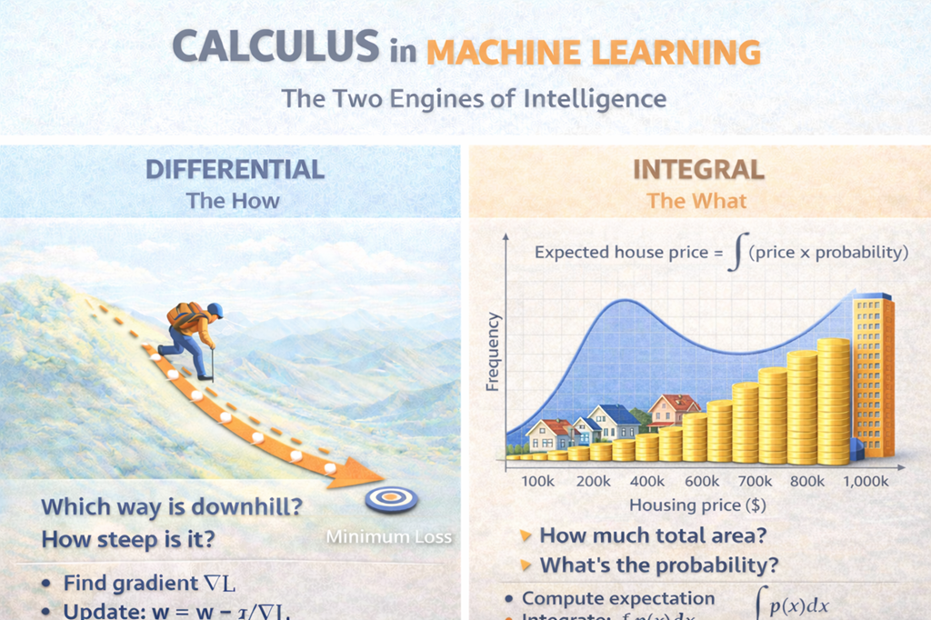
Applied Calculus in Machine Learning
Differential calculus tells the model how to change. Integral calculus tells the model what to expect.
Notes:
Machine learning models don’t learn magically.
They learn using calculus — mainly differential and integral calculus whcich are the tools ancient mathematics of Calculus.
In general calculus is simply the mathematics of change and accumulation.
Let’s understand this using a simple visual story.
On the left is how models learn.
On the right is how models reason under uncertainty.
Consider the man in this image as our machine learning model.
The goal of the model is to reach the downhill point, which represents minimum loss.
However, as shown in the image, the model has ended up at the top of the hill.
This means the model’s predictions are poor, and the model has high error, which we call loss.
The height of the hill represents how large the error is
Where the man stands is the current loss value
If the model moves high , predictions are bad
As the model moves downhill, predictions improve.
The man wants to move downhill, but it can’t see the whole landscape. assume man has blindfold
It can only feel the slope under its feet.
So it asks two questions:
Which way is downhill? → direction
How steep is the slope? → magnitude
These two together are given by the gradient, which is computed using the derivative (dy/dx) of the loss function.
The model updates its parameters by taking a small step in the opposite direction of the gradient, which reduces the loss.
This process repeats many times.
As the slope flattens, the steps become smaller.
When the slope is nearly zero, training has converged.
=============
new Integration
Now let’s see how model reason.
Here, the x-axis shows house prices,
and the y-axis shows how frequently those prices occur.
This curve represents a probability distribution of house prices.
Instead of picking one house,
we consider all possible prices, weighted by how likely they are.
When we add up all these tiny contributions,
we get the expected house price.
This total accumulation is computed using an integral.
Integration answers the question:
What happens on average, across all possibilities?
Differential → Learning
Integral → Reasoning

Slide 2
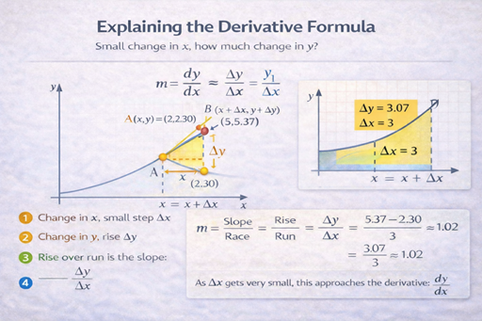
Derivative step by step Derivative = how fast y changes when x changes a little
This is the core idea of derivatives.
x → input (parameter, feature, weight)
y → output (loss, prediction, function value)
In ML terms:
If I slightly change a parameter,
how much does the loss change?
The curve represents a function (e.g., loss function)
Point A(2,2.30) is the current position
Point B(5,5.37) is a nearby position after a small step in x
These two points are not far apart — this is important.
Math | ML Meaning
x | Model parameters
y | Loss
Math | ML Meaning
Δx | Small parameter update
Δy | Change in loss
dy/dx | Gradient
Notes:
This image explains what a derivative really means.
Think of the curve as a function. We pick a point A, here at (2, 2.30), which is our current position.
We then move a small step along the x-axis, called Δx, and reach point B at (5, 5.37).
This causes a small change in the output, Δy.
The slope between these two points is Δy divided by Δx, also called rise over run.
Example calculation:
Change in y = $5.37−2.30=3.07$
Change in x = $5−2=3$ 𝑚=3.07/3≈1.02
A tangent line touching the curve at one point
That tangent’s slope = derivative at that point

Slide 3
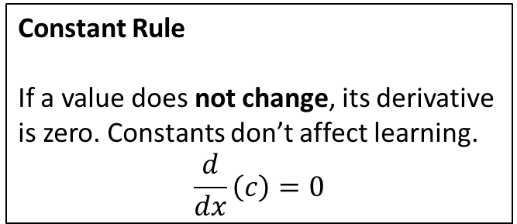
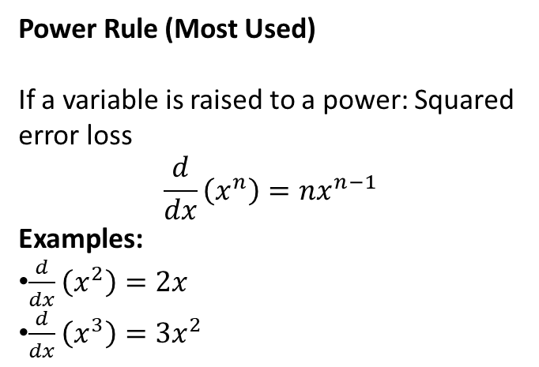
Derivative Rules:fundamental and most used in ML
Rule | Why it matters in ML
Constant | No learning signal
Power | Squared error, regularization
Sum | Loss aggregation
Chain | Backpropagation
Exponential | Softmax, sigmoid
Logarithmic | Log-loss, likelihood
Constant Rule
If a value does not change, its derivative is zero. Constants don’t affect learning.
$$\frac{d}{dx}\left(c\right)=0$$
Power Rule (Most Used)
If a variable is raised to a power: Squared error loss
$$\frac{d}{dx}\left(x^{n}\right)=nx^{n−1}$$
Examples:
$\frac{d}{dx}\left(x^{2}\right)=2x$
$\frac{d}{dx}\left(x^{3}\right)=3x^{2}$

Slide 4
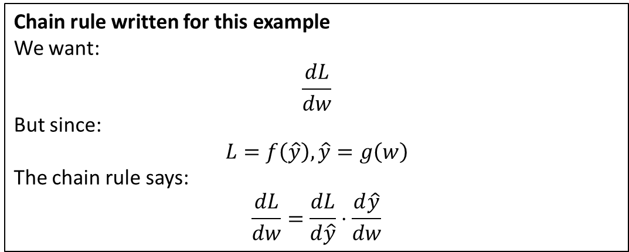
Derivative Rules continued
Chain Rule ( Most Important for ML)
Takes median income
Uses it to predict house price
Compares prediction with actual price
Computes loss (error)
So, the loss does not depend on income directly. It depends on income through multiple steps.
w → predicted price (ŷ) → loss (L)
Chain rule written for this example
We want:
$$\frac{dL}{dw}$$
But since:
$$L=f\left(\hat{y}\right), \hat{y}=g\left(w\right)$$
The chain rule says:
$$\frac{dL}{dw}=\frac{dL}{d\hat{y}}⋅\frac{d\hat{y}}{dw}$$
Notes:
A small change in weight changes the predicted house price. That change in predicted price changes the error. The chain rule multiplies these two effects.

Slide 5
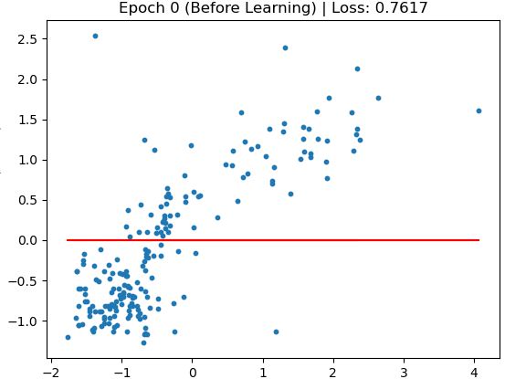
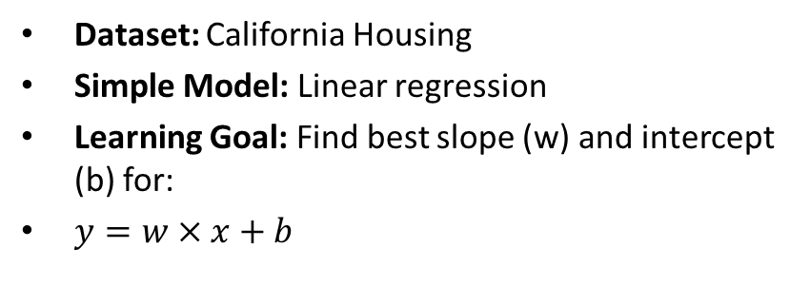
Visualizing Machine Learning Through Derivatives How gradient descent learns: California housing price prediction
Dataset: California Housing
Simple Model: Linear regression
Learning Goal: Find best slope (w) and intercept (b) for:
$y=w×x+b$
x → input feature
(Median income in a neighborhood)
ŷ → predicted output
w = weight , slope of the line
Large w → steep line
Small w → flat line
b is the baseline prediction when x = 0`.y-intercept
Shifts the entire line up or down
Initial Parameters: Weight (w) = 0 Bias (b) = 0 Result: Flat line at y=0 Loss: 0.7617 (Mean Squared Error)
Notes:
We are going to explore how machine learning models actually learn through a process called gradient descent. We will use a real-world example - predicting California housing prices.
We will use a simple linear model - just like drawing a line through data points - and our job is to find the best line.“
w decides how steep the prediction line is, and b decides where the line starts.
"We intentionally start with the worst possible model - a flat line at zero. This shows exactly why we need learning! Our predictions are terrible, but this gives us room for improvement."

Slide 6
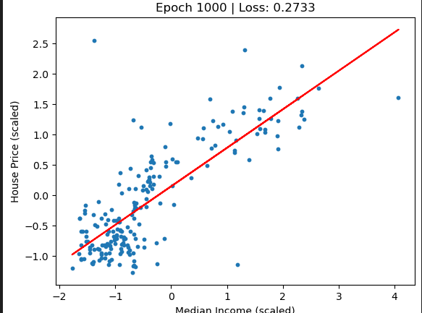
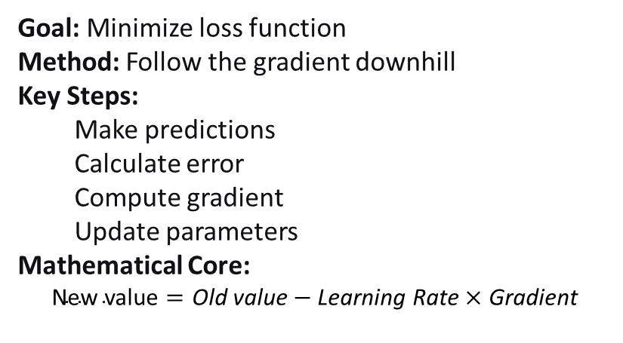
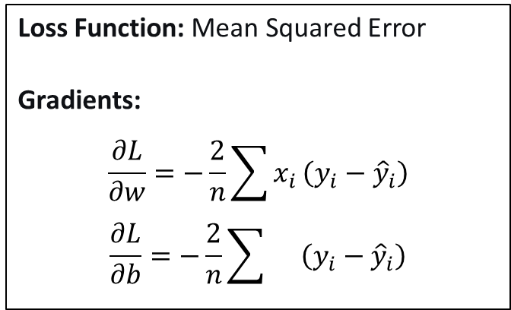
Visualizing Machine Learning Through Derivatives How gradient descent learns: California housing price prediction
Goal: Minimize loss function Method: Follow the gradient downhill Key Steps: Make predictions Calculate error Compute gradient Update parameters Mathematical Core: $$\text{New} \text{value}=\text{Old} \text{value}−\text{Learning} \text{Rate}×\text{Gradient}$$
Loss Function: Mean Squared Error
Gradients:
$$\frac{∂L}{∂w}=−\frac{2}{n}\sum{x_{i}}\left(y_{i}−{\hat{y}}_{i}\right)$$
$$\frac{∂L}{∂b}=−\frac{2}{n}\sum{}\left(y_{i}−{\hat{y}}_{i}\right)$$
Notes:
"This is where calculus comes in! The gradient is just the derivative of our loss function. It tells us how changing our parameters affects the loss.
The negative sign is crucial - it points us downhill toward lower loss.
You don’t need to derive calculus by hand
But understanding it improves ML debugging

Slide 7
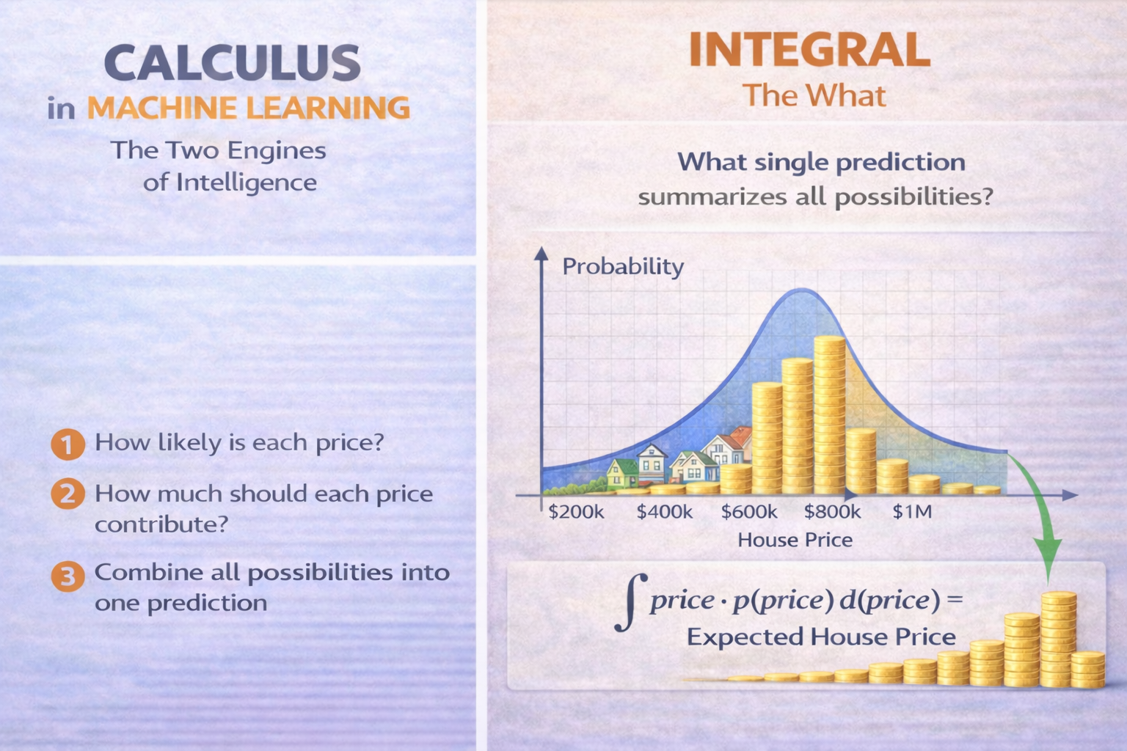
From Change to Expectation: Integral Calculus What Should We Expect for a House Price?
The model does not predict one fixed house price
It predicts a range of possible prices, each with a probability
Integral calculus combines all these possibilities into one meaningful prediction
X-axis: House Price
Y-axis: Probability
The curve shows how likely each price is
Simple numeric intuition (discrete)
$400k with probability 0.2
$700k with probability 0.4
$1M with probability 0.3
0.2(400)+0.4(700)+0.3(1000)≈660k
Notes:
“In the discrete case, probability already includes the size of each step. In the continuous case, we need d(price) to represent an infinitesimally small step.”

Slide 8
Q & A
Questions
Discussion
Notes:
Invite questions and discussion.

Slide 9
THANK YOU

