Slide 1
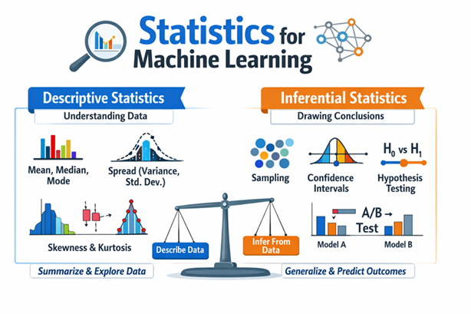
Statistics and Its Types
Descriptive Statistics
Inferential Statistics
Notes:
We use descriptive statistics to understand California housing prices.
Inferential statistics helps us predict prices for unseen houses.

Slide 2
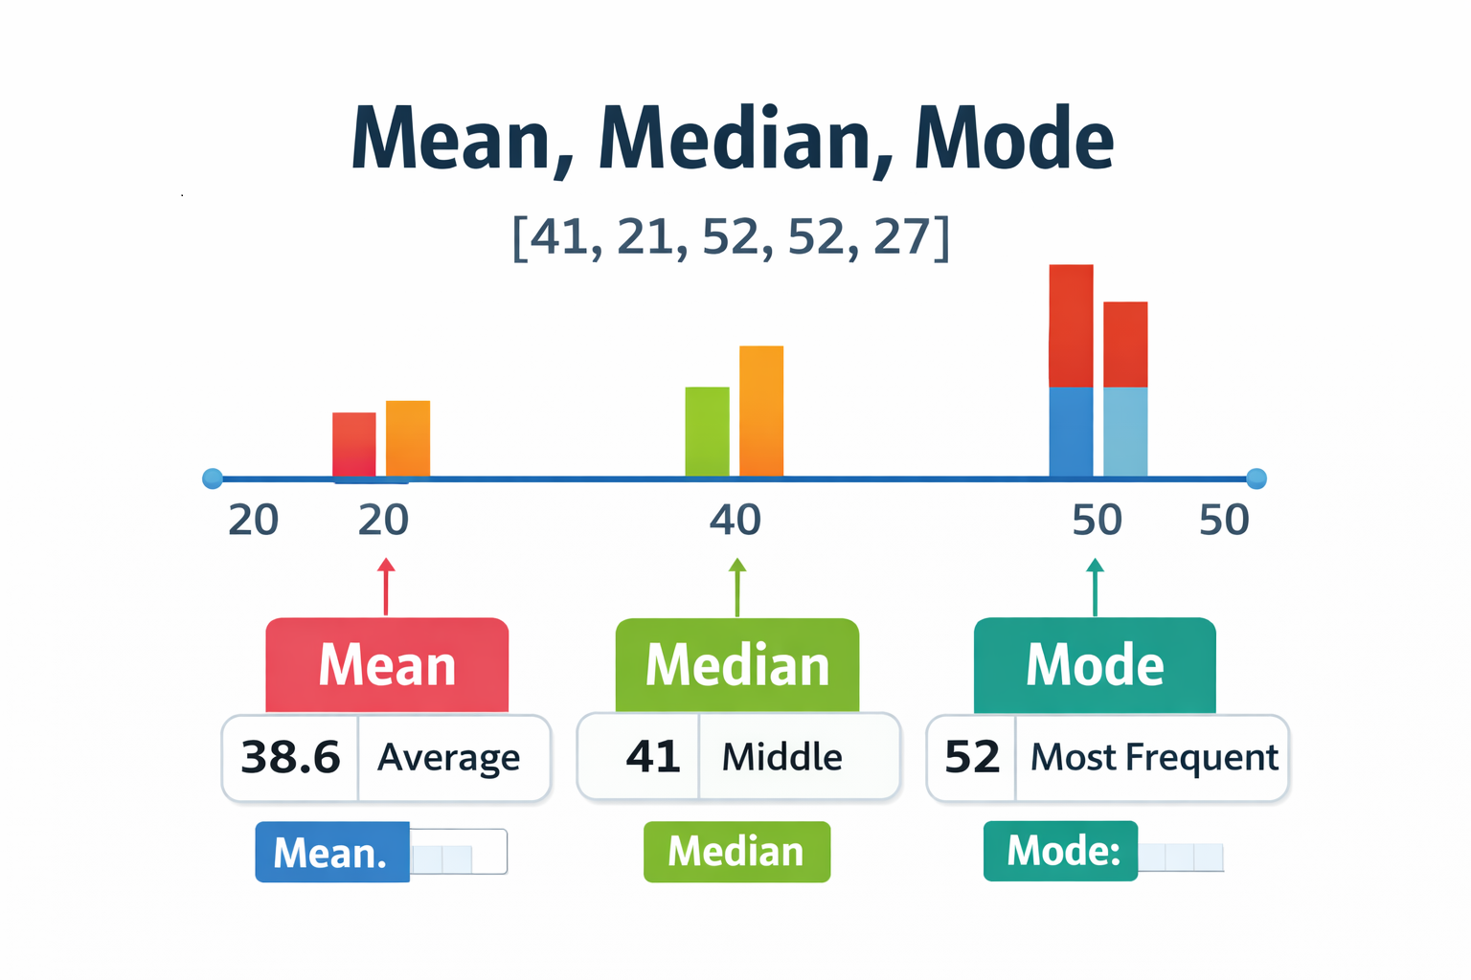
Descriptive Statistics – Central Tendency
Notes:
California house prices house age [41,21,52,52,27]
California house prices contain extreme values.
The mean gets skewed by very old houses.
Median is more robust and used in the dataset.
Mean vs Median (Outliers)

Slide 3
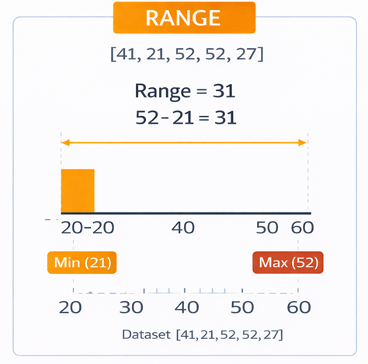
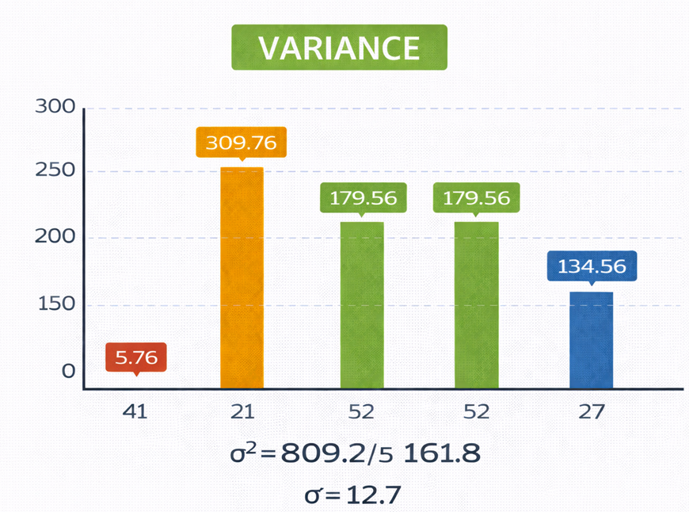
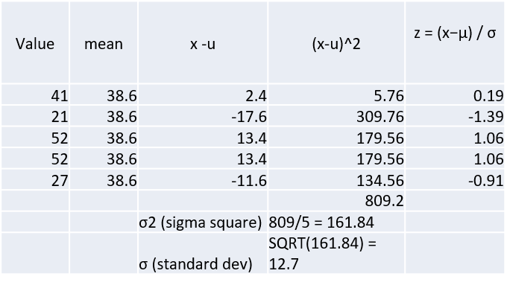
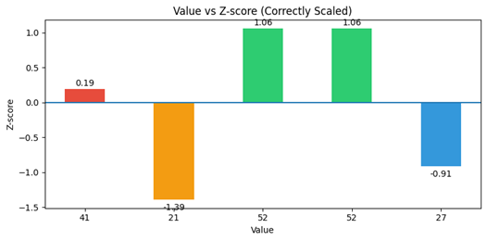
Measures of Spread
Notes:
Range shows older vs newer houses.
Variance shows how widely house age differ across California regions.
High variance affects model stability.
“These bars show how far each value deviates from its mean in standardized units
Prevents features with large values from dominating learning

Slide 4
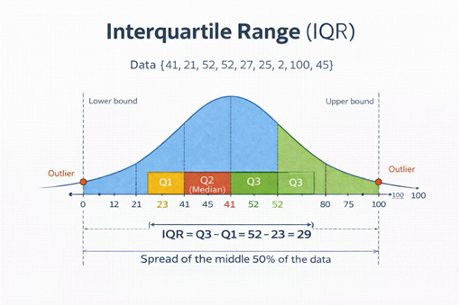
Interquartile Range (IQR)
Q1 (First Quartile): Separates the lowest 25% of the data
Q2 (Second Quartile / Median): Middle value of the dataset
Q3 (Third Quartile): Separates the highest 25% of the data
The Interquartile Range (IQR) tells us how spread out the middle 50% of the data
Interquartile Range = Upper Quartile (Q3)– Lower Quartile(Q1)
Notes:
IQR helps detect extreme house ages
The range $Q_{1}−1.5×IQR \text{to} Q_{3}+1.5×IQR$are considered outliers
Outliers are often removed or capped before training.
it focuses on the central 50% of the data which provides a clearer understanding of its true distribution.

Slide 5
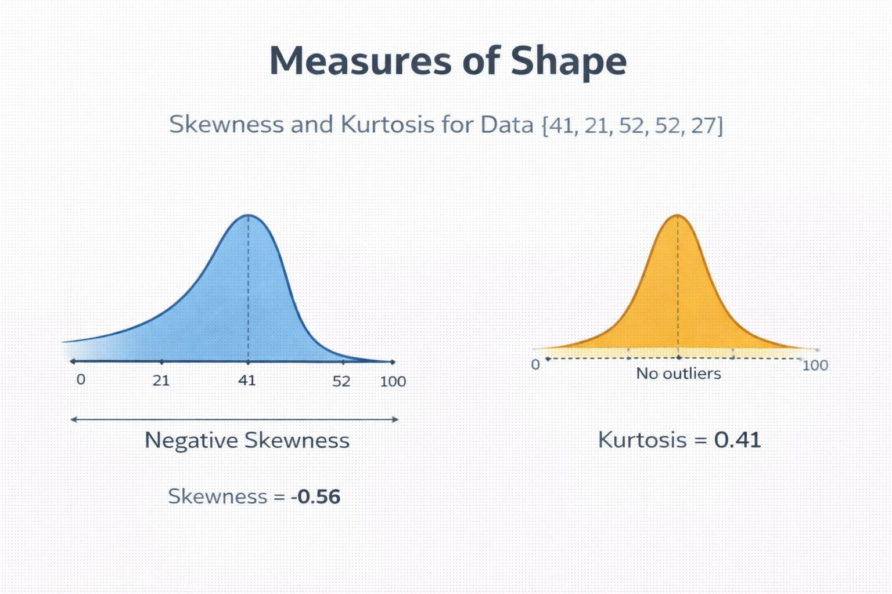
Measures of Shape: Skewness & Kurtosis
Skewness Formula:
Skewness = (1/n) Σ ((x − μ)/σ)³
Kurtosis Formula (Excess):
Kurtosis = (1/n) Σ ((x − μ)/σ)⁴ − 3
ML Insight:
• Skewness → need for transformations • Kurtosis → outlier sensitivity
Notes:
“Skewness tells us whether the data leans left or right, while kurtosis tells us how extreme the tails are. Both help us understand whether transformations or outlier handling are needed before training ML models.”
Skewness Asymmetry of the data distribution
Direction of the tail:
Positive skew → right tail longer
Negative skew → left tail longer

Slide 6
Inferential Statistics
We use descriptive statistics to understand California housing prices.
Inferential statistics helps us predict prices for unseen houses.
Notes:
We use descriptive statistics to understand California housing prices.
Inferential statistics helps us predict prices for unseen houses.
In the California housing problem, we do not observe prices for every house in the state. Instead, we train models on a sampled dataset of regions and households. Inferential statistics helps us estimate population-level trends, such as average house prices. It allows us to quantify how confident we are in these estimates. This ensures our model predictions generalize to unseen areas in California.

Slide 7
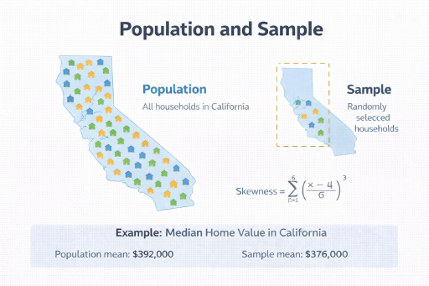
Population and Sample
Notes:
Population represents all houses in California.
Sample is the dataset we collect.
Train-test split simulates real-world deployment.

Slide 8
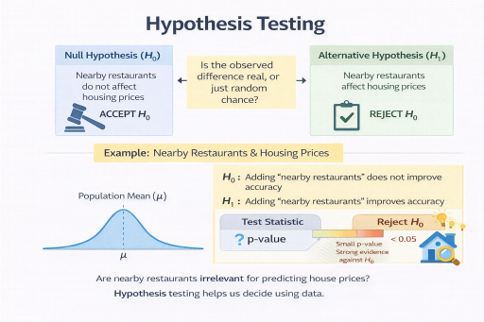
Hypothesis Testing
Our claim is “nearby restaurants” does not affect housing prices. it must be tested, not assumed. That belief itself becomes the null hypothesis
Hypothesis testing is a formal procedure to decide whether observed data provides enough evidence to reject a specific claim about the real world
Notes:
Formulating the Hypotheses (Correct Way)
Null Hypothesis (H₀)
Nearby restaurants do not affect housing prices (or) Adding the feature does not improve model performance
Alternative Hypothesis (H₁)
Nearby restaurants affect housing prices (or) Adding the feature improves model performance
All hypothesis tests compare sample-based estimates against a reference
The population mean μ is that reference.
We test whether adding “nearby restaurants” shifts the mean prediction away from μ

Slide 9
Hypothesis Testing
H₀: Nearby restaurants do not affect the mean housing price – Null Hypothesis
H₁: Nearby restaurants affect the mean housing price – Alternate Hypothesis
Affect
Change in either of model accuracy, RMSE, average predicted house price
Difference in mean house price between:
areas with many restaurants
areas with few restaurants
p-value = probability value
p < 0.05 → Reject H₀
p ≥ 0.05 → Fail to reject H₀
Notes:
Point estimate gives a single predicted price.
Confidence intervals express uncertainty.
Important for risk-aware predictions.

Slide 10
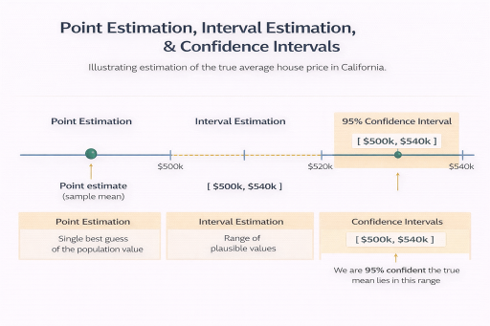
Estimation
Point Estimation → Best single guess
Interval Estimation → Range of plausible values
Confidence Interval → How confident we are in that range
Notes:
We do not know the true population value (e.g., average house price in California).
We take a sample of houses.
We compute one number from the sample.
That number is our best guess of the population value.
That single “best guess” is a point estimate.
In the California housing example, instead of saying the average house price is exactly $520k, we acknowledge uncertainty and estimate a range such as $500k to $540k.
In machine learning, interval estimation is important because models trained on different samples can produce slightly different results.

Slide 11
THANK YOU

