Slide 1

NHL Analytics: Predicting Player Salary
Sawyer Jacobson
Data Science Capstone
4/28/2021

Slide 2
Background
The National Hockey League is the highest level of professional hockey
Each team is limited by a salary cap
Players want to maximize their salary
Different positions value different attributes
Teams must budget in order to field a competitive team

Slide 3
Research Question
Can machine learning be utilized to determine a player’s salary (worth) based on on-ice statistics?
What features are most important in determining a player’s salary?

Slide 4
Data Source
Player Statistics
Player Salary
Obtained by scraping the NHL’s statsAPI
Data on JSON format
https://statsapi.web.nhl.com/api/v1/expands
Not readily available
Scraped from a 3rd party website
Only available going back to the 2018-19 season
https://www.spotrac.com/nhl/
Player statistics are aggregated by season
Complete data collected from the 2018-19 and 2019-20 seasons
1325 observations in total, 849 forwards and 476 defensemen

Slide 5
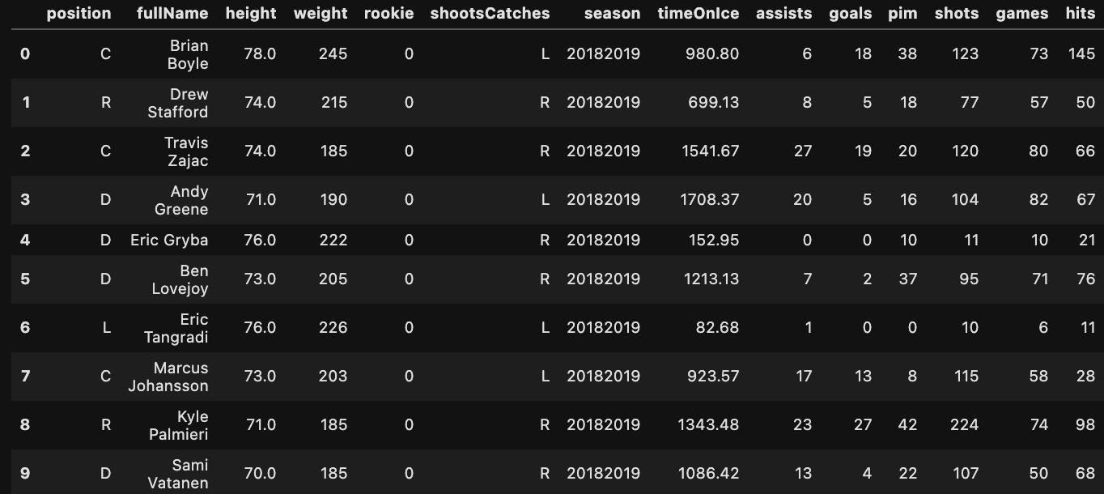
Data Source

Slide 6
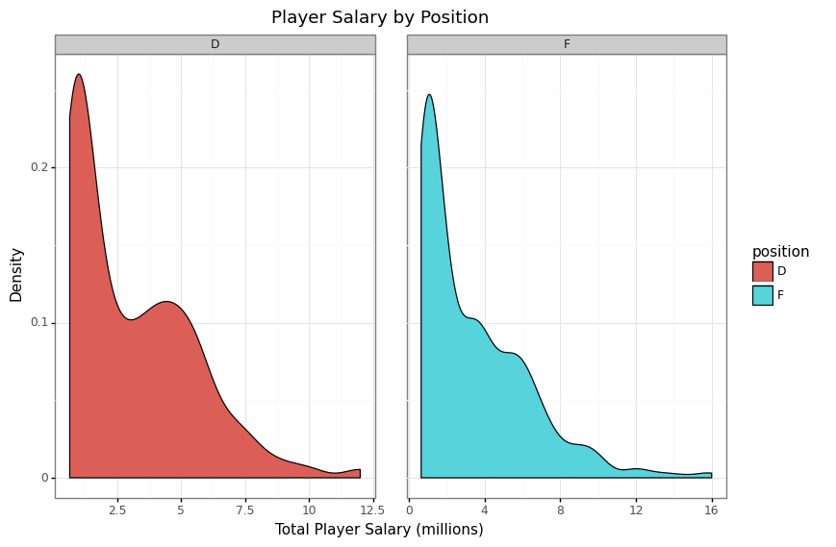
EDA

Slide 7
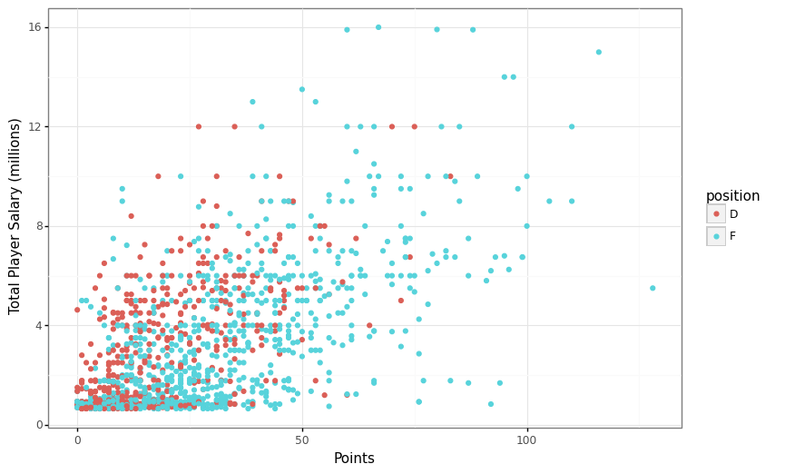
EDA (cont.)

Slide 8
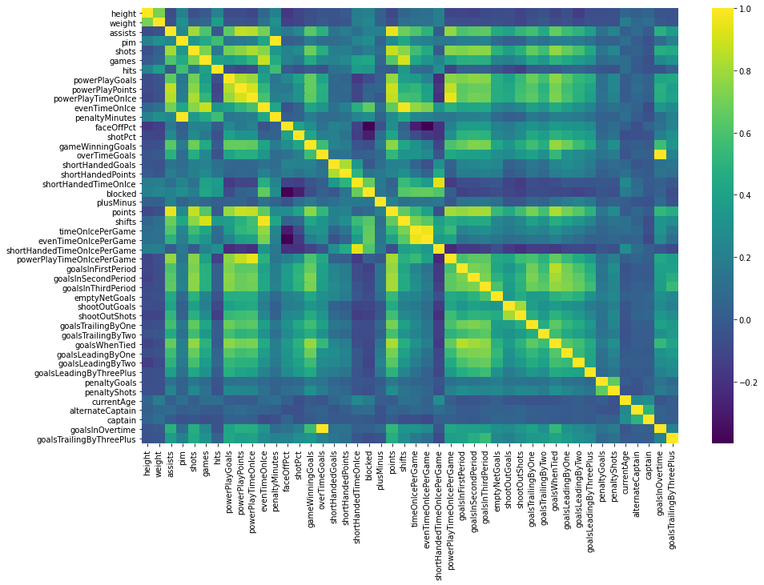
EDA (cont.)

Slide 9
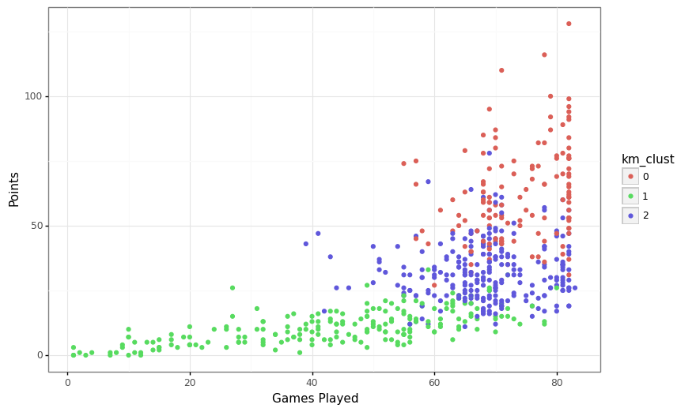
Model Building
Data split 70/30 into train/test sets
Kmeans clustering using 3 clusters was used as a form of feature engineering

Slide 10
Model Building (cont.)
Categorical variables encoded with one-hot-encoding
Numeric variables scaled using StandardScaler
5-fold cross validation used to optimize the models on training set
Models scored on left out test set

Slide 11
Model Building (cont.)
Models Fit
Linear Regression
Random Forest
K-Nearest Neighbors
LASSO
Ridge Regression
Gradient Boosting Model
Ensemble model

Slide 12
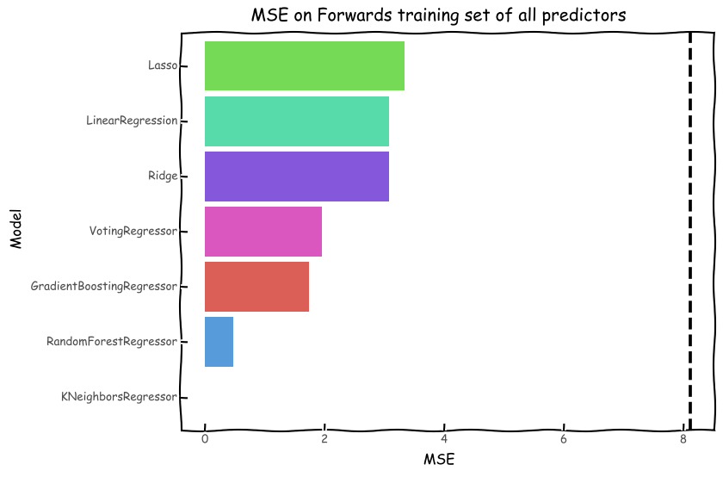
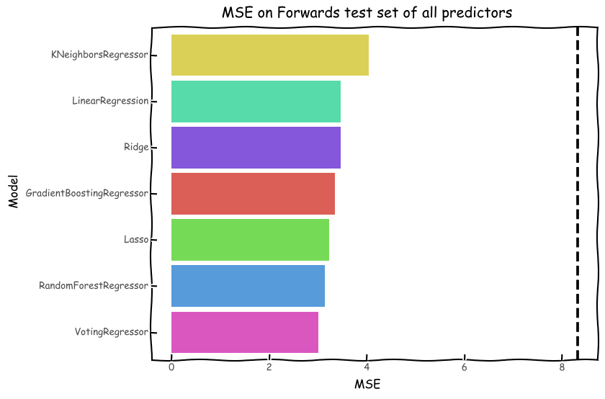
Model Results (forwards)

Slide 13
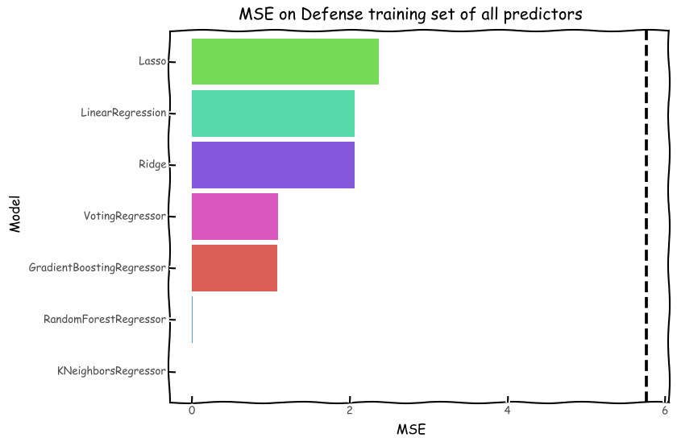
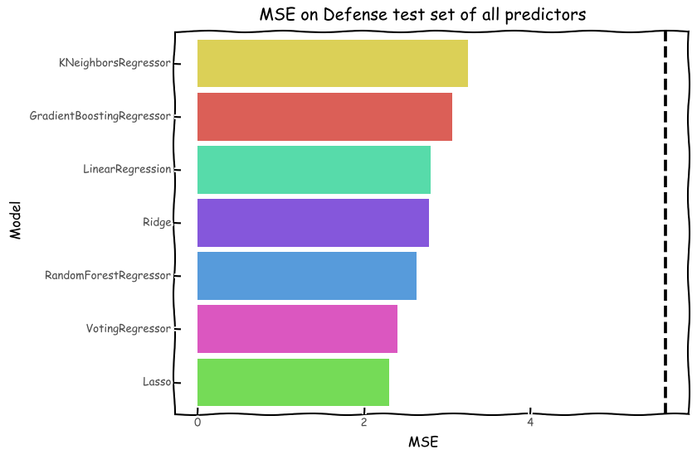
Model Results (defensemen)

Slide 14
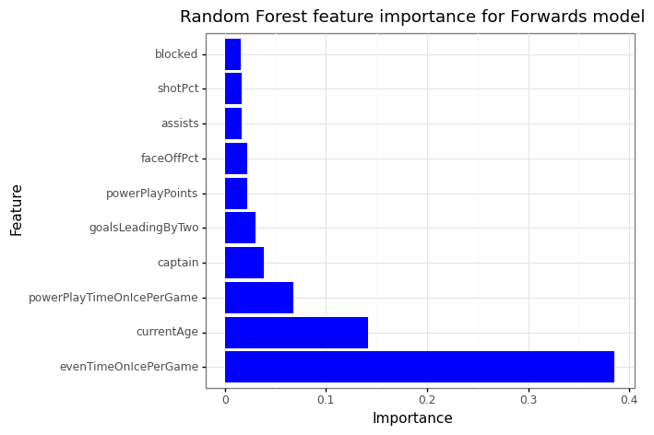
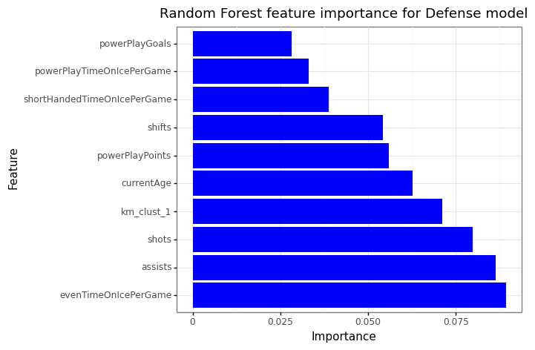
Model Results (RF feature importance)

Slide 15
Conclusions/Future Work
Model overfitting was seen in both groups
The ensemble model was in the top performers for both groups
Removing the very overfit KNN was key
Random forest feature importance shows important factors for both groups in determining salary
Simpson’s paradox can be observed if both positions are pooled together for predictions
Outside factors play into player salaries as well
Salary data was limited
Obtaining more salary data would potentially help reduce the overfitting
Examining salary data from the beginning of the player’s contract
Including more advanced hockey analytic features

Slide 16
Questions?

