Slide 1
Sales Performance
Dashboard
Data Analyst Internship · Task 4
Shravani Umaji Jadhav · Power BI · Financial Sample Dataset · 2013–2014

Slide 2
Objective & Tools
Objective
Tool Used
Design an interactive sales dashboard for business stakeholders to support data-driven decisions.
Power BI Desktop — free, Windows-based BI tool by Microsoft for building interactive dashboards.
Dataset
Deliverables
Financial Sample dataset from Kaggle — 700 rows covering Sales, Profit, Segments and Countries.
Interactive Power BI Dashboard (.pbix) + PowerPoint summary presentation.

Slide 3
Dataset Overview
700
5
5
2
Total Rows
Countries
Segments
Years (2013–14)
Key Columns
Segment
Government, Small Business, Enterprise, Midmarket, Channel Partners
Country
USA, Canada, France, Germany, Mexico
Metrics
Gross Sales, Profit, Units Sold, Sale Price, Discounts, COGS
Time
Monthly data across 2013 and 2014

Slide 4
KPI Summary
$127.93M
$16.89M
1,001
13.2%
Total Gross Sales
Total Profit
Units Sold
Profit Margin
Combined 2013 & 2014
After costs & discounts
Across all segments
Profit / Gross Sales
* Data filtered using Year slicer in Power BI. Click 2013 or 2014 to see individual year performance.

Slide 5
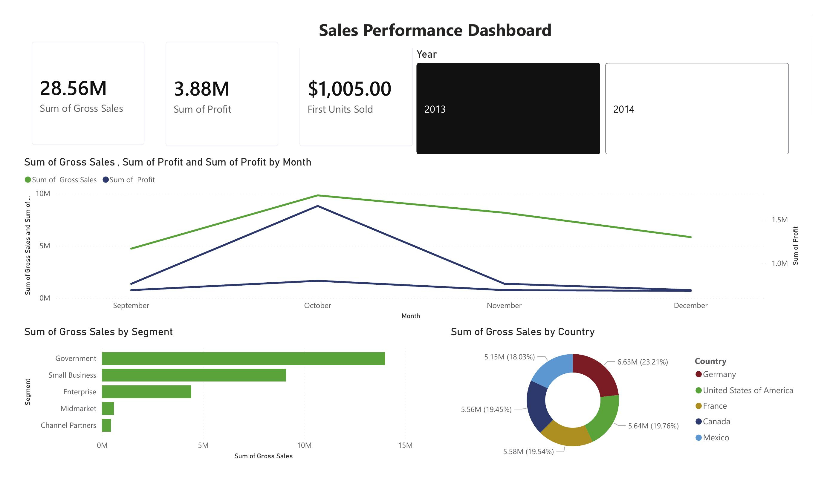
Dashboard Screenshot
Built by Shravani Umaji Jadhav · Power BI Desktop · Financial Sample Dataset

Slide 6
Dashboard Features
01
KPI Cards
02
Line Chart
Cards showing Total Gross Sales, Profit, and Units Sold at a glance.
Monthly Sales & Profit trend across 12 months to identify seasonal patterns.
03
Bar Chart
04
Donut Chart
Horizontal bar chart showing Gross Sales by Segment.
Sales distribution by Country (USA, Canada, France, Germany, Mexico).
05
Year Slicer
06
Color Theme
Interactive filter to switch between 2013 and 2014 — all visuals update instantly.
Consistent professional color theme applied across all charts and visuals.

Slide 7
Key Insights
Government leads all segments with ~$52.5M in gross sales.
Sales peak in Oct–Nov, showing strong seasonal pattern.
USA accounts for the largest share of country-wise sales.
2014 showed higher sales than 2013 across all segments.
Channel Partners and Midmarket have the lowest sales volume.

Slide 8
Interview Q&A
What is a KPI?
What are slicers?
A measurable value showing how effectively a business achieves objectives. E.g. Sales, Profit, Growth.
Visual filter controls in Power BI that update all connected charts when clicked.
Power BI vs Tableau?
How to handle large data?
Power BI is free & integrates well with Microsoft. Tableau is more powerful for exploration but paid.
Use aggregations, DirectQuery, filter at source, and incremental refresh for large datasets.

Slide 9
Thank You
Shravani Umaji Jadhav
Data Analyst Internship · Task 4 · Sales Performance Dashboard
Tools: Power BI Desktop | Dataset: Kaggle Financial Sample

