Slide 1
Bayesian Modelling Workshop
1st Session – Introduction
March 24th, 2023

Slide 2
Instructor – Dr. Seungjae Lee
Assistant Prof. in CIVMIN
Building science researcher
Not an applied mathematician, statistician, computer scientist, etc.

Slide 3
Workshop Objectives
By the end of this workshop (5-6 sessions), you will be able to:
Describe what Bayesian modelling is and relevant concepts, terminologies, etc.
Understand its pros and cons and where/when to use it
Develop a simple data-driven/regression model in a Bayesian way
Also, you will get to know some advanced techniques based on Bayesian modelling.

Slide 4
Topics
Session 1 – Introduction
Session 2 – Bayesian linear regression
Session 3 – How to incorporate prior knowledge into a model
Session 4 – How to deal with missing information and latent/unobservable variables
Session 5 – Gaussian process regression
Session 6 – Advanced topics
Bayesian optimization
Probabilistic deep learning

Slide 5
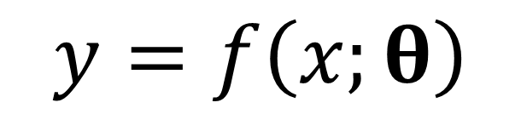
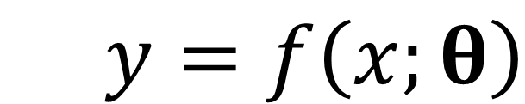
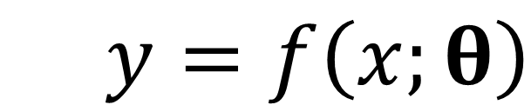
Forward vs Inverse Modelling
Model structure
Inputs
Model coefficients
Outputs
$$y=f\left(x;θ\right)$$
Model
$y=f\left(x;θ\right)$
$y=f\left(x;θ\right)$

Slide 6
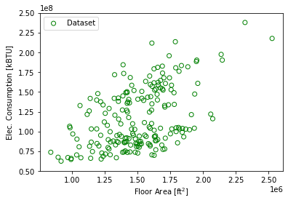
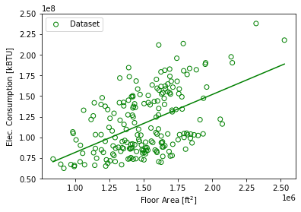
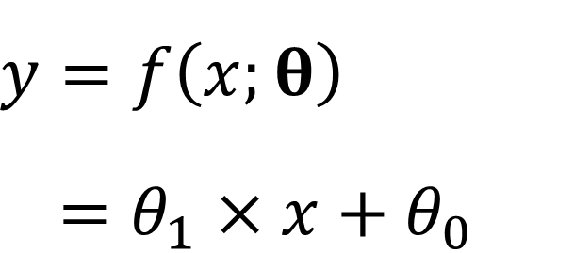
Inverse (Data-Driven) Modelling
$y=f\left(x;θ\right)$
$=θ_{1}×x+θ_{0}$

Slide 7
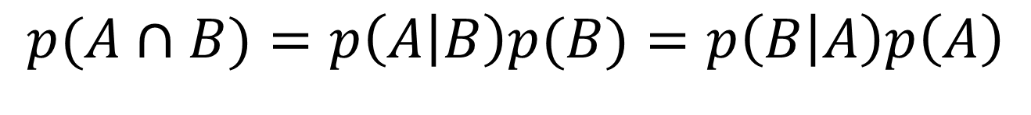
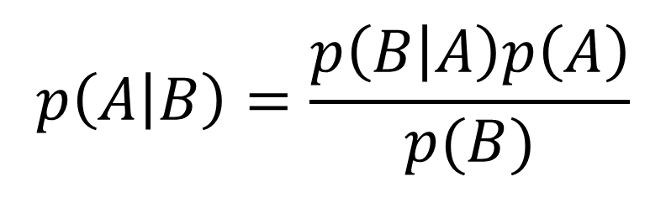
Baye’s Rule
$$p(A∩B)=p\left(A | B\right)p(B)=p\left(B | A\right)p\left(A\right)$$
$$p\left(A | B\right)=\frac{p\left(B | A\right)p\left(A\right)}{p(B)}$$

Slide 8
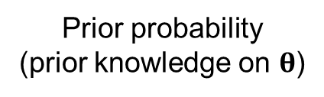
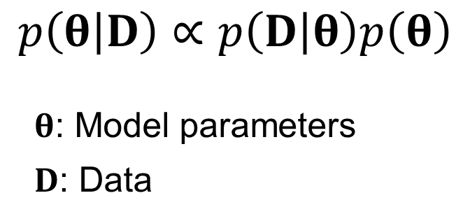
Bayesian Modelling
Data likelihood
Prior probability
(prior knowledge on $θ$)
$$p\left(θ | D\right)∝p\left(D | θ\right)p\left(θ\right)$$
$θ$: Model parameters
$D$: Data
Posterior probability
(Not a point estimation)
Encode our prior knowledge
Quantify the model uncertainty
Easily introduce hidden (unobserved) variables
Seamlessly combine data from heterogeneous sources
Flexibility
Drawbacks?

Slide 9
Example – Toy Data

Slide 10
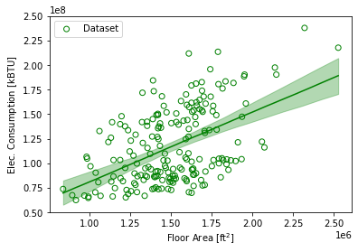
Example – Linear Regression
Least Squares (maximum-likelihood)
Bayesian

Slide 11
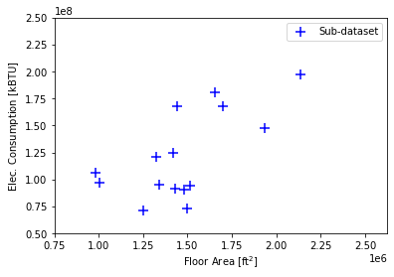
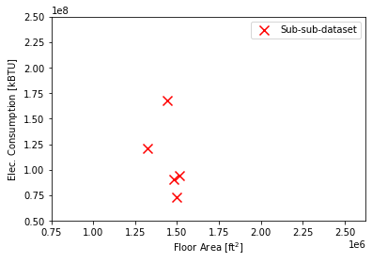
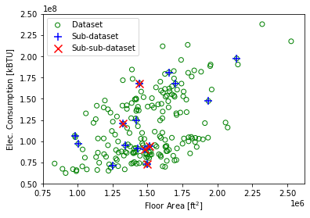
Example – Linear Regression

Slide 12
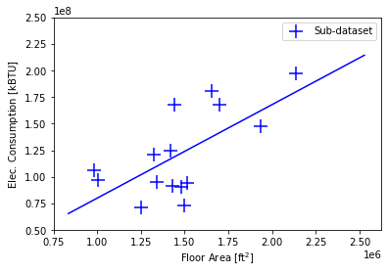
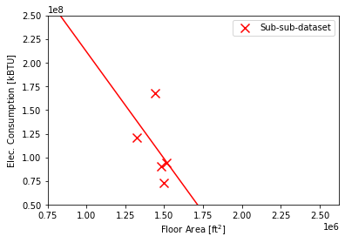
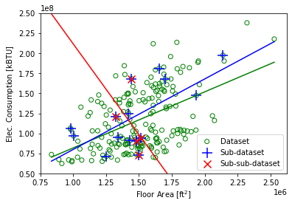
Example – Linear Regression

Slide 13
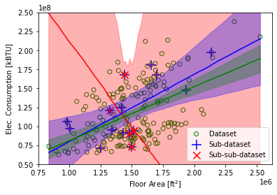
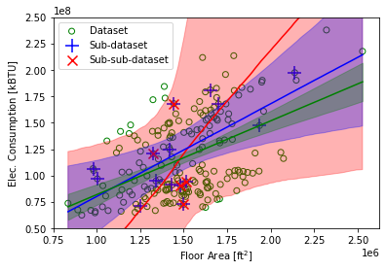
Example – Bayesian Linear Regression
Bayesian
Without informative prior
Bayesian
With informative prior (positive correlation)

Slide 14
Closing Remark
“Sometimes classical statistics gives up. Bayes never gives up, so we’re under more responsibility to check our models.”
– Andrew Gelman

Slide 15







GRID-INTERACTIVE CONTROL
ENERGY SYSTEM
OPTIMAL CONTROL
ENERGY & DATA
MANAGEMENT
FAULT DETECTION AND DIAGNOSIS
HUMAN-BUILDING INTERACTION
Thank you!
(sjae.lee@utoronto.ca)

Slide 16
Uncertainty Quantification

