Slide 1
Bayesian Modelling

Slide 2
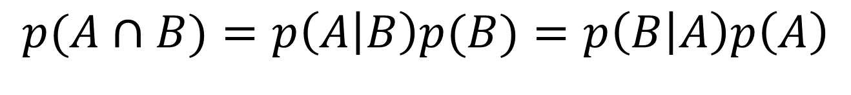
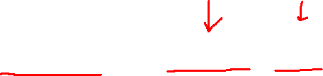
Bayes’ Rule
$$p(A∩B)=p\left(A | B\right)p(B)=p\left(B | A\right)p\left(A\right)$$

Slide 3
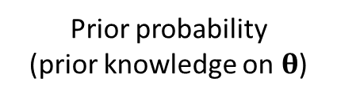
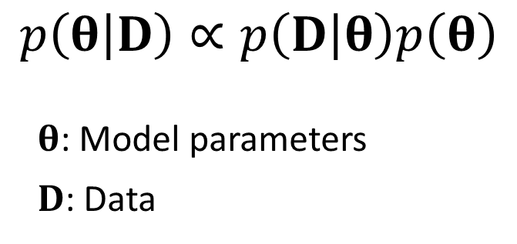
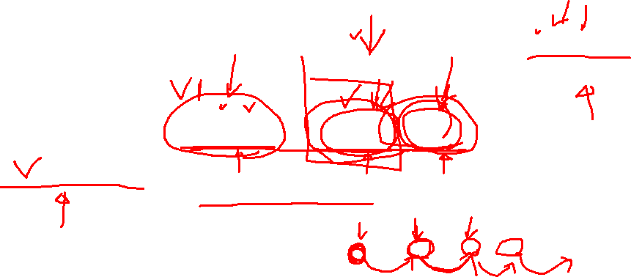
Bayes’ Rule
Data likelihood
Prior probability
(prior knowledge on $θ$)
$$p\left(θ | D\right)∝p\left(D | θ\right)p\left(θ\right)$$
$θ$: Model parameters
$D$: Data
Posterior probability
(Not a point estimation)
Encode our prior knowledge
Quantify the model uncertainty
Easily introduce hidden (unobserved) variables
Seamlessly combine data from heterogeneous sources
Flexible model structure
Drawbacks?

Slide 4
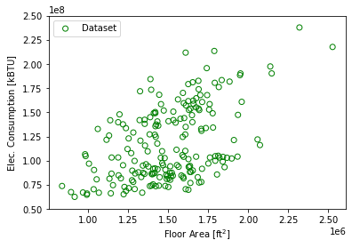
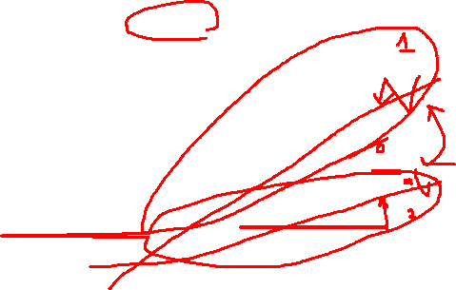

Slide 5
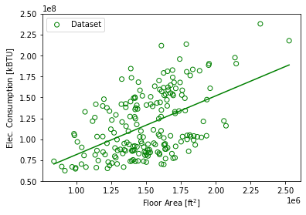
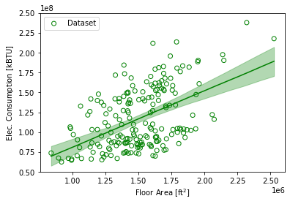
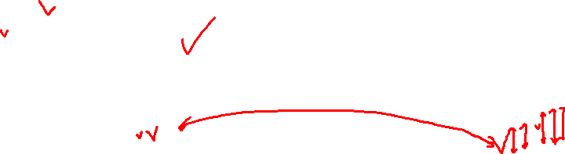
Least Squares (maximum-likelihood)
Bayesian

Slide 6
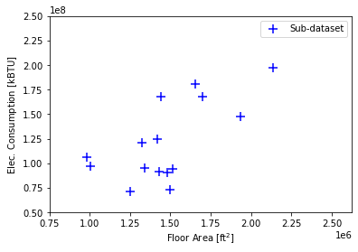
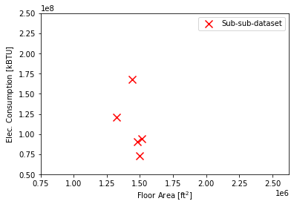
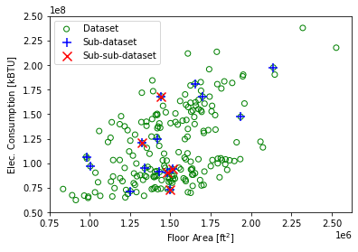


Slide 7
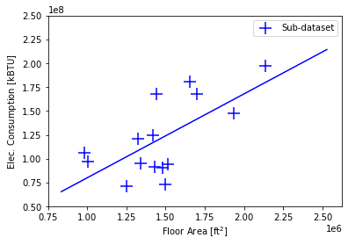
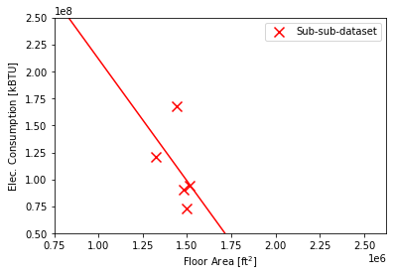
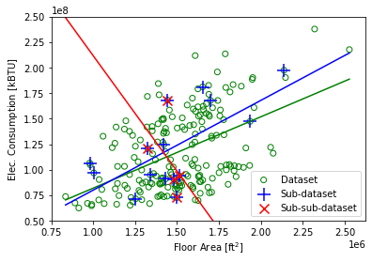


Slide 8
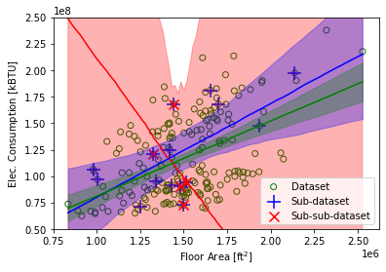
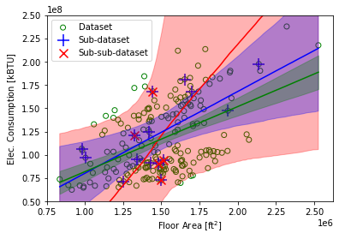
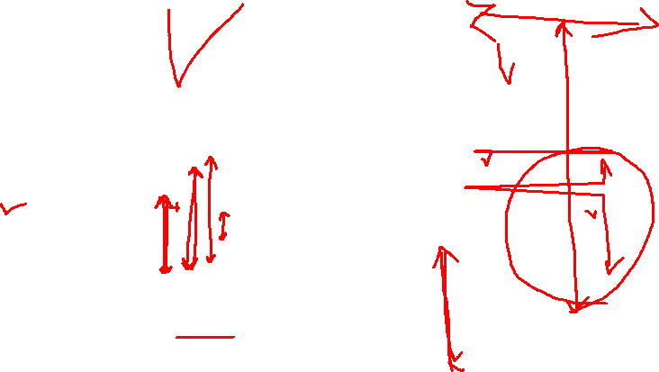
Bayesian
Without informative prior
Bayesian
With informative prior (positive correlation)

Slide 9

“Sometimes classical statistics gives up. Bayes never gives up, so we’re under more responsibility to check our models.”
– Andrew Gelman

