Slide 1
2025 Bayesian Modelling Workshop
Seungjae Lee
Department of Civil & Mineral Engineering
University of Toronto
May 20, 2025

Slide 2






Instructor – Seungjae Lee

Slide 3
Instructor – Seungjae Lee
Intelligent and Interactive Buildings Lab
Mission: Mitigate climate change and improve quality of life by realizing intelligent and interactive buildings
Create advanced AI solutions for the design and operation of building systems to improve energy performance, IEQ, occupant well-being, and grid reliability & resilience.
Explore uncharted fields of building science research to increase the depth and breadth of domain knowledge and facilitate engineering innovation.
Building System Modelling and Optimal Control
Digital Twinning
Grid-Interactive Controls
Reinforcement Learning
Uncertainty Quantification
Human-Building Interaction
Occupant Modelling
Occupant-Centric Controls
User Interface Design
Causal Inference
AI Building Expert
(Large) Language Models
Knowledge Encoding
Reinforcement Learning
Generative AI

Slide 4
Instructor – Seungjae Lee
I am
a building science researcher
a big fan of Bayesian/probabilistic modelling
interested in learning/applying/developing new methodologies
I am not (yet)
a Bayesian statistician
a data science methodologist

Slide 5
Workshop Outline
This informal workshop will focus on introducing Bayesian modelling and probabilistic programming. The tentative topics covered in the 6-hour workshop include:
Measurement uncertainty and Bayesian estimation: My sensor shows 23 °C. What is the actual current temperature?
Bayesian linear regression
Informative prior probability: Do you have any prior knowledge?
Latent/unobservable variables: Bayesian way of dealing with missing information.
Advanced Topics…

Slide 6
Measurement Uncertainty and Bayesian Estimation

Slide 7
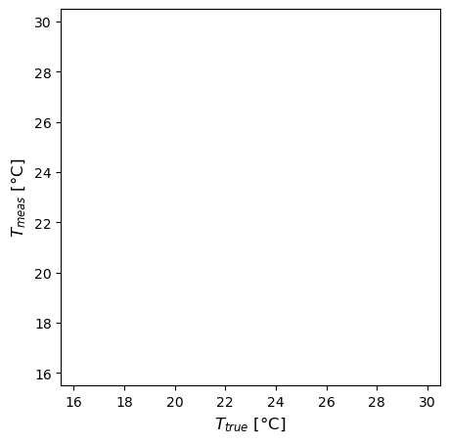
Measurement Uncertainty
Measuring room air temperature with a temperature sensor

Slide 8
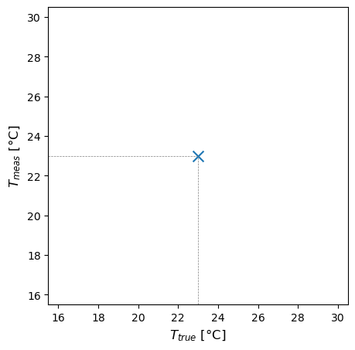
Measurement Uncertainty
Measuring room air temperature with a temperature sensor
Perfect sensor!

Slide 9
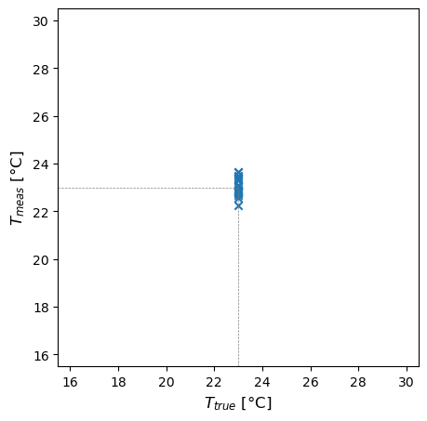
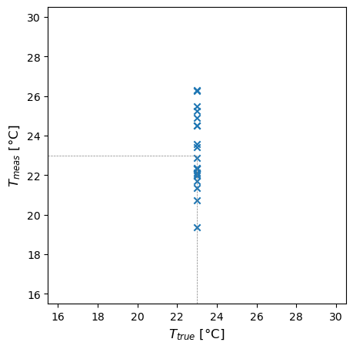
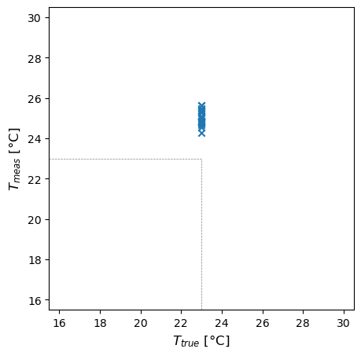
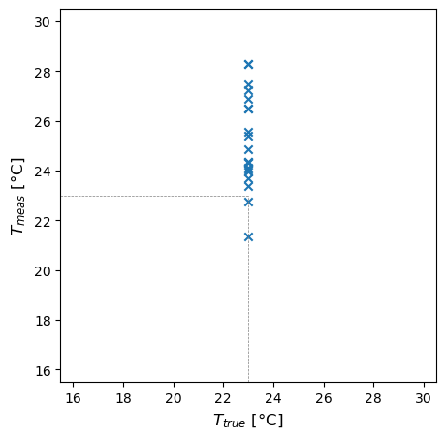
Measurement Uncertainty
Accuracy (systematic error) and Precision (random error)
High Accuracy
High Precision
High Accuracy
Low Precision
Low Accuracy
High Precision
Low Accuracy
Low Precision

Slide 10
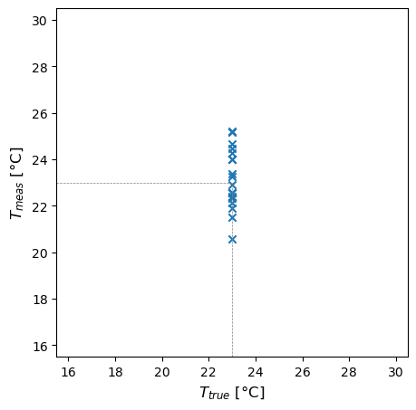

Measurement Uncertainty
Sensor characteristic
$$T_{meas} \sim 𝒩(T_{true},1)$$

Slide 11
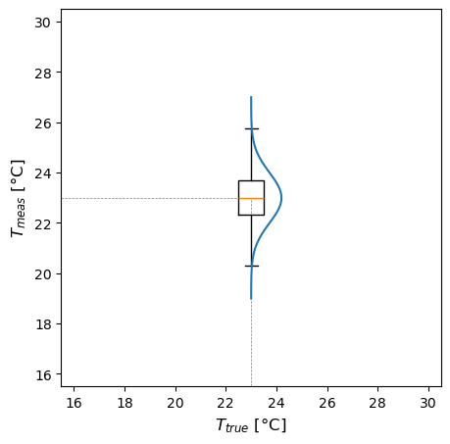

Measurement Uncertainty
Sensor characteristic
$$T_{meas} \sim 𝒩(T_{true},1)$$
$$𝒩(23,1)$$

Slide 12
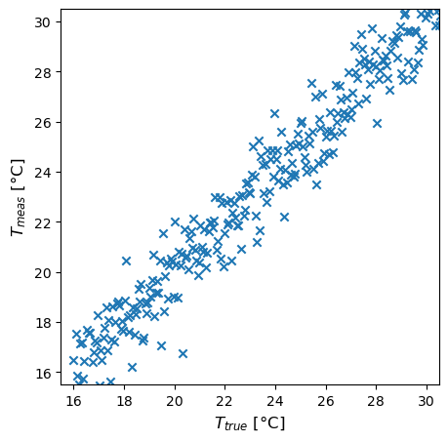
Measurement Uncertainty
Sensor characteristic
$$T_{meas} \sim 𝒩(T_{true},1)$$

Slide 13
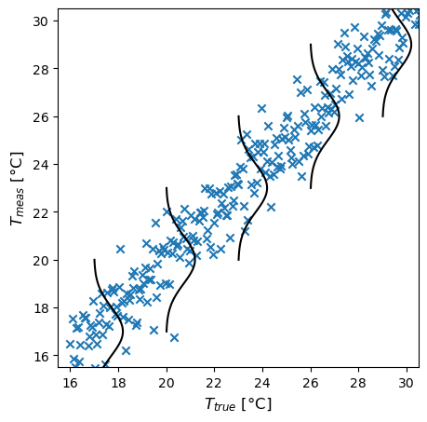





Measurement Uncertainty
Sensor characteristic
$$T_{meas} \sim 𝒩(T_{true},1)$$
$$𝒩(26,1)$$
$$𝒩(23,1)$$
$$𝒩(20,1)$$
$$𝒩(29,1)$$
$$𝒩(17,1)$$

Slide 14
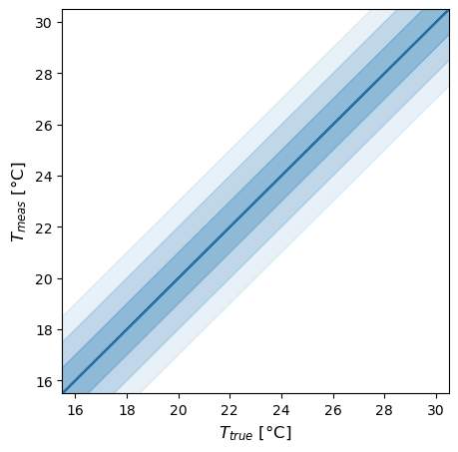



Measurement Uncertainty
Sensor characteristic
$$T_{meas} \sim 𝒩(T_{true},1)$$
$$±1σ$$
$$±2σ$$
$$±3σ$$

Slide 15
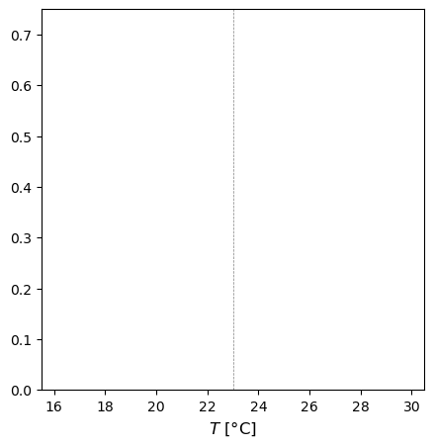
Measurement Uncertainty – Maximum Likelihood Estimation
Now, sensor reading is 23°C. What is the actual current temperature?
Can we know?
What is the best point estimation? 22°C? 26°C? 23°C?
This is your observation (sensor reading of 23°C)

Slide 16
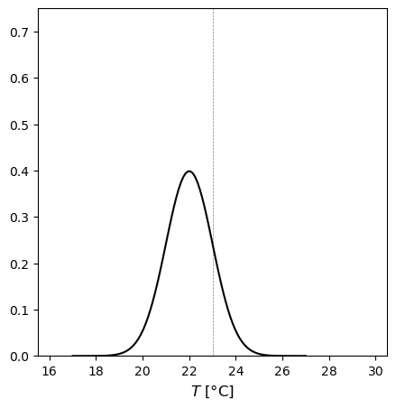

Measurement Uncertainty – Maximum Likelihood Estimation
Now, sensor reading is 23°C. What is the actual current temperature?
Can we know?
What is the best point estimation? 22°C? 26°C? 23°C?
If the actual temperature is 22°C, the likelihood of observing 23°C is
$$f\left(x\right)=\frac{1}{\sqrt{2πσ^{2}}}e^{−\frac{{\left(x−μ\right)}^{2}}{2σ^{2}}}=0.242$$

Slide 17
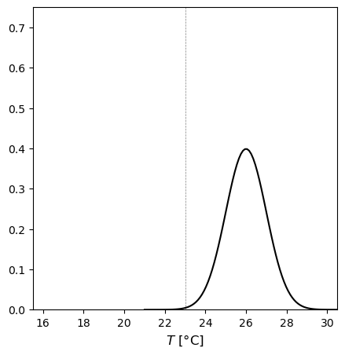

Measurement Uncertainty – Maximum Likelihood Estimation
Now, sensor reading is 23°C. What is the actual current temperature?
Can we know?
What is the best point estimation? 22°C? 26°C? 23°C?
If the actual temperature is 26°C, the likelihood of observing 23°C is
$$f\left(x\right)=\frac{1}{\sqrt{2πσ^{2}}}e^{−\frac{{\left(x−μ\right)}^{2}}{2σ^{2}}}=0.004$$

Slide 18
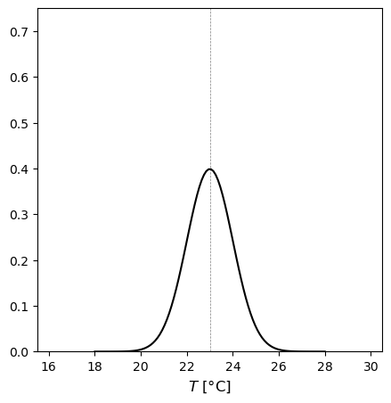

Measurement Uncertainty – Maximum Likelihood Estimation
Now, sensor reading is 23°C. What is the actual current temperature?
Can we know?
What is the best point estimation? 22°C? 26°C? 23°C?
If the actual temperature is 23°C, the likelihood of observing 23°C is
$$f\left(x\right)=\frac{1}{\sqrt{2πσ^{2}}}e^{−\frac{{\left(x−μ\right)}^{2}}{2σ^{2}}}=0.399$$
Maximum Likelihood Estimation (MLE)

Slide 19

Measurement Uncertainty – Maximum Likelihood Estimation
You have two sensor readings, 23°C and 25°C.
What is the actual current temperature?

Slide 20
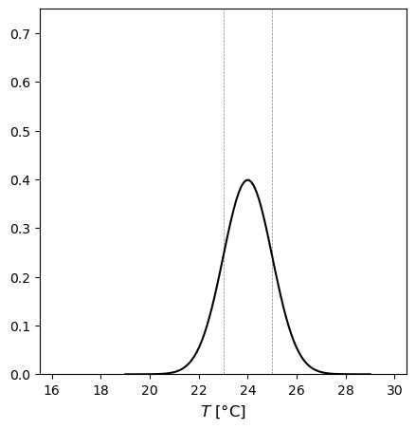
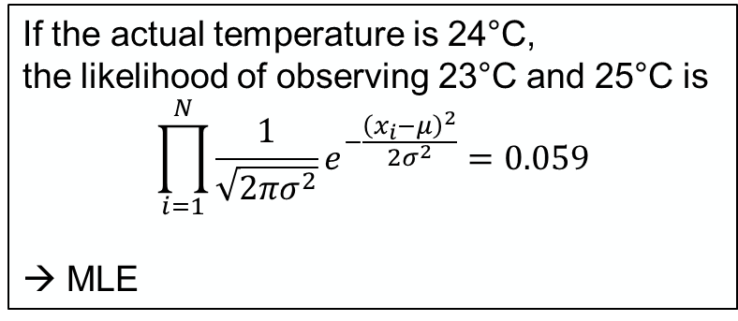
Measurement Uncertainty – Maximum Likelihood Estimation
You have two sensor readings, 23°C and 25°C.
What is the actual current temperature?
If the actual temperature is 24°C, the likelihood of observing 23°C and 25°C is
$$\prod_{i=1}^{N}{\frac{1}{\sqrt{2πσ^{2}}}e^{−\frac{{\left(x_{i}−μ\right)}^{2}}{2σ^{2}}}}=0.059$$
→ MLE
Things to think about: What if it’s not zero-mean Gaussian (systematic error is not zero; random error does not follow Gaussian)?

Slide 21
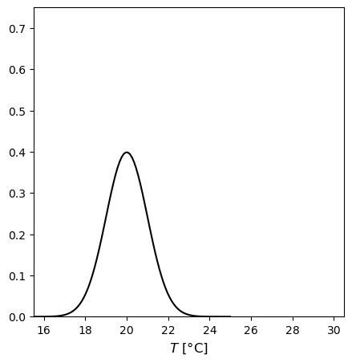
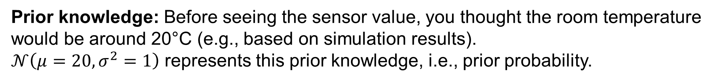
Measurement Uncertainty – Bayesian Way of Thinking
Prior knowledge: Before seeing the sensor value, you thought the room temperature would be around 20°C (e.g., based on simulation results).
$𝒩\left(μ=20,σ^{2}=1\right)$ represents this prior knowledge, i.e., prior probability.
Prior probability distribution

Slide 22
Measurement Uncertainty – Bayesian Way of Thinking
Prior knowledge: Before seeing the sensor value, you thought the room temperature would be around 20°C (e.g., based on simulation results).
$𝒩\left(μ=20,σ^{2}=1\right)$ represents this prior knowledge, i.e., prior probability.
Prior probability distribution
Prior estimation

Slide 23
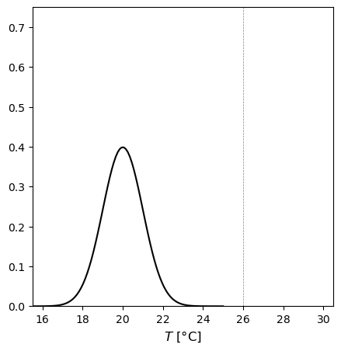

Measurement Uncertainty – Bayesian Way of Thinking
Prior knowledge: Before seeing the sensor value, you thought the room temperature would be around 20°C (e.g., based on simulation results).
$𝒩\left(μ=20,σ^{2}=1\right)$ represents this prior knowledge, i.e., prior probability.
Sensor reading
$$ε_{sensor}\sim 𝒩(0,1)$$
Prior probability distribution

Slide 24

Measurement Uncertainty – Bayesian Way of Thinking
Sensor reading
$$ε_{sensor}\sim 𝒩(0,1)$$
Maximum Likelihood Estimation

Slide 25
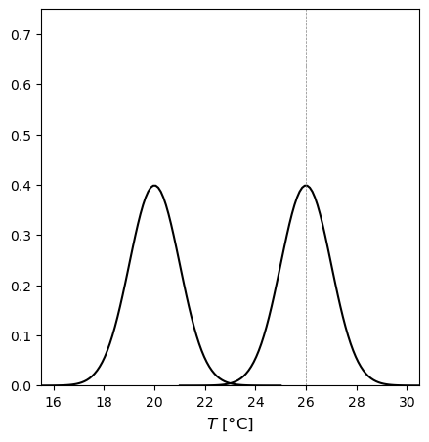
Measurement Uncertainty – Bayesian Way of Thinking
Sensor reading
$$ε_{sensor}\sim 𝒩(0,1)$$
Prior probability distribution
Maximum Likelihood Estimation

Slide 26
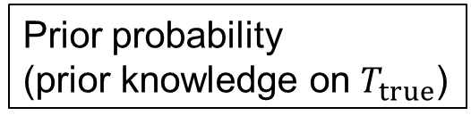

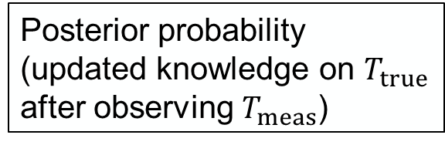
Measurement Uncertainty – Bayesian Way of Thinking
Bayes’ theorem
$$p\left(x,y\right)=p\left(x | y\right)p\left(y\right)=p\left(y | x\right)p\left(x\right)$$
$$p\left(x | y\right)=\frac{p\left(y | x\right)p\left(x\right)}{p\left(y\right)}$$
$$p\left(T_{true} | T_{meas}\right)=\frac{p\left(T_{meas} | T_{true}\right)p\left(T_{true}\right)}{p\left(T_{meas}\right)}$$
Prior probability
(prior knowledge on $T_{true}$)
Posterior probability
(updated knowledge on $T_{true}$ after observing $T_{meas}$)
Likelihood

Slide 27
Measurement Uncertainty – Bayesian Way of Thinking
$$p\left(T_{true} | T_{meas}\right)=\frac{p\left(T_{meas} | T_{true}\right)p\left(T_{true}\right)}{p\left(T_{meas}\right)}$$
Sensor reading
$$ε_{sensor}\sim 𝒩(0,1)$$
Maximum likelihood estimation
Prior probability distribution

Slide 28
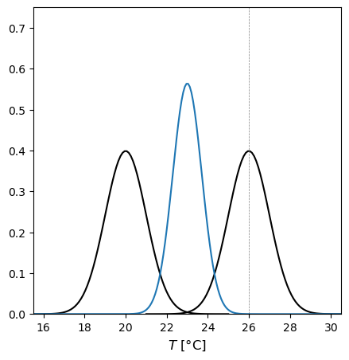
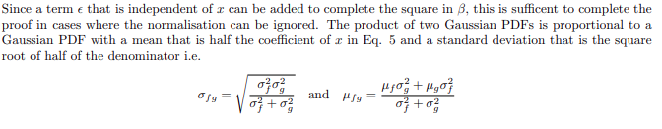
Measurement Uncertainty – Bayesian Way of Thinking
$$p\left(T_{true} | T_{meas}\right)=\frac{p\left(T_{meas} | T_{true}\right)p\left(T_{true}\right)}{p\left(T_{meas}\right)}$$
Sensor reading
$$ε_{sensor}\sim 𝒩(0,1)$$
Posterior probability distribution
Maximum likelihood estimation
Prior probability distribution

Slide 29
Measurement Uncertainty – Bayesian Way of Thinking
$$p\left(T_{true} | T_{meas}\right)=\frac{p\left(T_{meas} | T_{true}\right)p\left(T_{true}\right)}{p\left(T_{meas}\right)}$$
Maximum a posteriori estimation
Sensor reading
$$ε_{sensor}\sim 𝒩(0,1)$$
Posterior probability distribution
Maximum likelihood estimation
Prior probability distribution

Slide 30

Measurement Uncertainty – Bayesian Way of Thinking
Measurement
Simulation

Slide 31
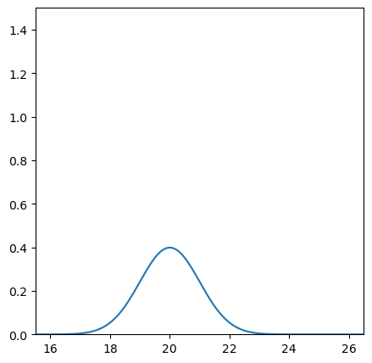
Bayesian Update
$$p\left(T_{true} | T_{meas}\right)=\frac{p\left(T_{meas} | T_{true}\right)p\left(T_{true}\right)}{p\left(T_{meas}\right)}$$
Prior probability distribution

Slide 32
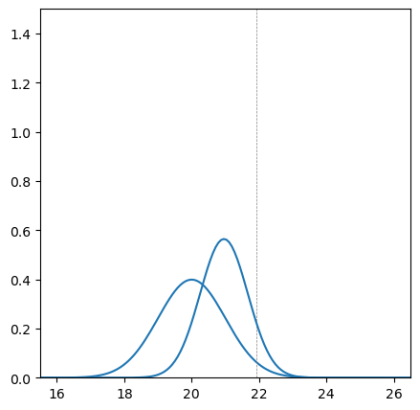
Bayesian Update
$$p\left(T_{true} | T_{meas}\right)=\frac{p\left(T_{meas} | T_{true}\right)p\left(T_{true}\right)}{p\left(T_{meas}\right)}$$
1
Posterior probability distribution
Prior probability distribution

Slide 33
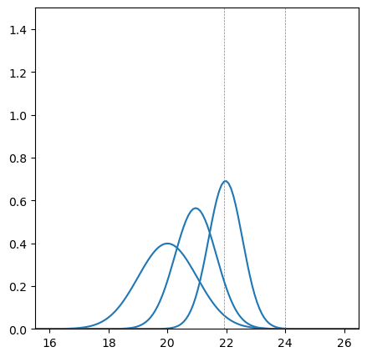
Bayesian Update
$$p\left(T_{true} | T_{meas}\right)=\frac{p\left(T_{meas} | T_{true}\right)p\left(T_{true}\right)}{p\left(T_{meas}\right)}$$
1
2
Posterior probability distribution
Prior probability distribution

Slide 34
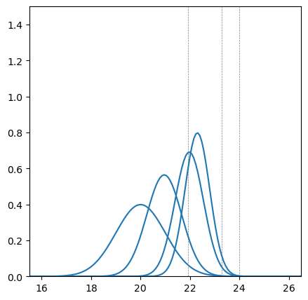
Bayesian Update
$$p\left(T_{true} | T_{meas}\right)=\frac{p\left(T_{meas} | T_{true}\right)p\left(T_{true}\right)}{p\left(T_{meas}\right)}$$
1
3
2
Posterior probability distribution
Prior probability distribution

Slide 35
Environment Setup

Slide 36
Thank you
Seungjae Lee
sjae.lee@utoronto.ca

