Slide 1
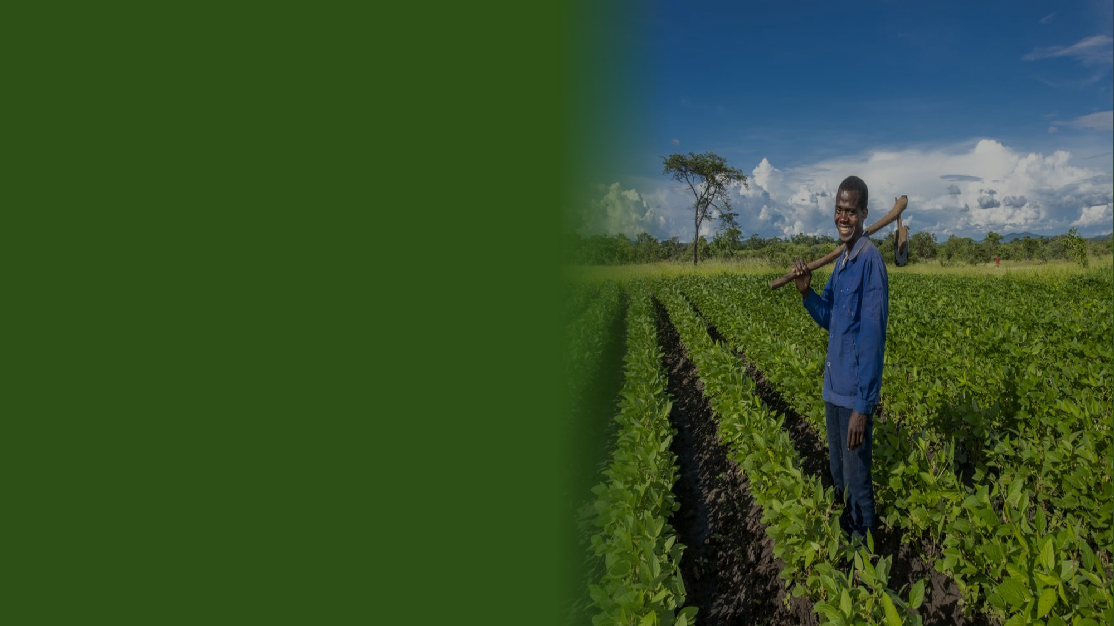
GNA
GOOD NATURE AGRO
Zambia · Agri-Intelligence Platform
Season 2025/26
Leadership Briefing
May 2026 · Confidential
22.6K
77%
6.1K
active farmers
buyback rate
high-risk farmers
Photo: Good Nature Agro / Zambia

Slide 2
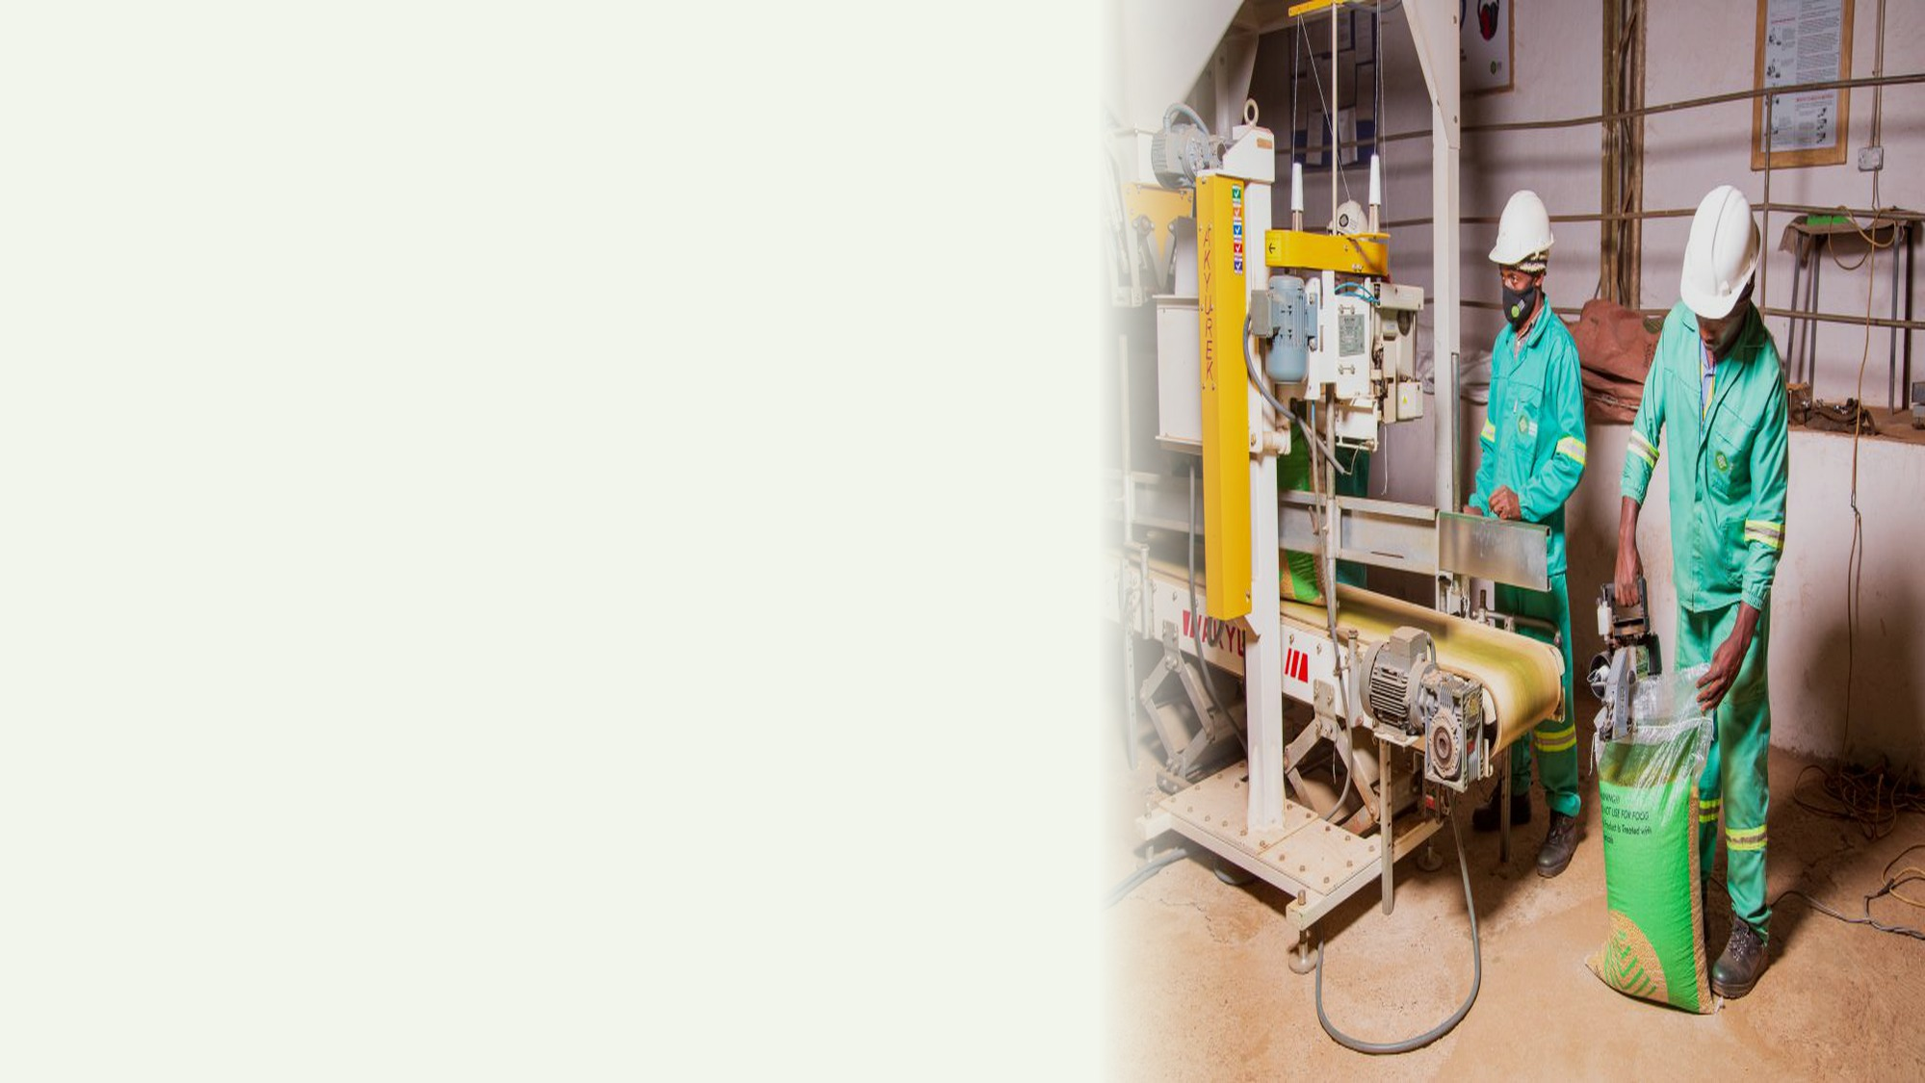
Season at a Glance
GNA · 2025/26
2025/26 · Zambia · 22,597 farmers
ACTIVE FARMERS
BUYBACK RATE
22.6K
77%
enrolled this season
sold back to GNA
HIGH-RISK FARMERS
IN-KIND GAP RATE
6.1K
16%
need field visit now
cannot cover repayment
GNA farmer · Zambia

Slide 3
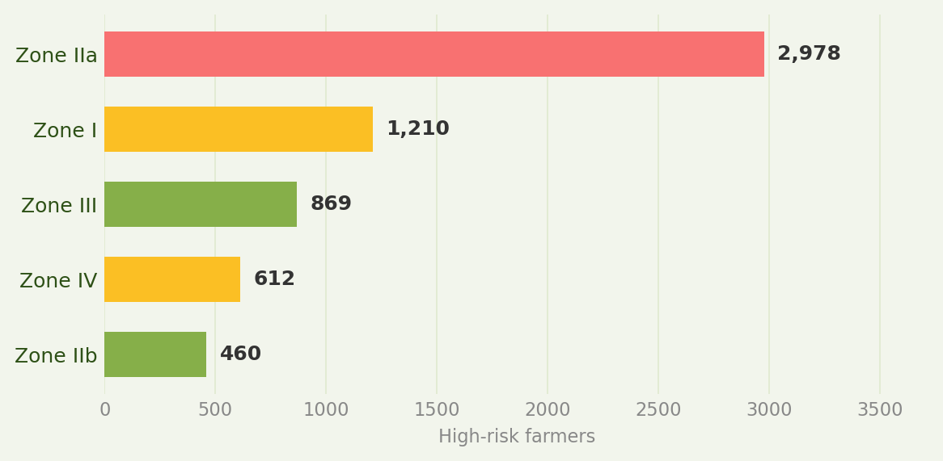
Zone Risk Overview
GNA · 2025/26
Risk scores · 22,597 farmers · 5 zones · Season 2025/26
ZONE I
ZONE III
ZONE IIa
ZONE IIb
ZONE IV
Gwembe & Luangwa
Northern Province
Central Plateau
Southern Plateau
Western Barotse
0.38
0.34
0.52
0.29
0.41
risk score
risk score
risk score
risk score
risk score
WATCH
OK
URGENT
OK
WATCH
4,102
3,618
7,841
5,230
1,806
farmers
farmers
farmers
farmers
farmers
Inoculant 74%
Inoculant 78%
Inoculant 61%
Inoculant 82%
Inoculant 69%
HIGH-RISK FARMER COUNT BY ZONE

Slide 4
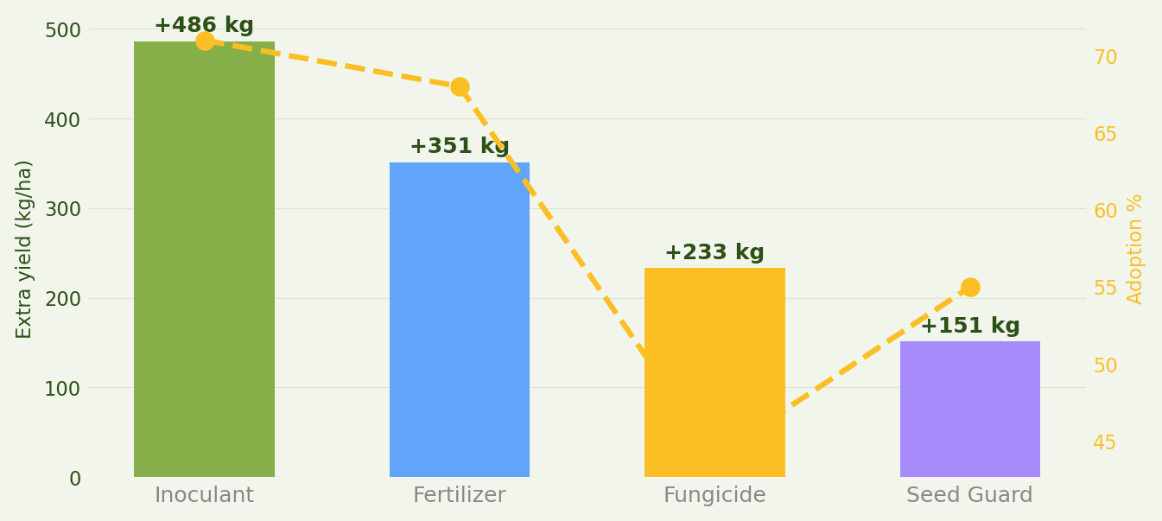
Input Effectiveness
GNA · 2025/26
Measured yield lift across GNA farmers · Season 2025/26
INOCULANT
FERTILIZER
FUNGICIDE
SEED GUARD
+486
+351
+233
+151
kg/ha
kg/ha
kg/ha
kg/ha
71% adoption
68% adoption
44% adoption
55% adoption
YIELD LIFT VS. ADOPTION RATE PER INPUT

Slide 5
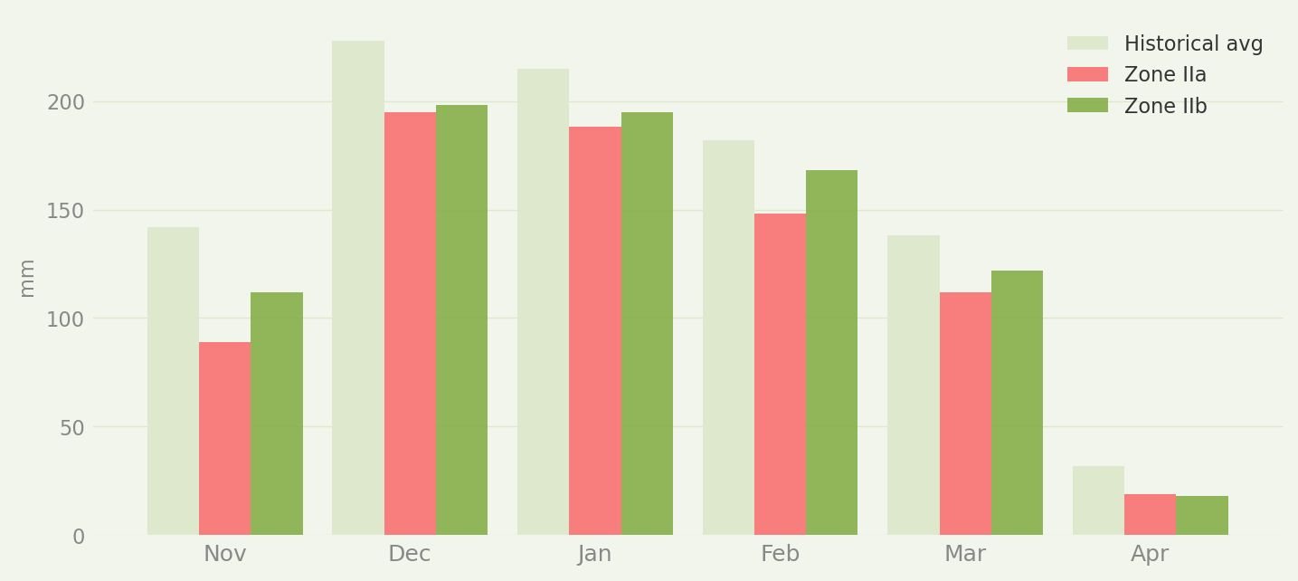
Rainfall & Zone Conditions
GNA · 2025/26
Actual vs. historical average · Nov 2025 – Apr 2026
ZONE I
ZONE IIa
ZONE IIb
ZONE III
ZONE IV
-6%
-20%
-4%
-3%
-9%
vs avg
vs avg
vs avg
vs avg
vs avg
992 mm
751 mm
813 mm
1286 mm
696 mm
MONTHLY RAINFALL · ZONE IIA VS ZONE IIB VS HISTORICAL AVERAGE

Slide 6
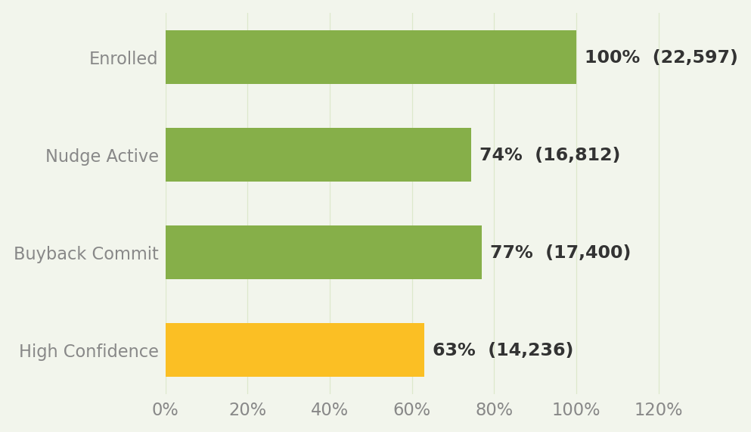
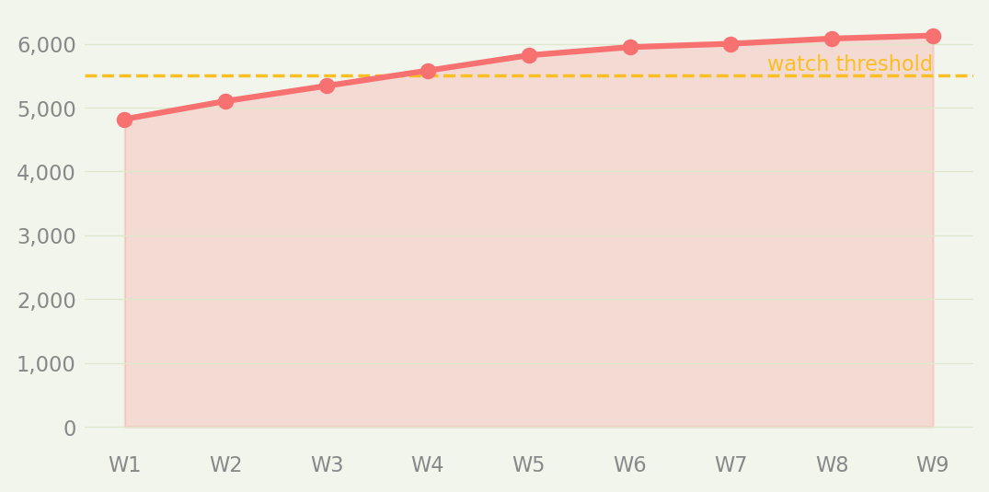
Farmer Segments & Financial Exposure
GNA · 2025/26
Season 2025/26
FARMER TIERS
PROCUREMENT FUNNEL
FINANCIAL EXPOSURE
ELITE
41%
TOTAL LOAN BOOK
$2.8M
2,260 farmers
of volume
AT-RISK EXPOSURE
CORE
35%
$0.5M
EXPOSURE GAP
6,779 farmers
of volume
$0.5M
GROWTH
20%
WEEKLY RISK TREND
9,039 farmers
of volume
AT-RISK
4%
4,519 farmers
of volume

Slide 7
Priority Actions
GNA · 2025/26
AI-ranked by procurement impact · Week ending May 3, 2026
CRITICAL
1
~180,000 kg procurement recovery
Deploy 15+ field agents to Zone IIa within 48 hours — 2,900 farmers past risk…
CRITICAL
2
Recover $467K of $2.85M loan book
Escalate 3,706 in-kind repayment gap cases to the GNA credit team for restruc…
HIGH
3
Protect top 10% = 41% of volume
Immediate outreach to 34 Elite-tier farmers with churn signals — this cohort …
HIGH
4
+340,000 kg if fully adopted
Run inoculant confirmation campaign for 6,553 farmers who skipped or didn't c…
MEDIUM
5
Avoid 120,000 kg overflow loss
Pre-allocate 12% additional warehouse capacity for Zone III, which is trackin…

Slide 8
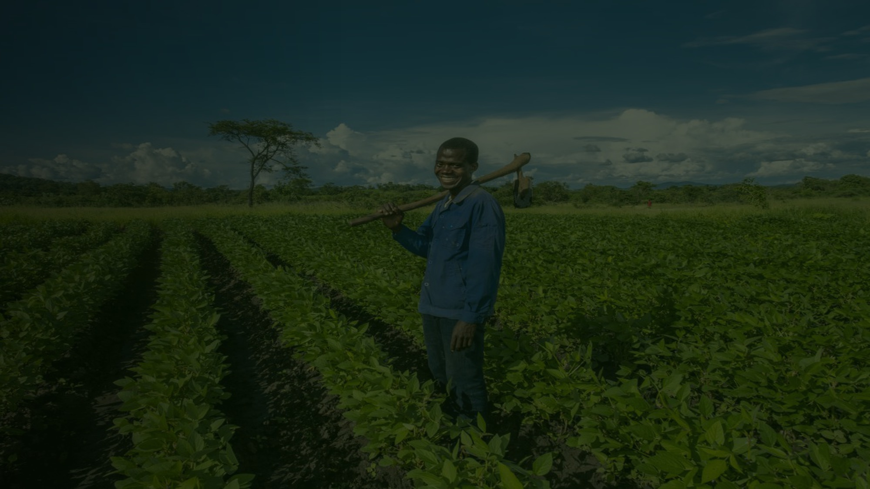

WhatsApp Farmer Advisor
GNA · 2025/26
AI-powered · real-time · personalised
HOW IT WORKS
LIVE CONVERSATION · AGNES BANDA, ZONE IIA
1
Agnes Banda
Farmer sends a WhatsApp message
online · Zone IIa · Season 1
My soybean leaves are turning yellow. What should I do?
2
AI reads live risk profile
Hi Agnes! 🌱 Yellow leaves = nitrogen deficiency. 1️⃣ Apply inoculant today 2️⃣ Add top-dress if available Reply 1 or 2 ✅
3
Claude generates personalised reply
I have inoculant at home but haven't applied it
4
Field agent alerted if high-risk
Apply today — dissolve in water, drench roots. Agent Joseph will call tomorrow to confirm. ✅
SEASON ENGAGEMENT
RESPONSE RATE
MSGS / FARMER
ESCALATIONS
63%
7.3
1,842
nudge engagement
avg over season
to field agents

Slide 9
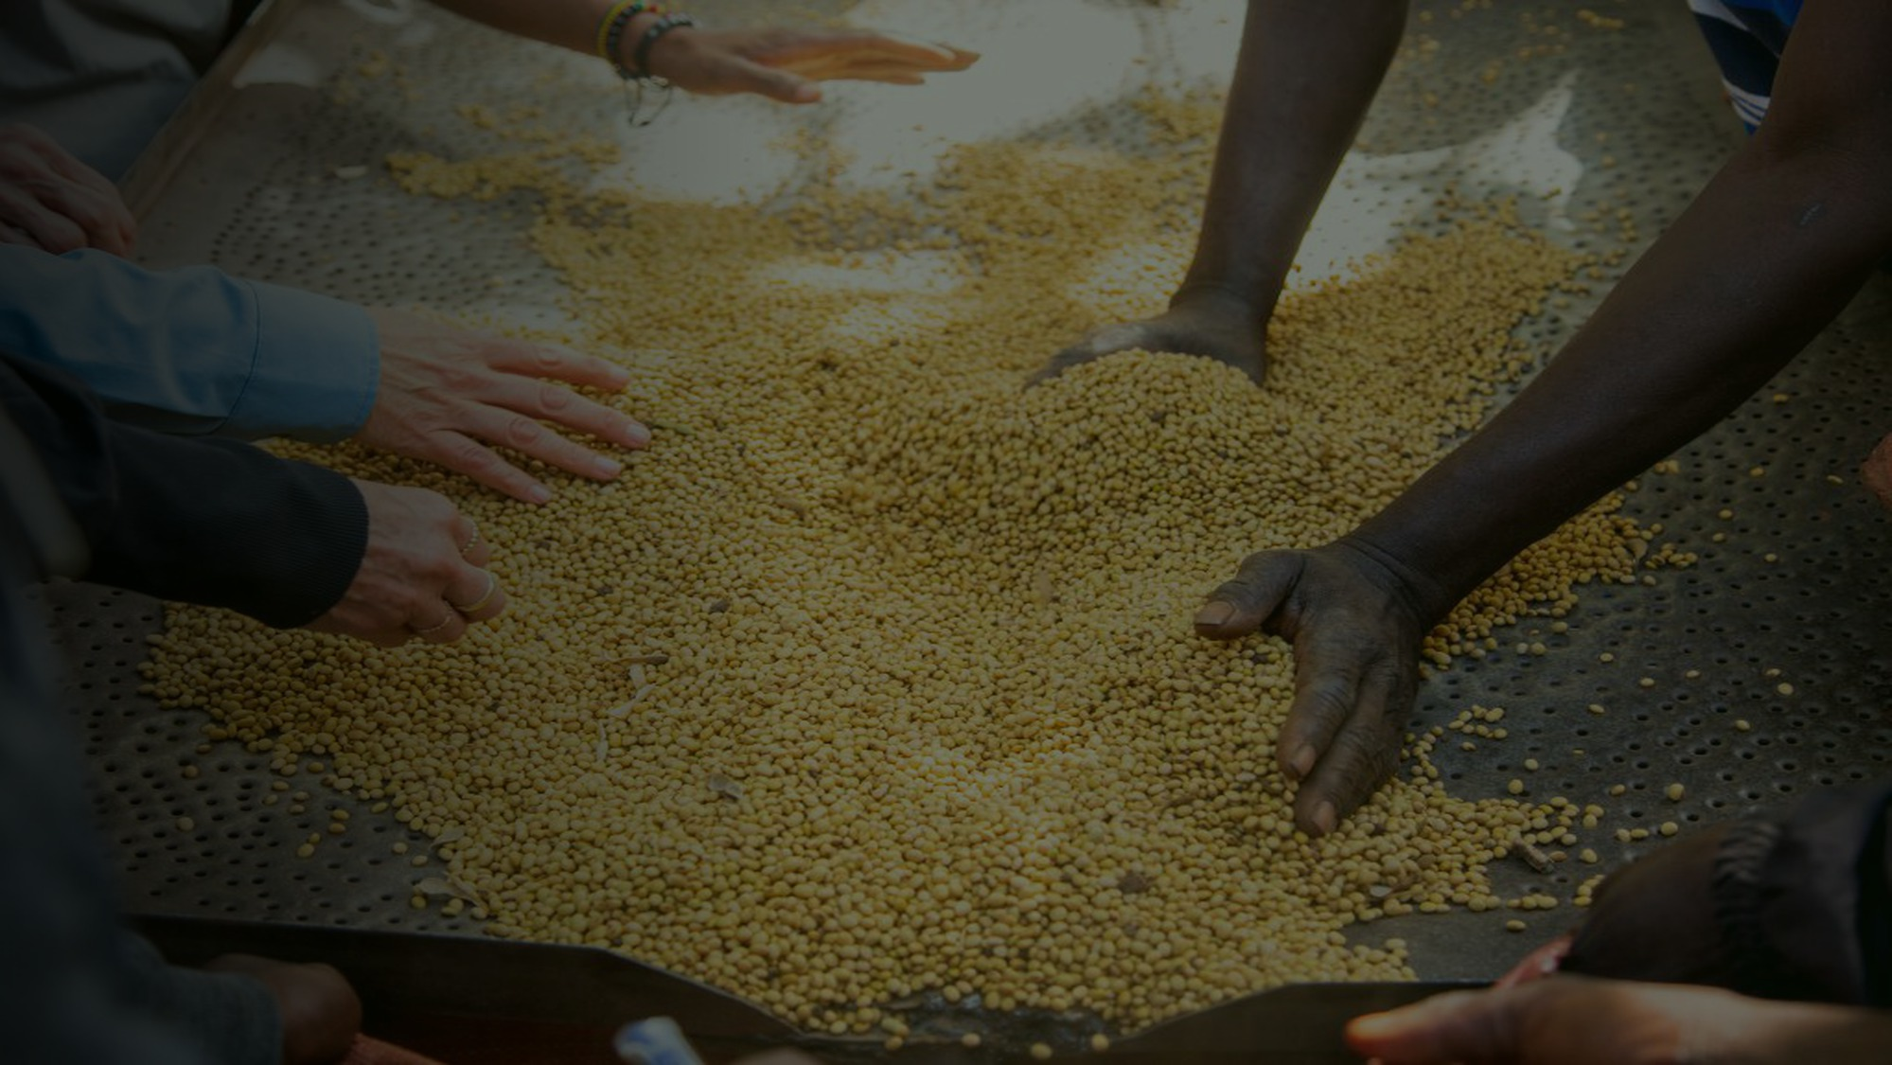
GNA
GOOD NATURE AGRO
Agri-Intelligence Platform
Season 2025/26 · Zambia
Helping Zambian farmers reach the middle class
goodnatureagro.com · Chipata, Zambia · Photos: Good Nature Agro
Built with GNA Agri-Intelligence · Powered by Claude AI

