Slide 1
Create a DynamoDB Table with a Stream Enabled
Created by Jai Singh

Slide 2
To create a DynamoDB table
Open
Open the DynamoDB console.
Choose
Choose Tables.
Choose
Choose the lambda-dynamodb-stream table.
Overview
Under Overview, choose Manage stream.
Choose
Choose Enable.

Slide 3
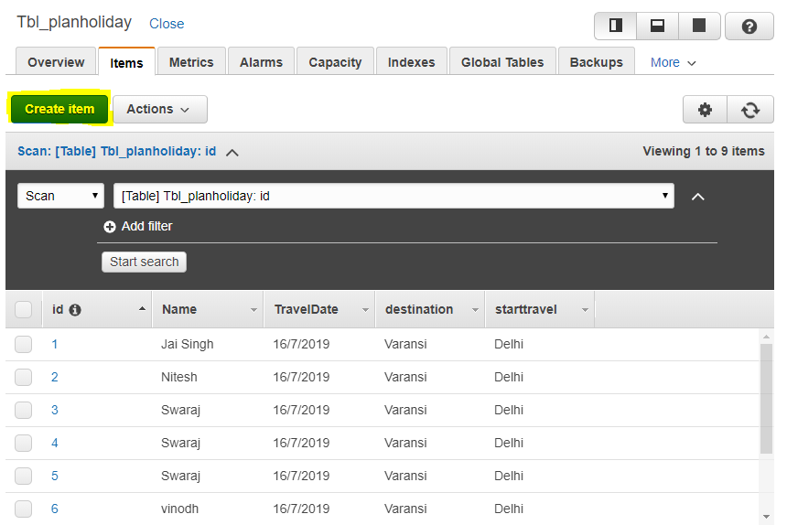
Add item in dynamodb

