Slide 1
Module 3: Build and Test Automation
Build and Test Automation
using Jenkins Pipeline

Slide 2
Objectives of the Session
Build SCM
Build Job Steps
Build Trigger
Post Build Actions
Run your Build
Notification
Build Setup
1.1
Configure Test Reports
Run Test Cases
Display Results
Test Automation
We will take a java web application with source code available in GitHub.
It is a multi-module
maven project.
Demonstrate how to check-in/out code using GIT
Build & run test cases using Jenkins
1.2
Jenkins Management
1.3
1
Build & Test Automation
2
Class Project
Activating Security
Identifying Jenkins Users
Authorization
Auditing
Securing Jenkins
Notification System
1.4
1. E-mail Notification

Slide 3
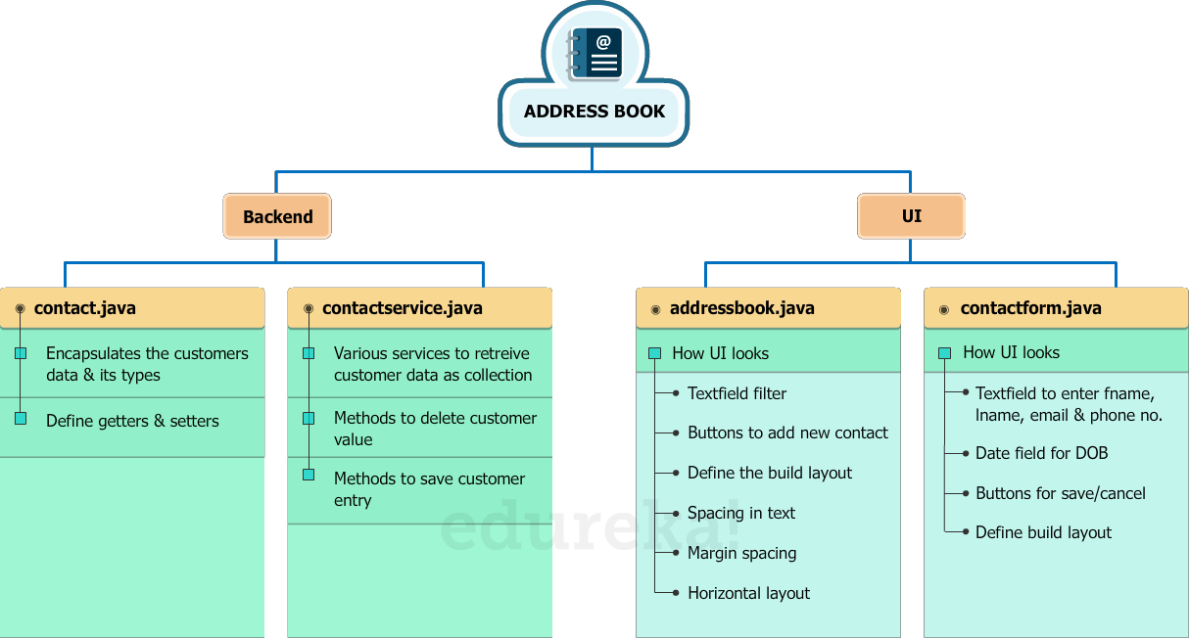
Project Snapshot

Slide 4
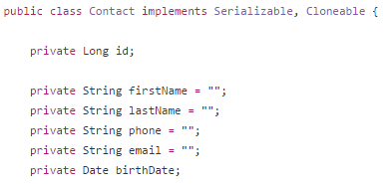

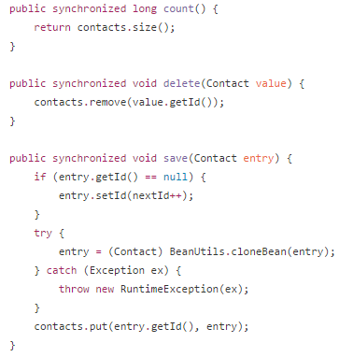
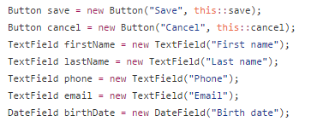
Project Snapshot
Contact.java
Addressbook.java
Contactform.java
ContactService.java

Slide 5
Delivery Pipeline for our Project
Our project corresponds to scenario 4. Hence we will be building the delivery pipeline for our project as shown below:
Developer Compile
Developer Code Review
QA Unit Test Case
QA Metric Check
QA Package
Deploy
Where,
Build Job | Description | Plugin
Developer Compile | Compiles the code pulled from GitHub repo | NA
Developer Code Review | Review the compiled code to check whether the code meets the organization’s standard | PMD (Programming Mistake Detector)
QA Unit Test | Perform unit test case | JUnit
QA Metric Check | Calculate the percentage of code accessed by testing | Cobertura
QA Package | Prepare a packaged code that can be deployed on any machine | WAR build package
Deploy | Specify the path to deploy the application | NA
Each of the CI process in Jenkins for the above jobs will be discussed in the later sections of Module 2 and Module 3

Slide 6

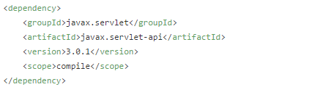

Configuring pom.xml
To run a build, you need to specify its goal in the pom.xml file, present in GitHub Repo
Let’s check the pom.xml file for the build jobs in our project:
Developer Compile Developer Code Review QA Unit Test
QA Metric Check QA Package
The word specified in the <scope> section should match with the job goal

Slide 7

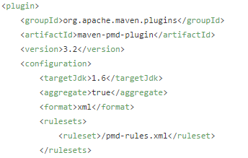

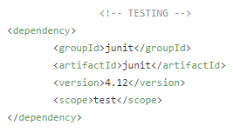



Configuring pom.xml
Developer Code Review
Developer Compile Developer Code Review QA Unit Test
QA Metric Check QA Package
QA Unit Test
For Developer Code Review, we use PMD (Programming Mistake Detector) plugin. PMD is an inbuilt plugin in Jenkins. Hence we do not specify its scope, instead we provide its configuration details
The word specified in the <scope> section should match with the job goal

Slide 8

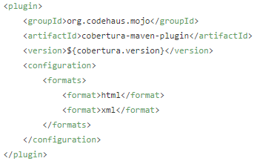

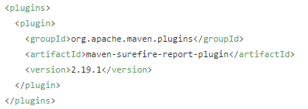

Configuring pom.xml
QA Metric Check
QA Package
Developer Compile Developer Code Review QA Unit Test
QA Metric Check QA Package
For QA Metric Check, we are using Cobertura plugin. Cobertura is an inbuilt plugin in Jenkins. Hence we do not specify its scope, instead we provide its configuration details
For QA Package, maven sure fire plugin is responsible for packaging the latest build that can be deployed on any machine

Slide 9




Now we have configured
the pom.xml file
Let’s start building our jobs

Slide 10
Build a Job
The set of tasks to build the job are listed below:
GitHub Repo
Link
Build Trigger
Job Goal
Post Build
Action
Specify the GitHub repo link to pull the code to Jenkins
Specify the previous job that triggers the current job. Hence NA for 1st job
Specify the testing action/goal for each job
Specify the next job/action to be triggered.

Slide 11
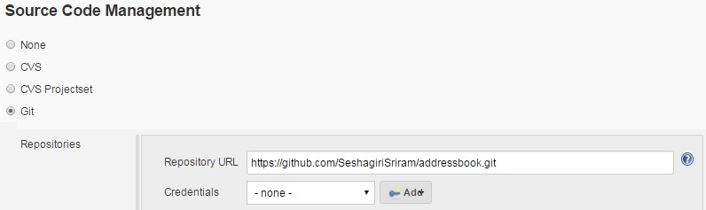
Demo Build a Job - Developer Compile
Action
GitHub Repo Link
Build Trigger
Job Goal
Post Build Action
Developer Compile Developer Code Review QA Unit Test
QA Metric Check
QA Package & deploy
Provide the GitHub path to checkout the code. Click Apply and Save.

Slide 12
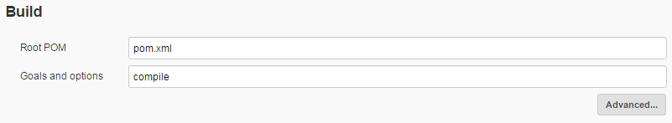
Demo Build a Job - Developer Compile
Action
GitHub Repo Link
Build Trigger - NA
Job Goal
Post Build Action
Developer Compile Developer Code Review QA Unit Test
QA Metric Check
QA Package & deploy
Configure the Developer Compile job to compile the code in the build section

Slide 13
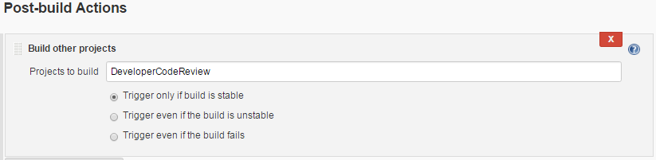
Demo Build a Job - Developer Compile
Action
GitHub Repo Link
Build Trigger - NA
Job Goal
Post Build Action
Developer Compile Developer Code Review QA Unit Test
QA Metric Check
QA Package & deploy
Once the Developer Compile process succeeds, the next job to be triggered is Developer
Code Review

Slide 14
Demo Build a Job - Developer Code Review
Action
GitHub Repo Link
Build Trigger
Job Goal
Post Build Action
Developer Compile Developer Code Review QA Unit Test
QA Metric Check
QA Package & deploy
Provide the GitHub path to checkout the code. Click Apply and Save.

Slide 15
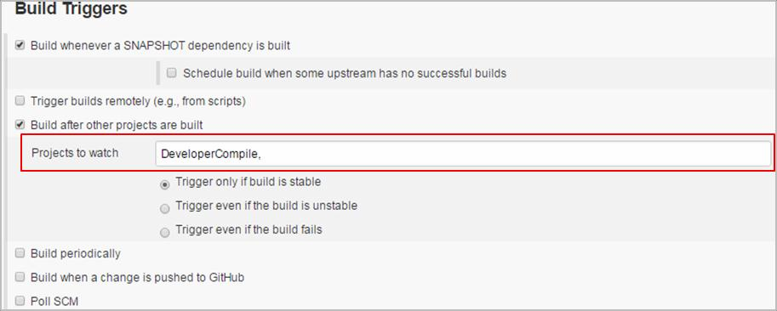
Demo Build a Job - Developer Code Review
Action
GitHub Repo Link
Build Trigger
Job Goal
Post Build Action
Developer Compile Developer Code Review QA Unit Test
QA Metric Check
QA Package & deploy
Developer Code Review is done when the compilation process succeeds. Hence the trigger
job for Developer Code Review will be Developer Compile job

Slide 16
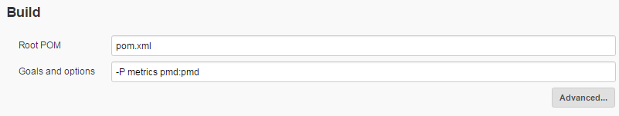
Demo Build a Job - Developer Code Review
Action
GitHub Repo Link
Build Trigger
Job Goal
Post Build Action
Developer Compile Developer Code Review QA Unit Test
QA Metric Check
QA Package & deploy
Configure the Developer Code Review job to detect any errors in the code in build section

Slide 17
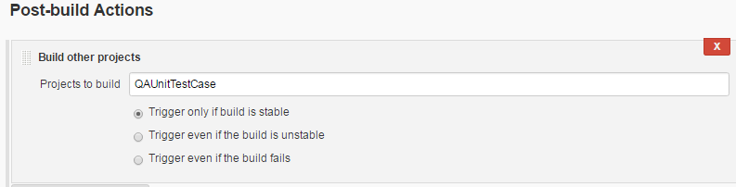
Demo Build a Job - Developer Code Review
Action
GitHub Repo Link
Build Trigger
Job Goal
Post Build Action
Developer Compile Developer Code Review QA Unit Test
QA Metric Check
QA Package & deploy
Once the Developer Code Review is done, the next job to be triggered is QA Unit Test

Slide 18
Demo Build a Job - QA Unit Test
Action
GitHub Repo Link
Build Trigger
Job Goal
Post Build Action
Developer Compile Developer Code Review QA Unit Test
QA Metric Check
QA Package & deploy
Provide the GitHub path to checkout the code. Click Apply and Save.

Slide 19
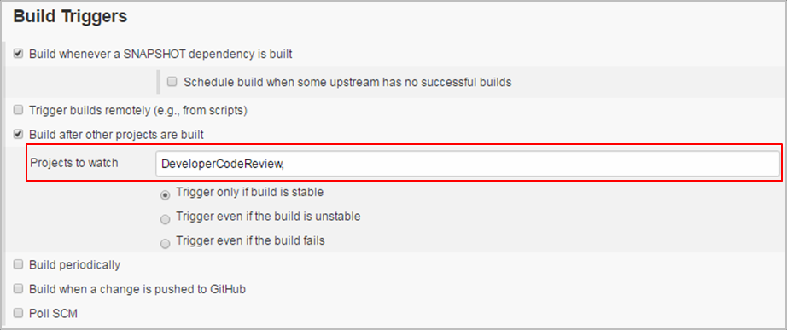
Demo Build a Job - QA Unit Test
Action
GitHub Repo Link
Build Trigger
Job Goal
Post Build Action
Developer Compile Developer Code Review QA Unit Test
QA Metric Check
QA Package & deploy
QA Unit Test is done when the code review succeeds. Hence the trigger job for QA Unit Test
will be Developer Code Review job

Slide 20
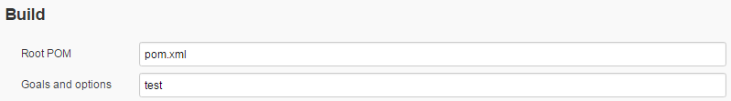
Demo Build a Job - QA Unit Test
Action
GitHub Repo Link
Build Trigger
Job Goal
Post Build Action
Developer Compile Developer Code Review QA Unit Test
QA Metric Check
QA Package & deploy
Configure the QA Unit Test job to run unit test cases in build section

Slide 21
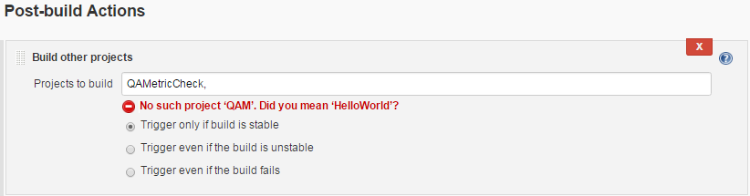
Demo Build a Job - QA Unit Test
Action
GitHub Repo Link
Build Trigger
Job Goal
Post Build Action
Developer Compile Developer Code Review QA Unit Test
QA Metric Check
QA Package & deploy
Once the testing is done, the next job to be triggered is QA Metric Check

Slide 22
Demo Build a Job - QA Metric Check
Action
GitHub Repo Link
Build Trigger
Job Goal
Post Build Action
Developer Compile Developer Code Review QA Unit Test
QA Metric Check
QA Package & deploy
Provide the GitHub path to checkout the code. Click Apply and Save.

Slide 23
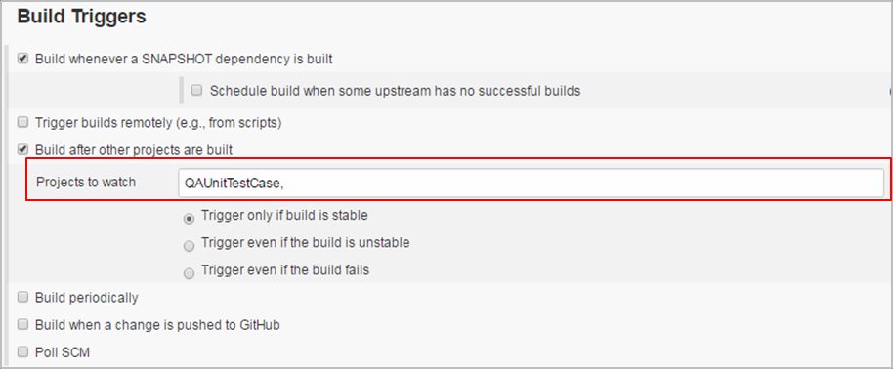
Demo Build a Job - QA Metric Check
Action
GitHub Repo Link
Build Trigger
Job Goal
Post Build Action
Developer Compile Developer Code Review QA Unit Test
QA Metric Check
QA Package & deploy
QA Metric Check is done when the QA Test is succeeded. Hence the trigger job for QA
Metric Check will be QA Unit Test

Slide 24
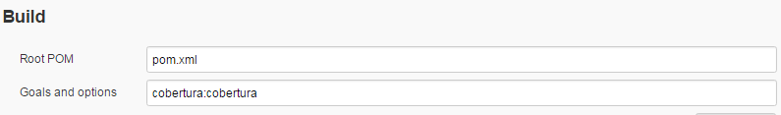
Demo Build a Job - QA Metric Check
Action
GitHub Repo Link
Build Trigger
Job Goal
Post Build Action
Developer Compile Developer Code Review QA Unit Test
QA Metric Check
QA Package & deploy
Configure the QA Metric Check to calculate the percentage of code accessed by testing in
build section

Slide 25
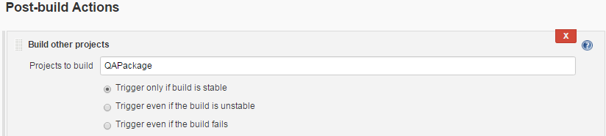
Demo Build a Job - QA Metric Check
Action
GitHub Repo Link
Build Trigger
Job Goal
Post Build Action
Developer Compile Developer Code Review QA Unit Test
QA Metric Check
QA Package & deploy
Once the QA Metric Check is done, we have to build a QA Package that can be deployed on
any machine

Slide 26
Demo Build a Job - QA Package
Action
GitHub Repo Link
Build Trigger
Job Goal
Post Build Action
Developer Compile Developer Code Review QA Unit Test
QA Metric Check
QA Package & deploy
Provide the GitHub path to checkout the code. Click Apply and Save.

Slide 27
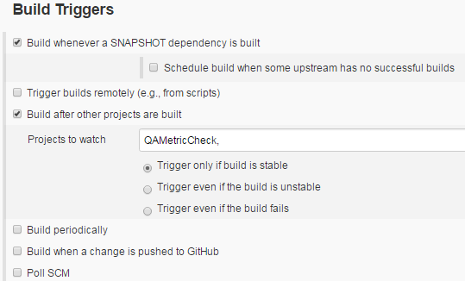
Demo Build a Job - QA Package
Action
GitHub Repo Link
Build Trigger
Job Goal
Post Build Action
Developer Compile Developer Code Review QA Unit Test
QA Metric Check
QA Package & deploy
QA Package is formed when the QA Metric Check succeeds. Hence the trigger job for QA
Package will be QA Metric Check

Slide 28
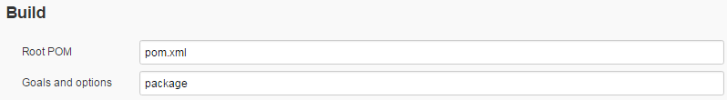
Demo Build a Job - QA Package
Action
GitHub Repo Link
Build Trigger
Job Goal
Post Build Action
Developer Compile Developer Code Review QA Unit Test
QA Metric Check
QA Package & deploy
Configure the QA Package to develop a final project package that can be deployed on any
machine

Slide 29
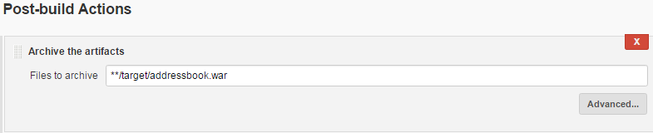
Demo Build a Job - QA Package
Action
GitHub Repo Link
Build Trigger
Job Goal
Post Build Action
Developer Compile Developer Code Review QA Unit Test
QA Metric Check
QA Package & deploy
Once the QA Package job succeeds, you need to archive the latest build so that it can be
used when required and you use this package to be deployed on any machine

Slide 30

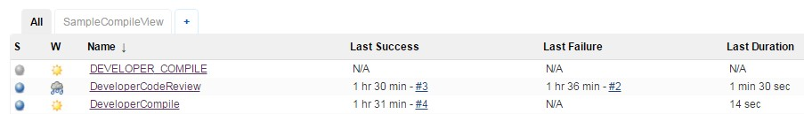
Demo Run Build Pipeline
Once you configure your builds, you need to run tests to create a delivery pipeline
Step 1: Install the Build Pipeline Plugin
Run Test Cases Display Results
Step 2: Create an additional tab in your Jenkins homepage to have a graphical view of the
test cases that are run (you can also see the console output here)

Slide 31
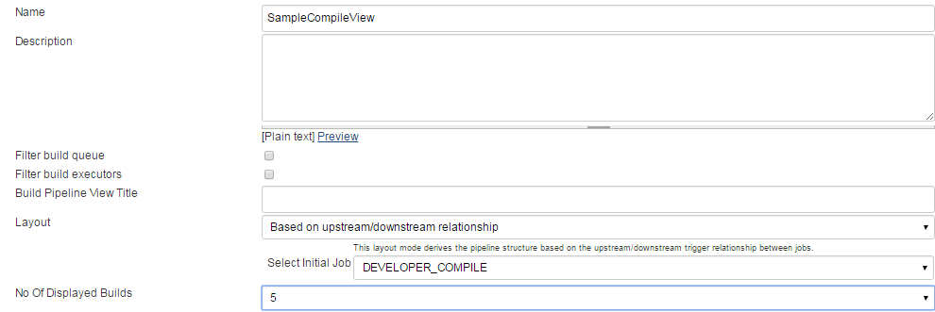
Demo Run Build Pipeline
Step 3: Set the number of builds to be displayed and from where to run the build jobs
Configure Test Reports
Run Test Cases Display Results
Run Test Cases Display Results

Slide 32
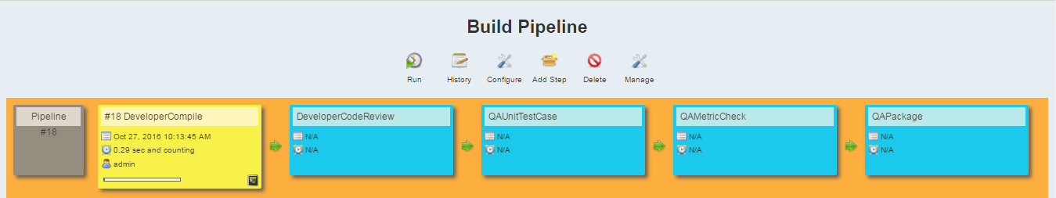
Demo Run Build Pipeline
Step 4: Below screen shows the graphical representation of the build. Click on run.
Configure Test Reports
Run Test Cases Display Results
Run Test Cases Display Results
Step 5: Your build starts executing

Slide 33
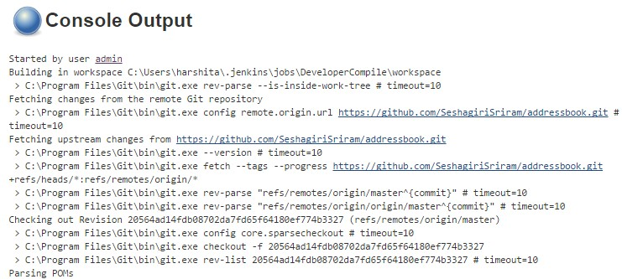
Demo Run Build Pipeline
Step 6: You can also see the console output by clicking on the highlighted button
Configure Test Reports
Run Test Cases Display Results
Run Test Cases Display Results

Slide 34
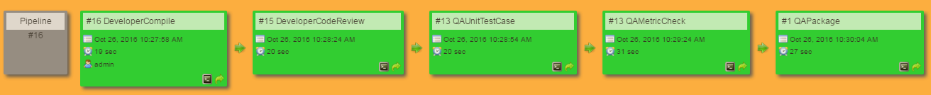
Demo Run Build Pipeline
Step 7: Once the build runs successfully, all the jobs in the delivery pipeline turns green
Configure Test Reports
Run Test Cases Display Results
Run Test Cases Display Results

Slide 35

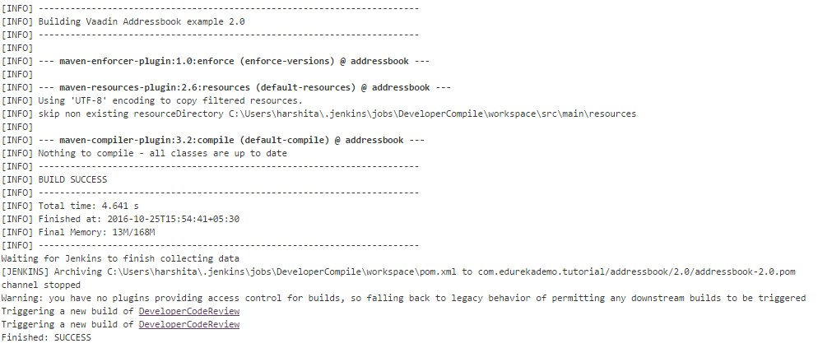
Demo Display Results
Build Job | Result
Developer Compile | Compilation
Developer Code Review | PMD Test Report
QA Unit Test | Unit Test Case Report
QA Metric Check | Cobertura Report
QA Package | WAR build Package
Configure Test Reports
Run Test Cases Display Results
Run Test Cases Display Results
The compilation results can be viewed in the console output

Slide 36
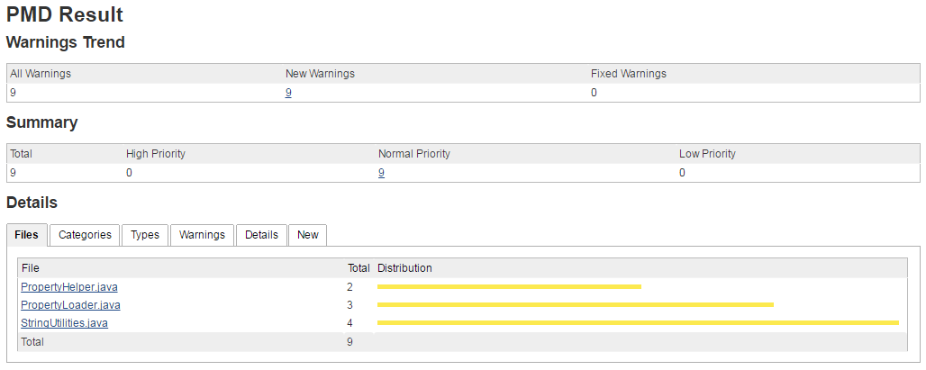
Demo Display Results
Build Job | Result
Developer Compile | Compilation
Developer Code Review | PMD Test Report
QA Unit Test | Unit Test Case Report
QA Metric Check | Cobertura Report
QA Package | WAR build Package
Configure Test Reports
Run Test Cases Display Results
Run Test Cases Display Results
You can also view the warnings returned for any build, by clicking on the PMD
Results in the Jenkins Homepage

Slide 37
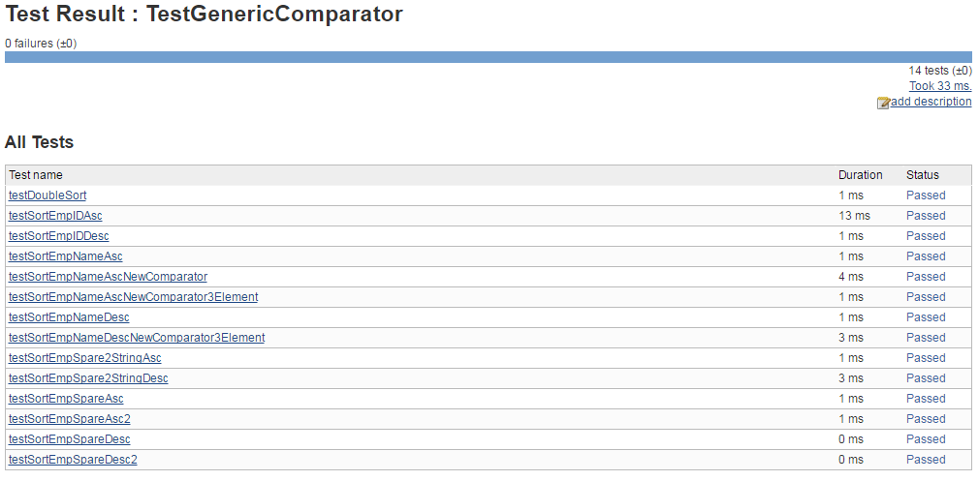
Demo Display Results
Build Job | Result
Developer Compile | Compilation
Developer Code Review | PMD Test Report
QA Unit Test | Unit Test Case Report
QA Metric Check | Cobertura Report
QA Package | WAR build Package
Configure Test Reports
Run Test Cases Display Results
Run Test Cases Display Results
You can also view the number of test cases, their status, the duration and their status

Slide 38
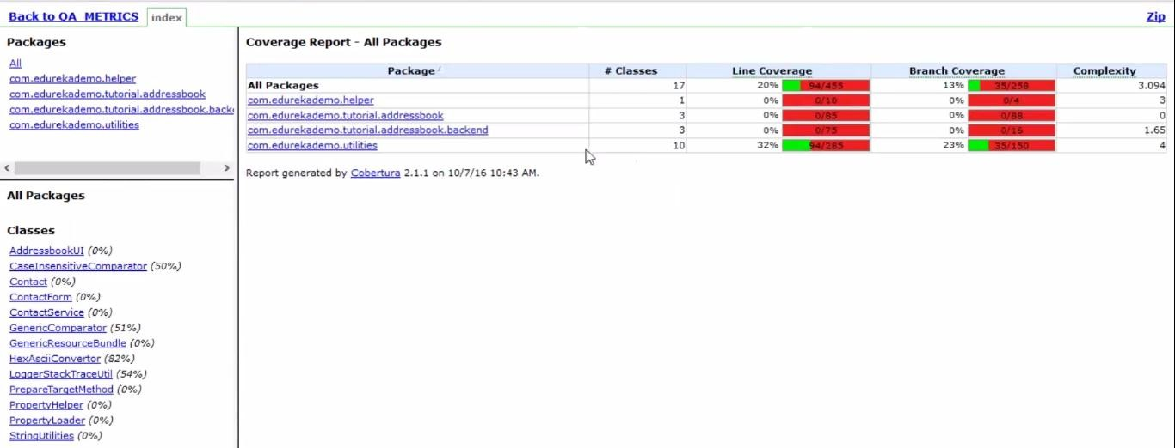
Demo Display Results
Build Job | Result
Developer Compile | Compilation
Developer Code Review | PMD Test Report
QA Unit Test | Unit Test Case Report
QA Metric Check | Cobertura Report
QA Package | WAR build Package
Configure Test Reports
Run Test Cases Display Results
Run Test Cases Display Results
You can also view the cobertura test results for the QA Metric Check

Slide 39

Demo Display Results
Build Job | Result
Developer Compile | Compilation
Developer Code Review | PMD Test Report
QA Unit Test | Unit Test Case Report
QA Metric Check | Cobertura Report
QA Package | WAR build Package
Configure Test Reports
Run Test Cases Display Results
Run Test Cases Display Results
You will find the QA deployable package in the QA Package Jenkins screen

Slide 40
Security in Jenkins
Activating Security
Identifying Jenkins Users
Authorization
Auditing

Slide 41


Activating Security
Immediately after installation, Jenkins will allow anyone to run, which is dangerous.
Jenkins supports several security models, and can integrate with several user repositories like LDAP.
In larger organizations, certain build jobs may be visible to all users whereas others will need to be hidden to unauthorized users. Thus we need security.
To activate security, go to Configure Global Security and check the enable security option
Activating Security Identifying Jenkins Users Authorization
Auditing

Slide 42
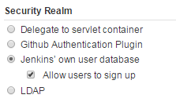
Identify Jenkins Users
Here, we establish the user authentication
For smaller & informal installations, you can allow Jenkins to maintain it’s own
user database
For enterprise installations, you will want to use your corporate service, which
allows users to log in to Jenkins with their organization’s username and password.
Activating Security Identifying Jenkins Users Authorization
Auditing

Slide 43
Identify Jenkins Users
Delegate to servlet container:
Used when you run Jenkins on a Servlet container such as Tomcat or GlassFish
Here you integrate the Servlet container with local enterprise user directory.
GitHub Authentication Plugin: Dedicated for GitHub users only
Activating Security Identifying Jenkins Users Authorization
Auditing
Jenkins own user database:
Authenticate the internal user name/password database
LDAP (Lightweight Directory Access Protocol)
Jenkins authenticate users using the LDAP repository, check group membership,
and retrieve the email address of authenticated users.

Slide 44
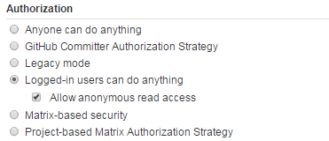
Authorization
Authorization, determines what users can do once they are logged in
This ranges from simple options like “Anyone can do anything” or “Logged-in users can do anything”
Activating Security Identifying Jenkins Users Authorization
Auditing

Slide 45
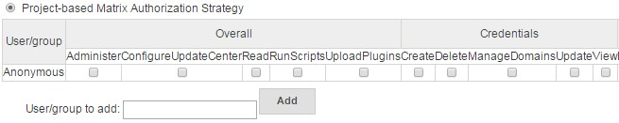
Authorization
Legacy mode
Admin - Full control of the system
Others - Only have the read access.
Matrix based security: Here, you can configure who can do what by using a big table.
Activating Security Identifying Jenkins Users Authorization
Auditing
Project based matrix authorization strategy
First you provide access and then add users/groups for the project.

Slide 46
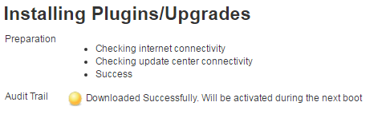
Auditing
Jenkins also keeps track of the individual user actions: who did what to server configuration.
Step 1: Install the audit trail plugin. The Audit Trail Plugin keeps track of the main user actions in a set of rolling log files.
Activating Security Identifying Jenkins Users Authorization
Auditing

Slide 47

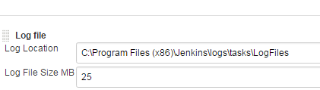
Auditing
Step 2: Indicate the directory in which the log files are to be written.
Activating Security Identifying Jenkins Users Authorization
Auditing

Slide 48
Notification Management
E-mail Notification

Slide 49
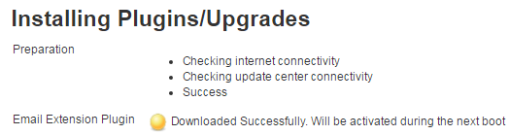
E-mail Notification
The premium feature of the Jenkins server is to let people know when a build breaks.
Email notification is the most obvious and most common form of CI notification.
Step 1: Install the “Email Ext” plugin

Slide 50
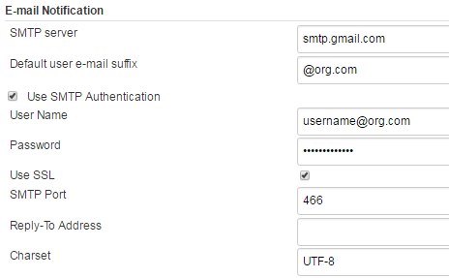
E-mail Notification
Step 2: Provide SMTP details

Slide 51
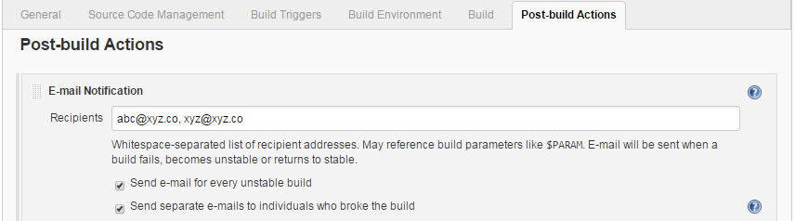
E-mail Notification
Step 3: Enter the email addresses of the team members to notify about the build status. Jenkins will send an email message to those users

Slide 52

Thank You
Slide 67 Course Url

