Slide 1
Climate_Trends
File created on: 11/18/24 9:56:39 PM PST

Slide 2
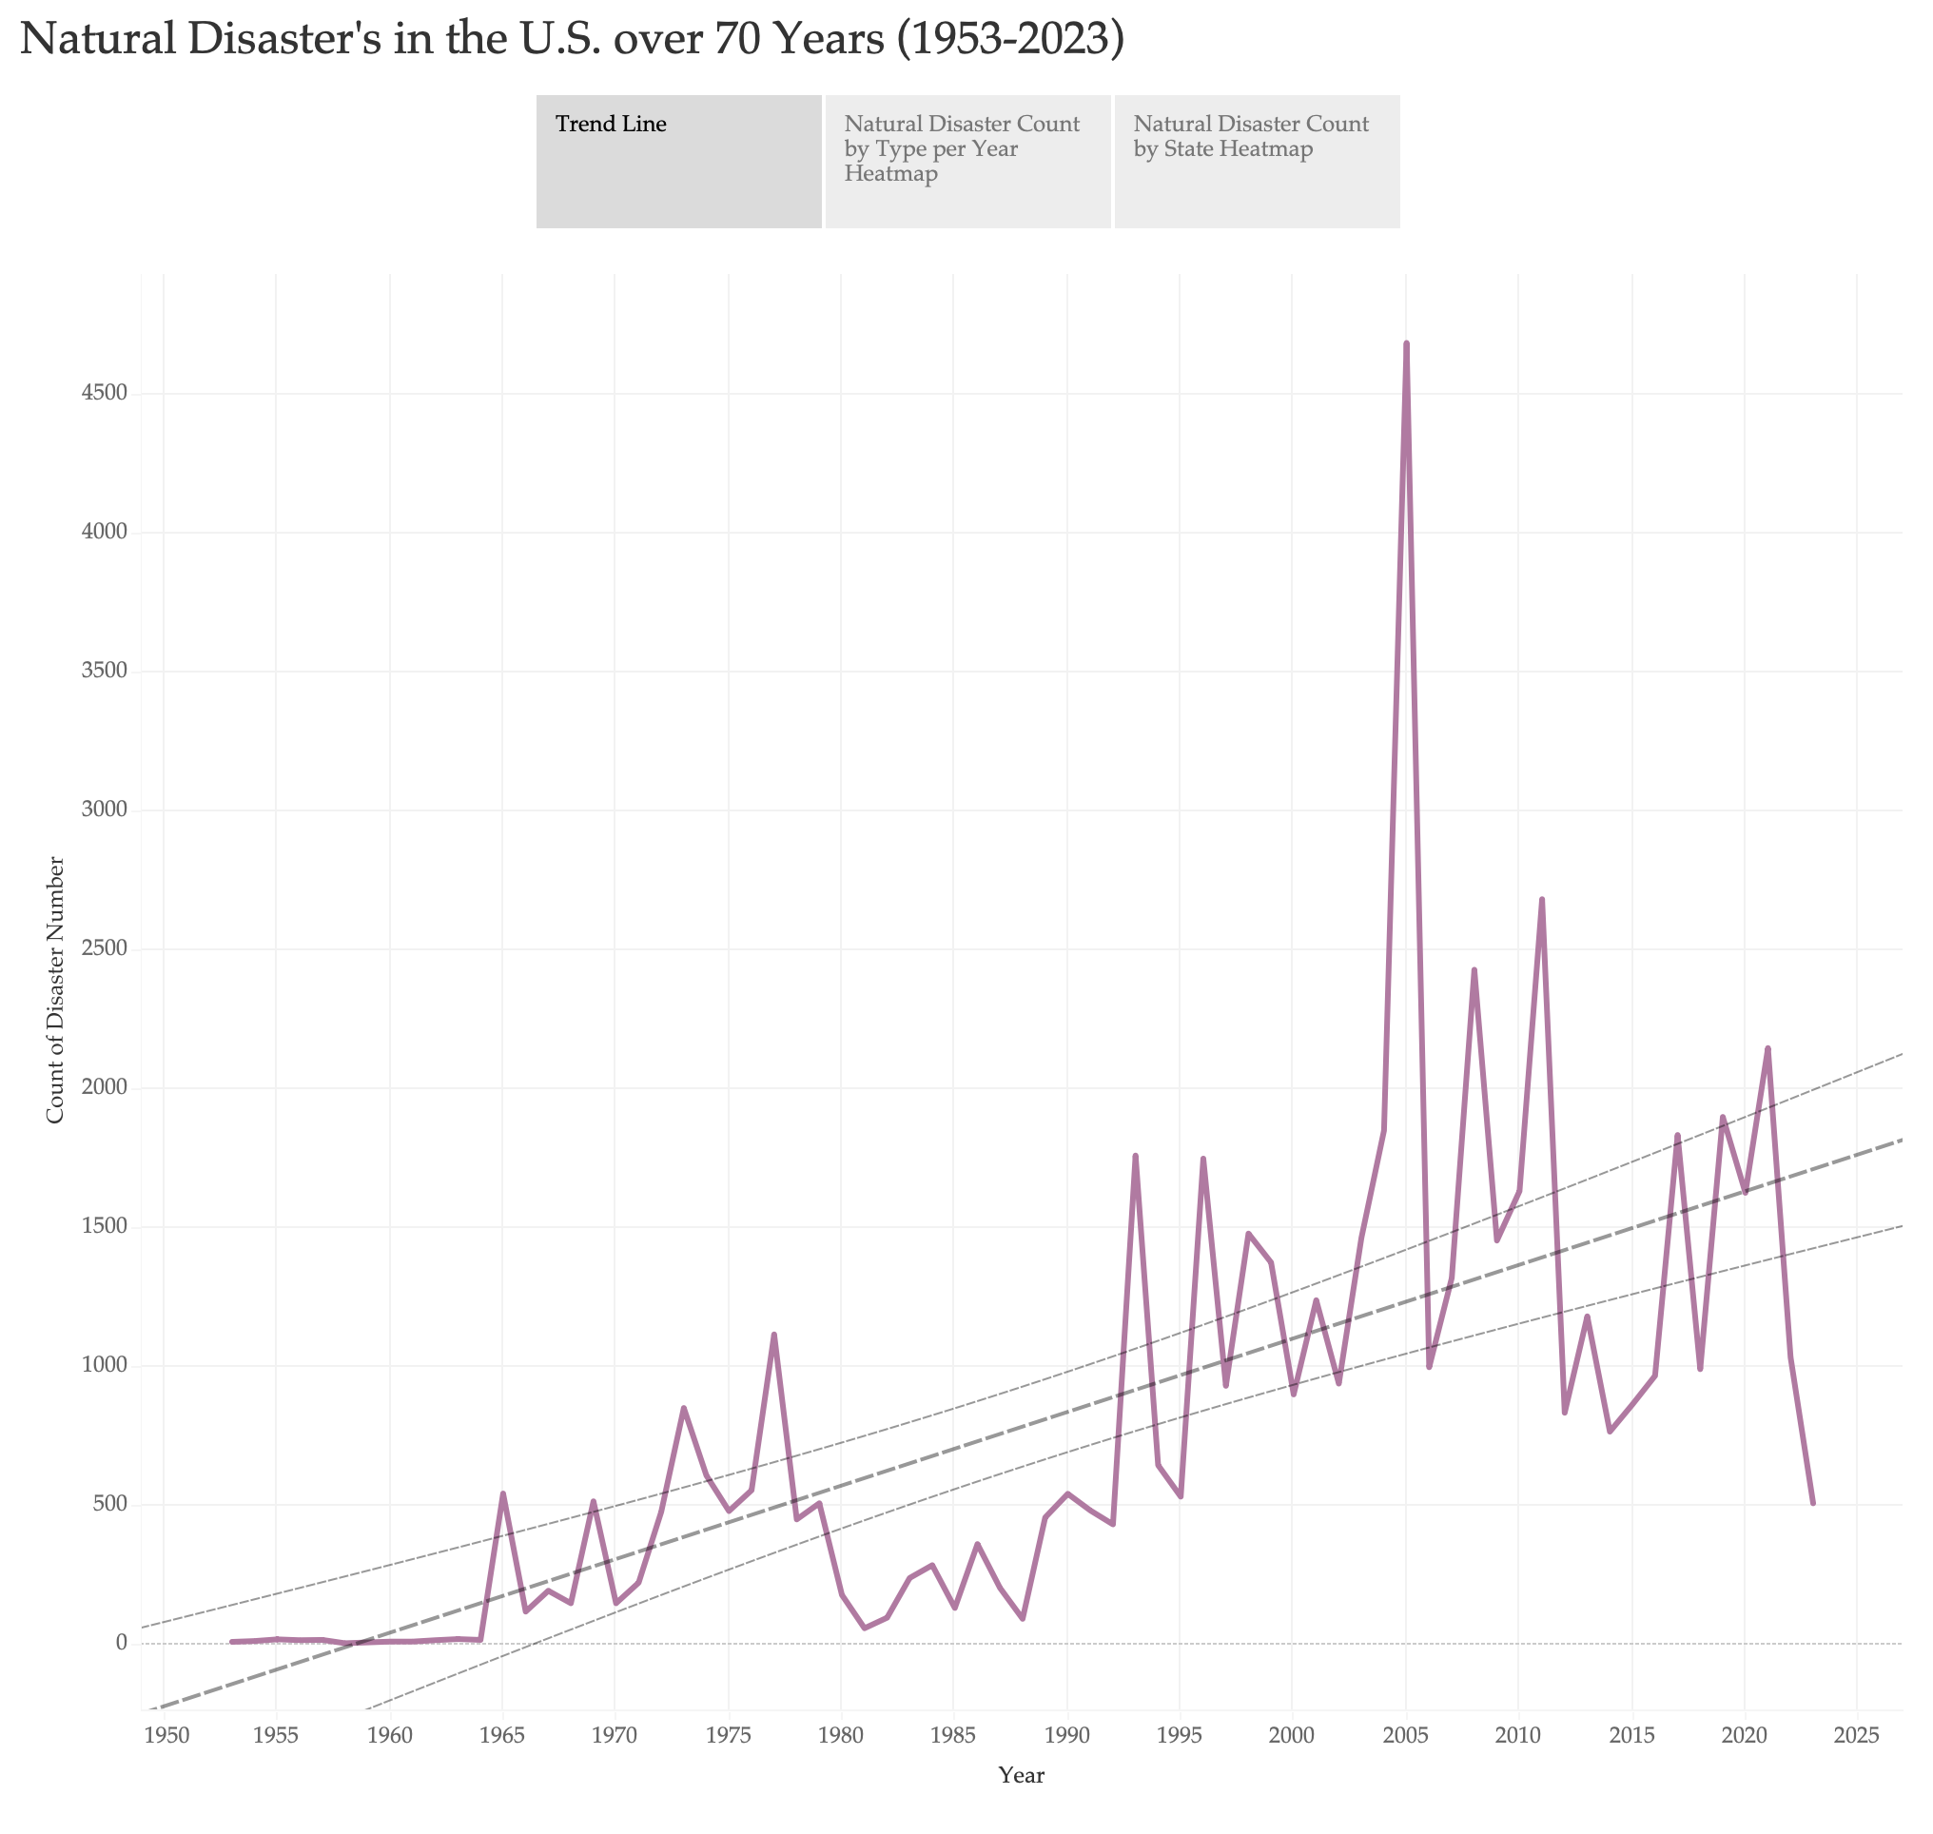

Slide 3
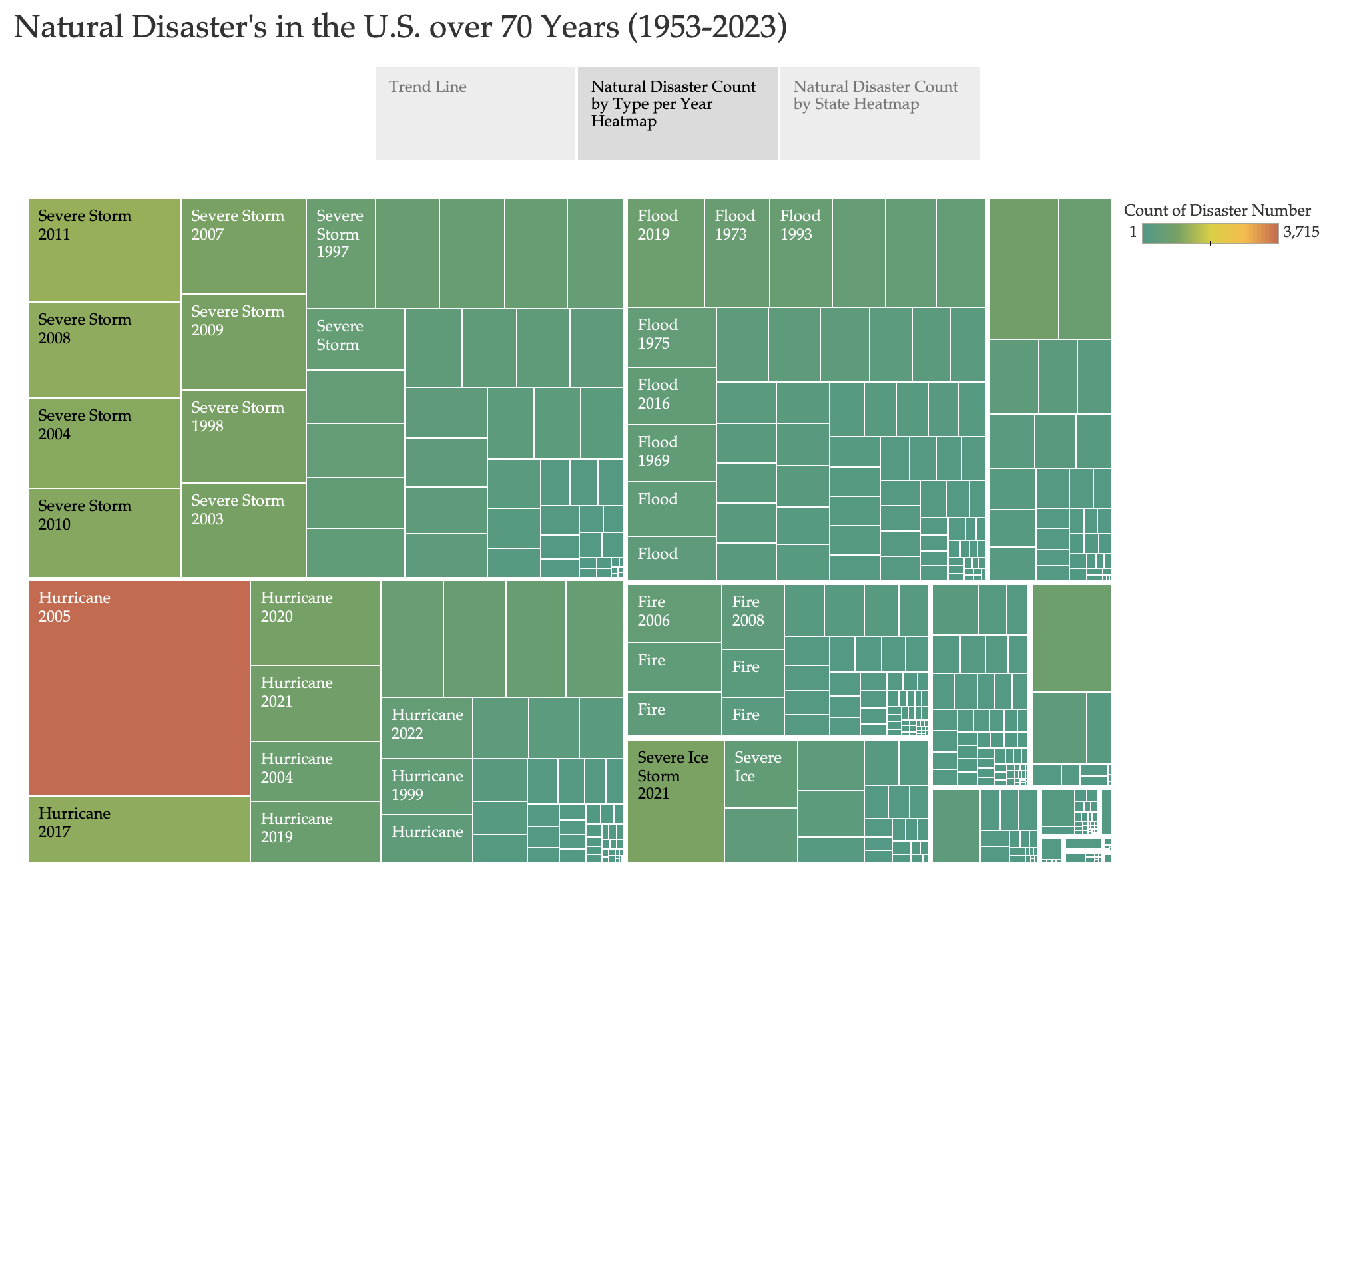

Slide 4
