Slide 1
SPD_Trends
File created on: 11/18/24 9:07:23 PM PST

Slide 2
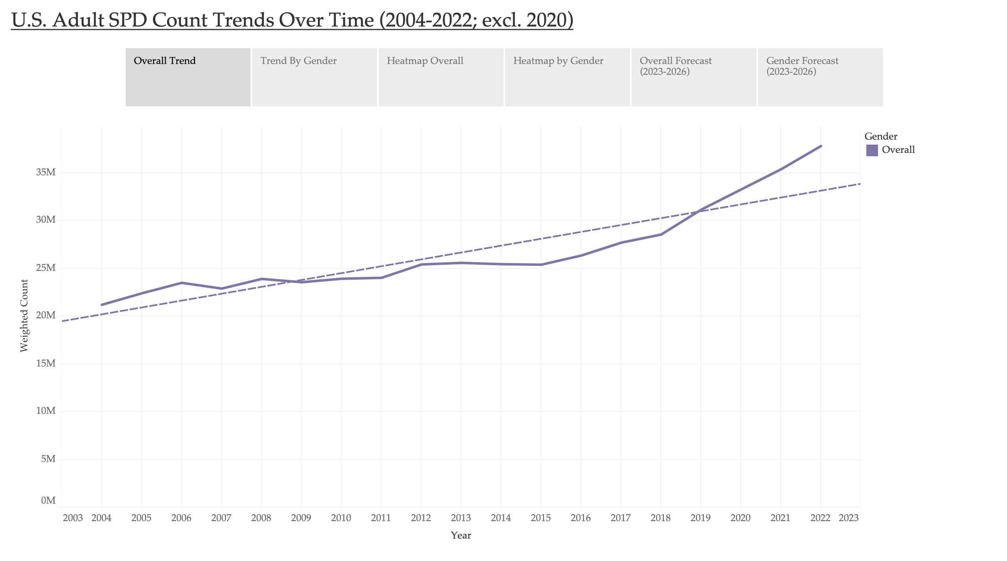
Notes:
The trend of sum of Weighted Count for Year. Color shows details about Gender. The view is filtered on Gender and Exclusions (Gender,Year). The Gender filter keeps Overall. The Exclusions (Gender,Year) filter keeps 56 members.

Slide 3
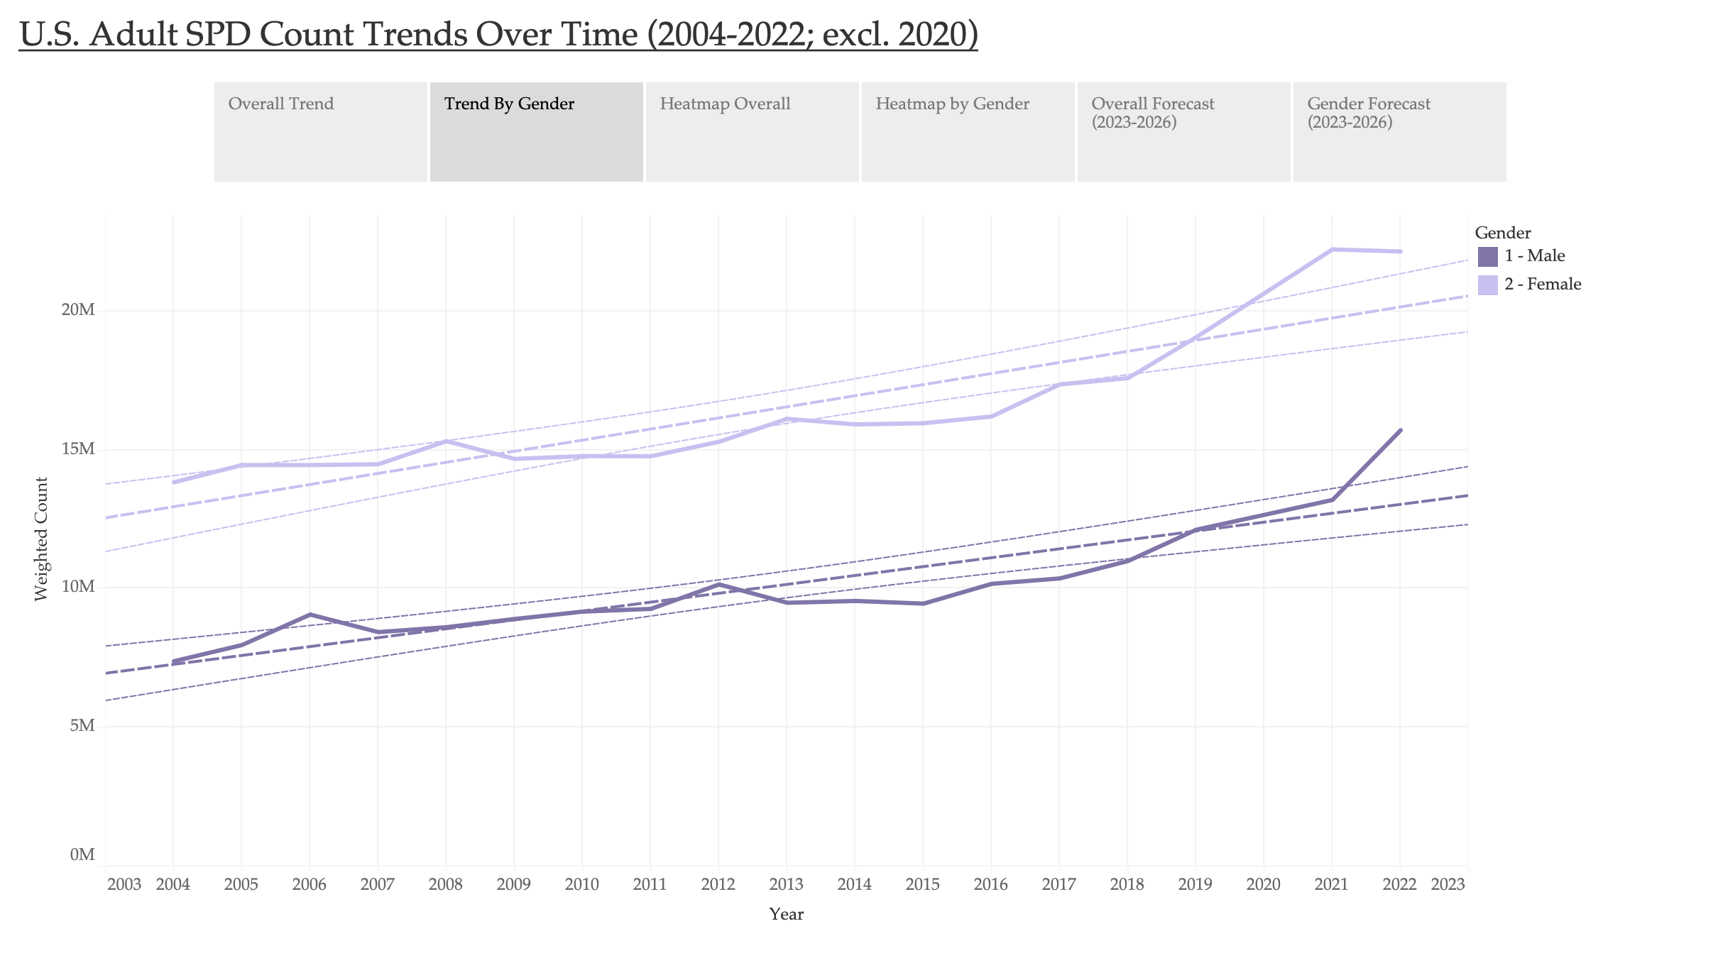
Notes:
The trend of sum of Weighted Count for Year. Color shows details about Gender. The view is filtered on Gender and Exclusions (Gender,Year). The Gender filter keeps 1 - Male and 2 - Female. The Exclusions (Gender,Year) filter keeps 55 members.
Trend Lines Model
A linear trend model is computed for sum of Weighted Count given Year. The model may be significant at p <= 0.05. The factor Gender may be significant at p <= 0.05.
Model formula: Gender*( Year + intercept )
Number of modeled observations: 36
Number of filtered observations: 0
Model degrees of freedom: 4
Residual degrees of freedom (DF): 32
SSE (sum squared error): 3.71896e+13
MSE (mean squared error): 1.16218e+12
R-Squared: 0.930795
Standard error: 1.07804e+06
p-value (significance): < 0.0001
Analysis of Variance:
Field DF SSE MSE F p-value
Gender 2 3.6596961e+14 1.82985e+14 157.45 < 0.0001
Individual trend lines:
Panes Color Line Coefficients
Row Column Gender p-value DF Term Value StdErr t-value p-value
Weighted Count Year 2 - Female < 0.0001 16 Year 399661 52090.5 7.67243 < 0.0001
intercept -7.87993e+08 1.04838e+08 -7.51627 < 0.0001
Weighted Count Year 1 - Male < 0.0001 16 Year 320027 42087.3 7.60389 < 0.0001
intercept -6.34084e+08 8.47057e+07 -7.48573 < 0.0001

Slide 4
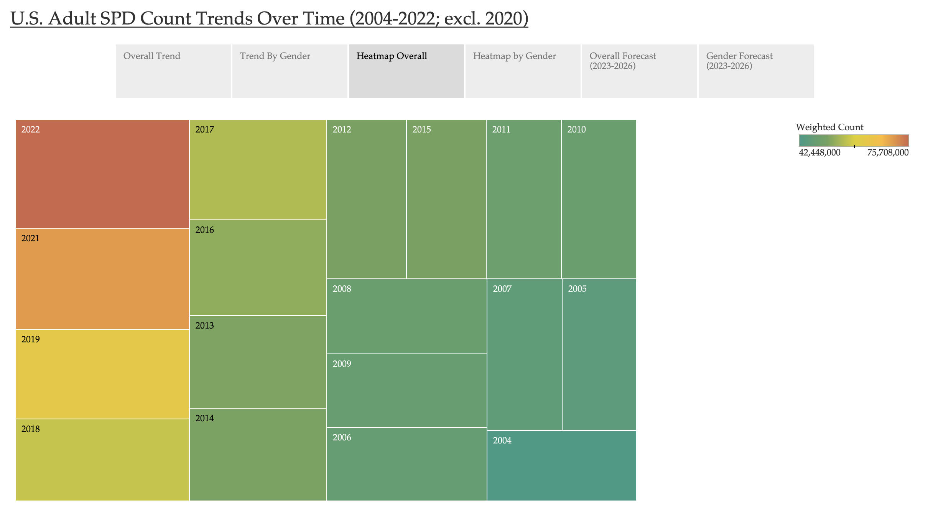
Notes:
Year. Color shows sum of Weighted Count. Size shows sum of Weighted Count. The marks are labeled by Year. The data is filtered on Year, which excludes 2020.

Slide 5
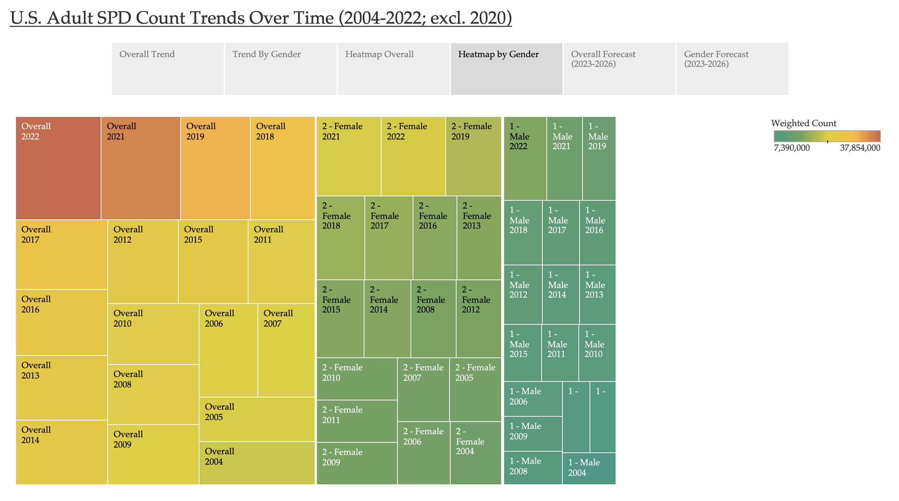
Notes:
Gender and Year. Color shows sum of Weighted Count. Size shows sum of Weighted Count. The marks are labeled by Gender and Year. The view is filtered on Exclusions (Gender,Year), which keeps 54 members.

Slide 6
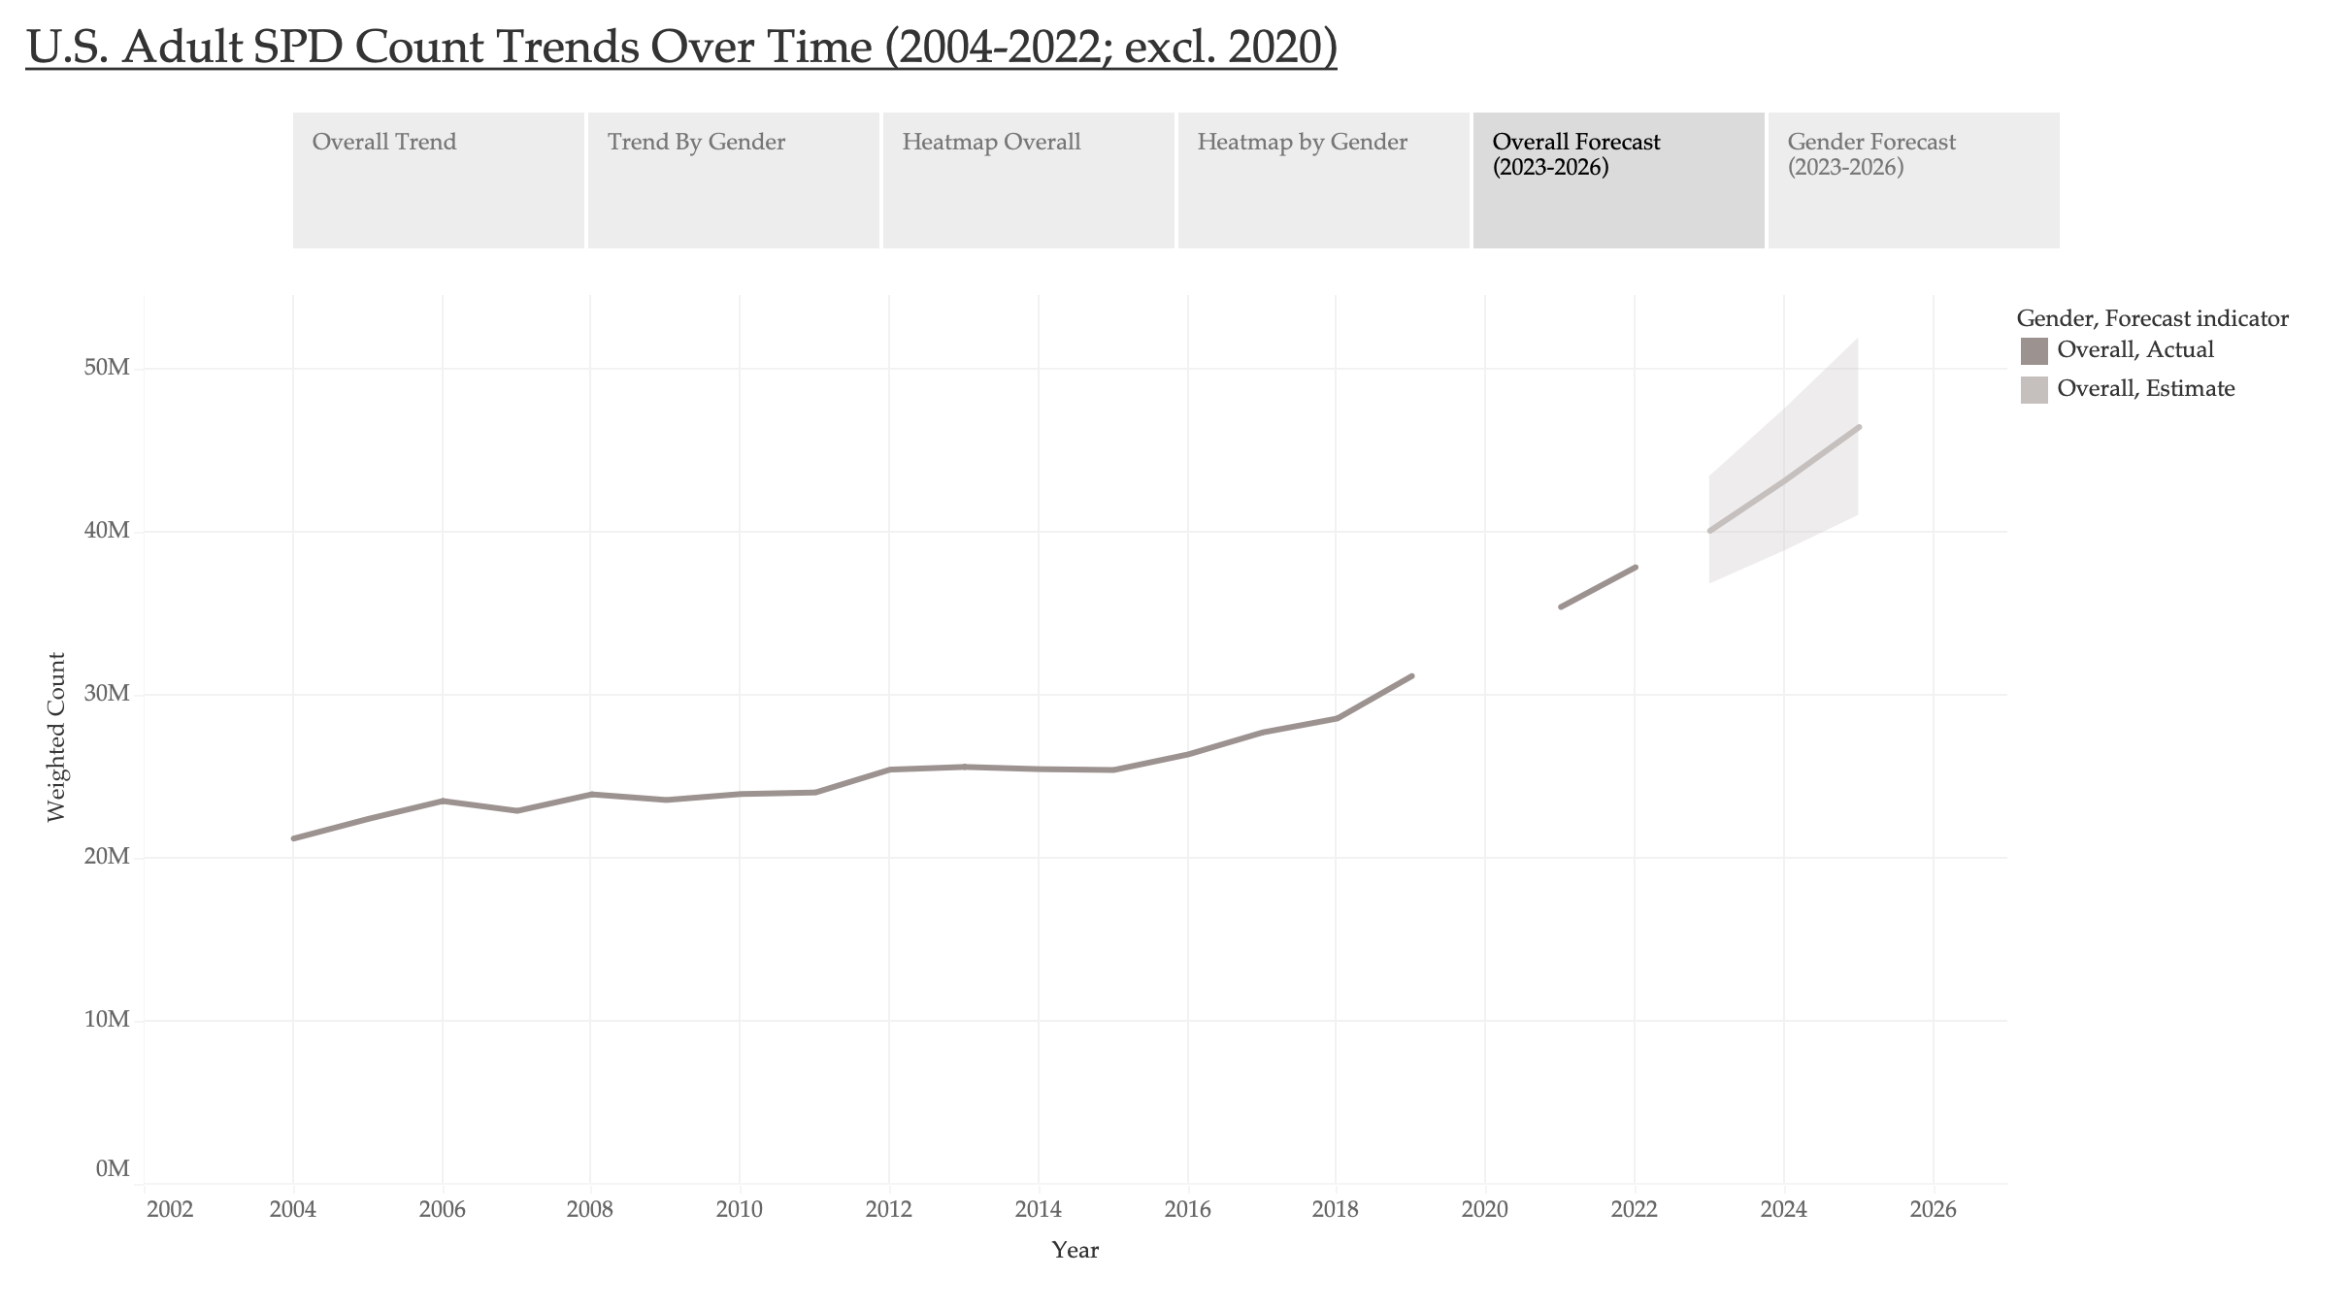
Notes:
The trend of sum of Weighted Count (actual & forecast) for Year. Color shows details about Gender and Forecast indicator. The view is filtered on Gender and Exclusions (Gender,Year). The Gender filter keeps Overall. The Exclusions (Gender,Year) filter keeps 56 members.
All forecasts were computed using exponential smoothing.
Sum of Weighted Count
Color Model Quality Metrics Smoothing Coefficients Gender Level Trend Season RMSE MAE
MASE MAPE AIC Alpha Beta Gamma Overall Multiplicative Multiplicative None 1,092,599 870,268
0.95 3.2% 511 0.500 0.500 0.000 The trend of sum of Weighted Count (actual & forecast) for Year. Color shows details about Gender and Forecast indicator. The view is filtered on Gender and Exclusions (Gender,Year). The Gender filter keeps Overall. The Exclusions (Gender,Year) filter keeps 56 members. The trend of sum of Weighted Count (actual & forecast) for Year. Color shows details about Gender and Forecast indicator. The view is filtered on Gender and Exclusions (Gender,Year). The Gender filter keeps Overall. The Exclusions (Gender,Year) filter keeps 56 members. The trend of sum of Weighted Count (actual & forecast) for Year. Color shows details about Gender and Forecast indicator. The view is filtered on Gender and Exclusions (Gender,Year). The Gender filter keeps Overall. The Exclusions (Gender,Year) filter keeps 56 members. The trend of sum of Weighted Count (actual & forecast) for Year. Color shows details about Gender and Forecast indicator. The view is filtered on Gender and Exclusions (Gender,Year). The Gender filter keeps Overall. The Exclusions (Gender,Year) filter keeps 56 members. The trend of sum of Weighted Count (actual & forecast) for Year. Color shows details about Gender and Forecast indicator. The view is filtered on Gender and Exclusions (Gender,Year). The Gender filter keeps Overall. The Exclusions (Gender,Year) filter keeps 56 members. The trend of sum of Weighted Count (actual & forecast) for Year. Color shows details about Gender and Forecast indicator. The view is filtered on Gender and Exclusions (Gender,Year). The Gender filter keeps Overall. The Exclusions (Gender,Year) filter keeps 56 members. The trend of sum of Weighted Count (actual & forecast) for Year. Color shows details about Gender and Forecast indicator. The view is filtered on Gender and Exclusions (Gender,Year). The Gender filter keeps Overall. The Exclusions (Gender,Year) filter keeps 56 members. The trend of sum of Weighted Count (actual & forecast) for Year. Color shows details about Gender and Forecast indicator. The view is filtered on Gender and Exclusions (Gender,Year). The Gender filter keeps Overall. The Exclusions (Gender,Year) filter keeps 56 members.

Slide 7
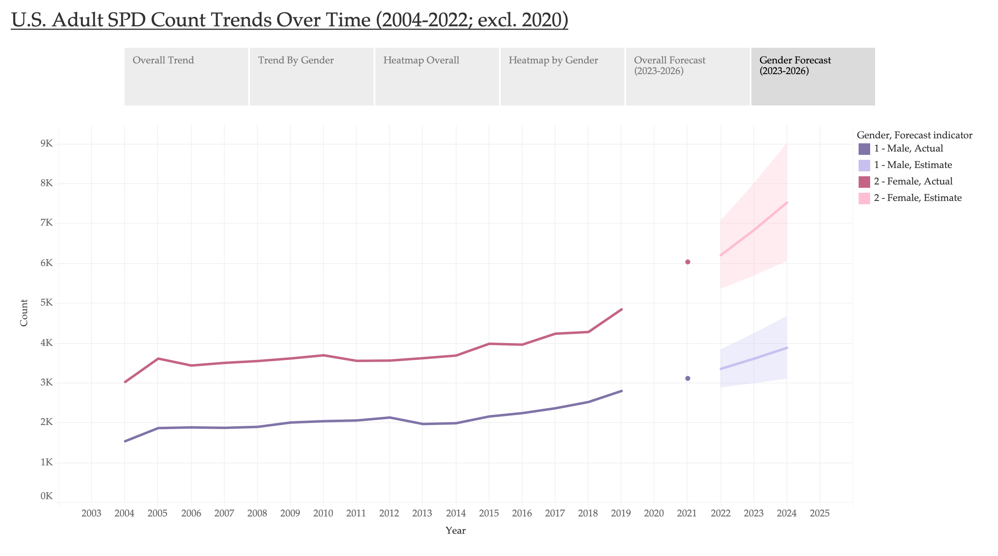
Notes:
The trend of sum of Count (actual & forecast) for Year. Color shows details about Gender and Forecast indicator. The view is filtered on Gender and Exclusions (Gender,Year). The Gender filter keeps 1 - Male and 2 - Female. The Exclusions (Gender,Year) filter keeps 55 members.
All forecasts were computed using exponential smoothing.
Sum of Count
Color Model Quality Metrics Smoothing Coefficients Gender Level Trend Season RMSE MAE
MASE MAPE AIC Alpha Beta Gamma 2 - Female Multiplicative Multiplicative None 284 191
1.15 4.7% 202 0.500 0.500 0.000 1 - Male Multiplicative Multiplicative None 138 106
0.99 5.3% 178 0.500 0.500 0.000 The trend of sum of Count (actual & forecast) for Year. Color shows details about Gender and Forecast indicator. The view is filtered on Gender and Exclusions (Gender,Year). The Gender filter keeps 1 - Male and 2 - Female. The Exclusions (Gender,Year) filter keeps 55 members. The trend of sum of Count (actual & forecast) for Year. Color shows details about Gender and Forecast indicator. The view is filtered on Gender and Exclusions (Gender,Year). The Gender filter keeps 1 - Male and 2 - Female. The Exclusions (Gender,Year) filter keeps 55 members. The trend of sum of Count (actual & forecast) for Year. Color shows details about Gender and Forecast indicator. The view is filtered on Gender and Exclusions (Gender,Year). The Gender filter keeps 1 - Male and 2 - Female. The Exclusions (Gender,Year) filter keeps 55 members. The trend of sum of Count (actual & forecast) for Year. Color shows details about Gender and Forecast indicator. The view is filtered on Gender and Exclusions (Gender,Year). The Gender filter keeps 1 - Male and 2 - Female. The Exclusions (Gender,Year) filter keeps 55 members. The trend of sum of Count (actual & forecast) for Year. Color shows details about Gender and Forecast indicator. The view is filtered on Gender and Exclusions (Gender,Year). The Gender filter keeps 1 - Male and 2 - Female. The Exclusions (Gender,Year) filter keeps 55 members. The trend of sum of Count (actual & forecast) for Year. Color shows details about Gender and Forecast indicator. The view is filtered on Gender and Exclusions (Gender,Year). The Gender filter keeps 1 - Male and 2 - Female. The Exclusions (Gender,Year) filter keeps 55 members. The trend of sum of Count (actual & forecast) for Year. Color shows details about Gender and Forecast indicator. The view is filtered on Gender and Exclusions (Gender,Year). The Gender filter keeps 1 - Male and 2 - Female. The Exclusions (Gender,Year) filter keeps 55 members. The trend of sum of Count (actual & forecast) for Year. Color shows details about Gender and Forecast indicator. The view is filtered on Gender and Exclusions (Gender,Year). The Gender filter keeps 1 - Male and 2 - Female. The Exclusions (Gender,Year) filter keeps 55 members.

