Slide 1
Web Programming Project-1
By:
Saurav Jangir
Anandita Dubey

Slide 2
About the Project:
A game very similar to odd one out.
A block choice has to be made having different shade as compared to others.
Three levels has been provided.
Beginners
Intermediate
Expertise
Very simple and fun game.
Using: HTML, CSS only.

Slide 3
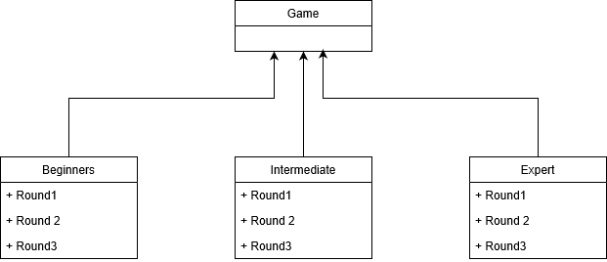
UML Class Diagram:

Slide 4

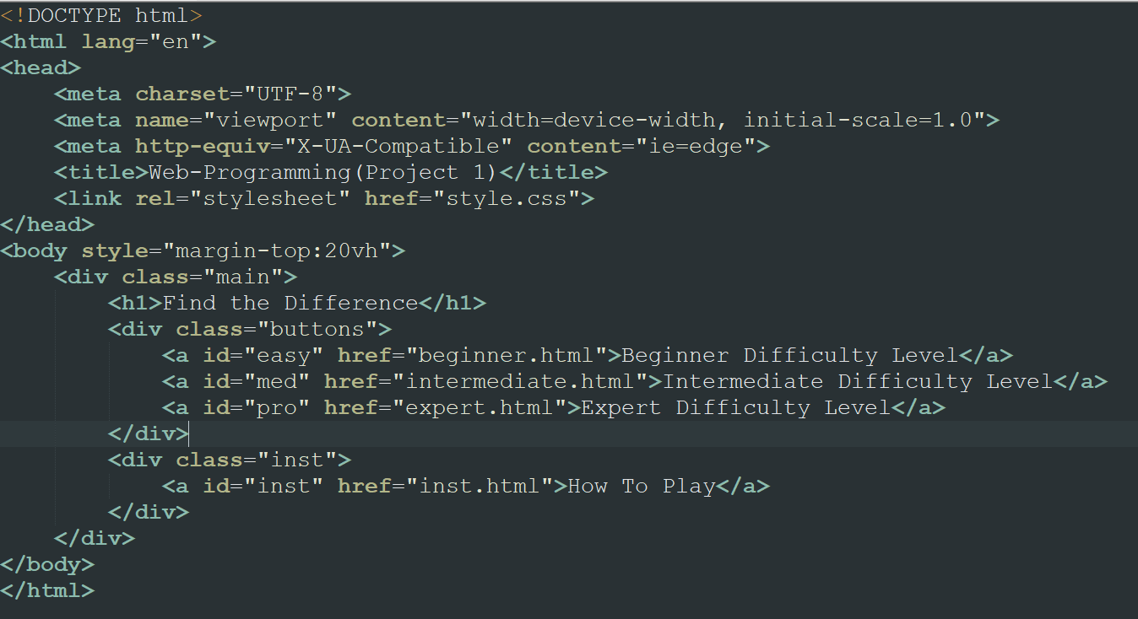
Designing Phase:
HTML:
We have created html pages for each difficulty level and and pages for their respective rounds.
Each difficulty page has been linked to the home page and each difficulty round page is liked to the next round page.

Slide 5
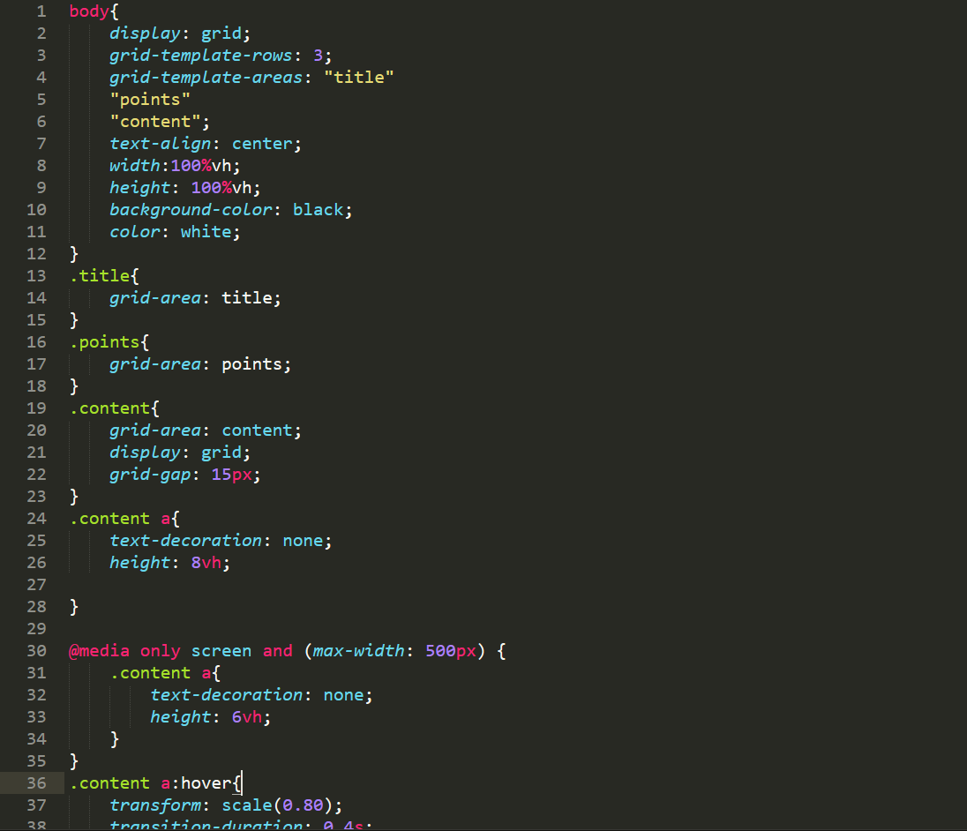
CSS:
Game styling is done in a grid layout manner.
We have created 3 grid rows.
Each row has some styling done for it.

Slide 6
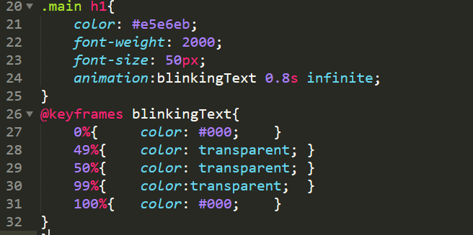
Animation Snippets
This animation is used for the Header of the Home Page.

Slide 7


We used the transform style to change the size of the tiles. When you hover over any tile the tile will scale according to the give parameter.
We used this animation in How to Play page. This animation will be used to flicker a tile to show the user the odd one.

Slide 8
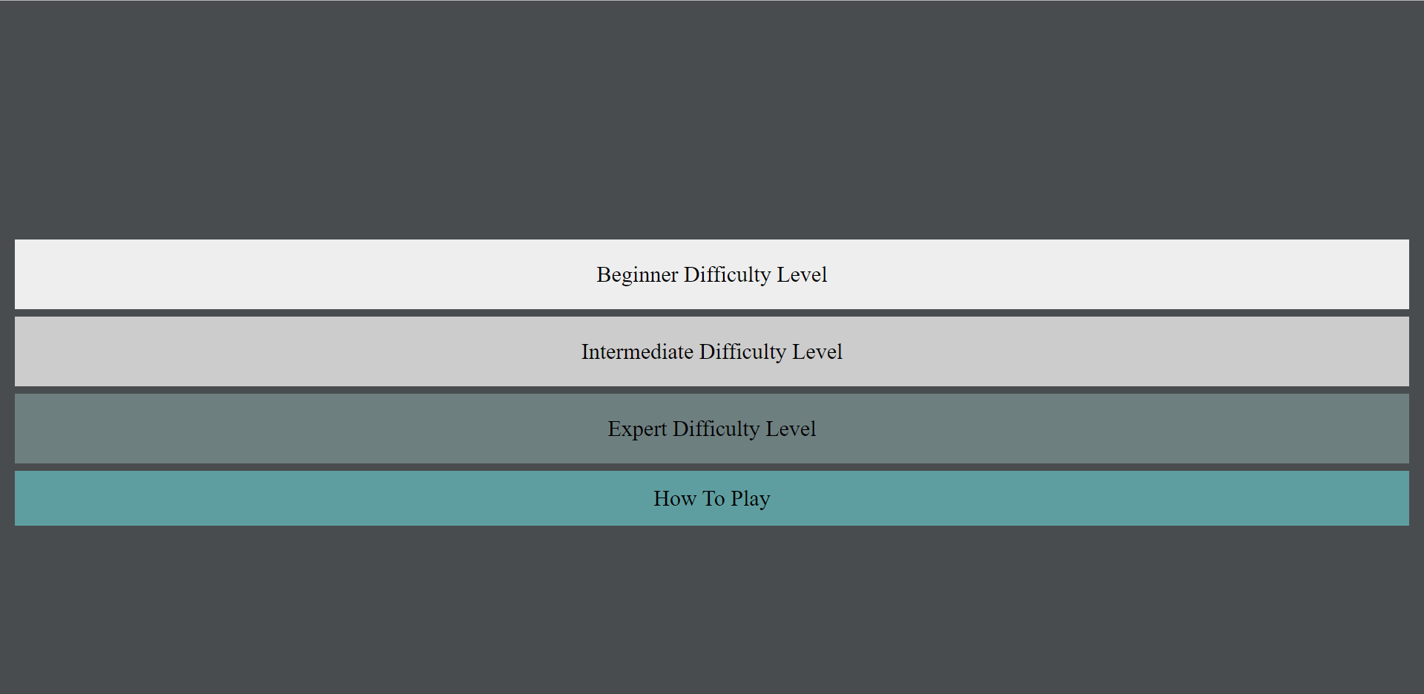
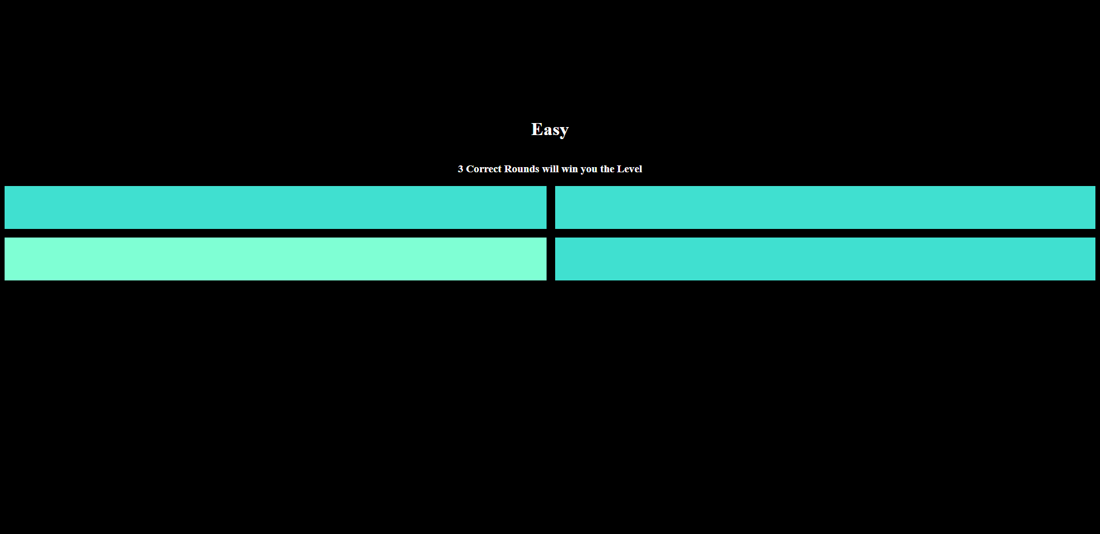
UI:
Fig1: The Home Page Fig2:Beginner Level game page

Slide 9
Demo:

Slide 10
Thank You

