Slide 1
In His Name
What does it mean to do something in the name of the Lord Jesus?
Notes:
This phrase often flies under the radar

Slide 2
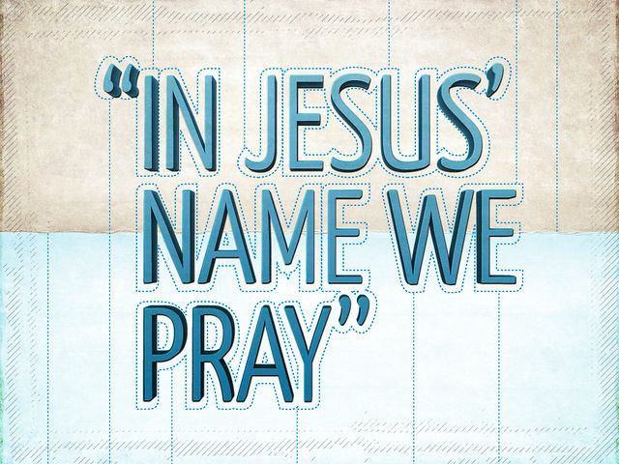

Slide 3
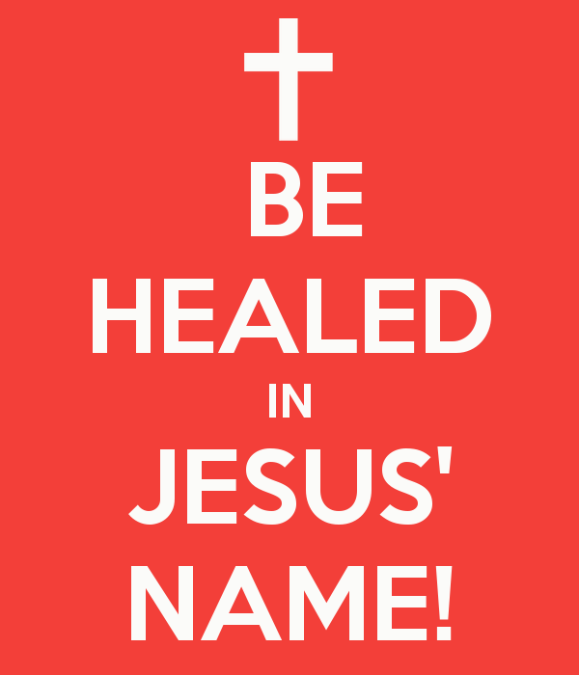

Slide 4
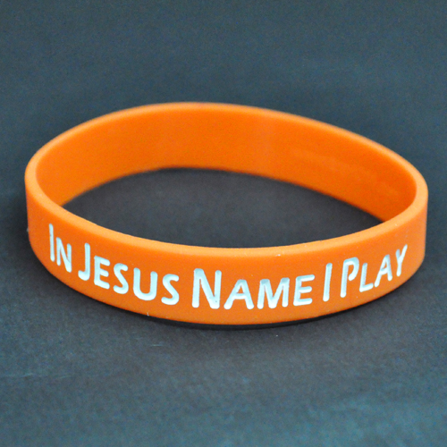

Slide 5


Slide 6


Slide 7
Col 3:17
And whatsoever ye do in word or deed, [do] all in the name of the Lord Jesus, giving thanks to God and the Father by him.
Notes:
This is all encompassing: it covers everything we do in both word and deed.
If we get this wrong, our words and our actions will be built on the wrong foundation.
Understanding "In His Name" starts with the word "Lord". This is the word for master, or one in authority

Slide 8
Phil 2:10
That at the name of Jesus every knee should bow, of [things] in heaven, and [things] in earth, and [things] under the earth;
Notes:
This is clear in Philippians, where Paul writes about every knee bowing at the name of Jesus
In other words, The name of Jesus is used to represent His authority as Lord.
The way we are going to start studying “in His name” is by understanding the Authority of Christ Himself
Found the best resource for this was studying the Gospels and Acts. We will at this phrase there and then come back to Colossians to see what we have learned.

Slide 9
The Father and the Son
The Authority of Christ
Notes:
The authority of Jesus was questioned by the Jewish religious leaders on multiple occasions.
Often, in answer to this, Jesus would respond with questions of His own or by appealing to the witness of others.
But in an encounter recorded in the gospel of John, we find one of the most direct expositions on authority in the words of Christ Himself.

Slide 10
The healing by the pool of Bethesda (John 5)
Notes:
On a journey to Jerusalem, [Jesus finds a lame man][3] by the pool called Bethesda and heals him, commanding him to get up, take his bed mat, and walk.
The catch is that this healing took place on the Sabbath.
When the Jews heard of this they promptly accused Jesus of breaking the Law of the Sabbath - first, by [healing on the Sabbath][5], and second, by commanding the man to [carry his mat on the Sabbath][6].
When confronted about this, Jesus does not enter into a detailed discourse on the law or the Sabbath.

Slide 11
John 15:17
But Jesus answered them, My Father worketh hitherto, and I work.
Notes:
Instead, He simply begins to explain His relationship with His Father.
He makes clear the link to His Father and in doing so identifies Himself as the Son of God.
If His "breaking of the Sabbath" were enough to anger these Jews, calling God His father takes things to a whole new level.
He goes on to speak in detail of this relationship.

Slide 12
John 5:19-20
Then answered Jesus and said unto them, Verily, verily, I say unto you, The Son can do nothing of himself, but what he seeth the Father do: for what things soever he doeth, these also doeth the Son likewise. For the Father loveth the Son, and sheweth him all things that himself doeth: and he will shew him greater works than these, that ye may marvel.
Notes:
How tempting it is to think that Jesus, being God in flesh, had no need to learn from anyone or answer to anyone.
Here we see that this is not the case. As a faithful servant and son, He learned everything from His Father.
He did nothing that was outside of His Father's plan.

Slide 13
John 5:22-27
For the Father judgeth no man, but hath committed all judgment unto the Son … And hath given him authority to execute judgment also, because he is the Son of man.
Notes:
First and foremost, He did not take the authority He had for Himself: he received it from the Father.
This was the authority for the purpose of Judgment
The 4 roles of Christ with Israel: Judge, Prophet, Priest, King
John reveals Christ as the rejected Judge of Israel

Slide 14
John 5:30
I can of mine own self do nothing: as I hear, I judge: and my judgment is just; because I seek not mine own will, but the will of the Father which hath sent me.
Notes:
The Son always exercises his judgment by faith. That is, it is [based on what He hears][7] from the Father.
Unlike the judgment of the Jewish leaders, which was often [based on thier traditions][11], His judgment was always based solidly on the Word of God in alignment with the Will of God.

Slide 15
Purpose
Trust
Faithfulness
Notes:
This close relationship between the Father and the Son illustrates three essential aspects of any relationship:
Purpose - the Father gave the Son authority to judge
Trust - the Son executed His authority through faith in the Father's Word
Faithfulness - the Son lived in perfect obedience to the Father's will

Slide 16
John 5:43
I have come in my Father’s name
Notes:
Christ summarized His ministry:
These are the words of a faithful servant.
For Christ, this meant nothing less than fulfilling the purpose the Father had given to Him.

Slide 17
Purpose
The Gospel and The calling of the twelve
Notes:
So often the good news of the gospel is presented as an opportunity for us to invite Christ into our lives. This may leave us thinking we have the power to initiate this relationship.
But this is completely backwards. In fact, we are [powerless][1] to do this.
Our relationship with Christ is not initiated by [us first seeking Him][2]:
He is the one that seeks out us. He invites us to become part of His life and purpose.

Slide 18
Matt 4:19-20
And he saith unto them, Follow me, and I will make you fishers of men. And they straightway left [their] nets, and followed him.
Notes:
This is seen clearly in the example of Christ calling His disciples as He began His earthly ministry. Walking by the Sea of Galilee, he encountered two brothers that were fishermen.
Christ is the one who extended the offer. He was the one that found Peter and Andrew, not the other way around.
He hinted at the bigger purpose He had for them: becoming "fishers of men" for His kingdom.
We may ponder what exactly went through their minds as they accepted the invitation or what they may or may not have known about Jesus at that instant.
But we cannot debate the simple fact that they accepted and followed. Their trust in Jesus began here as they took their first steps with Him.

Slide 19
Matt 10:1
And when he had called unto [him] his twelve disciples, he gave them power [against] unclean spirits, to cast them out, and to heal all manner of sickness and all manner of disease.
Notes:
After finding and gathering the twelve together, Christ gave them the authority for their ministry, much like the Father had given Him authority for His.
The works that we see the twelve and others doing during the gospels and book of Acts are possible because of the authority given for this purpose.

Slide 20
Matt 19:28
And Jesus said unto them, Verily I say unto you, That ye which have followed me, in the regeneration when the Son of man shall sit in the throne of his glory, ye also shall sit upon twelve thrones, judging the twelve tribes of Israel.
Notes:
The authority in proclaiming the kingdom that He shared with His disciples was in anticipation of the future realization of that kingdom on earth, when they would rule together in authority in that kingdom.
This emphasis on purpose is not to minimize the importance of redemption in any way.
In fact, the regeneration that Jesus speaks of here is completely impossible without the plan of redemption.

Slide 21
Redemption => Purpose
Notes:
Redemption is what enables the Father's purpose. To present the good news without His purpose is to present an incomplete gospel.
Just as Christ invited His disciples to follow Him in His earthly ministry, He is inviting us to be a part of what He is doing in His heavenly ministry.

Slide 22
Trust
Illustrations from the book of Acts
Notes:
The book of Acts is a record of works done in the name of Jesus.
We read about preaching, healing, and deliverance, all done "in His name".
It is the outworking of the authority Christ gave His disciples for proclaiming the good news of the kingdom.
Look at an incident that stands out in great contrast to the rest of the book

Slide 23
Acts 19:13-14
Then certain of the vagabond Jews, exorcists, took upon them to call over them which had evil spirits the name of the Lord Jesus, saying, We adjure you by Jesus whom Paul preacheth. And there were seven sons of [one] Sceva, a Jew, [and] chief of the priests, which did so.
Notes:
The term exorcist was applied to those who followed a formulaic approach to casting out deamons as a profession.
Typically this would be done by either finding out the name of the evil spirit and commanding it to leave by name, or invoking the name of a higher power to command it to leave.
These exorcists had seen or heard of the powerful works done by Paul in the name of Jesus and desired to apply it to their own handiwork.
The results were certainly not what they had in mind.

Slide 24
Acts 19:15-16
And the evil spirit answered and said, Jesus I know, and Paul I know; but who are ye?
And the man in whom the evil spirit was leaped on them, and overcame them, and prevailed against them, so that they fled out of that house naked and wounded.
Notes:
Here the name of Jesus was invoked but authority was totally lacking. The results were devestating.
The problem was not that the authority to cast out demons wasn't available.
In fact, Christ clearly said that this authority extended much further than the twelve.

Slide 25
Mark 16:17-18
And these signs shall follow them that believe; In my name shall they cast out devils; they shall speak with new tongues; They shall take up serpents; and if they drink any deadly thing, it shall not hurt them; they shall lay hands on the sick, and they shall recover.
Notes:
The missing link is the fact that "these signs" follow out of belief. It is only by faith that the authority for this power can be received.
This is not a mere belief in the existence of Jesus, which the exorcists no doubt had. It is a firm conviction of who He really is.
The context of Mark 16 is the resurrection of Christ. Here "believe" means belief in Christ as the resurrected Messiah.

Slide 26
Acts 3:6
Then Peter said, Silver and gold have I none; but such as I have give I thee: In the name of Jesus Christ of Nazareth rise up and walk.
Notes:
In Acts chapter 3, Peter illustrates belief in the resurrected Christ as the basis for work done "in His name".
When entering the temple for prayer with John, they encounter a man lame from birth at the gate.
Here the name of Jesus was invoked and the power followed.
What’s different this time?

Slide 27
Acts 3:16
And his name through faith in his name hath made this man strong, whom ye see and know: yea, the faith which is by him hath given him this perfect soundness in the presence of you all.
Notes:
Peter goes on to explain the healing to the people at the temple.
It was the power of Christ at work here: His Name stands for His authority. This time, the basis of faith was present.
Faith was the link in the chain that made it possible - the faith here is not the lame man's, it is Peter's faith in the resurrected Christ.

Slide 28
Trust in the
Resurrected Christ
Notes:
Trust in the resurrected Christ is central to all of God's purposes.
God invites to be a part of His purpose, but without a response of trust, there really can be no relationship.
There isn't power in His name if there is no relationship with Him.
You can’t use something you don’t have

Slide 29
Faithfulness
And entering the Kingdom
Notes:
The phrase "enter the Kingdom" is often used as a way to describe personal salvation.
When someone puts their trust in Christ, they are said to have "entered the kingdom".
But when we look at how this phrase is actually used by Christ, a different picture begins to emerge.

Slide 30
Matthew 7:21
Not every one that saith unto me, Lord, Lord, shall enter into the kingdom of heaven; but he that doeth the will of my Father which is in heaven.
Notes:
Entering the kingdom was not just about identifying Jesus as Lord, it was about doing the will of His Father.
Above and beyond faith alone, this required works.
This was a warning to those who were believers, not to those who didn't trust Christ in the first place.

Slide 31
Matthew 7:22-23
Many will say to me in that day, Lord, Lord, have we not prophesied in thy name? and in thy name have cast out devils? and in thy name done many wonderful works? And then will I profess unto them, I never knew you: depart from me, ye that work iniquity.
Notes:
There is no indication that the works done here were not genuine. In fact, these were the very signs that were support to follow them that believed.
And yet, entrance to the kingdom was denied.
Christ goes on to explain with the lesson of the builders

Slide 32
Matthew 7:24-25
Therefore whosoever heareth these sayings of mine, and doeth them, I will liken him unto a wise man, which built his house upon a rock:
And the rain descended, and the floods came, and the winds blew, and beat upon that house; and it fell not: for it was founded upon a rock.

Slide 33
Matthew 7:26-27
And every one that heareth these sayings of mine, and doeth them not, shall be likened unto a foolish man, which built his house upon the sand: And the rain descended, and the floods came, and the winds blew, and beat upon that house; and it fell: and great was the fall of it.
Notes:
Again, the example of the builders illustrates the fact that works are in view here, not just faith alone. They are each building something, but on very different foundations.
The question is whether the works will stand when tested.
What are the words that Christ is referring to here? Just a few versus earlier in this chapter we get a concise summary.

Slide 34
Matthew 7:12
Therefore all things whatsoever ye would that men should do to you, do ye even so to them: for this is the law and the prophets.
Notes:
Christ didn't come to abolish the law, he came to fulfill it. He has summed up the law in a nutshell.
Here in Matthew, entering the Kingdom isn't about redemption or initial salvation, it is a reward for faithful service done lawfully.
Those entering the kingdom could look forward to ruling with Christ in a position of authority.

Slide 35
Trust => Faithfulness
Notes:
There can be no faithfulness if there is not first faith.
The faithful servant aligns himself with the will of God.
This is not possible with efforts of the flesh, it requires the very power of God.
This is what Christ meant when he said "With men it is impossible, but not with God: for with God all things are possible."

Slide 36
In His Name
Purpose, Trust, Faithfulness
Notes:
Returning to the theme verse once again, we still have to examine the second part of the verse.

Slide 37
Col 3:17
And whatsoever ye do in word or deed, [do] all in the name of the Lord Jesus, giving thanks to God and the Father by him.
Notes:
What does giving thanks to God the Father have to do with doing everything "in the name of the Lord Jesus"?
Why does Paul mention this here?
Looking back to the first chapter of Colossians, we find our answer.

Slide 38
Col 1:12-14
Giving thanks unto the Father, which hath made us meet to be partakers of the inheritance of the saints in light: Who hath delivered us from the power of darkness, and hath translated [us] into the kingdom of his dear Son: In whom we have redemption through his blood, [even] the forgiveness of sins:
Notes:
It is always God that qualifies those He calls. He has prepared an inheritance and wants us to be part of it.
Without redemption, this purpose would not be possible.
This is thankfulness for the work He has done to prepare us.
This is the first time inheritance appears in Colossians, but there is another occurrence later in the book

Slide 39
Col 3:23-25
And whatsoever ye do, do [it] heartily, as to the Lord, and not unto men; Knowing that of the Lord ye shall receive the reward of the inheritance: for ye serve the Lord Christ. But he that doeth wrong shall receive for the wrong which he hath done: and there is no respect of persons.
Notes:
There is a difference between being "made meet" for the inheritance and actually receiving the reward of the inheritance.
Receiving the reward requires works. It is the result of faithful service.
What links being qualified for the inheritence (by the Father) and receiving the reward?

Slide 40
In His Name
Notes:
The difference is doing everything "in His name".
This really does touch every aspect of life, because in the preceding verses we see the relationships of husbands and wives, children and parents, and servants and masters (or maybe employees and employers).
Doing all things “in His name” means letting the very character and authority of Christ fill every area of our lives. This is very different that trying to merely “apply” it to the things we do.
The basis is always His Purpose and His Calling. When we become a part of that, He fills us according to that purpose and it overflows into everything we do.
That’s what I think it means to do everything in His name.

