Slide 1
Making Scientific Knowledge
Navigable for Agents
Stephanie Jarmak
Sourcegraph · Harvard & Smithsonian | Center for Astrophysics
MLOps Community · Research Copilot Workshop

Slide 2
Scientific knowledge is fragmented and weakly linked
We query it as if it were flat text. We can do better.
Knowledge is scattered
Literature, datasets, software, posters, talks — in different systems, with different identifiers, and no common seams.
The structure we have is incomplete
DOIs, citation graphs, data-availability statements, ORCIDs — partial coverage, inconsistent metadata, ambiguous attribution.
Relationships are underspecified
A citation can mean: builds on, disproves, mentions, reuses data from, or reuses methods from. The graph collapses all five into one edge.
Search is the universal API
Keyword or vector search returns a ranked list. That's fine for 'find me a paper.' It's not enough for 'map the landscape' or 'what breaks if this result is wrong.'
Stephanie Jarmak · MLOps Community · Making Scientific Knowledge Navigable for Agents
2 / 19

Slide 3
The scale problem: research output accelerates like codebases do
Engineers gave their agents structure. Scientists haven't — yet.
3M+
20–30%
AI-accelerated
scientific papers published per year
of a researcher's time
both code and research output
doubling every ~12 years
spent on literature search
the same growth curve hits both
Codebases outran human reading years ago. Engineers responded by giving agents structure — dependency graphs, call graphs, blast-radius tools. Scientific literature has the same shape of problem and has not yet had the same response.
Stephanie Jarmak · MLOps Community · Making Scientific Knowledge Navigable for Agents
3 / 19

Slide 4
Fragmentation of knowledge: serendipity over systems
Right now, transferable methods travel by chance. That's the thing to fix.
Citations encode more than dependency
Connections happen through serendipity, not systems
Prestige, convention, self-citation, availability bias. A clean technical DAG is not what the citation graph actually is.
Whether two lines of work meet depends on who read what, when. It is not a structural property of the knowledge itself.
Disciplinary silos hide transferable methods
The shift worth making
A technique useful in one field may have been solved in a neighbouring one years earlier — under different vocabulary.
Turn serendipitous discovery into retrievable relevance — so an agent can surface it, and a researcher can rely on it.
Stephanie Jarmak · MLOps Community · Making Scientific Knowledge Navigable for Agents
4 / 19

Slide 5
Codebases as analogy
Software stopped treating code as isolated files. Science can do the same.
Software engineering
Science
Dependencies
Reused methods and datasets
what code relies on to run
what a result relies on to hold
Call graphs
Chains of reasoning
chains of function calls
a claim that rests on a claim that rests on a dataset
Blast radius
Result impact
what breaks if this changes
which follow-on findings are at risk if this one is wrong
Citation graphs approximate all of this — but they're incomplete, semantically weak, and socially biased. The real signal is the underlying ecosystem of data, methods, results, code, and claims.
Stephanie Jarmak · MLOps Community · Making Scientific Knowledge Navigable for Agents
5 / 19

Slide 6
Toward 'debugging' science
Treat outputs as claims to evaluate — independent of citation count or venue prestige.
Science already has implicit acceptance criteria
· Physical consistency — does it fit known laws?
· Reproducibility — can someone else hit the same result?
· Compatibility — does it agree with adjacent findings?
What a navigable layer unlocks
Automated consistency checks
Conflicting-result detection
Flag claims that contradict well-established adjacent results.
Surface studies that disagree rather than burying the tension in citations.
Missing-link identification
Method-reuse surfacing
Point out papers that should cite each other but don't — and why.
Find transferable techniques across silos, not just nearest-neighbor prose.
Stephanie Jarmak · MLOps Community · Making Scientific Knowledge Navigable for Agents
6 / 19

Slide 7
What "navigable" means for an agent
Agents benefit from ranked lists too — they just benefit from more.
Human searcher
Agent (given the right primitives)
Ranked list
Graph topology
Scans titles, opens a few, satisfied — same primitive an agent uses for cheap queries.
Which papers bridge communities? Which are structurally central?
One-shot query
Session working set
Session state lives in the researcher's head.
Accumulates, dedupes, tags, reasons across turns.
Visual cues
Structured returns
Journal, authors, year, formatting.
Bibcodes, IDs, community labels, provenance — composes with other tools.
Stops when tired
Multi-hop moves
Implicit budget, intuition-driven.
Citation chains, co-citation, bridge-paper gaps, temporal.
Stephanie Jarmak · MLOps Community · Making Scientific Knowledge Navigable for Agents
7 / 19

Slide 8
Vector search and knowledge graphs, together
Hybrid retrieval is the table stakes. Agent-mediated iteration is the unlock.
Semantic
Lexical
Structural
Dense vectors — domain-tuned plus general-purpose, fused via reciprocal rank.
BM25 on titles, abstracts, keywords. Catches specific terms that embeddings blur.
Graph moves: citation chains, co-citation, shortest paths, community lenses.
Symbolic
Iterative
Entity and claim extraction — instruments, datasets, methods, results as first-class objects.
An agent chooses the next move based on what it just learned. The loop — not any single tool — is where the leverage lives.
Stephanie Jarmak · MLOps Community · Making Scientific Knowledge Navigable for Agents
8 / 19

Slide 9
Why MCP is a good fit for this layer
Model Context Protocol gives the agent tools it can actually hold.
Tool-calling primitives
Session context
First-class: name, typed args, typed returns. The agent knows what it can do.
Stateful per-connection. Working sets live on the server, not in the prompt.
Structured responses
Transport-agnostic
JSON objects, not HTML snippets. Compose cleanly with other tools.
stdio, HTTP, WebSocket. Works with Claude Desktop, Cursor, custom agents.
Portable discipline
If your research copilot speaks MCP, the same knowledge layer can be hosted by ADS, arXiv, your own group, or someone else.
Stephanie Jarmak · MLOps Community · Making Scientific Knowledge Navigable for Agents
9 / 19

Slide 10
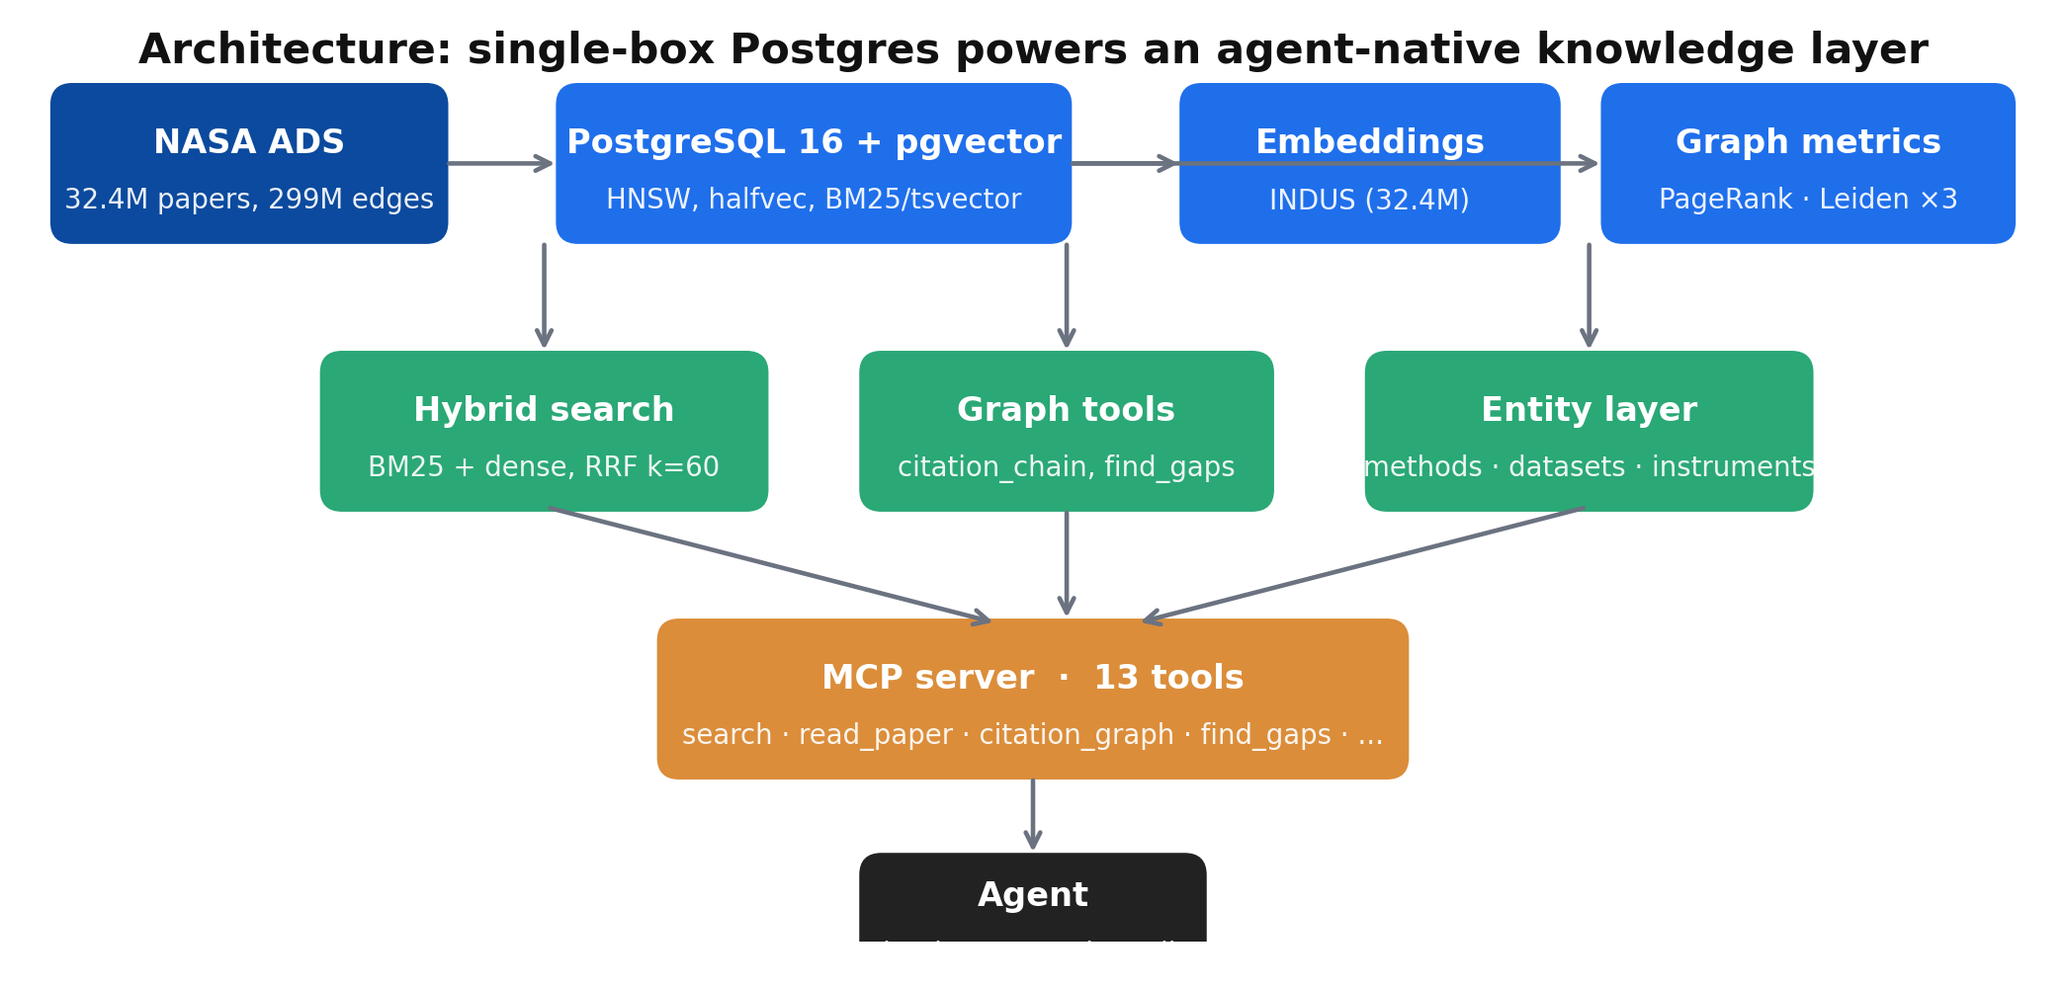
A working prototype: SciX on NASA ADS
32.4M papers, PostgreSQL + pgvector, single server, one MCP endpoint.
Deliberate simplicity: no separate vector DB, no orchestrator, no queue. Postgres + pgvector carries the corpus, the graph metrics, and the retrieval stack.
Stephanie Jarmak · MLOps Community · Making Scientific Knowledge Navigable for Agents
10 / 19

Slide 11
Two vector stores, two jobs
Pick the backend for the move — the agent only sees one MCP interface.
pgvector — the corpus
Qdrant — the recommendation move
· All 32.4M papers
· Pilot subset (top-N by PageRank) with rich payload
· Dense ANN via HNSW, joined with graph metrics and communities
· Multi-example recommendation: 'more like these, less like those'
· One SQL query composes retrieval + filters + PageRank
· Payload filters: year, doctype, community, arxiv class
· Good at: topical search, hybrid RRF, structural filters
· Good at: the one move pgvector can't cleanly do in SQL
One MCP tool surface (find_similar_by_examples). Two backends. The agent picks the move by name — not by where the vectors live.
Stephanie Jarmak · MLOps Community · Making Scientific Knowledge Navigable for Agents
11 / 19

Slide 12
Tool design for agent navigation of scientific literature
Principles from watching agents actually use these tools.
Fewer, composable tools > many specific tools
Return compact stubs, full text on request
Agent tool-selection accuracy degrades past a point. Prefer a small set of primitives the agent can combine over a catalog of bespoke endpoints.
bibcode · title · first_author · year · citation_count · snippet. Full paper only when the agent asks for it. Context is the scarcest resource.
Stable, typed schemas
Include provenance
JSON, no free-text fields that need parsing. Every response composes cleanly with whatever the agent does next.
Which tool returned this? Which query? The agent can reason about its own trail — and so can you, when you read the trace.
Cursor-based pagination
Idempotent reads, explicit side effects
Never return 10,000 bibcodes in one payload. Give the agent a cursor and let it ask for more if it needs more.
Same inputs → same outputs. Caching is trivial. Anything that writes state is called out in the tool name.
Stephanie Jarmak · MLOps Community · Making Scientific Knowledge Navigable for Agents
12 / 19

Slide 13
Unlocks: exploration modes you can't do with search alone
Each of these is a move an agent takes — not a UI the human drives.
Bridge papers between communities
Citation chains (what this claim depends on)
'Which papers are cited by both the exoplanet community and the atmospheric-chemistry community?' — a single structural query, not a month of hallway conversations.
Follow the chain of results the current paper rests on. Where does the chain terminate — a dataset? a theorem? an assumption someone flagged?
Co-citation and bibliographic coupling
Temporal evolution
Find papers that are read-alike (cited together) or reference-alike (share references). These are invisible-college detectors.
Which subfields are growing? Which are consolidating into review papers? Which had a flurry five years ago and went quiet?
Multi-lens community assignment
Three lenses — citation, semantic, taxonomic — and their disagreements are informative. A paper that's semantically central but citationally isolated is often an 'outsider with a good idea.'
Stephanie Jarmak · MLOps Community · Making Scientific Knowledge Navigable for Agents
13 / 19

Slide 14
Three community lenses — and their informative disagreements
Each lens has clean semantics. The agent picks the one that fits the question.
Citation
Semantic
Taxonomic
behavioral affinity
topical affinity
institutional affinity
· Leiden on the full citation graph
· k-means on INDUS embeddings
· arXiv class + UAT concepts
· Three resolutions: ~20 · ~200 · ~2000
· Three resolutions
· Hierarchical, human-curated
· Coverage: 62% of papers
· Coverage: 99% (all embedded)
· Coverage: ~8% (arXiv subset)
· 'Papers that cite each other'
· 'Papers with similar content'
· 'Papers in the same field'
· Finds invisible-college patterns
· Catches cross-citing subfields
· Sanity-check for the other two
A paper that's semantically central but citationally isolated is usually an outsider with a good idea — or a review the field hasn't caught up to.
Stephanie Jarmak · MLOps Community · Making Scientific Knowledge Navigable for Agents
14 / 19

Slide 15
Live demo
A research copilot maps the exoplanet-atmospheres landscape.
User prompt
'I'm preparing a grant on exoplanet atmospheric characterization. Map the research landscape — major subcommunities, foundational papers, recent bridges between communities, and what's worth reading first.'
Moves the copilot makes
1
search
broad hybrid hit on 'exoplanet atmospheric characterization'
2
graph_context
pull community assignments + PageRank for the top hits
3
citation_similarity
expand with co-citation bridges
4
temporal_evolution
see which communities are growing
5
find_gaps
bridge papers between working-set communities
6
read_paper
deep-dive on 3 foundational candidates
Stephanie Jarmak · MLOps Community · Making Scientific Knowledge Navigable for Agents
15 / 19

Slide 16
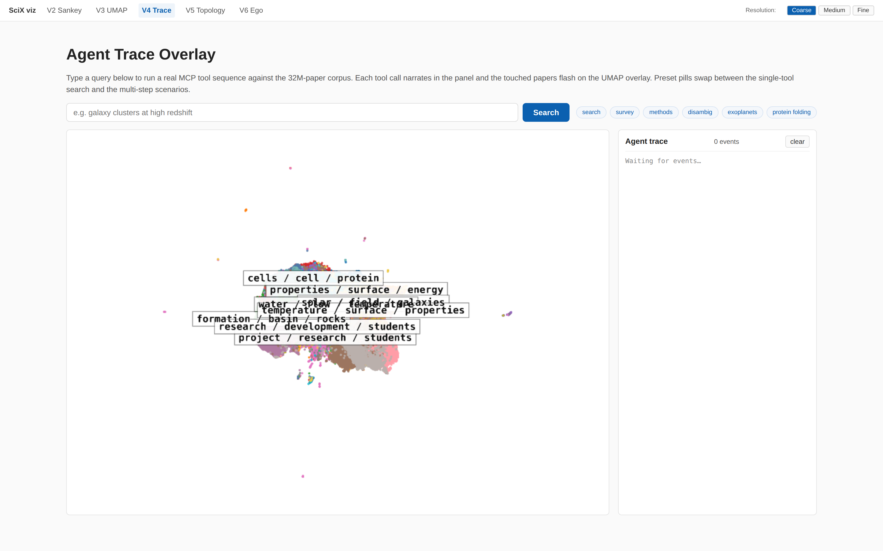
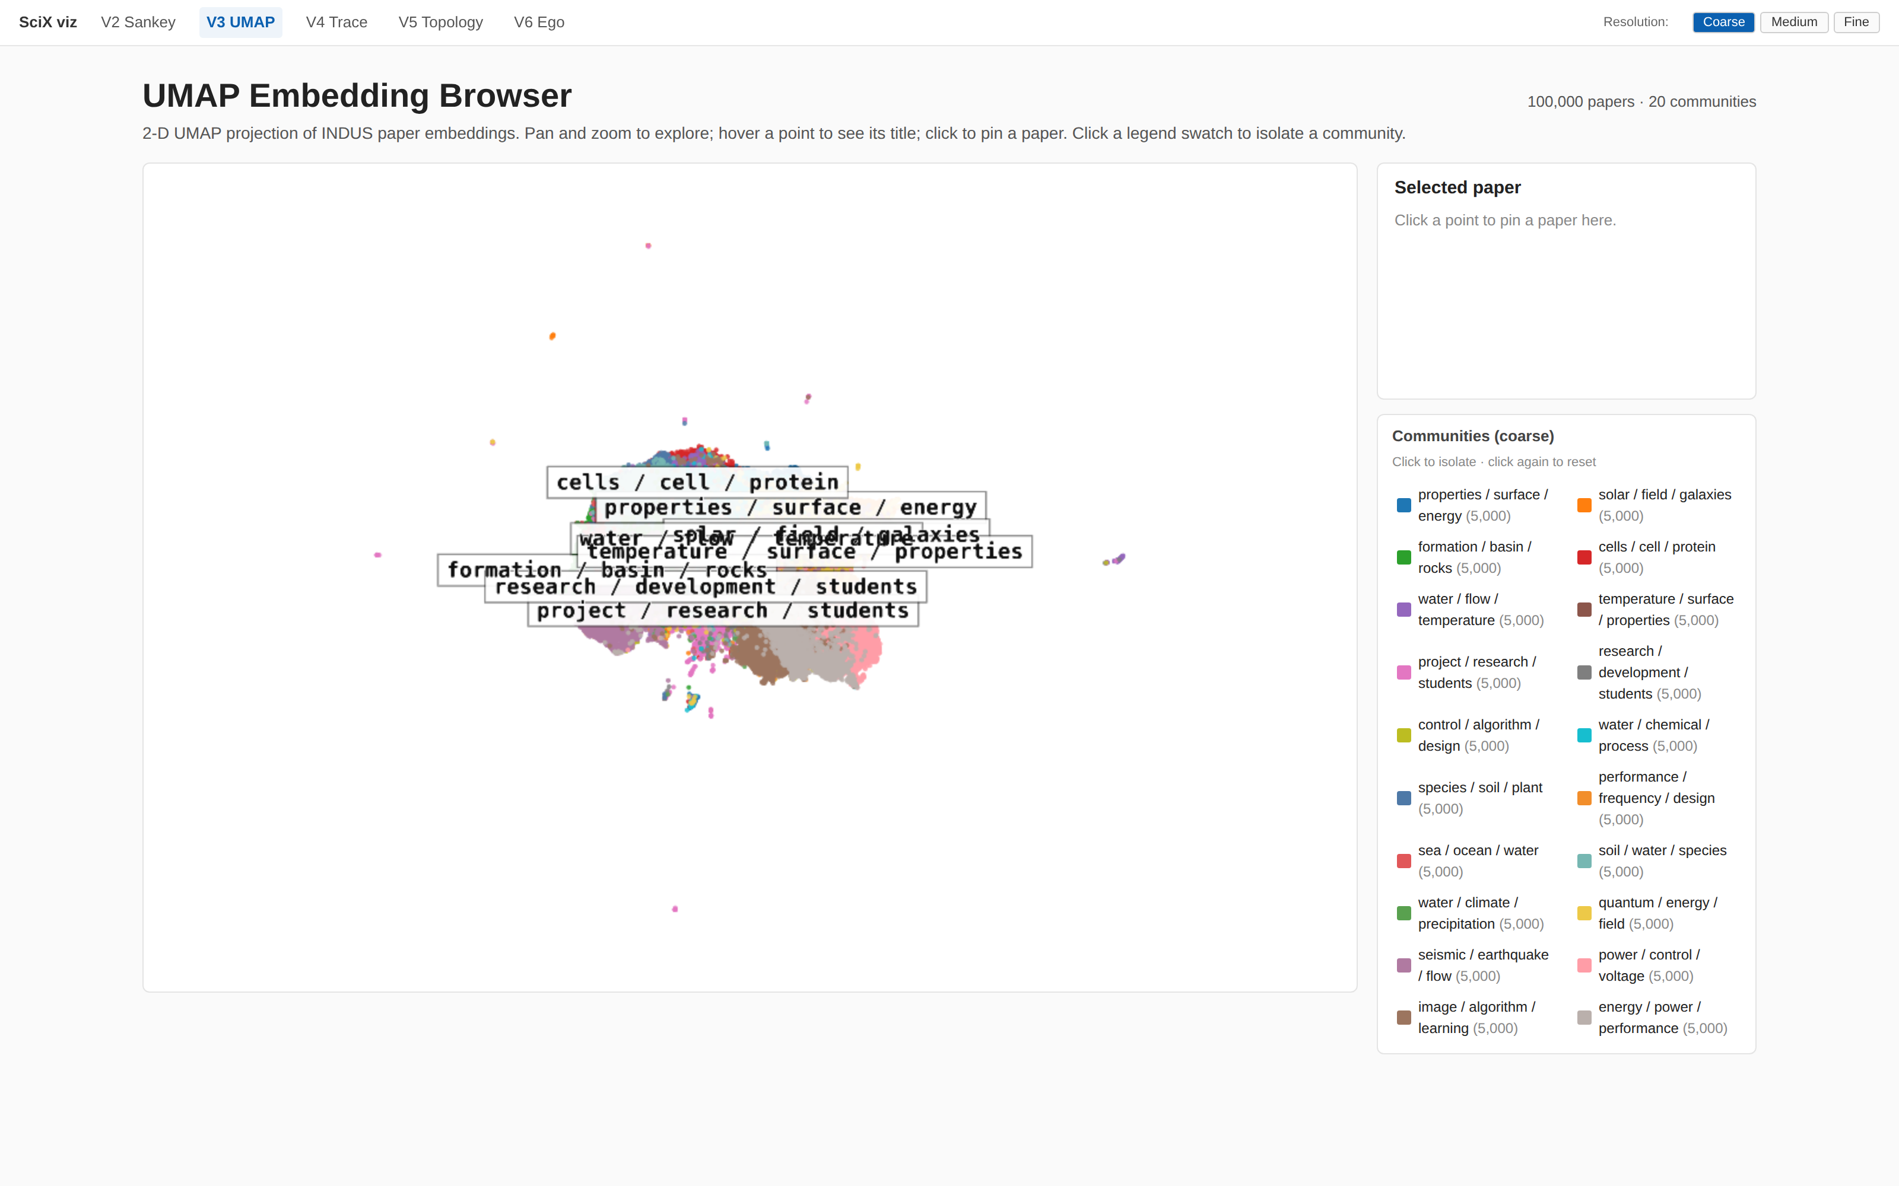
What the copilot sees while it works
Agent-trace overlay · UMAP of 32M INDUS embeddings.
These are the structural views an agent reasons over — not visually, but as graph edges, community IDs, and embedding coordinates.
Stephanie Jarmak · MLOps Community · Making Scientific Knowledge Navigable for Agents
16 / 19

Slide 17
What this means if you're using a research copilot
Most of you will be integrating one, not building the knowledge layer. The questions to ask are the same.
What does the corpus cover?
What moves does it support beyond search?
Full field or a rolling window? Do the graph metrics it returns mean what you think they mean?
Citation chains, co-citation, community bridges, temporal slices. If the only primitive is search, you have a faster librarian — not a navigation layer.
Does it return structured objects?
Can you trace what it consulted?
A bibcode, not a snippet. IDs compose; prose doesn't. Tools that return prose force the agent to parse its own context.
Every answer should come with the tool calls it made. This is how you trust it, debug it, and teach it.
How does it complement, not replace, your judgement?
Use it to expand the landscape and surface blind spots. Reserve peer review, interpretation, and prioritization for the human.
Stephanie Jarmak · MLOps Community · Making Scientific Knowledge Navigable for Agents
17 / 19

Slide 18
Takeaway
From search
→
to understanding
From retrieval
→
to navigable scientific context
From serendipity
→
to systems
Scientific knowledge gets more useful when we treat it like the system it already is — data, methods, results, code, claims — and let agents navigate the connections we've been leaving to chance.
Stephanie Jarmak · MLOps Community · Making Scientific Knowledge Navigable for Agents
18 / 19

Slide 19
Thank you
Questions?
Stephanie Jarmak
Sourcegraph · Harvard & Smithsonian | Center for Astrophysics
Resources
· Repository — github.com/sjarmak/scix-agent
· Live MCP endpoint — mcp.sjarmak.ai/mcp/ (local-only during workshop)
· Paper (ADASS 2026, preprint) — arXiv (pending)
· Contact — stephanie.jarmak1@gmail.com
Stephanie Jarmak · MLOps Community · Making Scientific Knowledge Navigable for Agents
19 / 19

