Slide 1
ICS370: Software Design Models Project: Binary Puzzles (aka Noughts and Crosses)
Siva Jasthi
Summer 2021

Slide 2
Binary Puzzles
Binary Puzzles (aka Noughts and Crosses)
http://www.clarity-media.co.uk/binary-puzzles.php
Watch this video
https://www.youtube.com/watch?v=TYnaFBjiwRM

Slide 3
Why is it called a Binary Puzzle?
Binary puzzles are played on a rectangular or square grid.
At the start of the puzzle, there are three possible states in which a cell can be: it can be empty, it can contain a zero, or it can contain a one.
In the completed puzzle, there are only two valid states: either a cell contains a 1 or a 0.
And hence the name of the puzzle: the Binary Puzzle.

Slide 4
Binary Puzzles - Rules
Basic Rule:
In a completed grid, there are certain rules that must be observed:
Repetition: no more than two cells in a row can contain the same number. Thus if there is a '1,1' then the cells either side must be '0'.
Equality: there must be an equal number of 0's and 1's in each row and column of the puzzle. Therefore there are the same number of 0's and 1's in the finished grid.
Advanced Rule:
There is also a popular variant on the basic binary puzzle, in which each row and column must be unique, thus if the row '101010' appeared in a 6 x 6 puzzle then no other row or column could be identical.

Slide 5
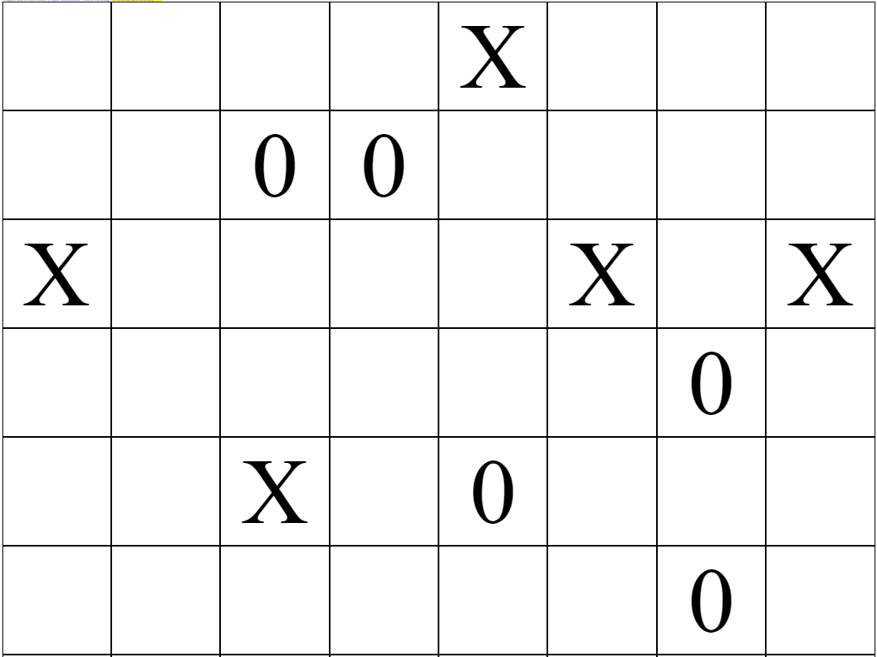
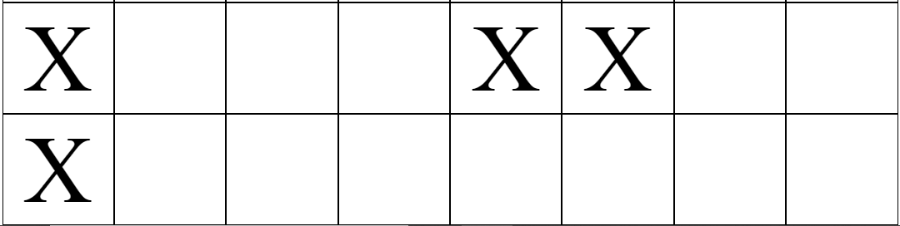
http://www.clarity-media.co.uk/online-puzzles/sample-noughts-and-crosses-puzzle.php

Slide 6
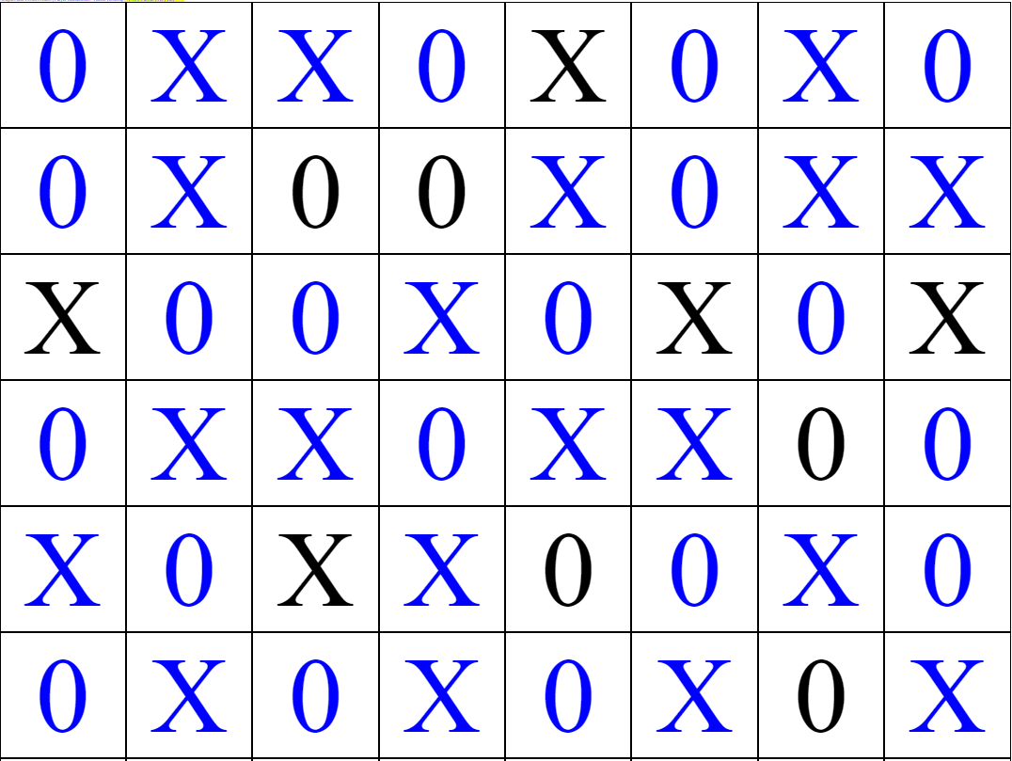
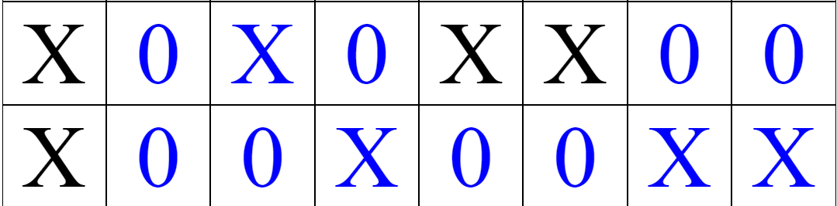
Noughts and Crosses: Final Solution

Slide 7
Scope for the “BinaryApp” – final project
[1] The grid can be square or rectangular. Width and Height can only be a even number
Default size: 8x8
Minimum width or height we support: 4
Maximum width or height we support: 16
[2] The placement characters are configurable:
Character Option: X, O
Number Option: 1,0
String Option: “Hi”, “Oh” (Default)
[3] How many cells are shown in the final puzzle? This number is also configurable.
Cell Count: 1/4th of the total number of cells (Default)
User Count: User can input an optional number
[4] Based on the above inputs, the “BinaryApp” generates a puzzle as well as solution.

Slide 8
Scope for the “BinaryApp” – final project
[5] The generated puzzle and solution are persisted in a database.
[6] The generated puzzle and solution are shown on HTML page, and the users can copy and paste these puzzles to the PPT slides.
[7] The puzzle and solution are also generated as Power Point slides through Java – PPTX integration.
[8] BinaryApp can pose/present a puzzle to the user.
[9] If user provides a solution grid in a string format, the application can validate whether it is a correct solution or not.
[10] (StretchGoal – not for this semester) BinaryApp puzzles are playable online.

Slide 9
Links
GITHUB: https://github.com/sjasthi/BinaryApp
Trello:

