Slide 1

Introduction to ICS325
(Internet Application Development)
Siva R Jasthi
ICS325 – Internet Application Development

Slide 2

Internet Applications
If you access something over a browser, that is an internet application.

Slide 3
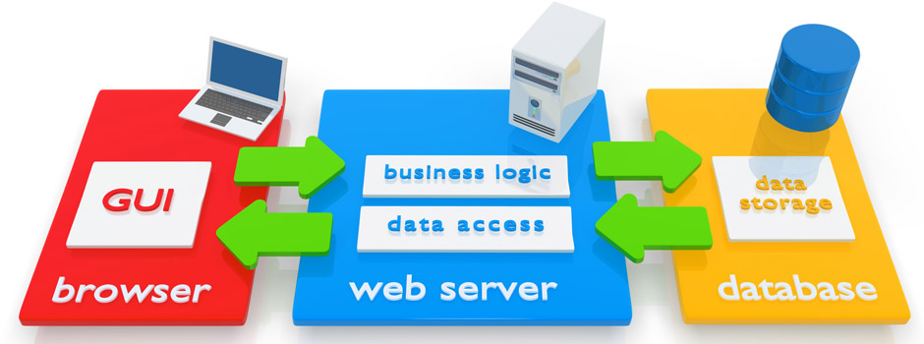
Web Application
How do I get a local Web Server on my desktop?
Mimicking a remote web server (which we typically get from BlueHost or GoDaddy or Hostgator).
Source: https://vtechsolution.com/wp-content/uploads/2014/05/web-application-development.jpg

Slide 4
Client Technologies
HTML
CSS
BootStrap Templates
JavaScript Basics
JQuery Usage
AJAX Basics
Chrome Developer Tools
moqups.com – wire framing / visual design tool for webapps
Open Source : A ton of useful libraries

Slide 5
Server Technologies
PHP Basics
PHP - As a Programming Language
PHP - As Object Oriented Programming Language
PHP - MySQL interaction
PHP - HTML / Client interaction
PHP – Tools
PHP - Libraries
Traditional Stack:
1. Front End: HTML/CSS/JavaScript/Jquery
2. Server: PHP
3. Back End: MySQL
Advanced / Latest:
Front End: React
Server: Python / FastAPI
Back end: MySQL
Front End (GUI) + Server + Back end = Full Stack

Slide 6
MySQL (Databases)
Database Concepts
DB Modelling - Normalization, Structure, Keys, Relationships, Indexing
MyPhpAdmin in XAMPP (Visualization of your DB)
CRUD of Database and Tables
Import/Export Operations
Designer/Visualizing the DB Schema
SQL - language of the DBMS

Slide 7
Web Application: Integrating all the stacks
Session Control in Web Applications
Security, Authentication and Authorization in Web Applications
Designing for Performance and Scalability
What are we building? Final Project

Slide 8
Course Outline
Prerequisites
HTML / CSS / JavaScript (ICS225)
Java Programming Language (ICS140)
OO A/D – OO principles, patterns (ICS141)
We learn about
PHP as a programing language
MySQL for persisting the data
PHP and MySQL integration
Applying PHP and MySQL for building web applications

Slide 9
Today’s Objectives
What are Internet applications?
What is a web server?
What is PHP?
What is MySQL?
What is XAMPP?
Other technologies (HTML, CSS, JavaScript)

Slide 10
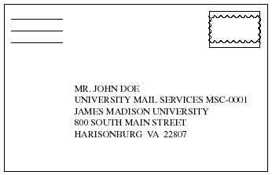
What is URL?
URL Defined
A Uniform Resource Locator (URL) is a standard way developed to specify the location of a resource available electronically.

Slide 11
URL Syntax and Examples
General URL syntax
<scheme>:<scheme-dependent-information>
Scheme examples:
http
https
ftp
news

Slide 12
URL Example
http://www.metrostate.edu/msweb/explore/catalog/course_desc/index.cfm
This request is for a Web (http) server
The server program is running on a computer with the domain name www.metrostate.edu
Look in a subdirectory called msweb/explore/catalog/course_desc
If there is a file called index.cfm, send it back to the client to be displayed
Notes:
Here we summarize the meaning of the four parts of a URL. In addition to learning about the parts of a URL, we saw that they may be shortened using a service like Bit.ly and that some parts of the URL were optional.

Slide 13

XAMPP
X (Linux, Windows, ios, Solaris, etc.)
A (Apache – Web Server)
M (MySQL – Database)
P (PHP – Server side scripting language)
P (Perl – Scripting Language)
Can you guess what these stand for?
LAMP
WAMP

Slide 14
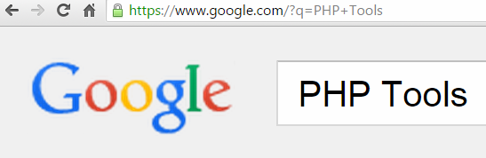

URL Parameters
URL_Parameters are parameters whose values are set dynamically in a page's URL, and can be accessed by its template and its data sources. This makes pages incredibly dynamic, enabling a single page to power an endless number of views.
Notes:
Here we summarize the meaning of the four parts of a URL. In addition to learning about the parts of a URL, we saw that they may be shortened using a service like Bit.ly and that some parts of the URL were optional.

Slide 15
What is HTML?
Elements (tags) for structure and Attributes
Block and Inline Comments
General element categories
Structure
Formatting
Tables
Images
Links
Forms
Notes:
Here we summarize the meaning of the four parts of a URL. In addition to learning about the parts of a URL, we saw that they may be shortened using a service like Bit.ly and that some parts of the URL were optional.

Slide 16
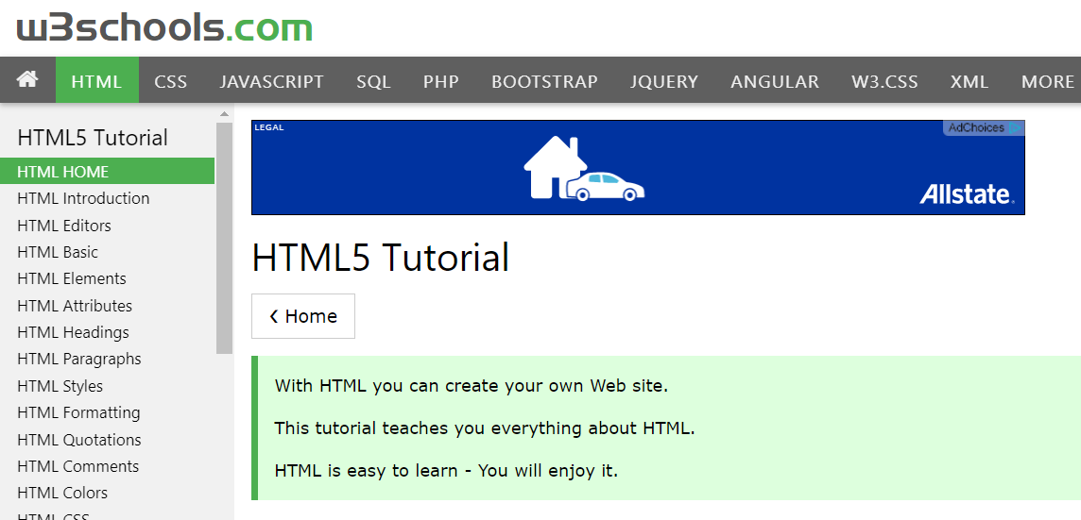
W3school.com HTML is a good resource

Slide 17
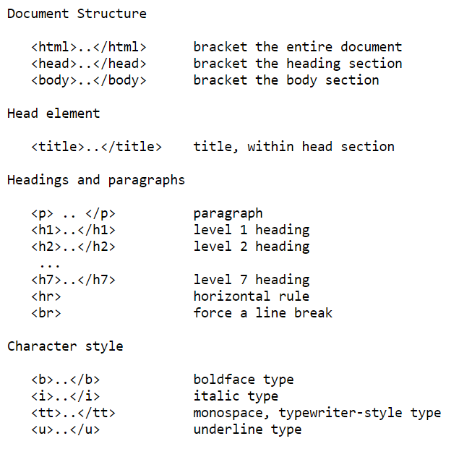
Basic Tags in HTML

Slide 18
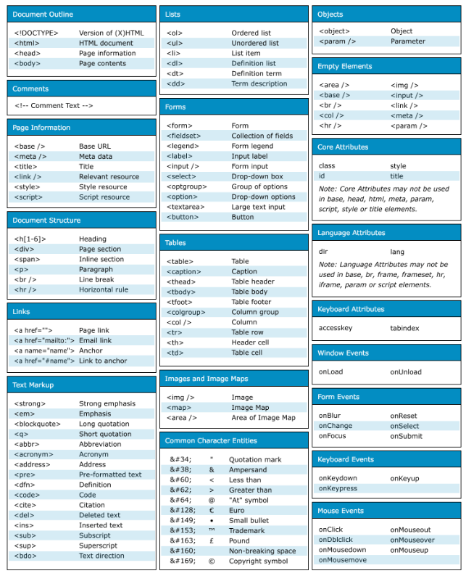
HTML all Tags

Slide 19
HTML Forms Review
Input Type | Attribute | Description
button | name | Generic button with no default action.
text | name, size, maxlength | Text box of given size, with up to maxlength characters allowed.
textarea | name, size, rows,cols | Text area that can take input spanning multiple lines. Size given using [rows, cols].
password | name, value | Text box but input is hidden.
checkbox | name, value | Creates name/value pairs from user input.
radio | name, value | Like checkboxes, except only one button can be checked.
select | name, size, multiple | Drop down and scrollable lists. size defines number of visible elements. Only one can be selected unless multiple specified. Z
file | name | File to be uploaded to server. MIME type is multipart/form-data.
hidden | name, value | Name/value pair without displaying an object on the screen.
submit | name, value | Button that submits the form to the server program.
image | src, value, align | Same as submit button, but displays an image instead of text.
reset | name, value | Clears all input fields.

Slide 20
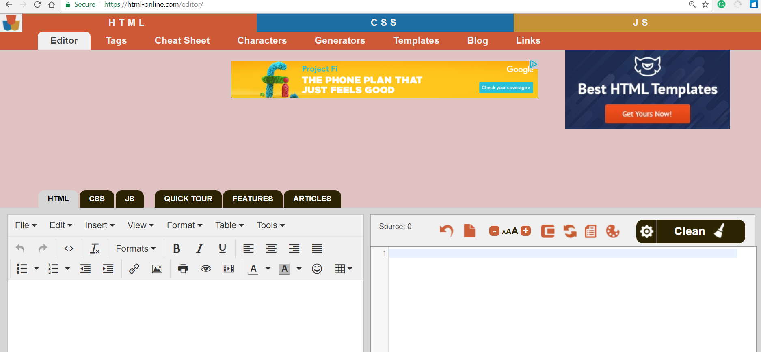
https://html-online.com/editor/

Slide 21
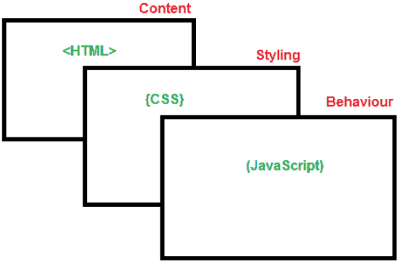
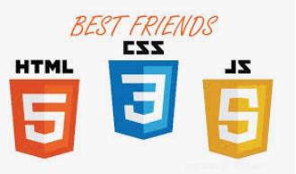
Cascading Stylesheets (CSS)
Problem: Structure & content intertwined with format
CSS separates styling from structure.
Style rules
HTML + CSS → Broswer rendering engine
HTML, CSS, JavaScript are three BFFs
HTML provides the content.
CSS gives the styling.
JavaScript enables the interatction.

Slide 22
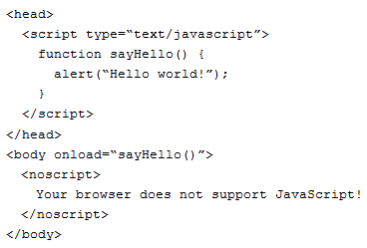

JavaScript and the DOM
Background
LiveScript by Brendan Eich at Netscape (1995)
Executed by an interpreter built into the browser
Cannot perform file I/O or screen painting
Adding script
Inline
External file

Slide 23
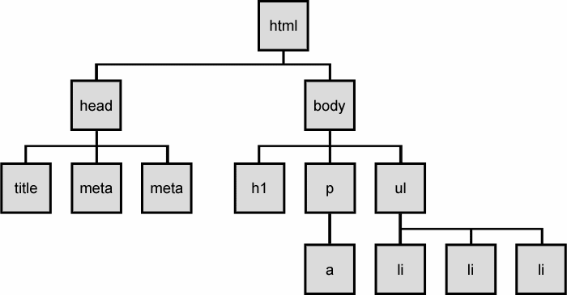
HTML Document Object Model (DOM) tree

Slide 24

jQuery – JavaScript Framework
jQuery is a cross-platform JavaScript library designed to simplify the client-side scripting of HTML.
Identification: how do I obtain a reference to the node that I want.
Traversal: how do I move around the DOM tree.
Node Manipulation: how do I get or set aspects of a DOM node.
Tree Manipulation: how do I change the structure of the page.

Slide 25
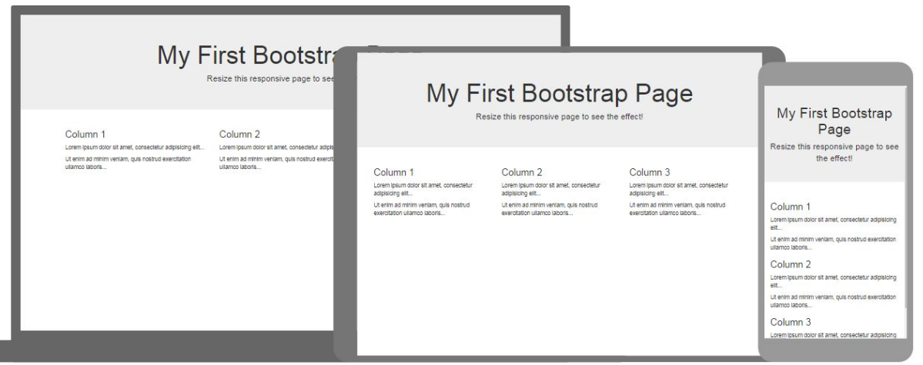
Bootstrap – HTML
Bootstrap is the most popular HTML, CSS, and JavaScript framework for developing responsive, mobile-first web sites.

Slide 26
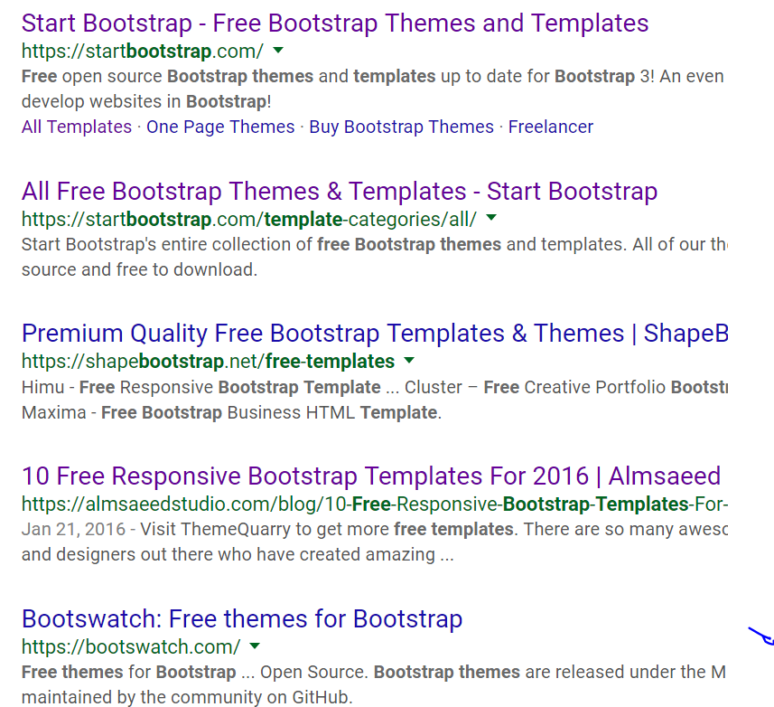
Bootstrap – Themes
Many free open source themes

Slide 27
What is PHP?
PHP is a server side scripting language.
There are other server side scripting available like ASP, JSP...
PHP involves
simplicity in scripting
platform independence.
PHP is
primarily designed for web applications
well optimized for the response times needed for web applications
Is an open source.

Slide 28
PHP Overview
PHP Hypertext Preprocessor.
Other Names : Personal Home Page, Professional Home Page
PHP is a server-side scripting language whose scripts are embedded in HTML documents
Is a server side scripting language.
Capable of generating the HTML pages
HTML generates the web page with the static text and images.
The need for dynamic web pages resulted in XAMPP stack.

Slide 29
PHP Development Environment
Edit → Compile → Run Cycle (eg: Java)
Edit → Host / Deploy → Access (eg: PHP)
What is the editor?
Where do I host?
How do I access?
How do these run?

Slide 30
A la carte – on your own
Install a Web server
http://httpd.apache.org/
Install PHP
http://www.php.net/downloads.php
Install MySQL
http://dev.mysql.com/downloads/
Portable WAMP server
http://www.uniformserver.com/
Any IDE or editor:
SublimeText, NetBeans, Eclipse

Slide 31
Packaged Sandboxes
XAMPP: is a very easy to install package for (Linux-Windows- Apple). http://www.apachefriends.org/
Apache, MySQL, PHP, Perl, and many more.
WampServer will install Apache, PHP5 and MySQL on your Windows.
http://www.wampserver.com/
ZendFramework:
the most popular framework for modern, high performance php application. (http://www.zend.com/)

Slide 32
What do we do in this course?
VisualCode or SublimeText or Notepad+ or Eclipse or other IDE: For writing PHP programs
XAMPP: We will start with this to host our programs in development
Once everything is working great in the sandboxed / development environment, we will host these on metrostate linux server to try these out

Slide 33
Common Problems you may encounter during the installation of XAMPP
[1] Instead of accepting the default user name (root) and password (empty password), you over thake the user name and password. Then you forgot about what you selected.
Solution: Till you master the configuration of XAMPP, simply accept the defaults during the installation.
[2] Other applications you have on your machine are conflicting with XAMPP while accessing the available PORTs.
By default, APACE listens to 8080 (port 80), 443 (SSL). And MySQL listens to 3306.
If any of the other applications are accessing the same ports, then XAMPP will not start. So, you need to change these values in the configuration files.
This reference will be useful in identifying the configuration files.
http://webdevzoom.com/install-run-multiple-xampp-windows/

Slide 34
Summary
Be familiar with the web technologies
Ensure that you have the development environment to develop PHP/MySQL applications
Use the right set of tools to ensure that you are productive
Visit w3schools.com for basics and go through HTML, JavaScript outline for the prerequisites.

