Slide 1

Ch.05
Reusing Code and
Writing Functions
Siva R Jasthi
ICS325 – Unrestrictedet Application Development
Information and Computer Sciences
Metropolitan State University

Slide 2
Outline
Advantages of reusing code
Using require( ) and include( )
Introducing functions
Defining functions
Using parameters
Understanding scope
Returning values
Calling by references versus by value
Implementing recursion
Using namespaces

Slide 3
Code Reuse
Cost of maintaining software will go down
Reliability of the software will go up
Consistency of the software will go up.
Functions (Functional programming / Structured Programming / Object Oriented Programming – in all paradigms) come to our rescue for code reuse.

Slide 4
What can be reused?
Any file content
PHP snippets / functions
HTML Snippets
HTML Headers
HTML Footers
Scripts
Text
PHP Classes
CSS Definitions
You use include( ) and require( ) constructs to reuse the content.
When mergers and acquisistions happen, changing one header and footer will change the entire look and feel of the entire system.

Slide 5
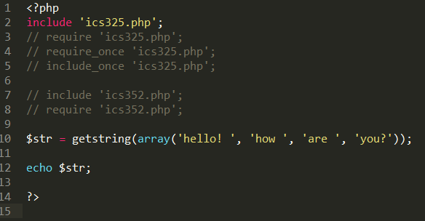
Reuse Mechanisms: require( ) and include( )
include( ) gives a warning if the included file doesn’t exist
Require( ) gives a fatal error under the same condition.
include_once and require_once() includes the file only once (even if you keep the same statement by mistake or recursively in each of the files)

Slide 6
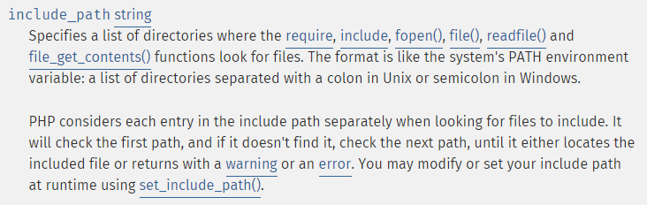
Naming and Location Considerations
Extension is not validated when files are included.
PHP code will be executed even if extension is .inc
By convention, use .inc or .php extension
You can keep the files in any directory;
include_path configuration as well set_include_path( ) methods will tell PHP where to look

Slide 7
What is a Function?
Self contained module with
a prescribed interface (the prototype)
Eg: see next slide for “explode” function details
a defined responsibility
a possible return value
Function Names
only letters, digits, underscores;
cannot begin with digit
case insensitive (echo, eCho, Echo, ECHO – all are same)
use all lowercase (convention)
no function overloading

Slide 8
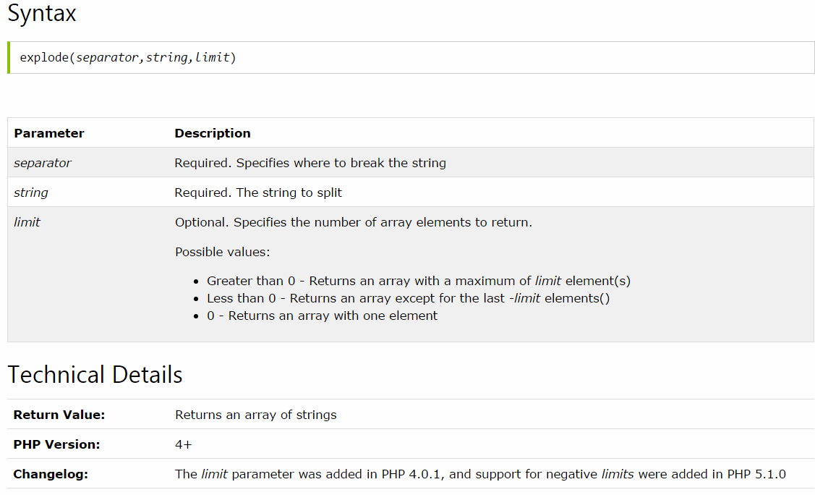
Function is a a prescribed interface (the prototype)

Slide 9
Visibility of the functions
A function will not execute immediately when a page loads.
A function will be executed by a call to the function.
Built-in functions are visible everywhere
Custom functions are visible only to scripts
where they are declared.
Where they are included.

Slide 10
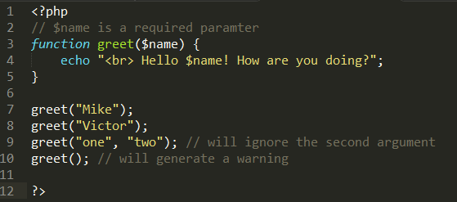
Functions: Required Parameters
Required Parameters
Functions can accept any number / type of arguments.
Each argument is separated by a comma.
When the function is called, it should supply all the required parameters. Otherwise, it will be a warning.
When additional / extra parameters are passed to the function, those will be ignored.

Slide 11
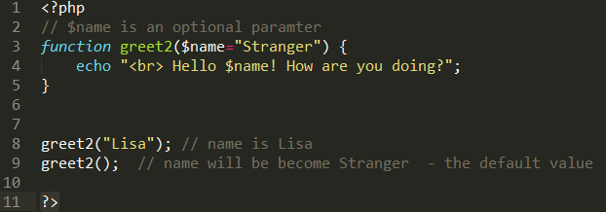
Functions: Optional Parameters
Optional Parameters
Functions can define default values to some arguments
Such arguments can be optional for the callers.
If callers supply the parameters, function uses those. If those are missing, default values will be used.
The evaluation / binding of the arguments is from left to right.
Any additional parameters will be ignored.

Slide 12
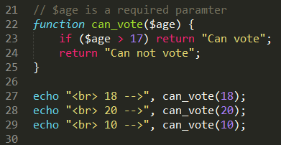
Functions: Return Parameters
Return Arguments
Functions can return values
Functions can have multiple return statements (usually included in the conditional statements).
Execution of a function terminates when it comes across the first “return” statement.
Function may decide not to return anything (all the statements will get executed and the caller will not get anything back).

Slide 13
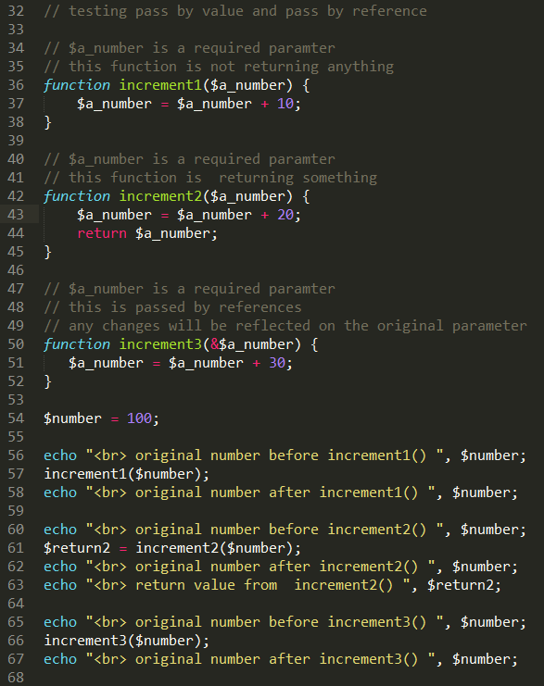
Pass By Value (default behavior) Pass By Reference (prefex &)
PASS BY VALUE
By default, all arguments are passed by value.
That is .. A copy of the argument is passed to the function.
Any changes done to that parameter inside the function does NOT impact the original parameter.
PASS BY REFERENCE
When it is required to pass an argument by reference, simply prefix & before the argument name.
& indicates that the argument is passed by reference.
Any changes within the function reflect on the original argument.

Slide 14
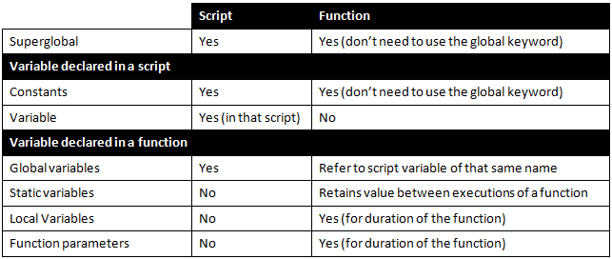
Scope of a Variable
Yes, you need to use the global keyword

Slide 15
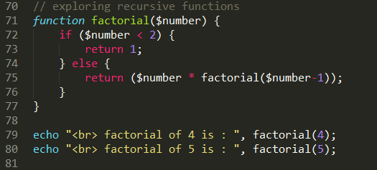
Recursion in PHP
Recursive functions are supported in PHP
An example is given below (in general, iteration wins over recursion; That is.. Recursion should be avoided when possible)

Slide 16
Namespaces
Similar to packages in Java.
Helps to avoid the conflicts between the class names (classes within different name spaces can have the same name).
Also helps to organize the classes into hierarchal directory structure.
Helps to assign ownerships based on the directory structure.
Namespaces can be referred to by default / current path, by absolute path, by relative path (just like referring to a file name)

Slide 17
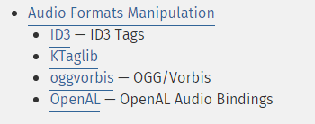
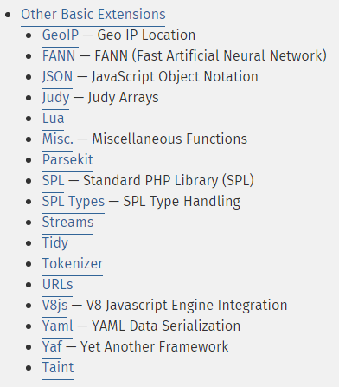
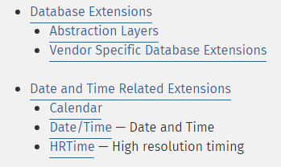
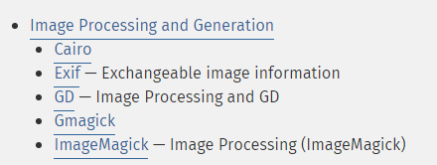
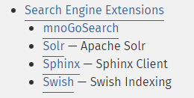
Function References

Slide 18

Summary
Don’t put everything in one huge, monolithic block of code. Think of functions.
PHP and its extensions offers a large number of functions. Use those first before you invent your own.
Leverage require( ) and include( ) constructs to organize your code.

Slide 19
References
PHP Function Reference / Libraries
http://php.net/manual/en/funcref.php
Variable Functions:
http://php.net/manual/en/functions.variable-functions.php
W3 Schools
http://www.w3schools.com/php/php_functions.asp
Namespaces
http://daylerees.com/php-namespaces-explained/

