Slide 1



GitHub
For
Desktop
Siva R Jasthi
Community Faculty
Computer Sciences and Cyber Security
Metropolitan State University

Slide 2
Outline
[1] What is GIT?
[2] What is GitHub?
[3] Wat is GitHub For Desktop?
[4] Using GitHub for Solo Projects
[5] Using GitHub for Group Projects

Slide 3
[1] What is Git?
Git
Git is a Version Control System (VCS).
We use it to track and control changes to source code, configuration files, and documentation.
You can check the history of changes over time.
You can revert back to a previous version if needed.
You can use it solo, but it is particularly useful when working in a team.
Git stores the history of changes in a database called repository.
(repository = folder of source files + .git subdirectory created by Git to story the history)

Slide 4
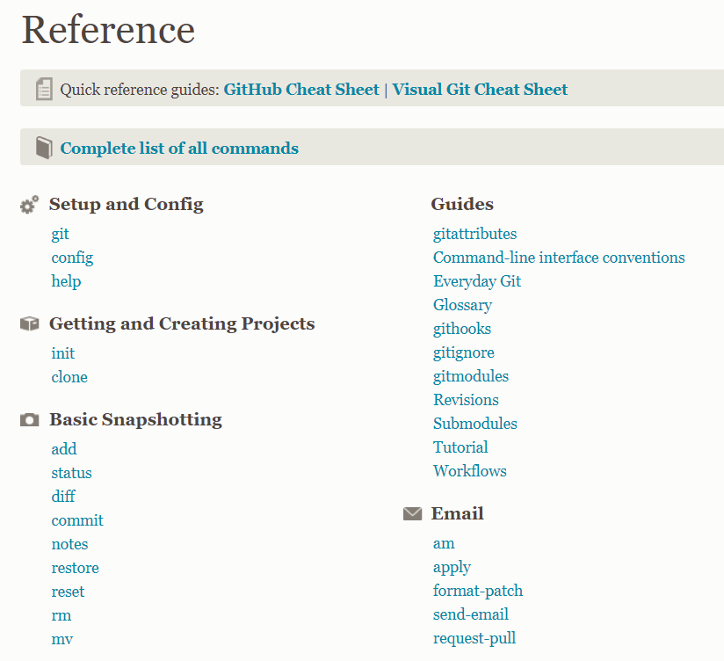
Git - Reference
Git Reference
https://git-scm.com/docs
Visual Git
https://ndpsoftware.com/git-cheatsheet.html

Slide 5
[2] What is GitHub?
GitHub
Don’t we need a place to host our local repositories to collaborate with others?
GitHub is such a place: it is a hosting service for Git repositories on the internet.
And it is free to use for open source projects (which are public. All others can see your code).
GitHub is also social networking site for developers.

Slide 6
[3] What is GitHub Desktop?
GitHub Desktop
The client application provides a GUI (Graphical User Interface) front-end to the most common git commands.
GitHub Desktop simplifies the development workflows and tasks.

Slide 7
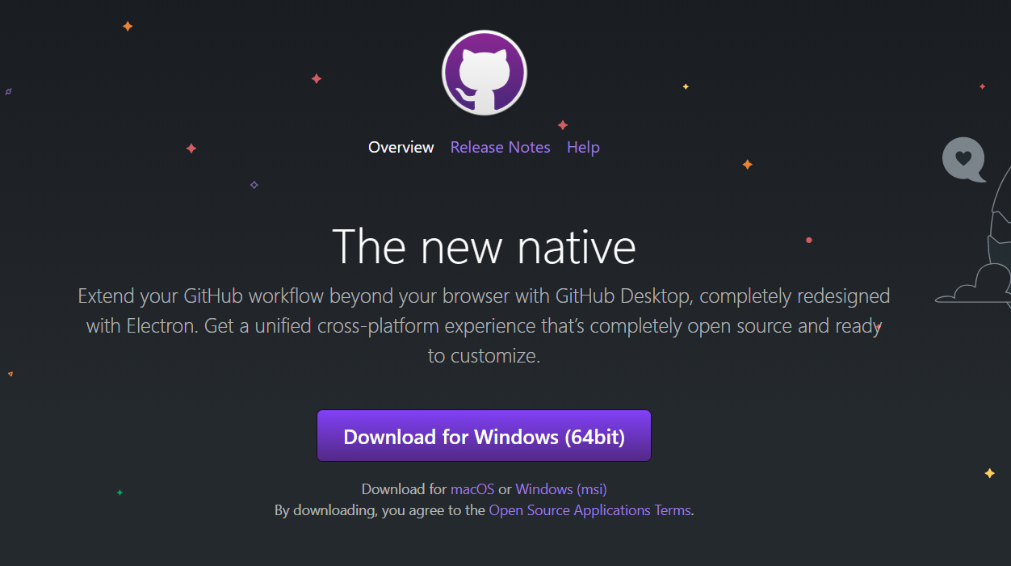
Download GitHub Desktop Client from this link
https://desktop.github.com/

Slide 8
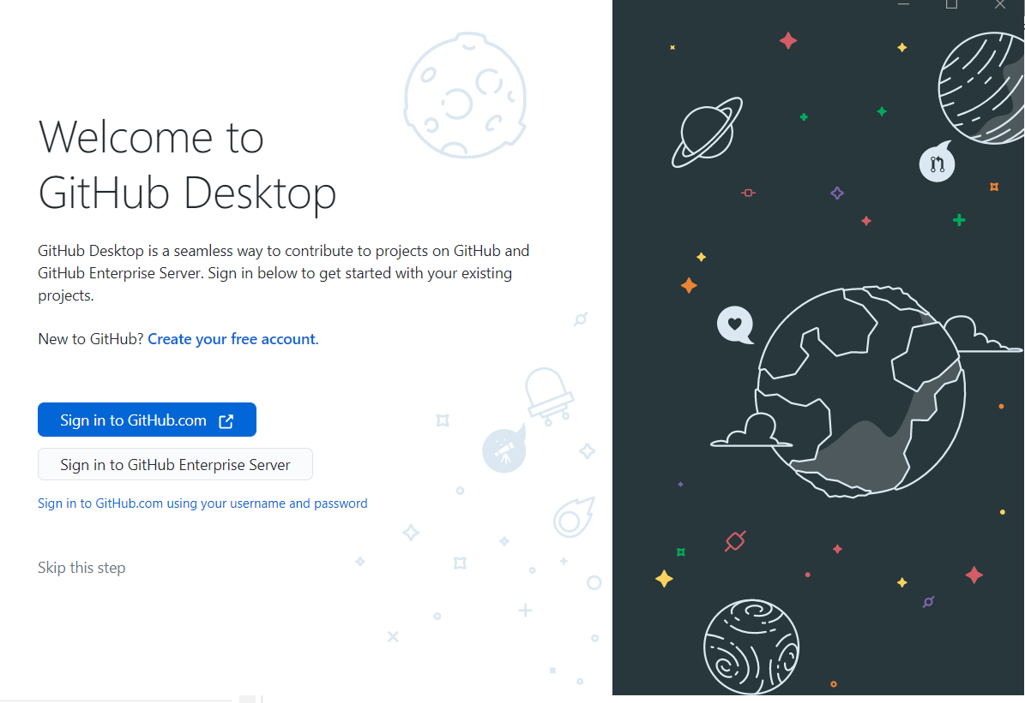

Slide 9
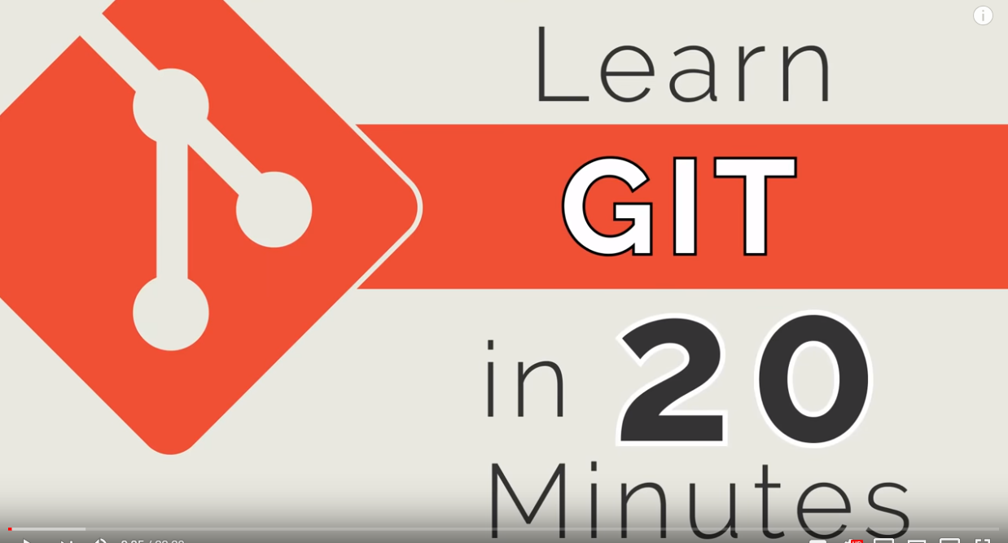
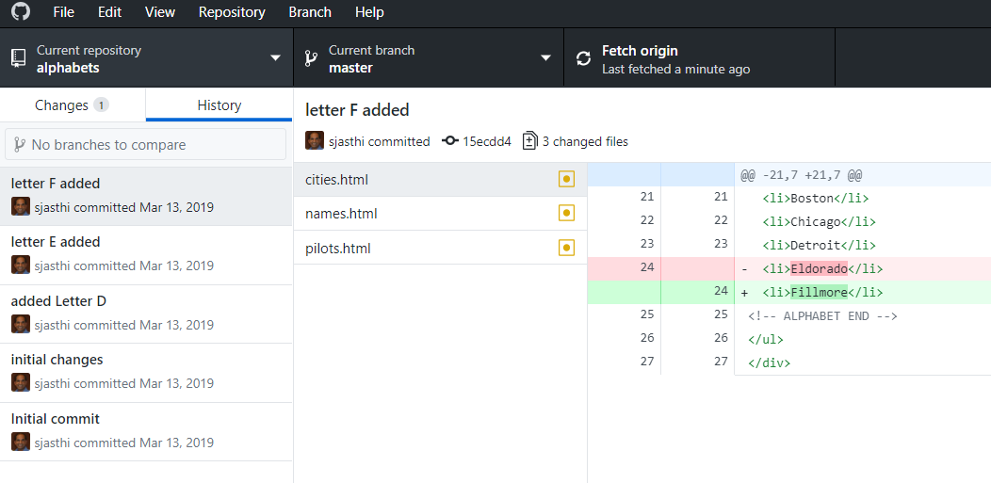
GitHub for Desktop
Learn Git in 20 minutes
https://www.youtube.com/watch?v=IHaTbJPdB-s
GitHub for Desktop
http://desktop.github.com (download)
https://www.youtube.com/watch?v=77W2JSL7-r8

Slide 10
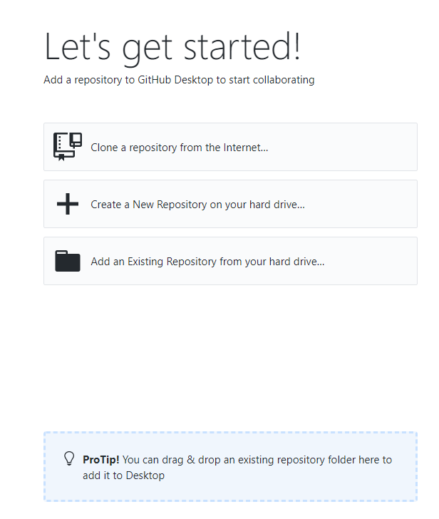
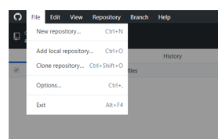
Three ways of creating a Repository

Slide 11
Three ways of creating a Repository
What to do? | Option
You already have a repository on github.com You want to clone that to a local directory on your desktop | Clone a Repository from the internet..
You have an application (or directory) on your local machine. And you want to make it as a git repository. You will also get an opportunity to push it to github.com once you make it as a git repository. | Create new repository on your hard drive..
If you already have a repository locally (*), then you can add it to make it visible in GitHub Desktop. * You may have temporarily removed it from GitHub Desktop to reduce the clutter. | Add an existing repository from your hard drive..

Slide 12
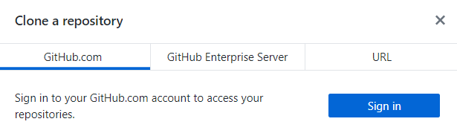
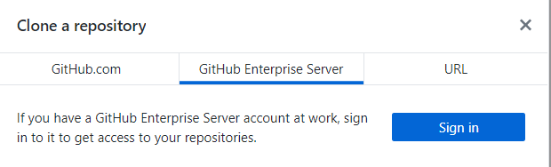
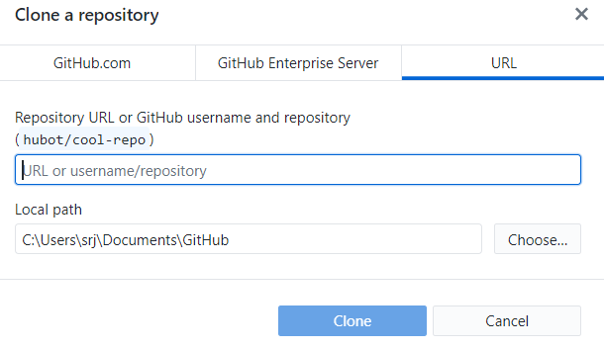
[1] Create a Repository from Internet
For PHP applications, your local directory will be in your “xampp/htdocs” directory

Slide 13
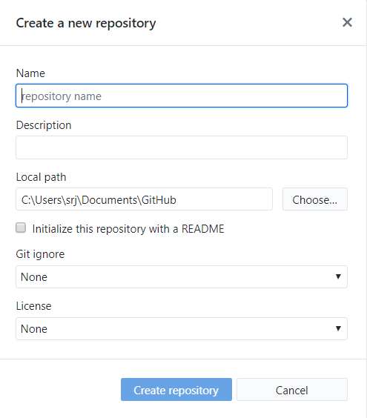
[2] Create a new Repository on your Hard Drive

Slide 14
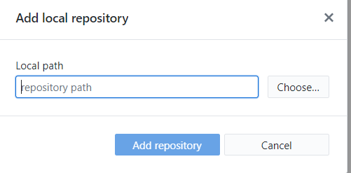
[3] Add an existing Repository from your Hard Drive

Slide 15
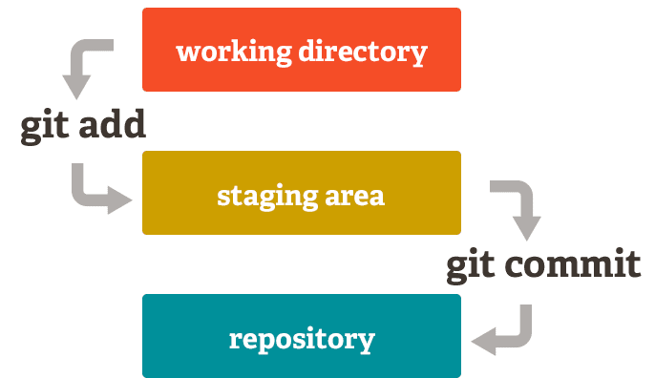
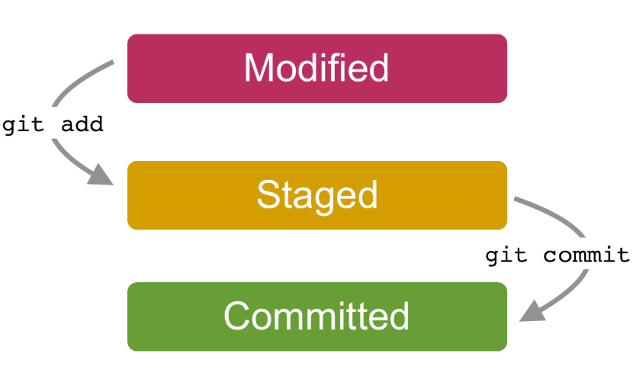
Concept: Staging vs Committing

Slide 16
Doing solo projects
Workflow 1:
Create a Repository on GitHub (github.com)
a. Either from scratch
b. Or through a fork
Clone it in GitHub4Desktop
Make Changes → Commit → Push
Workflow 2:
Create a Repository on your local desktop
Make Changes → Commit
Push the changes to github.com

Slide 17
Doing group projects
Workflow:
Access a project (master repository) on GitHub
Fork the project (it creates a local copy on GitHub under your account)
Clone your copy (it creates a local copy on your desktop for you to make further changes)
Make changes in your local copy
Commit your changes to the local copy
Push your changes to github (still your own copy)
Create a Pull Request
(Project Owner) processes the Pull Request
(As needed) sync up with the Master Repository

Slide 18
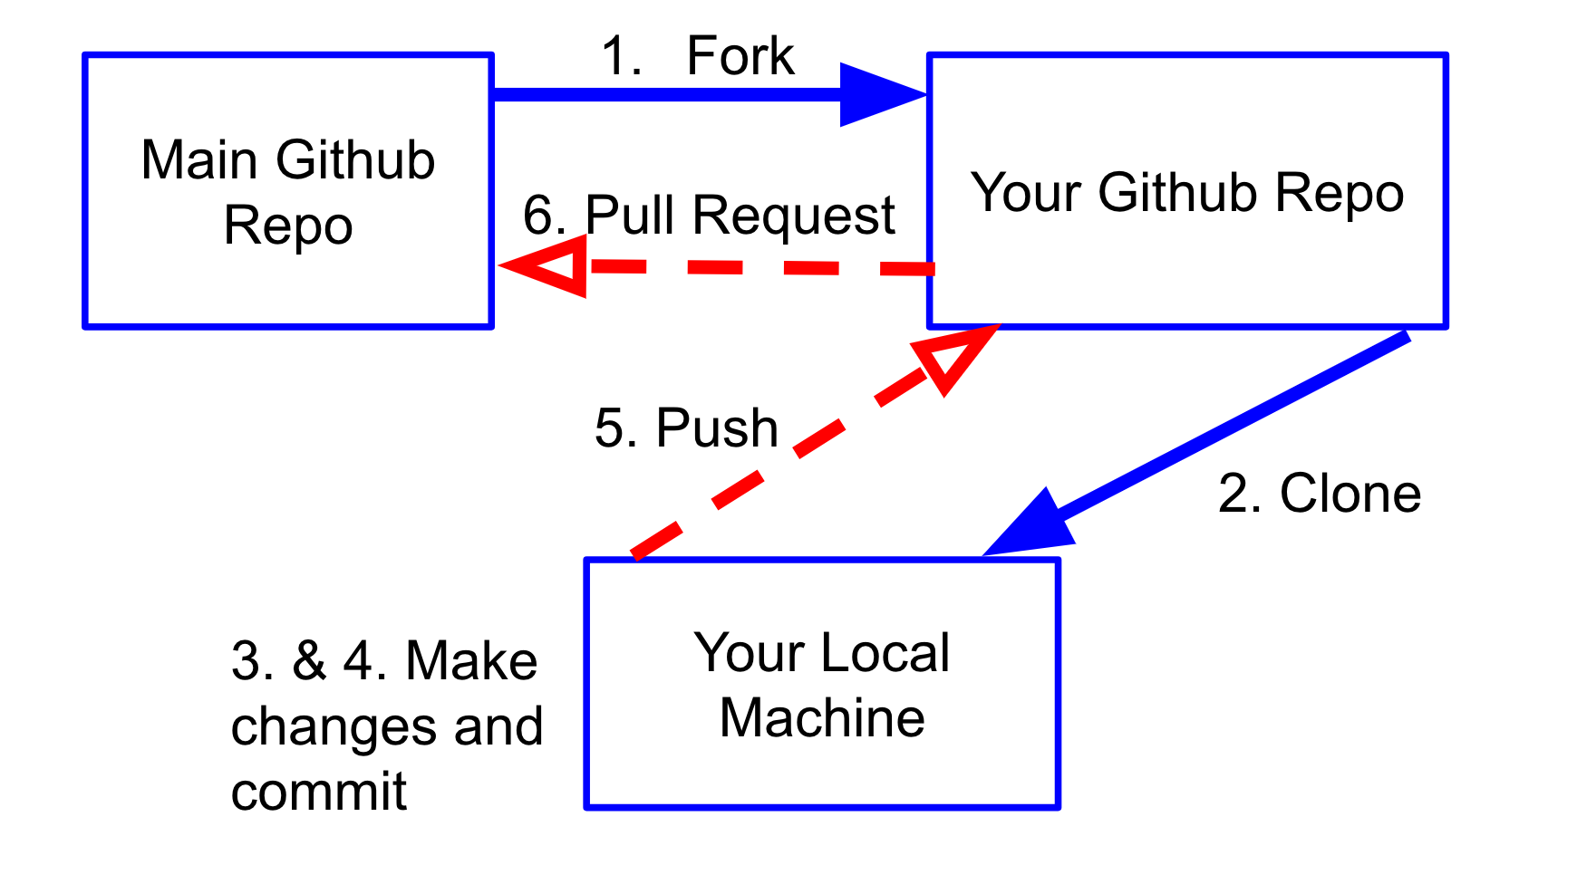
Fork, Clone, Push, Pull request, pull, fetch, merge

Slide 19
Fork, Clone, Push, Pull request, pull, fetch, merge

Slide 20
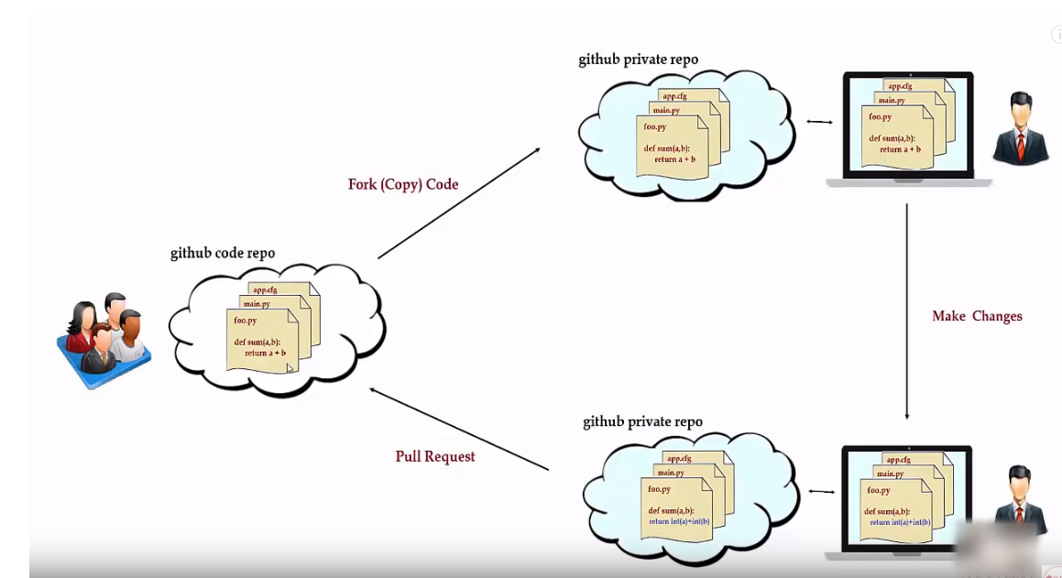
Pull Request (video)

Slide 21
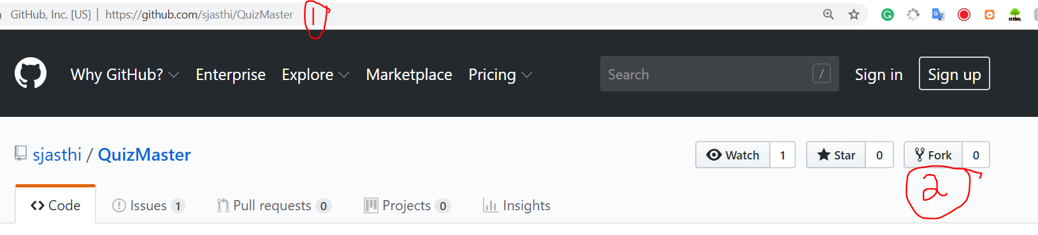
Forking a Repository (on GitHub)
Cloning a Repository (to local machine)
Ensure that you are logged in to GitHub.
Otherwise, FORK will not be available to you.

Slide 22
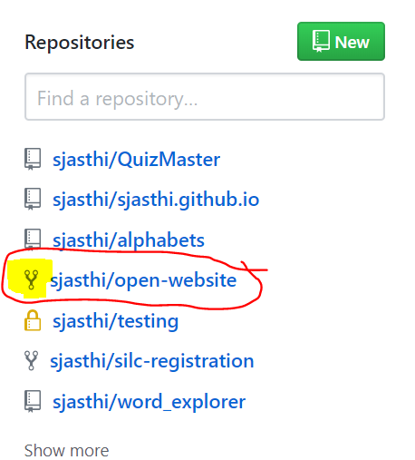
List of repositories
Fork icon indicates that it is forked

Slide 23
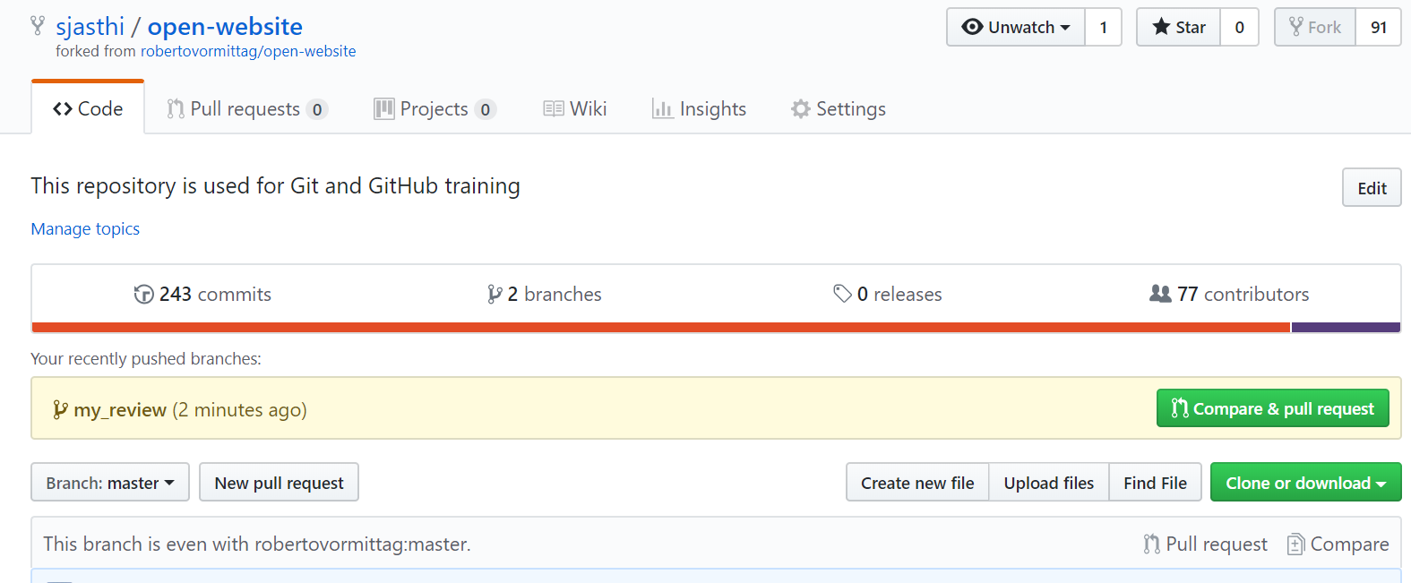
Creating a new pull request
(From Project Contributor to Project Owner)

Slide 24
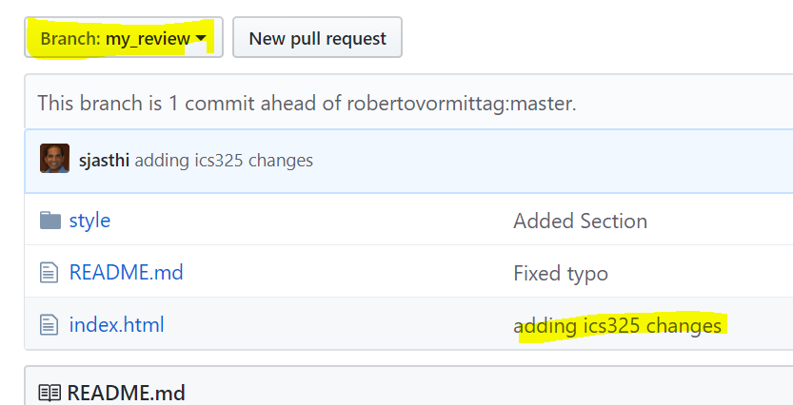
Creating a new pull request
(From Project Contributor to Project Owner)

Slide 25
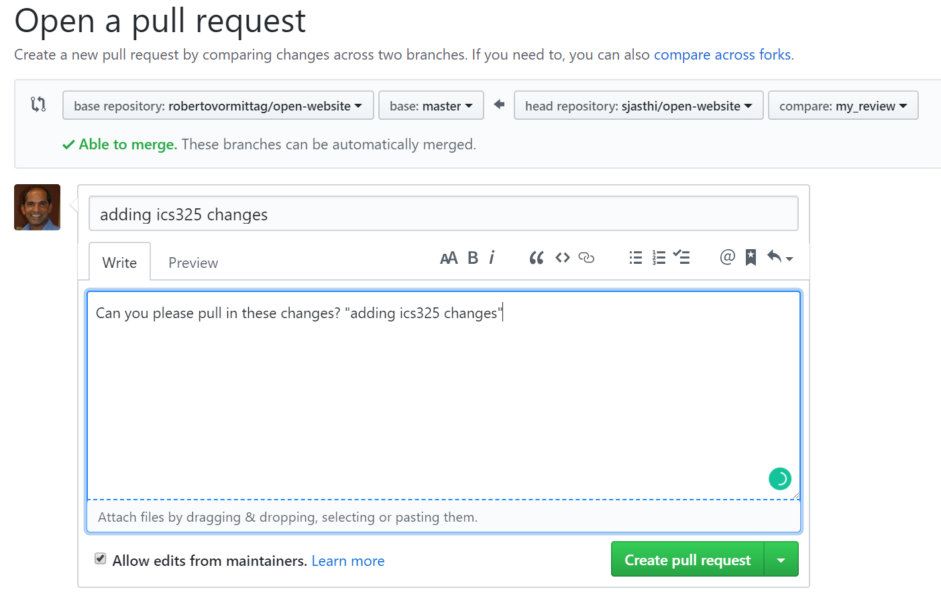

Slide 26
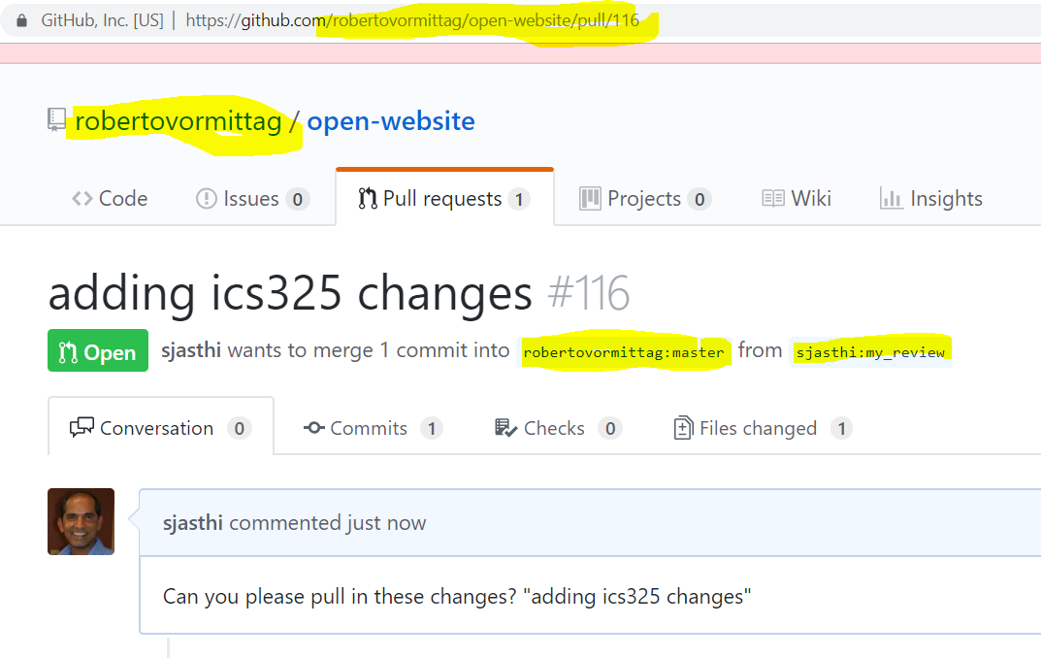
Project owner reviewing the Pull Requests

Slide 27
(As a project Owner) Process the Pull Requests
Review the pull request
Review the changes
Merge/Integrate the changes into the master branch
Close the pull request

Slide 28
Recap
What is…
Git
GitHub
GitHub Desktop
Fork
Clone
Staging (Add)
Commit
Push
Pull Request
Fetch
Merge
Pull (fetch + merge)
Sync

Slide 29
Summary of Workflows
(As Team Member – 1st time) Fork → Clone → Change → Push → Open Pull Request
(As Team Member → Continuous) Fetch → Merge → Change → Push → Open Pull Request
(As Owner of Master Repository) Process Pull Requests

Slide 30
Keeping
UPSTREAM, FORK, and CLONE
In Sync
Siva R Jasthi
Community Faculty
Computer Sciences and Cyber Security
Metropolitan State University

Slide 31
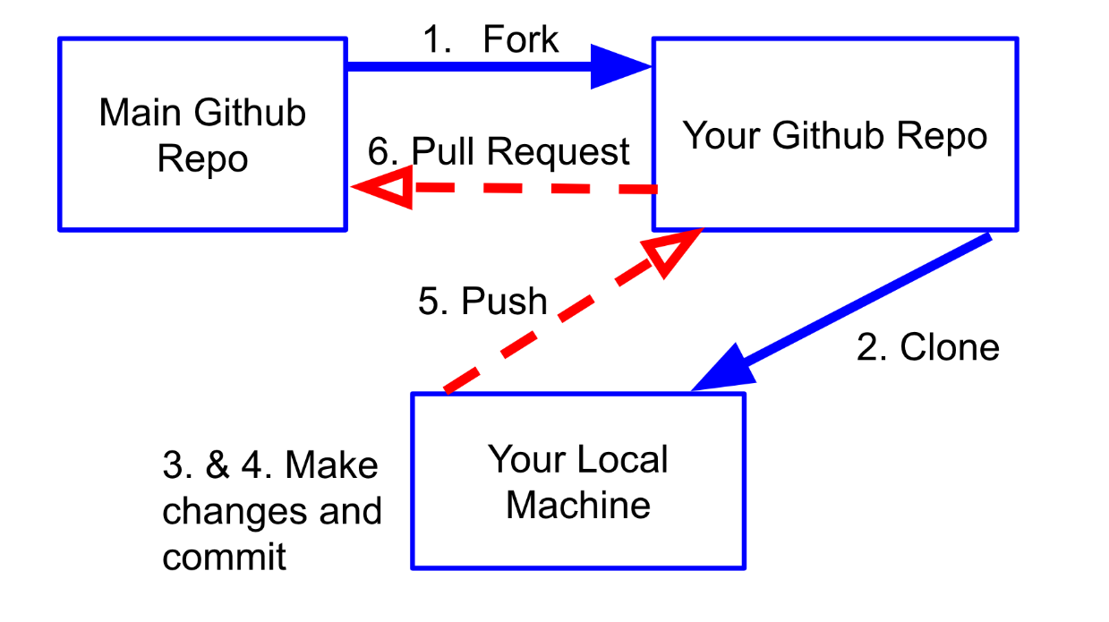
Syncing the FORK with the Upstream
How do you keep your Fork (Your Github Repo) in sync with the Upstream (Main Github Repo)?
How do you pull the changes into your own Fork?
Upstream
Fork
Clone

Slide 32
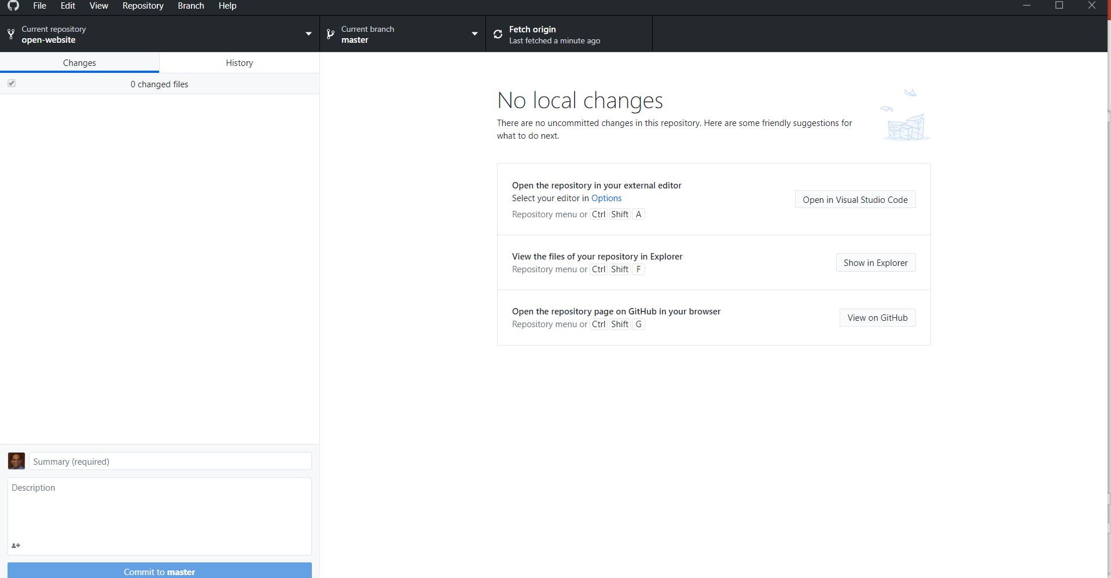
GitHub Desktop: Review your CLONE
Your CLONE
is in sync
with the FORK

Slide 33
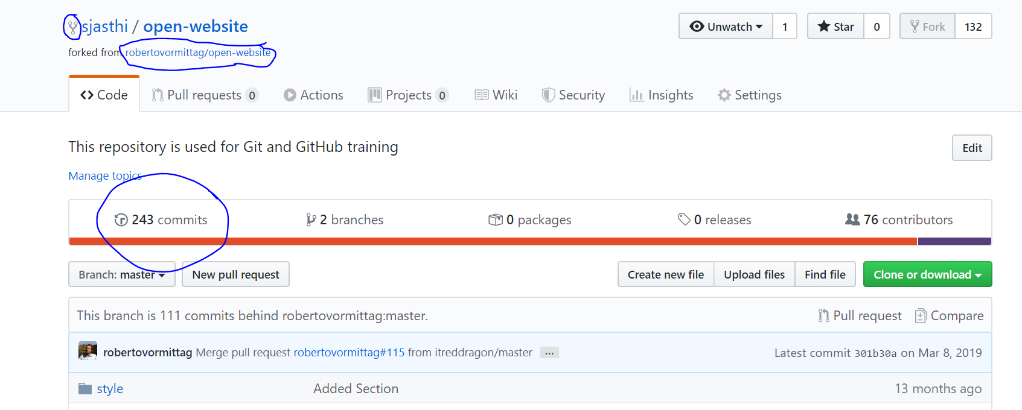
FORKED Repo (sjasthi)
https://github.com/sjasthi/open-website (243 commits)
Is forked from
https://github.com/robertovormittag/open-website (354 commits)

Slide 34
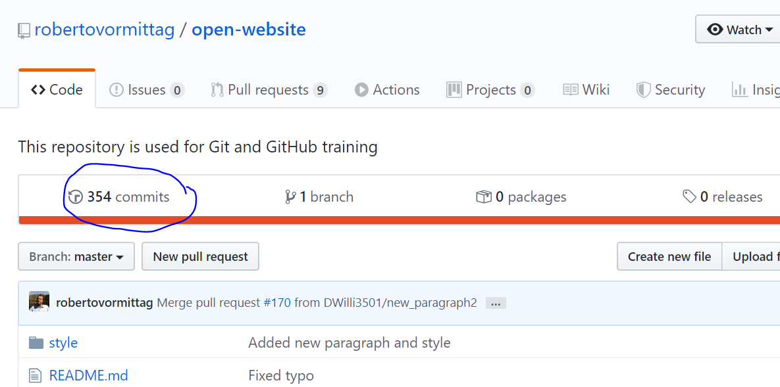
MASTER Repo (robertovormittag)
https://github.com/sjasthi/open-website (243 commits)
Is forked from
https://github.com/robertovormittag/open-website (354 commits)

Slide 35
Two options! Remote vs Local!
The MASTER Repo from which I forked has additional commits.
How do I sync my fork with the MASTER repo?
There are two options
[1] Sync up the forked repo on github.com (Remote) (We will follow this)
https://github.com/KirstieJane/STEMMRoleModels/wiki/Syncing-your-fork-to-the-original-repository-via-the-browser
[2] Sync up cloned repo on local github desktop (Local) (not covered here)
https://nearsoft.com/blog/how-to-synchronize-your-github-fork/
https://www.youtube.com/watch?v=-zvHQXnBO6c

Slide 36
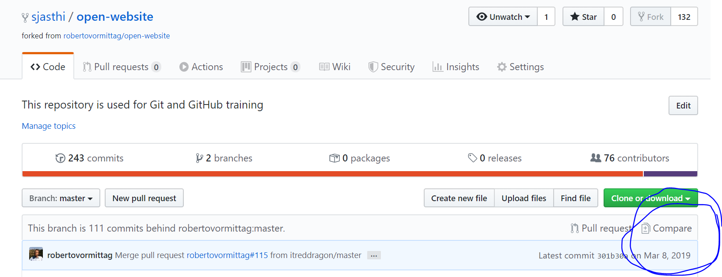
1. Go to your remote Repo (your Fork)
Go to your remote Repo (your Fork)
Hit “Compare”

Slide 37
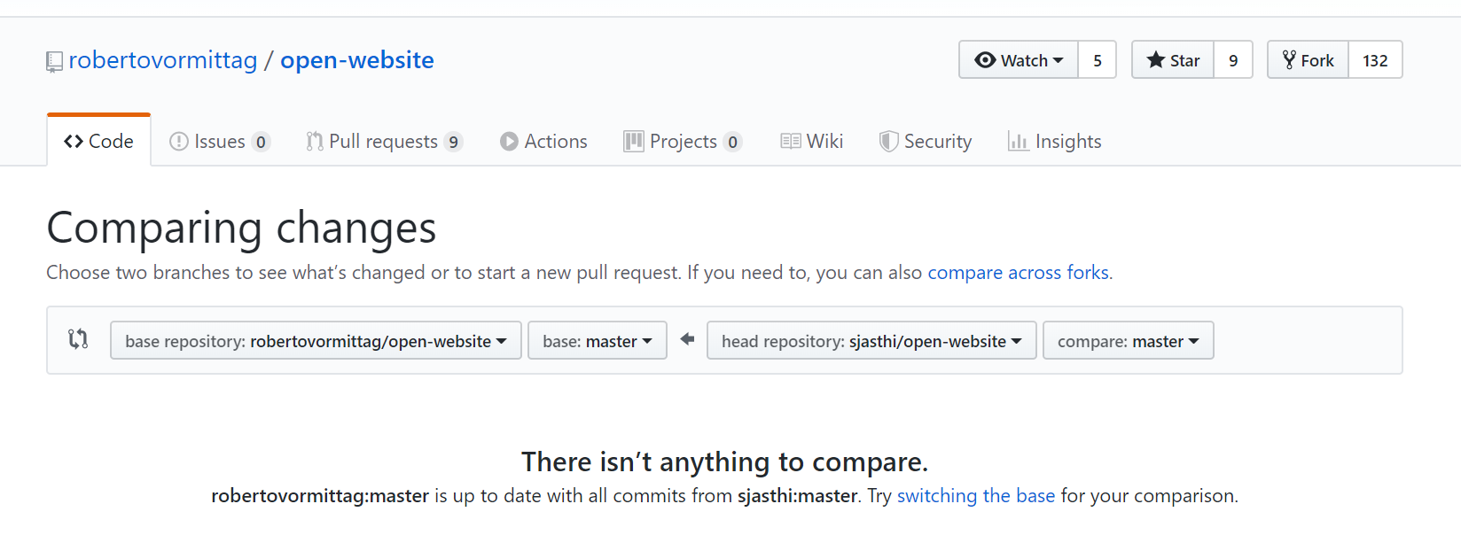
2. Switch the base
If you notice, the “compare changes” switches the control to “upstream” repo (your source repo from which you forked).
Also notice the arrow between the two repos. It is going from your FORK to the UPSTREAM repo.
But we want to fetch the changes from UPSTREAM to our FORK.
So, change the base repository to the “fork”.

Slide 38
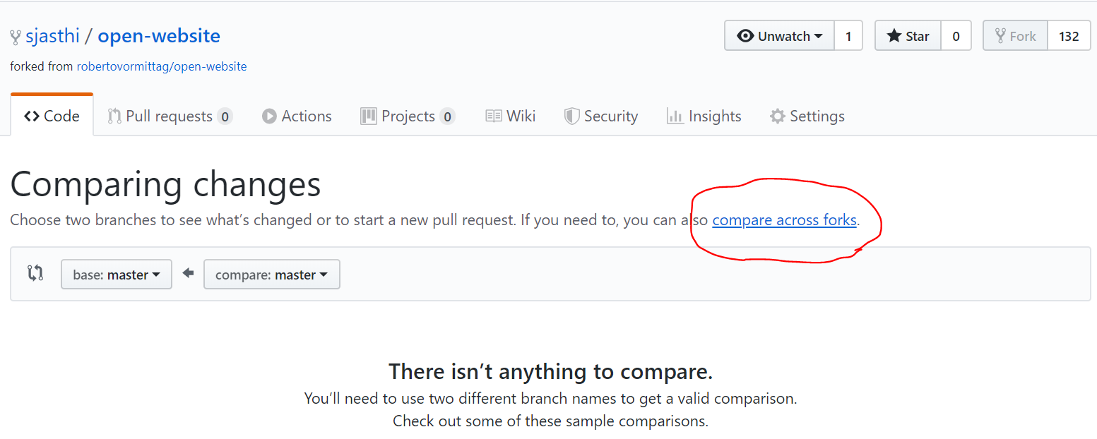
3. Compare across forks.
The control now switches back to your FORK.
You can notice that both base and compare are pointing to the identical repositories. (Since GITHUB thinks that you are comparing your own branches).
But our interest to compare across the forks (That is .. Compare the Upstream with the fork).
So, click “Compare across forks”

Slide 39
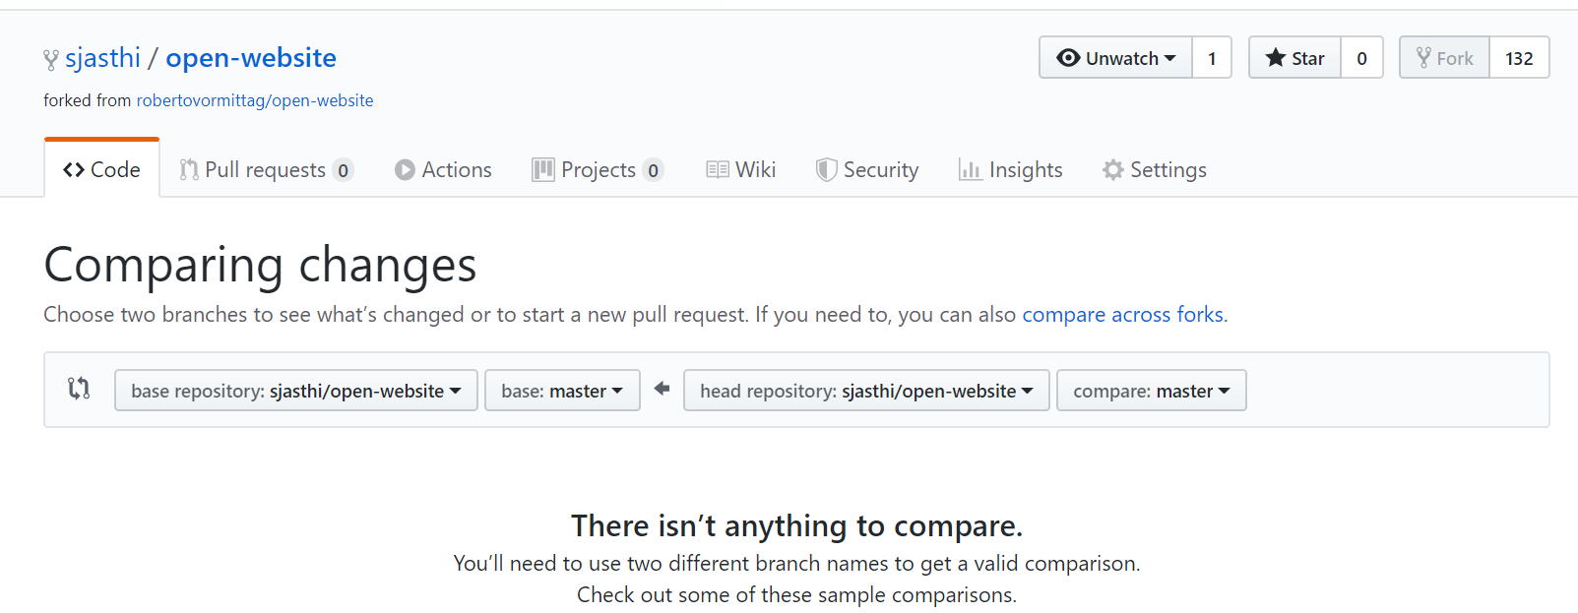
4. Compare across forks (Contd.
In the previous screen, we see two branches in our fork.
But in this screen (after clicking “compare across forks”, we see the options to select a different upstream.
Change the “head repository” to the UPSTREAM repo.

Slide 40
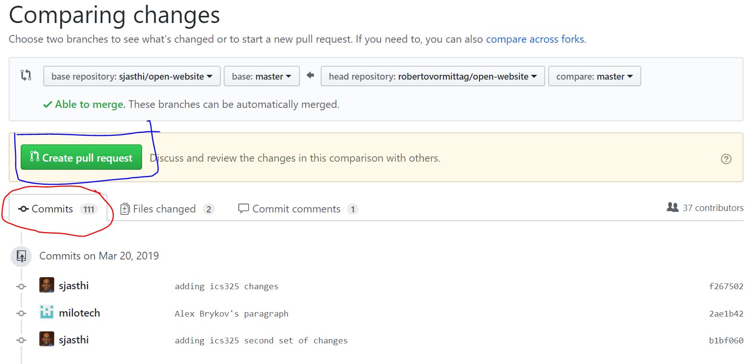
5. Create the Pull Request.
In this page, you will see the number of commits your UPSTREAM is ahead of your FORK.
Notice the direction of arrow! It is starting at UPSTREAM and is going towards the FORK.
Now you can create the “Create Pull Request”.
Make sure that you are logged in. Otherwise, “Create pull request” green button will not show up.

Slide 41
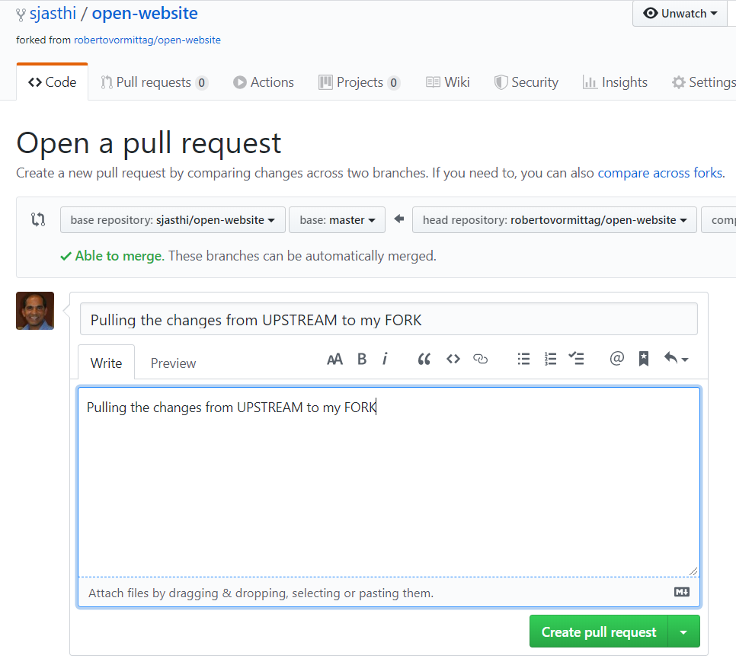
6. Create pull request (Contd.)
Enter the title and brief description to the “pull request”.
Click “Create pull request”.

Slide 42
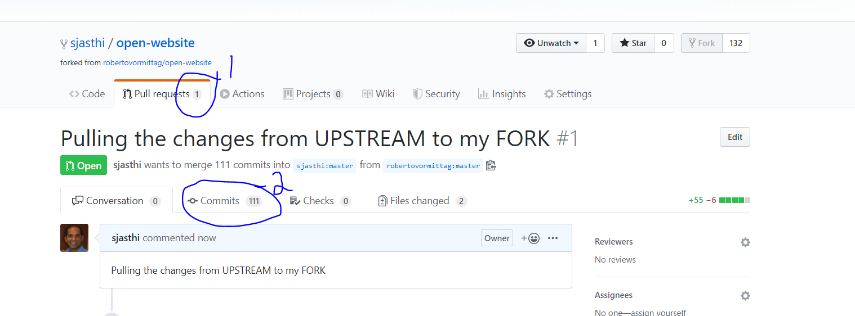
7. Review the pull request
Now you can see that there is an open “Pull request” in your FORK.
You can also see the number of commits (from all other team members; these commits are sitting on the UPSTREAM).
Scroll down to the bottom of the page to see “Merge Pull Request” option. (See next slide).

Slide 43
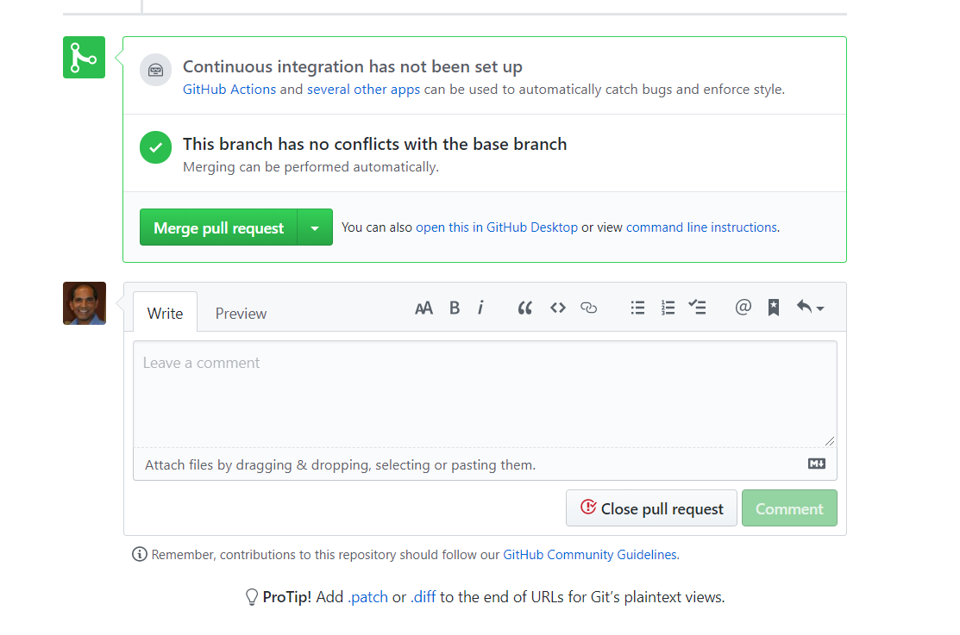
8. Merge the pull request
You can now “Merge the Pull Request”.
If all the team members are working on different files, the branches will not have any conflicts. And the merge is automatic.
Even if multiple team members are working on the same file, the merge will be automatic if they are working on different sections of the file.
However, there will be some carses where there can be conflicts.

Slide 44
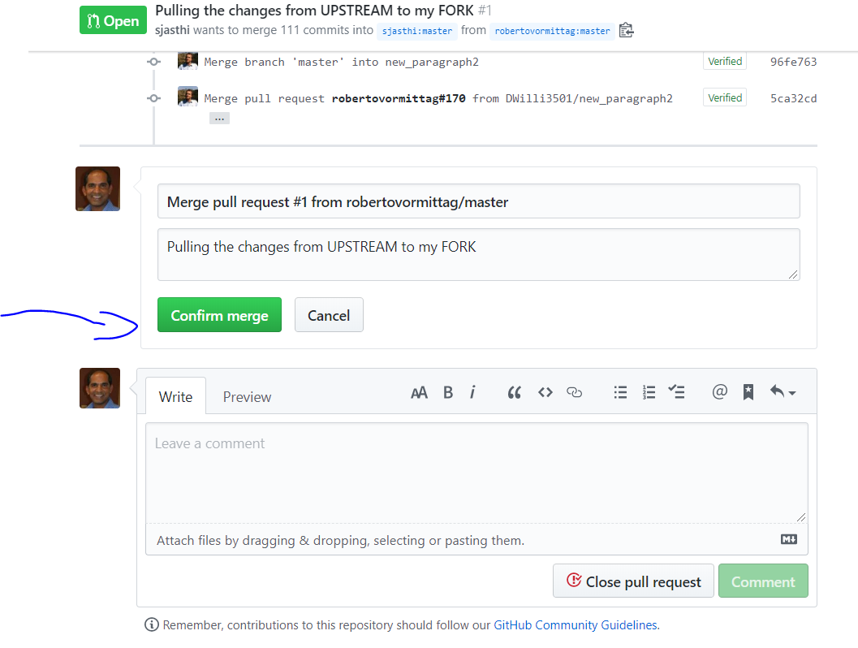
9. Confirm the merge
Confirm the merge – to pull the changes from UPSTREAM to the FORK.

Slide 45
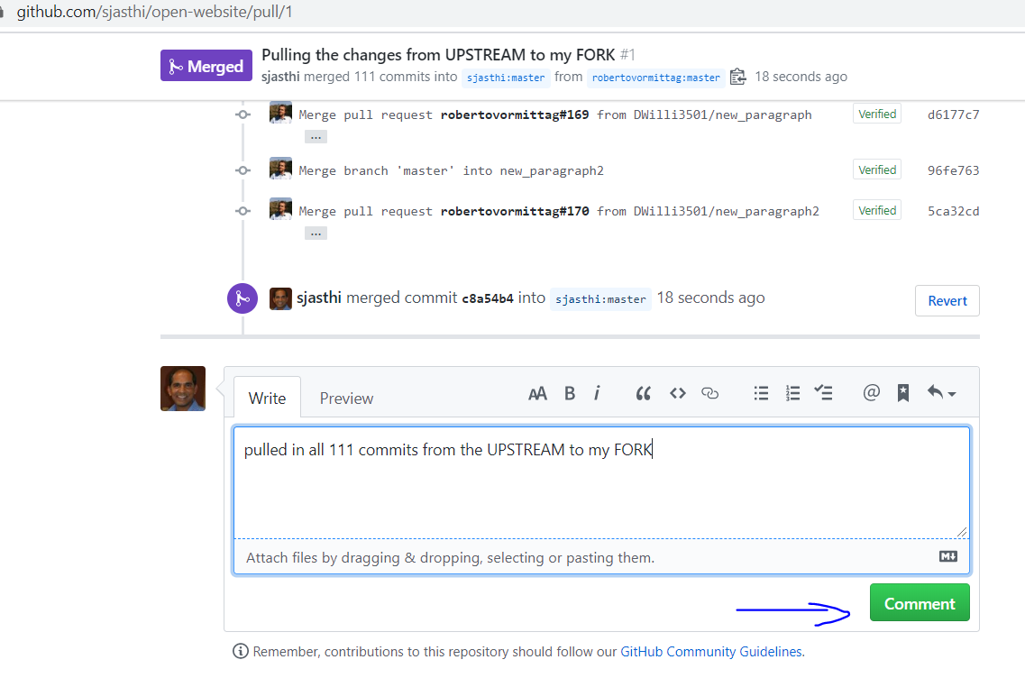
10. Leave a comment
You can also leave a comment on the merge request.

Slide 46
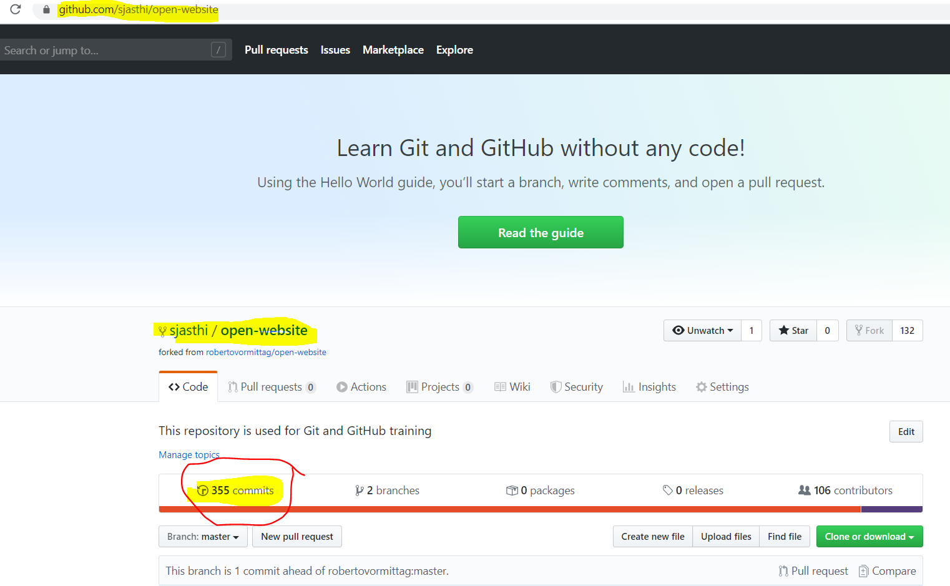
11. FORK and UPSTREAM are in sync
Your FORK is now in sync with the UPSTREAM.
Now, we need to sync up the CLONE on your desktop.

Slide 47
12. GitHub Desktop: Review your CLONE
Click “Fetch Origin” to fetch the changes from your FORK (on github.com) to your local CLONE

Slide 48

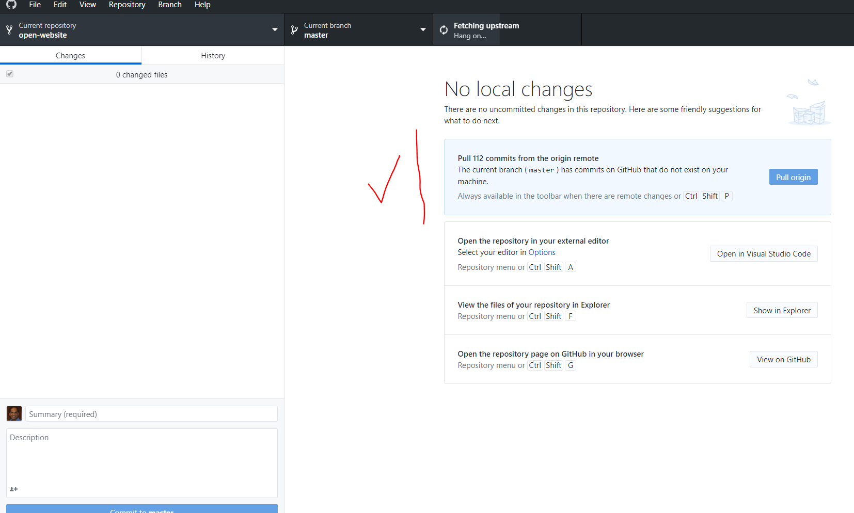
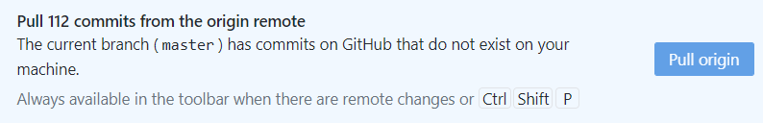
13. Pull the changes from your FORK to CLONE.
Now, open your CLONED Repo on GitHub Desktop.
It will tell you that your REMOTE (which is your FORK on github.com) has additional commits (111 we pulled from the REMOTE + one commit we made into the FORK = a total of 112 commits).
You click “Pull Origin” to sync your CLONE with the FORK (REMOTE);
It takes time to SYNC.
Be Patient.

Slide 49

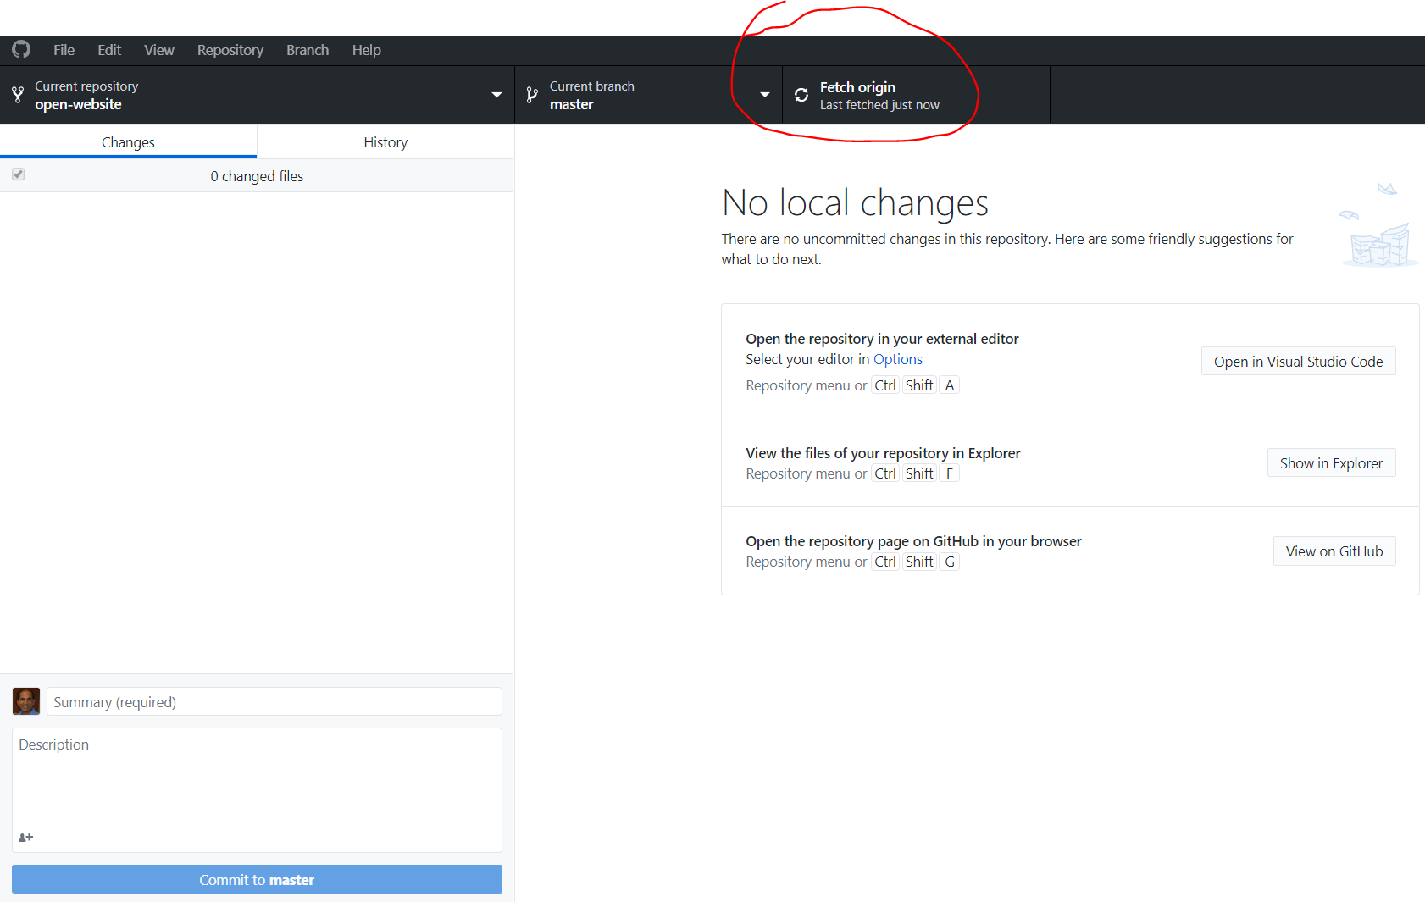
14. Your CLONE and FORK are in sync now
You can now see that
CLONE = FORK = UPSTREAM are all in sync.
Congratulations!

Slide 50
Summary
You need to sync up
The remote UPSTREAM (source repo)
Your remote FORK (on github.com)
Your local CLONE (on GitHub Desktop)
periodically to ensure that
you are not working on a stale/old code
You do not get into merge conflicts

