Slide 1
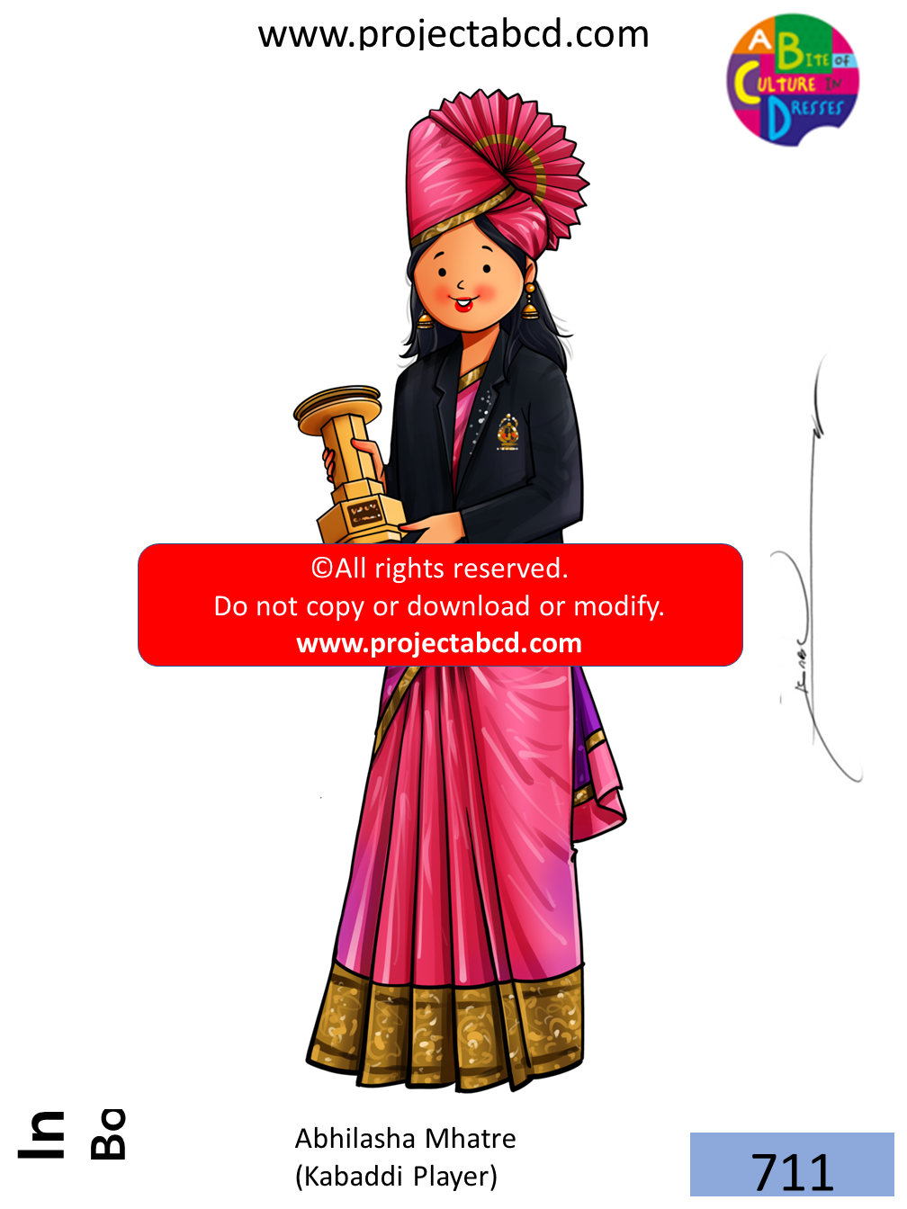

Slide 2
ABHILASHA MHATRE
DESCRIPTION:
I am a talented kabaddi player from Maharashtra. I started playing kabaddi when I was very young. I attended Swami Muktanand High School in Mumbai, where my kabaddi journey began. I played for the Chembur Krida Kendra Club, where I saw many big tournaments and learned from senior players. However, my road to success was not easy. After representing India at the age of just 17, I suffered severe injuries in 2007 and 2008 that required operations on both knees. But with my determination and hard work, I made a strong comeback in 2010. I represented India in various international competitions and won several gold medals. I debuted at the 2006 South Asian Games in Sri Lanka, where India won the gold medal. I played a crucial role in winning the Kabaddi World Cup in 2012 and the gold medal at the Asian Games 2014. My achievements were recognized when I received the Arjuna Award from the Government of India in 2015. I was also awarded the "Shiv Chhatrapati Krida Puraskar" by the Government of Maharashtra in 2017. My story is about dedication, perseverance, and pursuing excellence in sports, making me a true role model for all aspiring sportspersons.
DID YOU KNOW?
I am known for my incredible skills and am often called the "Queen of Kabaddi."

Slide 3
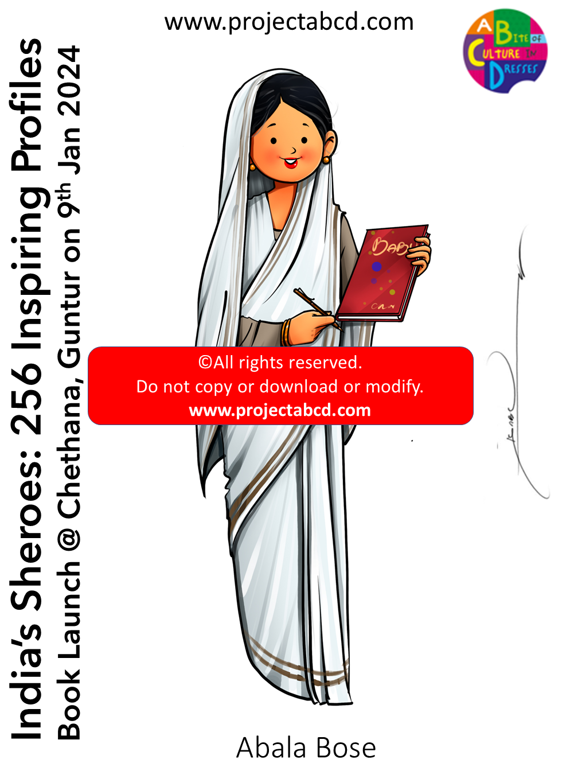

Slide 4
ABALA BOSE
DESCRIPTION:
I, also known as Lady Bose, was an Indian social worker. I was the spouse of the renowned scientist Jagdish Chandra Bose. In the 1880s, I was denied admission to Calcutta Medical College due to the institution's policy of not accepting female students. Undeterred, I embarked on a journey to Madras (now Chennai) in 1882, supported by a scholarship from the Bengal government, intending to pursue a medical education. I am a staunch advocate for women's suffrage, a stance that defies societal norms of my time. I was raised in an environment that encouraged the higher education of women. I established nearly 88 primary schools and 14 adult education centers across the British province of Bengal during my lifetime. My exposure to the Montessori education system during my travels in Europe and accompanying my husband proved instrumental in shaping my established training system. My indomitable spirit and dedication to education and social welfare have left an indelible mark on Indian history.
DID YOU KNOW?
With Sister Nivedita's help, I was able to train teachers at the kindergarten level, and we revolutionized the educational system by providing self-defense training to young girls.

Slide 5
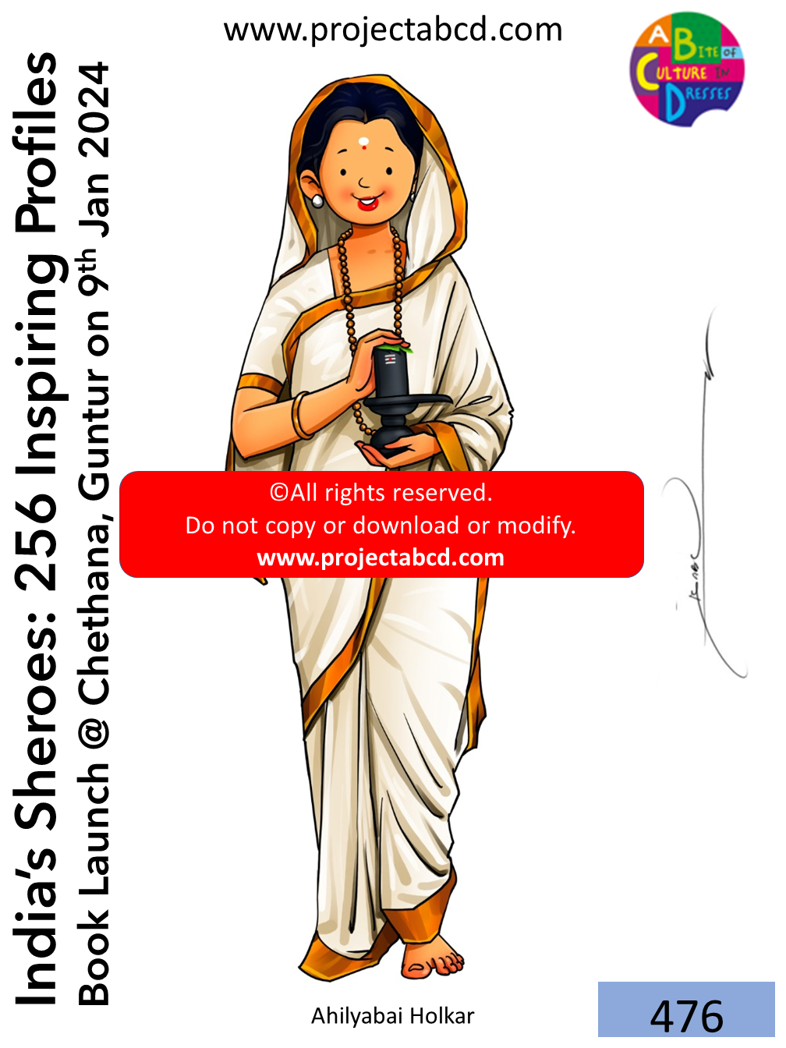

Slide 6
AHILYABAI HOLKAR
DESCRIPTION:
I was a prominent ruler of the Maratha Malwa kingdom during the 18th century. I am celebrated as one of India's most successful and compassionate rulers. I was born in 1725 in present-day Maharashtra. I became the queen of Malwa in 1767 after my husband, Malhar Rao Holkar, passed away. As a ruler, I displayed exemplary leadership qualities and a deep commitment to the welfare of my people. I am credited for my contributions to developing and renovating various temples and pilgrimage sites across India. I helped construct several ghats (steps leading to the river) along the Ganges River in Varanasi, which are still in use today. My reign was marked by good governance, religious tolerance, and a commitment to justice and social welfare. My dedication to my subjects earned me widespread admiration and respect. I ruled until my death in 1795.
DID YOU KNOW?
I renovated the Kashi Vishwanath temple in Varanasi after it was demolished by Mughal Emperor Aurangzeb.

