Slide 1

GULABO SAPERA
DESCRIPTION:
Gulabo Sapera is an extraordinary woman from Pushkar, Rajasthan, who has overcome incredible challenges to become a shining example and role model for girls everywhere. Gulabo is known for her mastery of Kalbelia dance, also known as Sapera dance,_x000D_ inspired by snake movements. She has not only preserved this traditional dance form but has also brought it to the world stage. Gulabo traveled to America when she was 13 to perform in Washington, DC. After being featured in leading newspapers, she_x000D_ gained great respect and recognition. This paved the way for her to become a renowned dancer and teacher, inspiring the next generation of young dancers in her community. She offers free classes for girls in rural Rajasthan. She also has residences_x000D_ in France and Denmark and is spreading her legacy worldwide. She is committed to preserving India's rich folk dance culture and has been awarded the prestigious Padma Shri Award for her services. Gulabo's story is not just about dance; it's about_x000D_ breaking barriers, empowering others, and advocating for the livelihood of artisans.
Dress ID: 102
Page No. 1
DID YOU KNOW?
Gulabo survived female infanticide, a tragic practice, and became a symbol of resilience and talent.

Slide 2
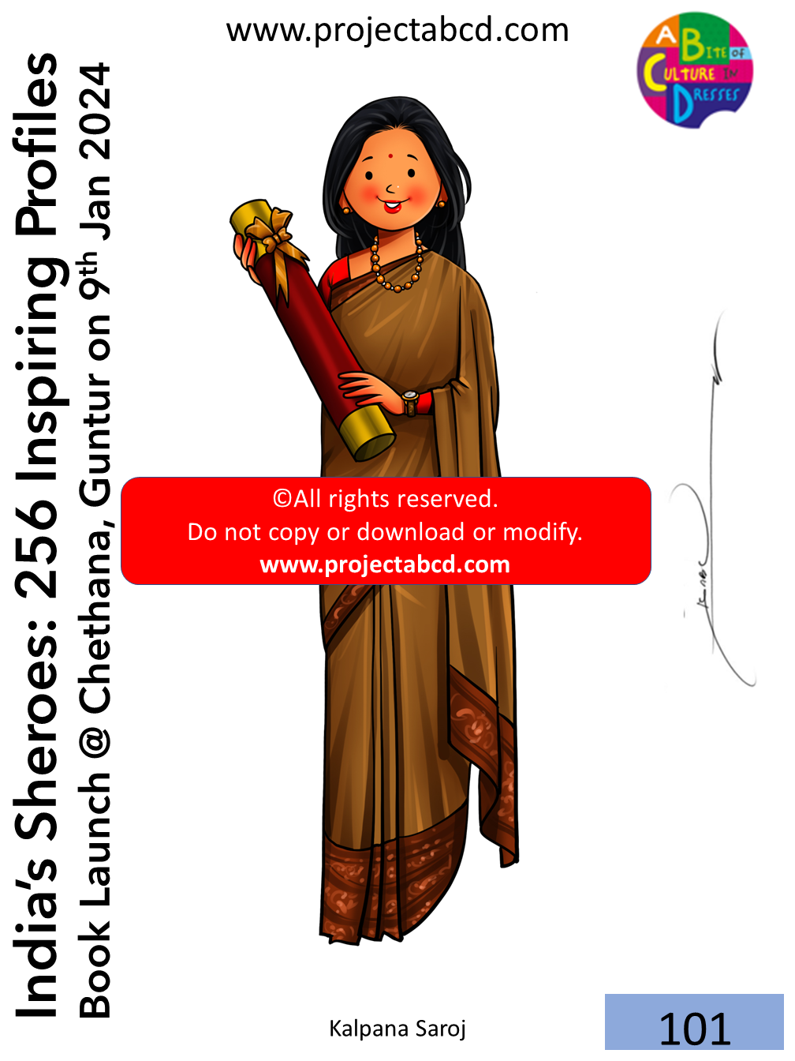
KALPANA SAROJ
DESCRIPTION:
Kalpana Saroj's life is an inspiring story of a woman who overcame hardships, including domestic abuse, injustice, and even suicidal thoughts, to become a TEDx speaker, entrepreneur, and CEO of a company called Kamani Tubes. Born in a small town in_x000D_ Maharashtra, India, in 1961, Kalpana faced bullying at school and was married off at 12. She moved to Mumbai to live with her husband, where she endured physical and emotional abuse from her in-laws. This torment drove her to attempt suicide at the_x000D_ age of 16. Kalpana's life took a different turn when her aunt saved her. She realized the value of life and decided to overcome her challenges. She returned to Mumbai, worked hard in a garment factory, and eventually started her tailoring business._x000D_ With determination and a sharp mind, she ventured into various businesses, including film production and real estate. Kalpana is often called the original 'Slumdog Millionaire' due to her rags-to-riches journey. Kalpana's dedication and_x000D_ contributions earned her a Padma Shri, one of India's highest honors, in 2013.
Dress ID: 101
Page No. 2
DID YOU KNOW?
Dr. Bhimrao Ambedkar, a Dalit social reformer and the primary architect of the Indian Constitution, serves as her inspiration.

Slide 3

LONG KURTI
DESCRIPTION:
Long Kurti is identical to the regular kurti, except for that this one is floor length, and generally becomes wider and flares from the waist down. It can be made from many different fabrics, and in many different designs and patterns.
DID YOU KNOW?
The kurti style tunic is worn all across the world!
Dress ID: 100
Page No. 3

