Slide 1
Course | Python for Data Science
Term
Class
Date
Chapter. Topic
Data Types
Siva R Jasthi
Computer Science and Cybersecurity
Metropolitan State University

Slide 2
Outline
What is Data Science?
Why Data Science?
Data Science Process
Data Sources
Data Types

Slide 3
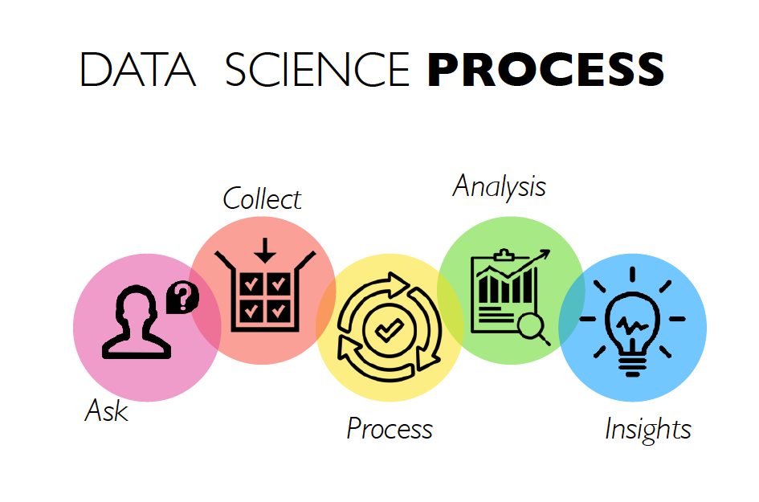
https://www.yellowslice.in/bed/data-science-design-thinking-process-of-amalgamation-to-perfection/

Slide 4
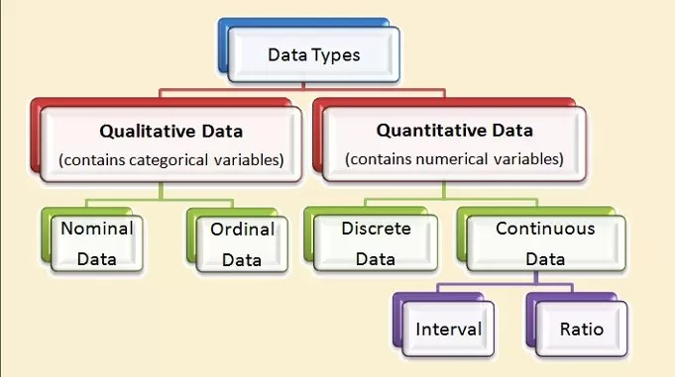
Data Types

Slide 5
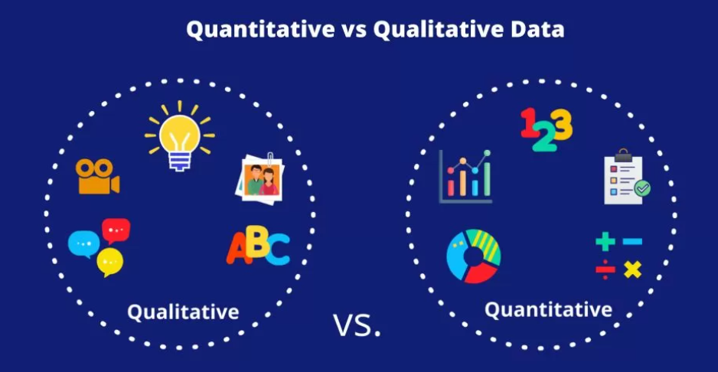
Data Types
https://microbiologynote.com/difference-between-quantitative-and-qualitative-data/

Slide 6
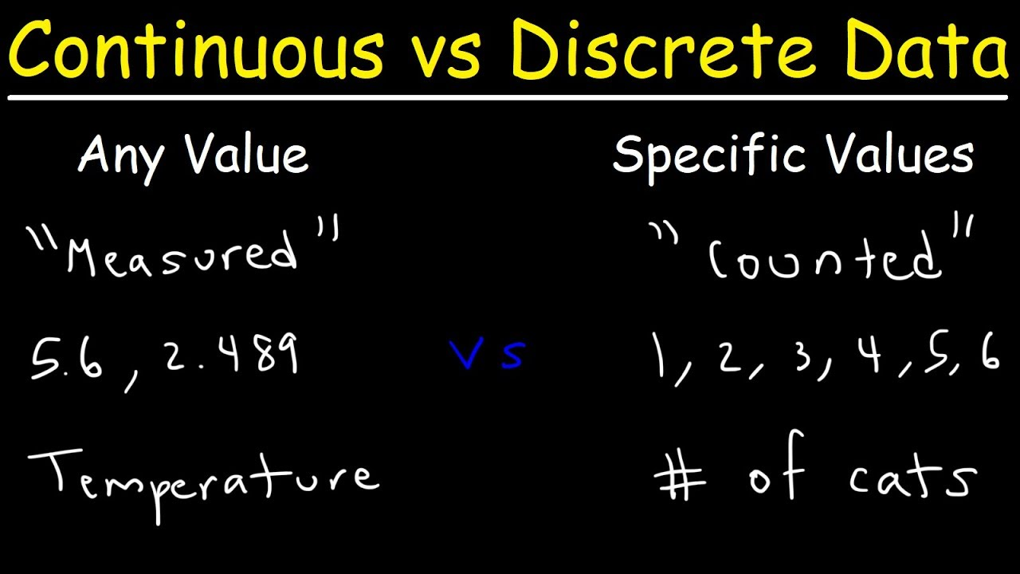
Data Types
https://www.youtube.com/watch?v=cz4nPSA9rlc

Slide 7
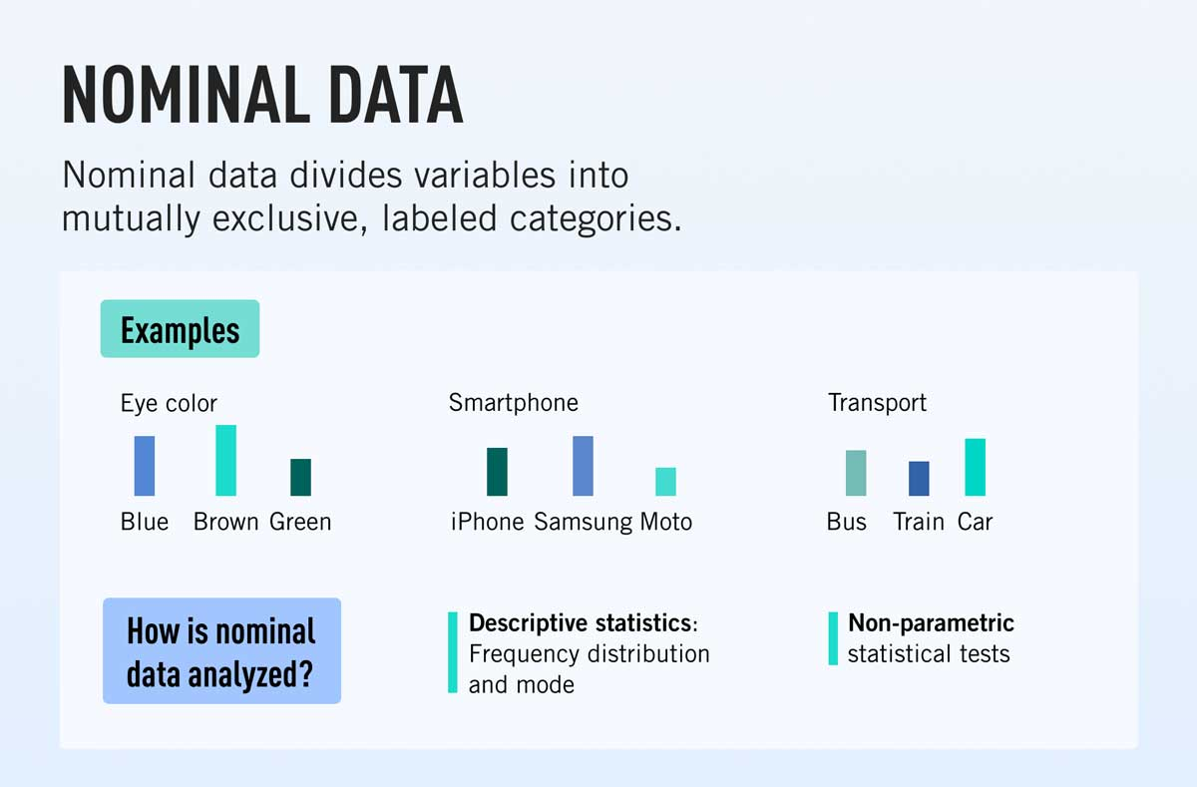
Four levels of Measurement
https://careerfoundry.com/en/blog/data-analytics/what-is-nominal-data/

Slide 8
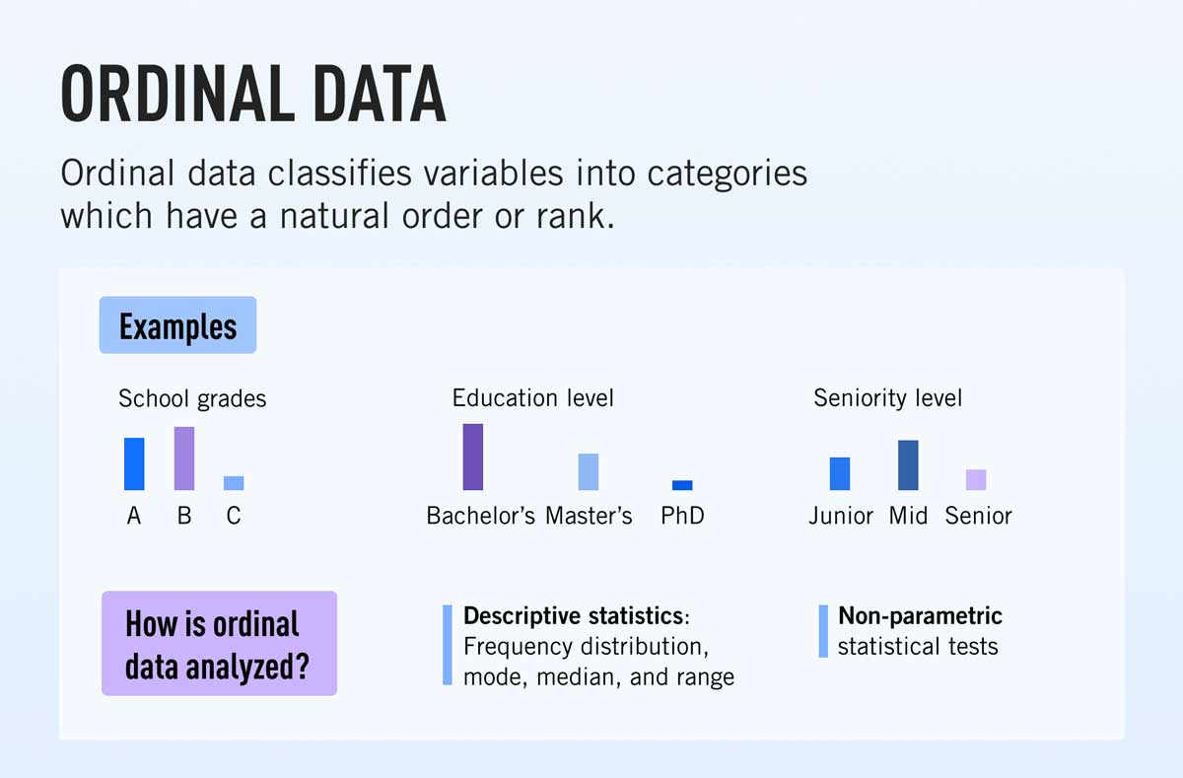
Four levels of Measurement
https://careerfoundry.com/en/blog/data-analytics/what-is-ordinal-data/

Slide 9
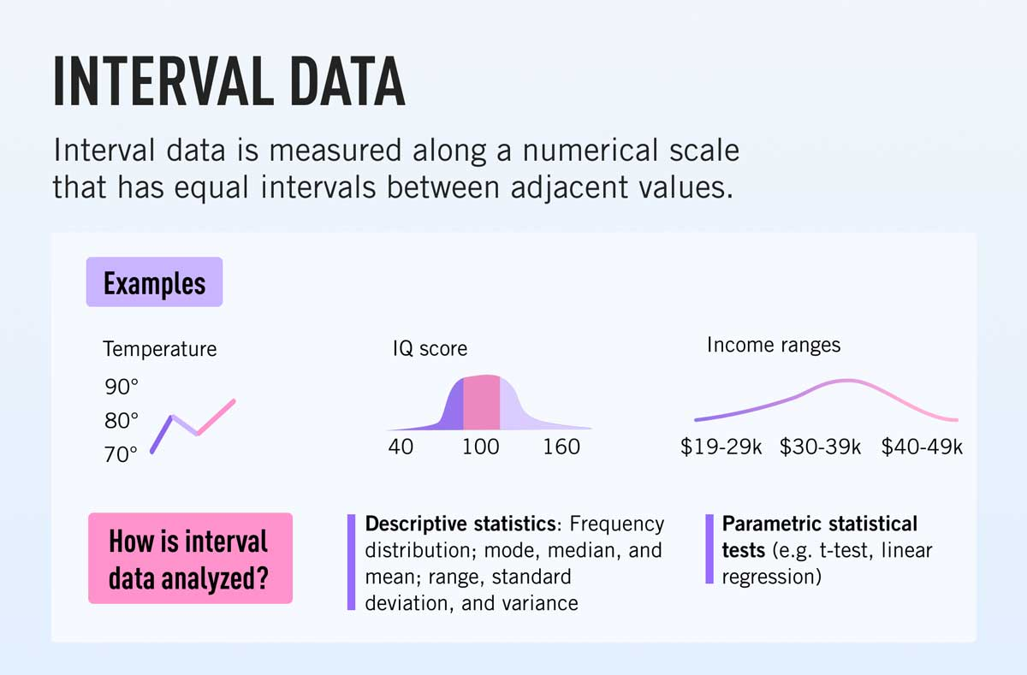
Four levels of Measurement
https://careerfoundry.com/en/blog/data-analytics/what-is-interval-data/

Slide 10
Why is temperature data called “interval” data?
Temperature measurements in Celsius are considered interval data because they meet the following criteria:
Equal Intervals: The difference between any two consecutive values (e.g., 15°C to 20°C) is consistent. The interval between each unit of measurement is the same, making it possible to perform meaningful mathematical operations like addition and subtraction.
No True Zero: Interval data lacks a true zero point that indicates the absence of the variable being measured. In the Celsius scale, 0°C does not represent the complete absence of temperature, but rather the freezing point of water. This distinguishes interval data from ratio data, which does have a meaningful zero point (e.g., weight, where 0 kg means no weight).
Therefore, while you can calculate differences between temperatures in Celsius, you cannot multiply or divide them meaningfully (e.g., you can’t say 20°C is twice as warm as 10°C), which is why it's classified as interval rather than ratio data.

Slide 11
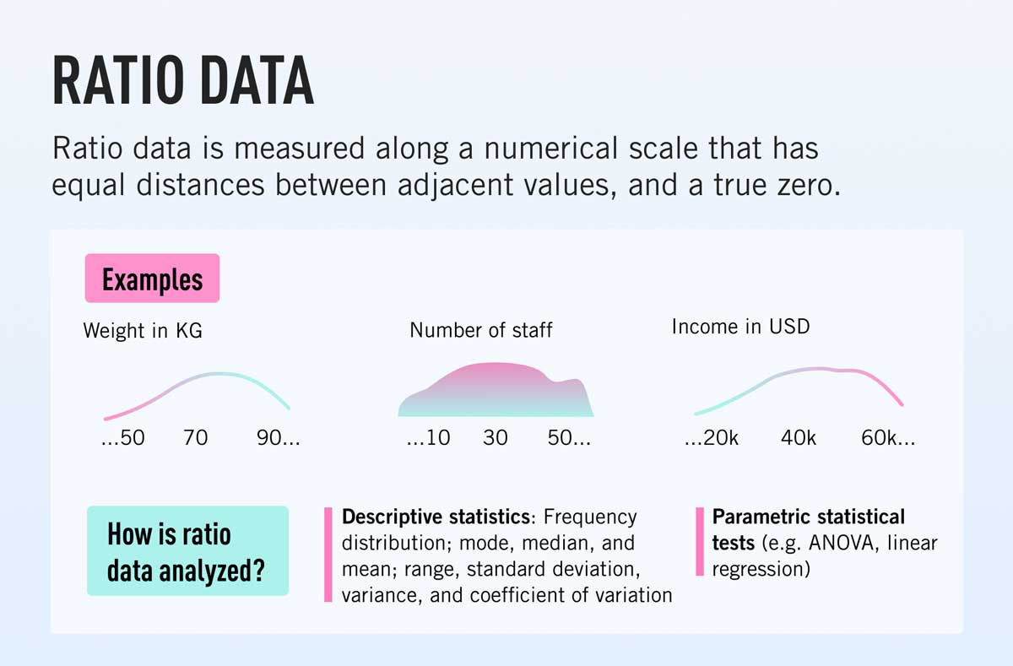
Four levels of Measurement
https://careerfoundry.com/en/blog/data-analytics/what-is-ratio-data/

Slide 12
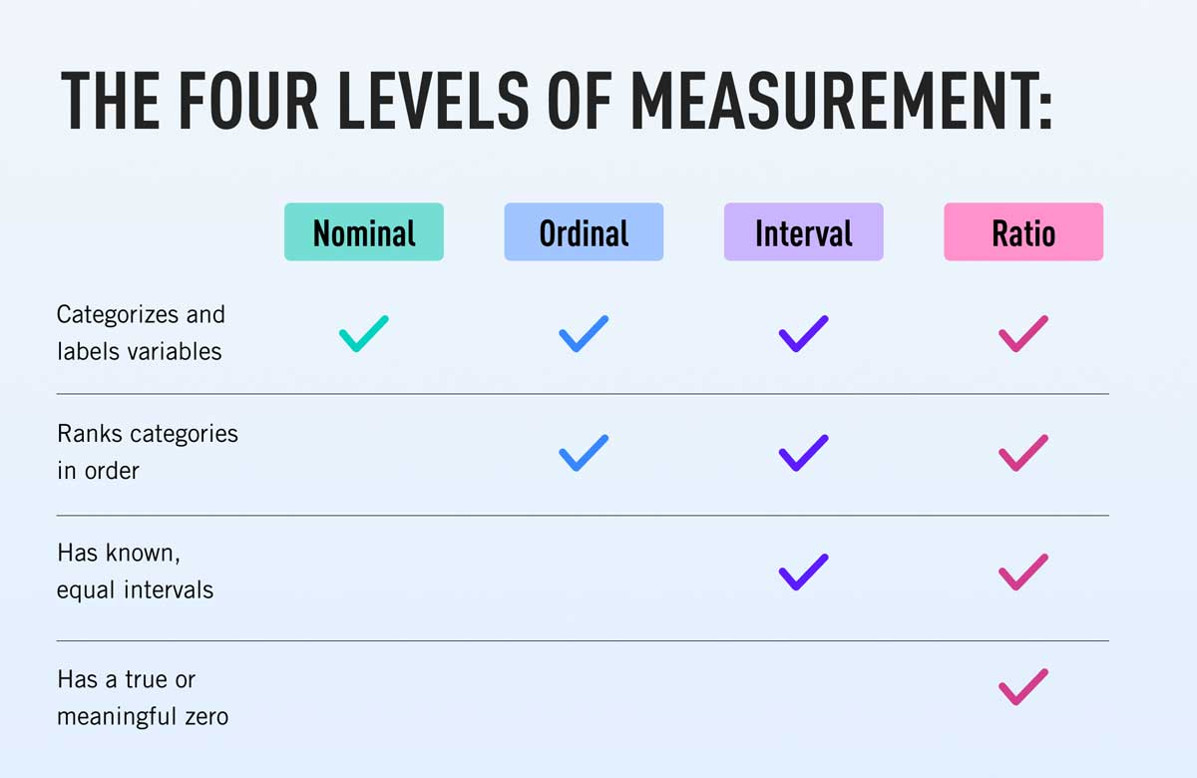
Four levels of Measurement
https://careerfoundry.com/en/blog/data-analytics/what-is-interval-data/

Slide 13
Attribute Types
Nominal: categories, states, or “names of things” – Not ordered(smaller or greater)
Hair_color = {auburn, black, blond, brown, grey, red, white}
marital status, occupation, ID numbers, zip codes
Binary
Nominal attribute with only 2 states (0 and 1)
Symmetric binary: both outcomes equally important/opportunity
e.g., gender
Asymmetric binary: outcomes not equally important.
e.g., medical test (positive vs. negative)
Convention: assign 1 to most important outcome (e.g., HIV positive)
Ordinal: There is order
Values have a meaningful order (ranking) but magnitude between successive values is not known
Size = {small, medium, large}, grades, army rankings

Slide 14
Numeric Attribute Types
Quantity (integer or real-valued)
Interval
Measured on a scale of equal-sized units
Values have order
E.g., temperature in C˚or F˚, calendar dates(gradual process)
No true zero-point
Ratio
Inherent zero-point
We can speak of values as being an order of magnitude larger than the unit of measurement (10 K˚ is twice as high as 5 K˚).
e.g., temperature in Kelvin, length, counts, monetary quantities(Double money then what you have)

Slide 15
Discrete vs. Continuous Attributes
Discrete Attribute: Certain precision
Has only a finite or countably infinite set of values
E.g., zip codes(no decimal values), profession, or the set of words in a collection of documents
Sometimes, represented as integer variables
Note: Binary attributes are a special case of discrete attributes
Continuous Attribute
Has real numbers as attribute values
E.g., temperature, height, or weight
Practically, real values can only be measured and represented using a finite number of digits
Continuous attributes are typically represented as floating-point variables

Slide 16
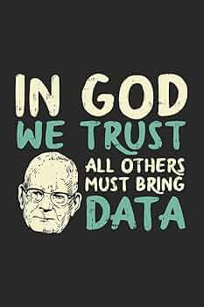

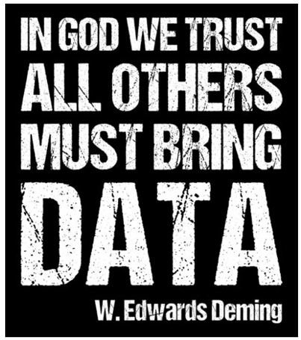
Summary

Slide 17

Thank You.

