Slide 1


<Project Title> Python for Data Science
Name of the student
<grade>
School Name, City

Slide 2
List of Questions
Overview
Totals and Gender Demographic
Provide brief description about your project, domain, data sets
Provide a quick overview of the analysis you are planning to carry out
Provide the link to your dataset

Slide 3
List of Questions
Some questions we are trying to answer
List all your questions on this slide
List all your questions on this slide

Slide 4
Totals and Gender Demographic
How did I solve the problem?
List the tools, modules you used.
Outline how you collected the data
Outline how you cleaned up the data and processed the data, etc.

Slide 5
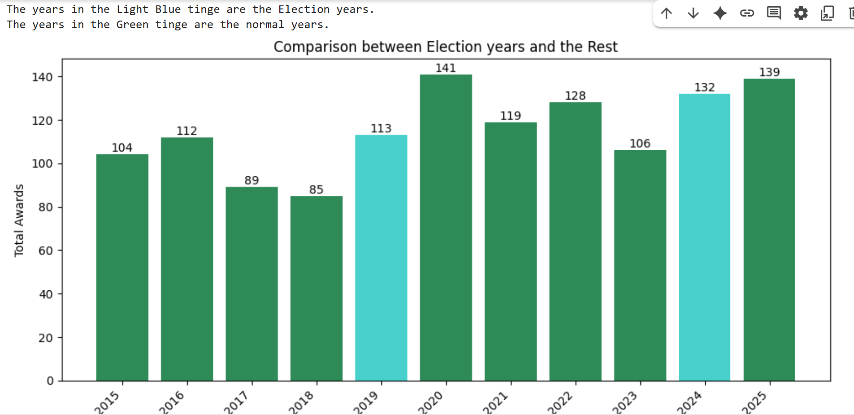
Totals and Gender Demographic
(Q1) What is your first question?
Write your question as the title
Provide your answer here on this slide (in one or two sentences).
Provide your visual here.
Do NOT include the code.
If there are any questions from the instructor or observers, you can take them to your google colab notebook

Slide 6
Totals and Gender Demographic
(Q2) What is your second question?
Repeat the previous slide 16 times.
One slide for each question.

Slide 7
Totals and Gender Demographic
Summary
What is your summary?
What are your conclusions?
What did you learn from this analysis?
What did surprise you? What is expected result? Etc.

Slide 8
Totals and Gender Demographic
References
What are the data sources / web sites you used?
What are the some references you used?

