Slide 1
Course
Term
Week
Date
Chapter. Topic | 1. Introduction to Pandas
pandas
Siva R Jasthi
Computer Science and Cybersecurity
Metropolitan State University

Slide 2

What is pandas?
One of the most popular libraries for data analysis
Pandas: The name is derived from the term "panel data systems", an econometrics term for data sets that include both time-series and cross-sectional data
It is an open-source product.
Notes:
Cross sectional data means that we have data from many units, at one point in time. Time series data means that we have data from one unit, over many points in time. Panel data (or time series cross section) means that we have data from many units, over many points in time.

Slide 3
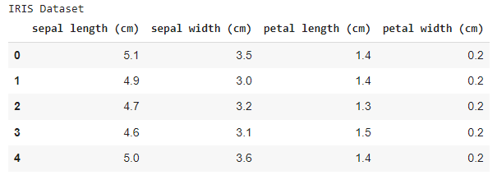
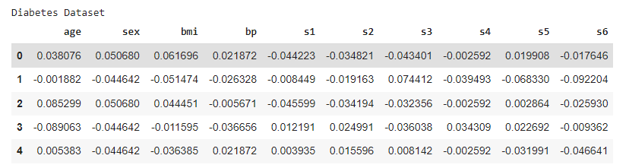
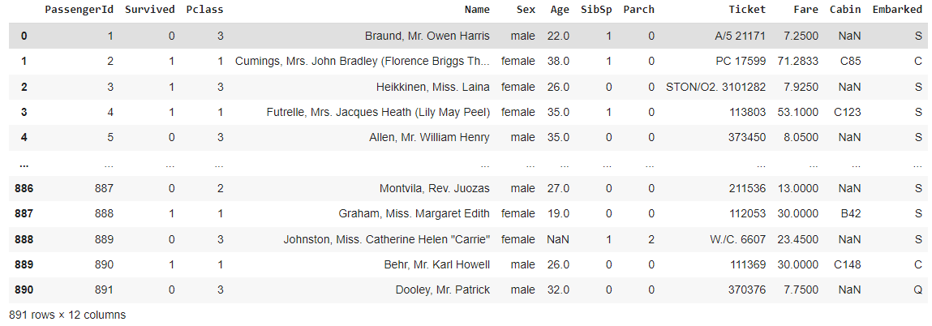
What is pandas? (contd.)
display(dataframe)
Notes:
Cross sectional data means that we have data from many units, at one point in time. Time series data means that we have data from one unit, over many points in time. Panel data (or time series cross section) means that we have data from many units, over many points in time.

Slide 4
Typical Questions we can ask
Give me all (or unique) the values of a given column?
Give me all rows matching certain criteria on a column? Who got > 90% in the final test?
Give me a row where the column is matching the max of all values? Who stood first in this class?
What is the average, frequency, mode, median of values sitting in a column?
Give me all the column values that match a criteria on another column? Who are all from Dallas in this class?

Slide 5
What is pandas? (Contd.)
It is built on top of NumPy
Key components provided by Pandas: (1) Series and (2) DataFrame
Pandas
(series + dataframe)
numpy
python

Slide 6
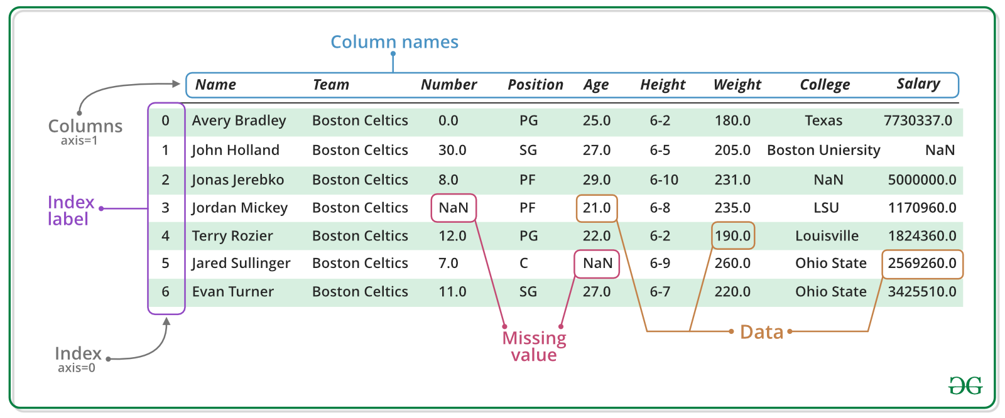
pandas DataFrame: overview
https://www.geeksforgeeks.org/creating-a-pandas-dataframe/

Slide 7
What is Series?

Slide 8
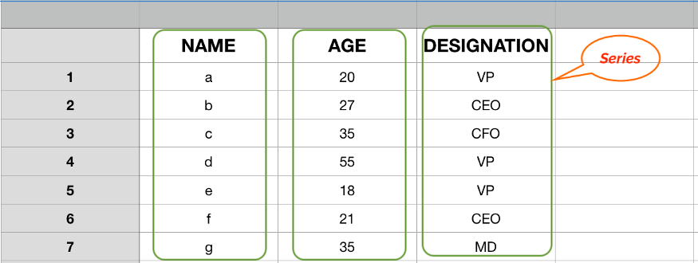
Pandas Series
https://towardsdatascience.com/pandas-series-a-lightweight-intro-b7963a0d62a2

Slide 9
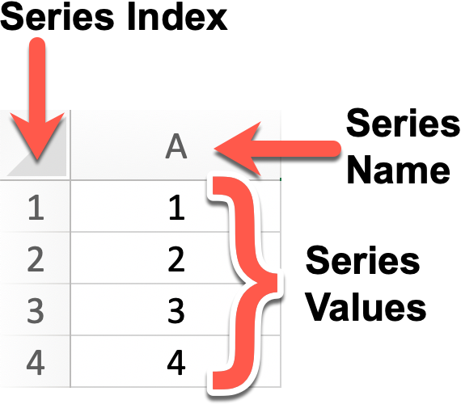
Series
Series = a column in a dataframe
Series = a row in a data frame
Series = row or column can be partial data matching some criteria
Typically, a series contains data of some type. (ints, strings, floats).
However, if add a float data to int column, then the whole series becomes ‘float’.
Similarly, if you add “string” data to a “float” column, then the whole series becomes “string”

Slide 10
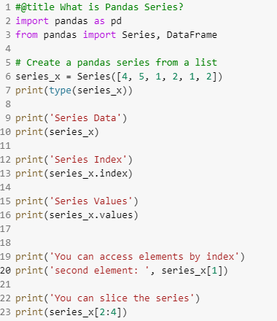
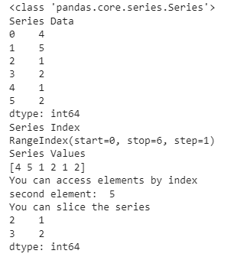
Series
One dimensional array-like object
It contains an array of data (of any NumPy data type) with associated indexes.
By default, the index will be from 0 to size-1
However, the indexes can be labeled with other data types (ex. Strings)

Slide 11
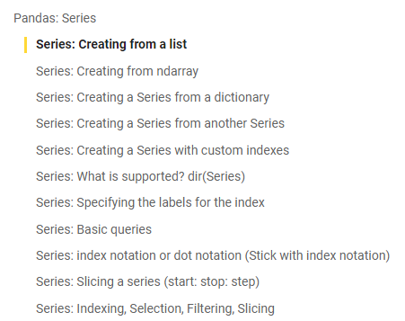
Series: Exploration
See the google colab notebook (intro_to_pandas.ipynb)

Slide 12

Pandas DataFrame

Slide 13
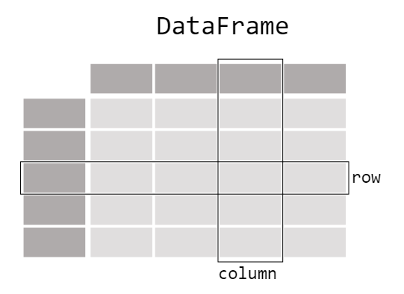
DataFrame: Visualization

Slide 14
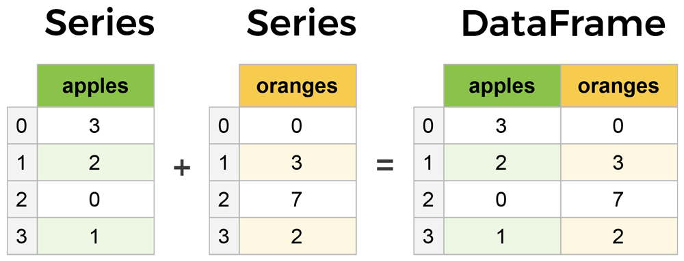
pandas = Series & DataFrames
Series is a sequence or column
DataFrame is a collection of Series
DataFrames and Series are quite similar (accessing, index labeling, slicing, descriptive statistics, etc.)
Series is a one-dimensional array (D) like structure with homogeneous data.
DataFrame is a two-dimensional array (2D) with heterogeneous data.
columns
rows

Slide 15
DataFrame: Creating
pandas.DataFrame(data, index , columns , dtype , copy )
data: data takes various forms like ndarray, series, map, lists, dict, constants and also another DataFrame.
index: For the row labels, that are to be used for the resulting frame, Optional, Default is np.arrange(n)if no index is passed.
columns: For column labels, the optional default syntax is - np.arrange(n). This is only true if no index is passed.
dtype: Data type of each column.
copy: This command is used for copying data. The default is False.

Slide 16
DataFrame: Source of creation
pandas.DataFrame(data, index , columns , dtype , copy )
  A pandas DataFrame can be created using various inputs like −
    Lists
    dict
    Series
    Numpy ndarrays
    Another DataFrame

Slide 17
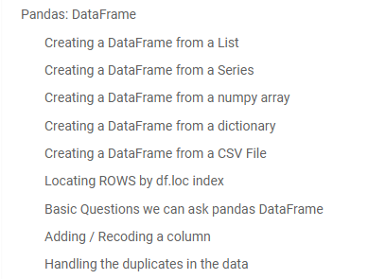
DataFrame: Exploration
  See the google colab notebook (intro_to_pandas.ipynb)
  Reading/Loading CSV/Excel/JSON files
  Querying the DataFrame
  Typical operations
    Create, Read, Update, Delete
    Traversal, Selection, Filtering
    Column encoding, recoding
    Joins, Transformations

Slide 18

Thank You.

