Slide 1
Course
Term
Week
Date
Chapter. Topic | 1. Introduction to Pandas
pandas
Siva R Jasthi
Computer Science and Cybersecurity
Metropolitan State University

Slide 2

What is pandas?
One of the most popular libraries for data analysis
Pandas: The name is derived from the term "panel data systems", an econometrics term for data sets that include both time-series and cross-sectional data
It is an open-source product.
Notes:
Cross sectional data means that we have data from many units, at one point in time. Time series data means that we have data from one unit, over many points in time. Panel data (or time series cross section) means that we have data from many units, over many points in time.

Slide 3
What is pandas? (Contd.)
It is built on top of NumPy
Key components provided by Pandas: (1) Series and (2) DataFrame
Pandas
Series and DataFrame
numpy
python

Slide 4
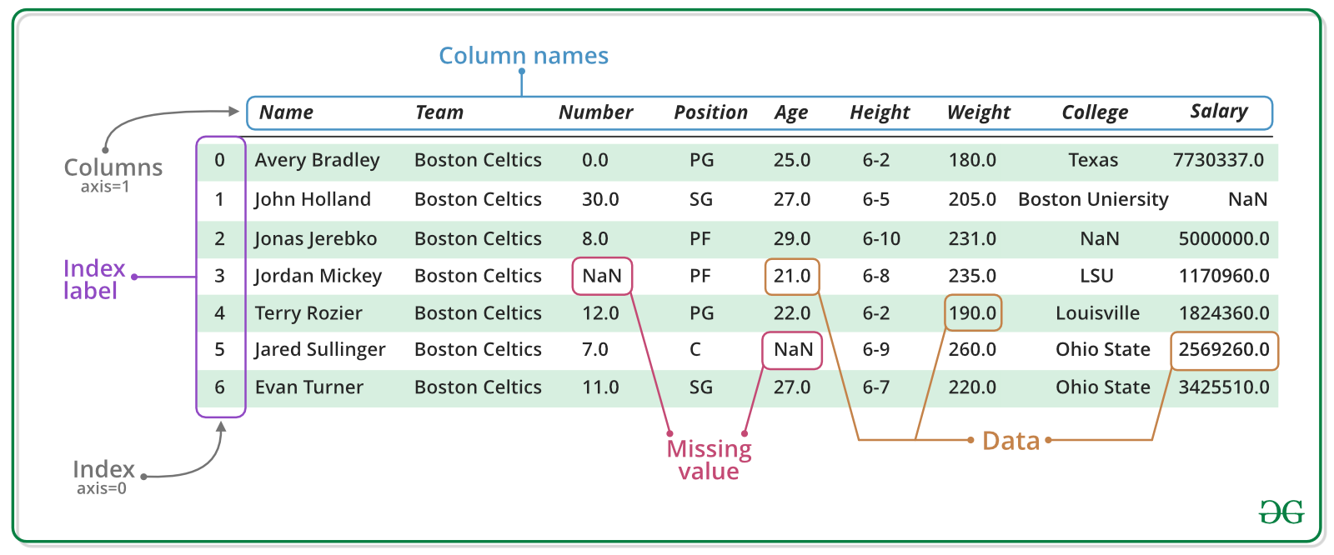
pandas DataFrame: overview
https://www.geeksforgeeks.org/creating-a-pandas-dataframe/

Slide 5
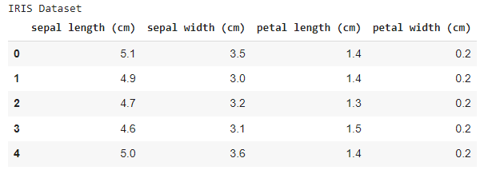
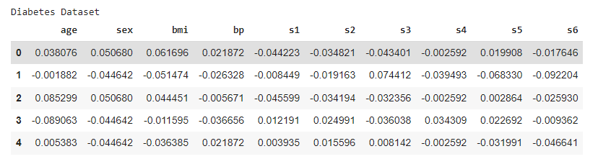
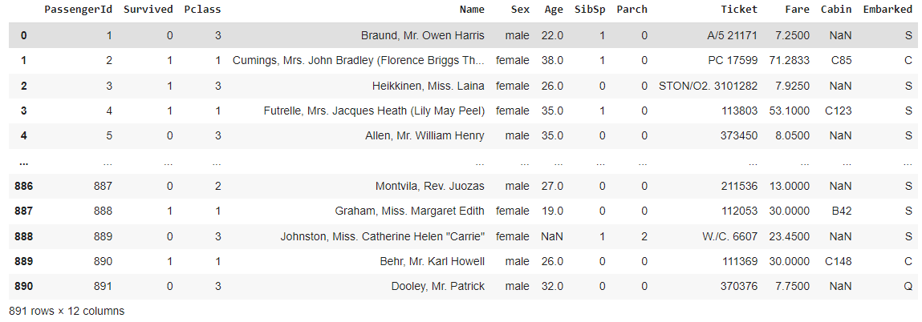
What is pandas? (contd.)
display(dataframe)
Notes:
Cross sectional data means that we have data from many units, at one point in time. Time series data means that we have data from one unit, over many points in time. Panel data (or time series cross section) means that we have data from many units, over many points in time.

Slide 6
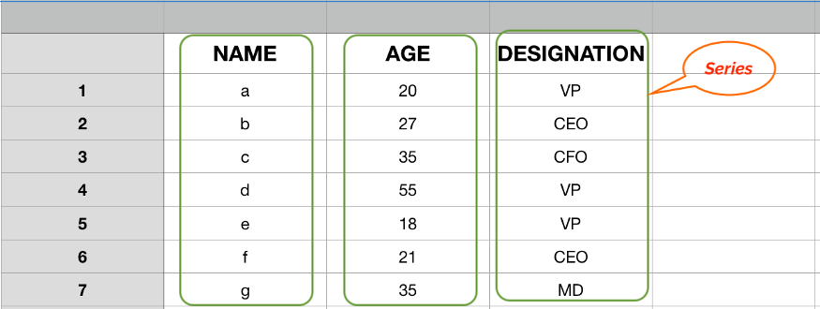
Pandas Series
https://towardsdatascience.com/pandas-series-a-lightweight-intro-b7963a0d62a2

Slide 7
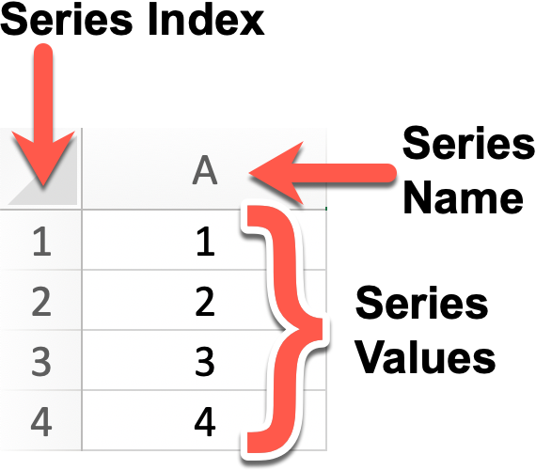
Series
Series = a column in a dataframe
Series = a row in a data frame
Series = row or column can be partial data matching some criteria
Typically, a series contains data of some type. (ints, strings, floats).
However, if add a float data to int column, then the whole series becomes ‘float’.
Similarly, if you add “string” data to a “float” column, then the whole series becomes “string”

Slide 8
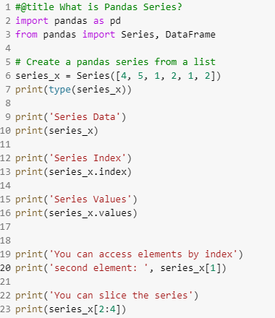
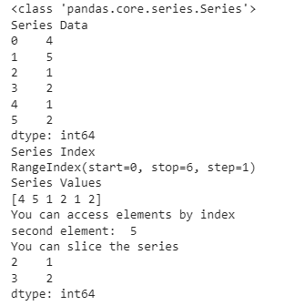
Series
One dimensional array-like object
It contains an array of data (of any NumPy data type) with associated indexes.
By default, the index will be from 0 to size-1
However, the indexes can be labeled with other data types (ex. Strings)

Slide 9
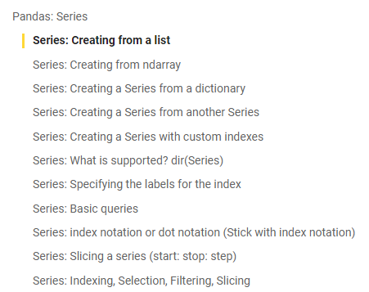
Series: Exploration
See the google colab notebook (1_pandas_intro_to_series.ipynb)

Slide 10

Pandas DataFrame

Slide 11
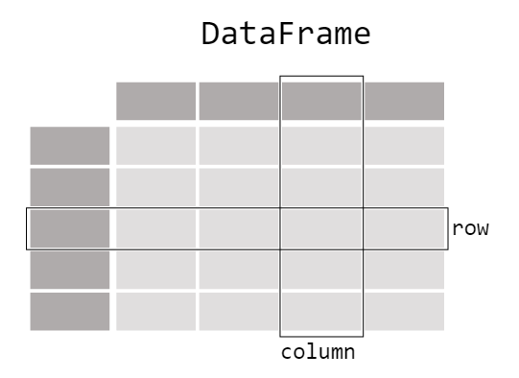
DataFrame: Visualization

Slide 12
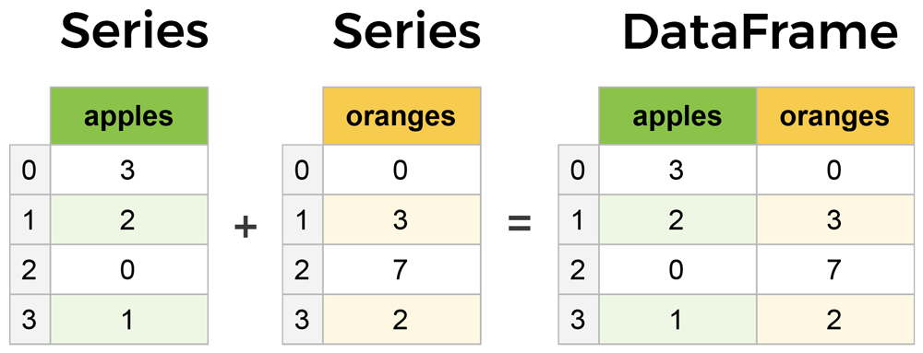
pandas = Series & DataFrames
Series is a sequence or column
DataFrame is a collection of Series
DataFrames and Series are quite similar (accessing, index labeling, slicing, descriptive statistics, etc.)
Series is a one-dimensional array (D) like structure with homogeneous data.
DataFrame is a two-dimensional array (2D) with heterogeneous data.
columns
rows

Slide 13
DataFrame: Creating
pandas.DataFrame(data, index , columns , dtype , copy )
data: data takes various forms like ndarray, series, map, lists, dict, constants and also another DataFrame.
index: For the row labels, that are to be used for the resulting frame, Optional, Default is np.arrange(n)if no index is passed.
columns: For column labels, the optional default syntax is - np.arrange(n). This is only true if no index is passed.
dtype: Data type of each column.
copy: This command is used for copying data. The default is False.

Slide 14
DataFrame: Source of creation
pandas.DataFrame(data, index , columns , dtype , copy )
  A pandas DataFrame can be created using various inputs like −
    Lists
    dict
    Series
    Numpy ndarrays
    Another DataFrame

Slide 15
pandas.DataFrame
pandas.DataFrame(data, index , columns , dtype , copy )
data: data takes various forms like ndarray, series, map, lists, dict, constants and also another DataFrame.
index: For the row labels, that are to be used for the resulting frame, Optional, Default is np.arrange(n)if no index is passed.
columns: For column labels, the optional default syntax is - np.arrange(n). This is only true if no index is passed.
dtype: Data type of each column.
copy: This command (or whatever it is) is used for copying of data, if the default is False.
Create DataFrame
  A pandas DataFrame can be created using various inputs like −
    Lists
    dict
    Series
    Numpy ndarrays
    Another DataFrame

Slide 16
Creating a DataFrame from scratch

Slide 17
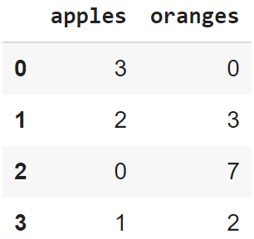
Creating a DataFrame from scratch
There are many ways to create a DataFrame from scratch, but a great option is to just use a simple dict. But first you must import pandas.
Let's say we have a fruit stand that sells apples and oranges. We want to have a column for each fruit and a row for each customer purchase. To organize this as a dictionary for pandas we could do something like:
And then pass it to the pandas DataFrame constructor:
import pandas as pd
data = { 'apples':[3, 2, 0, 1] , 'oranges':[0, 3, 7, 2] }
df = pd.DataFrame(data)

Slide 18
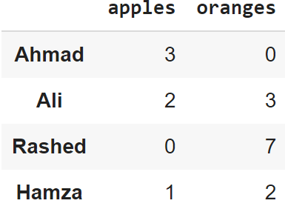
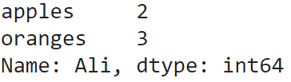
How did that work?
Each (key, value) item in data corresponds to a column in the resulting DataFrame.
The Index of this DataFrame was given to us on creation as the numbers 0-3, but we could also create our own when we initialize the DataFrame.
E.g. if you want to have customer names as the index:
df = pd.DataFrame(data, index=['Ahmad', 'Ali', 'Rashed', 'Hamza'])
So now we could locate a customer's order by using their names:
df.loc['Ali']

Slide 19
pandas.DataFrame.from_dict
pandas.DataFrame.from_dict(data, orient='columns', dtype=None, columns=None)
data : dict
  Of the form {field:array-like} or {field:dict}.
orient : {‘columns’, ‘index’}, default ‘columns’
  The “orientation” of the data.
  If the keys of the passed dict should be the columns of the resulting DataFrame, pass ‘columns’ (default).
  Otherwise if the keys should be rows, pass ‘index’.
dtype : dtype, default None
  Data type to force, otherwise infer.
columns : list, default None
  Column labels to use when orient='index'. Raises a ValueError if used with orient='columns'.
https://pandas.pydata.org/pandas-docs/version/0.23/generated/pandas.DataFrame.from_dict.html

Slide 20
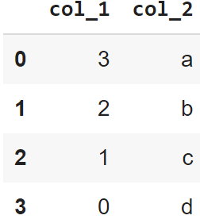
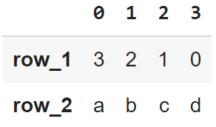
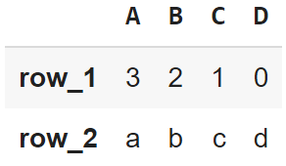
pandas’ orient keyword
data = {'col_1':[3, 2, 1, 0], 'col_2':['a','b','c','d']}
pd.DataFrame.from_dict(data)
data = {'row_1':[3, 2, 1, 0], 'row_2':['a','b','c','d']}
pd.DataFrame.from_dict(data,
orient='index')
data = {'row_1':[3, 2, 1, 0], 'row_2':['a','b','c','d']}
pd.DataFrame.from_dict(data,
orient = 'index',
columns = ['A','B','C','D'])

Slide 21
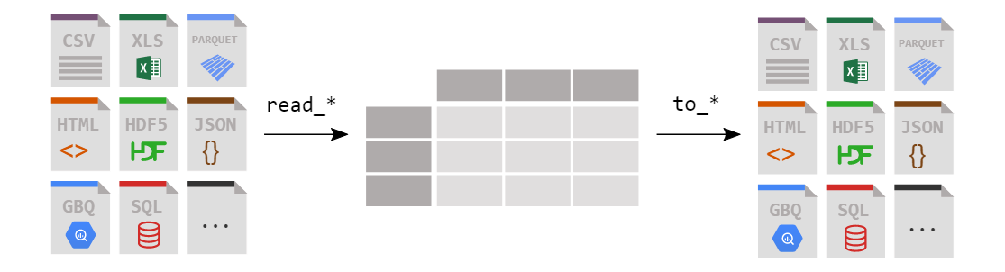
Loading a DataFrame from files

Slide 22
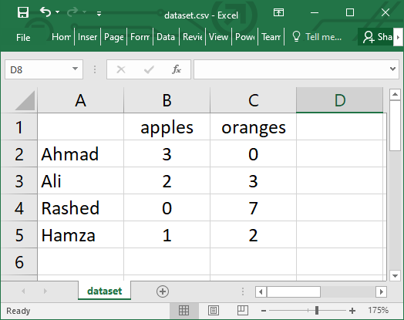
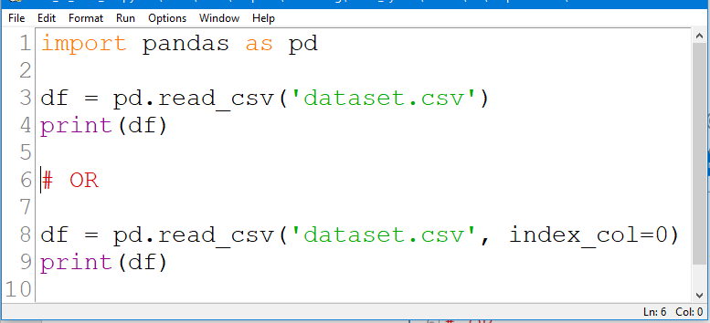
Reading data from a CSV file

Slide 23
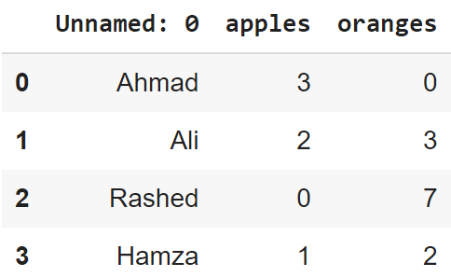
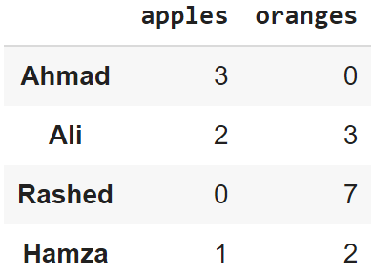
Reading data from CSVs
With CSV files, all you need is a single line to load in the data:
df = pd.read_csv('dataset.csv')
CSVs don't have indexes like our DataFrames, so all we need to do is just designate the index_col when reading:
df = pd.read_csv('dataset.csv', index_col=0)
Note: here we're setting the index to be column zero.

Slide 24
Reading data from JSON
If you have a JSON file — which is essentially a stored Python dict — pandas can read this just as easily:
df = pd.read_json('dataset.json')
Notice this time our index came with us correctly since using JSON allowed indexes to work through nesting.
Pandas will try to figure out how to create a DataFrame by analyzing structure of your JSON, and sometimes it doesn't get it right.
Often you'll need to set the orient keyword argument depending on the structure

Slide 25
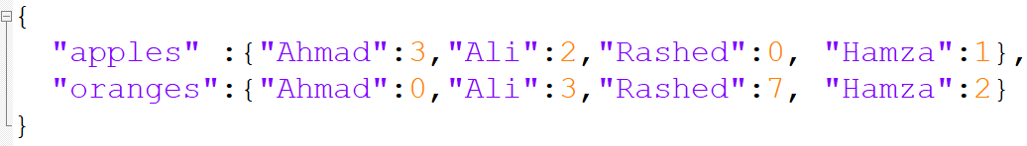
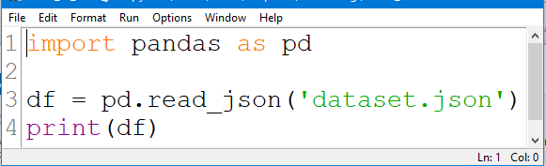
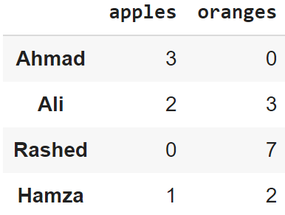
Example #1:Reading data from JSON

Slide 26
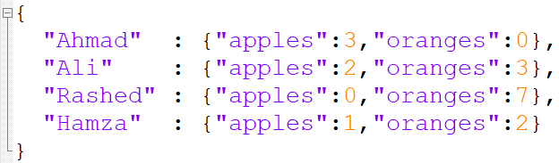
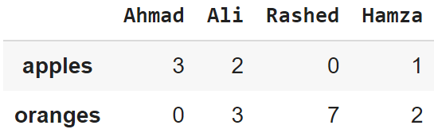
Example #2: Reading data from JSON

Slide 27
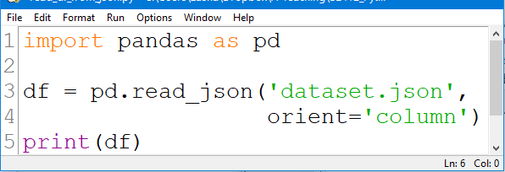
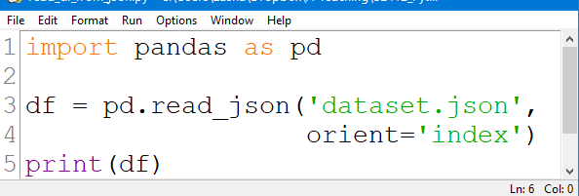
Example #3: Reading data from JSON

Slide 28
Converting back to a CSV or JSON
So after extensive work on cleaning your data, you’re now ready to save it as a file of your choice. Similar to the ways we read in data, pandas provides intuitive commands to save it:
When we save JSON and CSV files, all we have to input into those functions is our desired filename with the appropriate file extension.
df.to_csv('new_dataset.csv')
df.to_json('new_dataset.json')
df.to_sql('new_dataset', con)
Reference: https://pandas.pydata.org/pandas-docs/stable/reference/api/pandas.DataFrame.to_json.html

Slide 29
Most important DataFrame operations
DataFrames possess hundreds of methods and other operations that are crucial to any analysis.
As a beginner, you should know the operations that:
  that perform simple transformations of your data and those
  that provide fundamental statistical analysis on your data.

Slide 30
Loading dataset
We're loading this dataset from a CSV and designating the movie titles to be our index.
movies_df = pd.read_csv("movies.csv", index_col="title")
https://grouplens.org/datasets/movielens/

Slide 31
Viewing your data
The first thing to do when opening a new dataset is print out a few rows to keep as a visual reference. We accomplish this with .head():
.head() outputs the first five rows of your DataFrame by default, but we could also pass a number as well: movies_df.head(10) would output the top ten rows, for example.
To see the last five rows use .tail() that also accepts a number, and in this case we printing the bottom two rows.:
movies_df.head()
movies_df.tail(2)

Slide 32
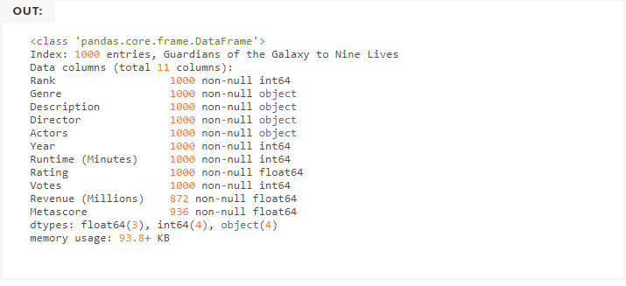

Getting info about your data
.info() should be one of the very first commands you run after loading your data
.info() provides the essential details about your dataset, such as the number of rows and columns, the number of non-null values, what type of data is in each column, and how much memory your DataFrame is using.
movies_df.info()
movies_df.shape

Slide 33


Handling duplicates
This dataset does not have duplicate rows, but it is always important to verify you aren't aggregating duplicate rows.
To demonstrate, let's simply just double up our movies DataFrame by appending it to itself:
Using append() will return a copy without affecting the original DataFrame. We are capturing this copy in temp so we aren't working with the real data.
Notice call .shape quickly proves our DataFrame rows have doubled.
temp_df = movies_df.append(movies_df)
temp_df.shape
Now we can try dropping duplicates:
temp_df = temp_df.drop_duplicates()
temp_df.shape

Slide 34
Handling duplicates
Just like append(), the drop_duplicates() method will also return a copy of your DataFrame, but this time with duplicates removed. Calling .shape confirms we're back to the 1000 rows of our original dataset.
It's a little verbose to keep assigning DataFrames to the same variable like in this example. For this reason, pandas has the inplace keyword argument on many of its methods. Using inplace=True will modify the DataFrame object in place:
Another important argument for drop_duplicates() is keep, which has three possible options:
  first: (default) Drop duplicates except for the first occurrence.
  last: Drop duplicates except for the last occurrence.
  False: Drop all duplicates.
temp_df.drop_duplicates(inplace=True)
https://www.learndatasci.com/tutorials/python-pandas-tutorial-complete-introduction-for-beginners/

Slide 35
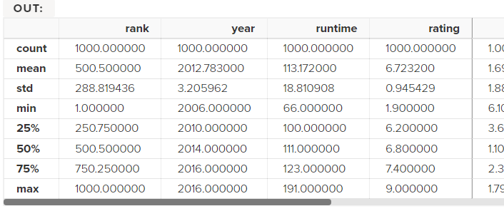
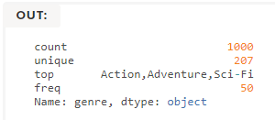
Understanding your variables
Using .describe() on an entire DataFrame we can get a summary of the distribution of continuous variables:
.describe() can also be used on a categorical variable to get the count of rows, unique count of categories, top category, and freq of top category:
This tells us that the genre column has 207 unique values, the top value is Action/Adventure/Sci-Fi, which shows up 50 times (freq).
movies_df.describe()
movies_df['genre'].describe()

Slide 36


More Examples
import pandas as pd
data = [1,2,3,10,20,30]
df = pd.DataFrame(data)
print(df)
import pandas as pd
data = {'Name' : ['AA', 'BB'], 'Age': [30,45]}
df = pd.DataFrame(data)
print(df)

Slide 37
More Examples
import pandas as pd
data = [{'a': 1, 'b': 2},{'a': 5, 'b': 10, 'c': 20}]
df = pd.DataFrame(data)
print(df)
a b c
0 1 2 NaN
1 5 10 20.0
import pandas as pd
data = [{'a': 1, 'b': 2},{'a': 5, 'b': 10, 'c': 20}]
df = pd.DataFrame(data, index=['first', 'second'])
print(df)
a b c
first 1 2 NaN
second 5 10 20.0

Slide 38
More Examples
E.g. This shows how to create a DataFrame with a list of dictionaries, row indices, and column indices.
import pandas as pd
data = [{'a': 1, 'b': 2},{'a': 5, 'b': 10, 'c': 20}]
#With two column indices, values same as dictionary keys
df1 = pd.DataFrame(data,index=['first','second'],columns=['a','b'])
#With two column indices with one index with other name
df2 = pd.DataFrame(data,index=['first','second'],columns=['a','b1'])
print(df1)
print('...........')
print(df2)
a b
first 1 2
second 5 10
...........
a b1
first 1 NaN
second 5 NaN

Slide 39
More Examples:
Create a DataFrame from Dict of Series
import pandas as pd
d = {'one' : pd.Series([1, 2, 3] , index=['a', 'b', 'c']),
'two' : pd.Series([1,2, 3, 4], index=['a', 'b', 'c', 'd'])
}
df = pd.DataFrame(d)
print(df)
one two
a 1.0 1
b 2.0 2
c 3.0 3
d NaN 4

Slide 40
More Examples: Column Addition
import pandas as pd
d = {'one':pd.Series([1,2,3], index=['a','b','c']),
'two':pd.Series([1,2,3,4], index=['a','b','c','d'])
}
df = pd.DataFrame(d)
# Adding a new column to an existing DataFrame object
# with column label by passing new series
print("Adding a new column by passing as Series:")
df['three'] = pd.Series([10,20,30],index=['a','b','c'])
print(df)
print("Adding a column using an existing columns in DataFrame:")
df['four'] = df['one']+df['three']
print(df)
Adding a column using Series:
one two three
a 1.0 1 10.0
b 2.0 2 20.0
c 3.0 3 30.0
d NaN 4 NaN
Adding a column using columns:
one two three four
a 1.0 1 10.0 11.0
b 2.0 2 20.0 22.0
c 3.0 3 30.0 33.0
d NaN 4 NaN NaN

Slide 41
More Examples: Column Deletion
# Using the previous DataFrame, we will delete a column
# using del function
import pandas as pd
d = {'one' : pd.Series([1, 2, 3], index=['a', 'b', 'c']),
'two' : pd.Series([1, 2, 3, 4], index=['a', 'b', 'c', 'd']),
'three' : pd.Series([10,20,30], index=['a','b','c'])
}
df = pd.DataFrame(d)
print ("Our dataframe is:")
print(df)
# using del function
print("Deleting the first column using DEL function:")
del df['one']
print(df)
# using pop function
print("Deleting another column using POP function:")
df.pop('two')
print(df)
Our dataframe is:
one two three
a 1.0 1 10.0
b 2.0 2 20.0
c 3.0 3 30.0
d NaN 4 NaN
Deleting the first column:
two three
a 1 10.0
b 2 20.0
c 3 30.0
d 4 NaN
Deleting another column:
a 10.0
b 20.0
c 30.0
d NaN

Slide 42
More Examples: Slicing in DataFrames
import pandas as pd
d = {'one' : pd.Series([1, 2, 3], index=['a', 'b', 'c']),
'two' : pd.Series([1, 2, 3, 4], index=['a', 'b', 'c','d'])
}
df = pd.DataFrame(d)
print(df[2:4])
one two
c 3.0 3
d NaN 4

Slide 43
More Examples: Addition of rows
import pandas as pd
d = {'one' : pd.Series([1, 2, 3], index=['a', 'b', 'c']),
'two' : pd.Series([1, 2, 3, 4], index=['a', 'b', 'c','d'])
}
df = pd.DataFrame(d)
print(df)
df2 = pd.DataFrame([[5,6], [7,8]], columns = ['a', 'b'])
df = df.append(df2 )
print(df)
one two
a 1.0 1
b 2.0 2
c 3.0 3
d NaN 4
one two a b
a 1.0 1.0 NaN NaN
b 2.0 2.0 NaN NaN
c 3.0 3.0 NaN NaN
d NaN 4.0 NaN NaN
0 NaN NaN 5.0 6.0
1 NaN NaN 7.0 8.0

Slide 44
More Examples: Deletion of rows
import pandas as pd
d = {'one':pd.Series([1, 2, 3], index=['a','b','c']),
'two':pd.Series([1, 2, 3, 4], index=['a','b','c','d'])
}
df = pd.DataFrame(d)
print(df)
df2 = pd.DataFrame([[5,6], [7,8]], columns = ['a', 'b'])
df = df.append(df2 )
print(df)
df = df.drop(0)
print(df)
one two
a 1.0 1
b 2.0 2
c 3.0 3
d NaN 4
one two a b
a 1.0 1.0 NaN NaN
b 2.0 2.0 NaN NaN
c 3.0 3.0 NaN NaN
d NaN 4.0 NaN NaN
0 NaN NaN 5.0 6.0
NaN NaN 7.0 8.0
one two a b
a 1.0 1.0 NaN NaN
b 2.0 2.0 NaN NaN
c 3.0 3.0 NaN NaN
d NaN 4.0 NaN NaN
1 NaN NaN 7.0 8.0

Slide 45
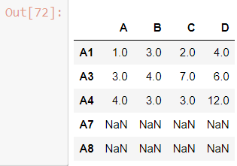
More Examples: Reindexing
Pandas dataframe.reindex_like() function return an object with matching indices to myself.
Any non-matching indexes are filled with NaN values.
import pandas as pd
# Creating the first dataframe
df1 = pd.DataFrame({"A":[1, 5, 3, 4, 2],
"B":[3, 2, 4, 3, 4],
"C":[2, 2, 7, 3, 4],
"D":[4, 3, 6, 12, 7]},
index =["A1", "A2", "A3", "A4", "A5"])
# Creating the second dataframe
df2 = pd.DataFrame({"A":[10, 11, 7, 8, 5],
"B":[21, 5, 32, 4, 6],
"C":[11, 21, 23, 7, 9],
"D":[1, 5, 3, 8, 6]},
index =["A1", "A3", "A4", "A7", "A8"])
# Print the first dataframe
print(df1)
print(df2)
# find matching indexes
df1.reindex_like(df2)

Slide 46
More Examples:
Concatenating Objects (Data Frames)
import pandas as pd
df1 = pd.DataFrame({'Name':['A','B'], 'SSN':[10,20], 'marks':[90, 95] })
df2 = pd.DataFrame({'Name':['B','C'], 'SSN':[25,30], 'marks':[80, 97] })
df3 = pd.concat([df1, df2])
df3

Slide 47
Handling categorical data
There are many data that are repetitive for example gender , country , and codes are always repetitive .
Categorical variables can take on only a limited
The categorical data type is useful in the following cases −
A string variable consisting of only a few different values. Converting such a string variable to a categorical variable will save some memory.
The lexical order of a variable is not the same as the logical order (“one”, “two”, “three”).
  By converting to a categorical and specifying an order on the categories, sorting and min/max will use the logical order instead of the lexical order.
As a signal to other python libraries that this column should be treated as a categorical variable (e.g. to use suitable statistical methods or plot types).

Slide 48
Examples
import pandas as pd
cat = pd.Categorical(['a', 'b', 'c', 'a', 'b', 'c'])
print(cat)
import pandas as pd
import numpy as np
cat = pd.Categorical(["a", "c", "c", np.nan], categories=["b", "a", "c"])
df = pd.DataFrame({"cat": cat, "s":["a", "c", "c", np.nan]})
print(df.describe())
print(df["cat"].describe())

Slide 49
Reading data from a SQL database
f you’re working with data from a SQL database you need to first establish a connection using an appropriate Python library, then pass a query to pandas. Here we'll use SQLite to demonstrate.
First, we need pysqlite3 installed, so run this command in your terminal:
  pip install pysqlite3
  Or run this cell if you're in a notebook: !pip install pysqlite3
sqlite3 is used to create a connection to a database which we can then use to generate a DataFrame through a SELECT query.
  So first we'll make a connection to a SQLite database file:
  In this SQLite database we have a table called purchases, and our index is in a column called "index".
  By passing a SELECT query and our con, we can read from the purchases table:
import sqlite3
con = sqlite3.connect("database.db")
df = pd.read_sql_query("SELECT * FROM purchases", con)

Slide 50
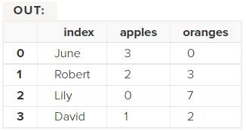
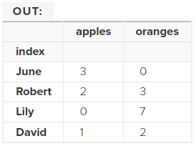
Reading data from a SQL database
In this SQLite database we have a table called purchases, and our index is in a column called "index".
By passing a SELECT query and our con, we can read from the purchases table:
Just like with CSVs, we could pass index_col='index', but we can also set an index after-the-fact:
  In fact, we could use set_index() on any DataFrame using any column at any time. Indexing Series and DataFrames is a very common task, and the different ways of doing it is worth remembering.
df = pd.read_sql_query("SELECT * FROM purchases", con)
df = df.set_index('index')

Slide 51
References
pandas documentation
  https://pandas.pydata.org/pandas-docs/stable/index.html
pandas: Input/output
  https://pandas.pydata.org/pandas-docs/stable/reference/io.html
pandas: DataFrame
  https://pandas.pydata.org/pandas-docs/stable/reference/frame.html
pandas: Series
  https://pandas.pydata.org/pandas-docs/stable/reference/series.html
pandas: Plotting
  https://pandas.pydata.org/pandas-docs/stable/reference/plotting.html

Slide 52
DataFrame
A DataFrame is a tabular data structure comprised of rows and columns, akin to a spreadsheet or database table.
It can be treated as an ordered collection of columns
  Each column can be a different data type
  Have both row and column indices
data = {'state': ['Ohio', 'Ohio', 'Ohio', 'Nevada', 'Nevada'],
'year': [2000, 2001, 2002, 2001, 2002],
'pop': [1.5, 1.7, 3.6, 2.4, 2.9]}
frame = DataFrame(data)
print(frame)
#output
state year pop
0 Ohio 2000 1.5
1 Ohio 2001 1.7
2 Ohio 2002 3.6
3 Nevada 2001 2.4
4 Nevada 2002 2.9

Slide 53
DataFrame – specifying columns and indices
Order of columns/rows can be specified.
Columns not in data will have NaN.
frame2 = DataFrame(data, columns=['year', 'state', 'pop', 'debt'], index=['A', 'B', 'C', 'D', 'E'])
Print(frame2)
year state pop debt
A 2000 Ohio 1.5 NaN
B 2001 Ohio 1.7 NaN
C 2002 Ohio 3.6 NaN
D 2001 Nevada 2.4 NaN
E 2002 Nevada 2.9 NaN
Same order
Initialized with NaN

Slide 54
DataFrame – from nested dict of dicts
Outer dict keys as columns and inner dict keys as row indices
pop = {'Nevada': {2001: 2.9, 2002: 2.9}, 'Ohio': {2002: 3.6, 2001: 1.7, 2000: 1.5}}
frame3 = DataFrame(pop)
print(frame3)
#output
Nevada Ohio
2000 NaN 1.5
2001 2.9 1.7
2002 2.9 3.6
Transpose
print(frame3.T)
2000 2001 2002
Nevada NaN 2.9 2.9
Ohio 1.5 1.7 3.6
Union of inner keys (in sorted order)

Slide 55
DataFrame – index, columns, values
frame3.index.name = 'year'
frame3.columns.name='state‘
print(frame3)
state Nevada Ohio
year
2000 NaN 1.5
2001 2.9 1.7
2002 2.9 3.6
print(frame3.index)
Int64Index([2000, 2001, 2002], dtype='int64', name='year')
print(frame3.columns)
Index(['Nevada', 'Ohio'], dtype='object', name='state')
print(frame3.values)
[[nan 1.5]
[2.9 1.7]
[2.9 3.6]]

Slide 56
DataFrame – retrieving a column
A column in a DataFrame can be retrieved as a Series by dict-like notation or as attribute
data = {'state': ['Ohio', 'Ohio', 'Ohio', 'Nevada', 'Nevada'],
'year': [2000, 2001, 2002, 2001, 2002],
'pop': [1.5, 1.7, 3.6, 2.4, 2.9]}
frame = DataFrame(data)
print(frame['state'])
0 Ohio
1 Ohio
2 Ohio
3 Nevada
4 Nevada
Name: state, dtype: object
print(frame.state)
0 Ohio
1 Ohio
2 Ohio
3 Nevada
4 Nevada
Name: state, dtype: object

Slide 57
Activity 5
Download the following csv file and load it to your python module or use the url directly in pd.read_csv(url) which will read it to a DataFrame
  https://www.cs.odu.edu/~sampath/courses/f19/cs620/files/data/values.csv
Calculate the average and standard deviation (std) of the column factor_1 and display the result.
  Pandas mean() and std()
Notes:
Obj = pd.read_csv(‘values.csv’)

Slide 58
DataFrame – getting rows
loc for using indexes and iloc for using positions
  loc gets rows (or columns) with particular labels from the index.
  iloc gets rows (or columns) at particular positions in the index (so it only takes integers).
data = {'state': ['Ohio', 'Ohio', 'Ohio', 'Nevada', 'Nevada'],
'year': [2000, 2001, 2002, 2001, 2002],
'pop': [1.5, 1.7, 3.6, 2.4, 2.9]}
frame2 = DataFrame(data, columns=['year', 'state', 'pop', 'debt'], index=['A', 'B', 'C', 'D', 'E'])
print(frame2)
year state pop debt
A 2000 Ohio 1.5 NaN
B 2001 Ohio 1.7 NaN
C 2002 Ohio 3.6 NaN
D 2001 Nevada 2.4 NaN
E 2002 Nevada 2.9 NaN
print(frame2.loc['A'])
year 2000
state Ohio
pop 1.5
debt NaN
Name: A, dtype: object
print(frame2.loc[['A', 'B']])
year state pop debt
A 2000 Ohio 1.5 NaN
B 2001 Ohio 1.7 NaN
print(frame2.loc['A':'E',['state','pop']])
state pop
A Ohio 1.5
B Ohio 1.7
C Ohio 3.6
D Nevada 2.4
E Nevada 2.9
print(frame2.iloc[1:3])
year state pop debt
B 2001 Ohio 1.7 NaN
C 2002 Ohio 3.6 NaN
print(frame2.iloc[:,1:3])
state pop
A Ohio 1.5
B Ohio 1.7
C Ohio 3.6
D Nevada 2.4
E Nevada 2.9

Slide 59
DataFrame – modifying columns
frame2['debt'] = 0
print(frame2)
year state pop debt
A 2000 Ohio 1.5 0
B 2001 Ohio 1.7 0
C 2002 Ohio 3.6 0
D 2001 Nevada 2.4 0
E 2002 Nevada 2.9 0
frame2['debt'] = range(5)
print(frame2)
year state pop debt
A 2000 Ohio 1.5 0
B 2001 Ohio 1.7 1
C 2002 Ohio 3.6 2
D 2001 Nevada 2.4 3
E 2002 Nevada 2.9 4
val = Series([10, 10, 10], index = ['A', 'C', 'D'])
frame2['debt'] = val
print(frame2)
year state pop debt
A 2000 Ohio 1.5 10.0
B 2001 Ohio 1.7 NaN
C 2002 Ohio 3.6 10.0
D 2001 Nevada 2.4 10.0
E 2002 Nevada 2.9 NaN
Rows or individual elements can be modified similarly. Using loc or iloc.

Slide 60
DataFrame – removing columns
del frame2['debt']
print(frame2)
year state pop
A 2000 Ohio 1.5
B 2001 Ohio 1.7
C 2002 Ohio 3.6
D 2001 Nevada 2.4
E 2002 Nevada 2.9
Notes:
Df = frame.drop('r1', 0) # 0 for row, 1 for columns

Slide 61
More on DataFrame indexing
import numpy as np
data = np.arange(9).reshape(3,3)
print(data)
[[0 1 2]
[3 4 5]
[6 7 8]]
frame = DataFrame(data, index=['r1', 'r2', 'r3'], columns=['c1', 'c2', 'c3'])
print(frame)
c1 c2 c3
r1 0 1 2
r2 3 4 5
r3 6 7 8
print(frame['c1'])
r1 0
r2 3
r3 6
Name: c1, dtype: int32
print(frame.loc['r1'])
c1 0
c2 1
c3 2
Name: r1, dtype: int32
print(frame['c1']['r1'])
0
print(frame[['c1', 'c3']])
c1 c3
r1 0 2
r2 3 5
r3 6 8
print(frame.loc[['r1','r3']])
c1 c2 c3
r1 0 1 2
r3 6 7 8
print(frame.iloc[:2])
c1 c2 c3
r1 0 1 2
r2 3 4 5
print(frame[:2])
c1 c2 c3
r1 0 1 2
r2 3 4 5
Row slices

Slide 62
More on DataFrame indexing - 2
print(frame.loc[['r1', 'r2'], ['c1', 'c2']])
c1 c2
r1 0 1
r2 3 4
print(frame.iloc[:2,:2])
c1 c2
r1 0 1
r2 3 4
v = DataFrame(np.arange(9).reshape(3,3), index=['a', 'a', 'b'], columns=['c1','c2','c3'])
print(v)
c1 c2 c3
a 0 1 2
a 3 4 5
b 6 7 8
print(v.loc['a'])
c1 c2 c3
a 0 1 2
a 3 4 5
print(frame.loc['r1':'r3', 'c1':'c3'])
c1 c2 c3
r1 0 1 2
r2 3 4 5
r3 6 7 8
Duplicated keys

Slide 63
More on DataFrame indexing - 3
print(frame)
c1 c2 c3
r1 0 1 2
r2 3 4 5
r3 6 7 8
print(frame <3)
c1 c2 c3
r1 True True True
r2 False False False
r3 False False False
print(frame[frame['c1']>0])
c1 c2 c3
r2 3 4 5
r3 6 7 8
print(frame['c1']>0)
r1 False
r2 True
r3 True
Name: c1, dtype: bool
frame[frame<3] = 3
print(frame)
c1 c2 c3
r1 3 3 3
r2 3 4 5
r3 6 7 8

Slide 64
Activity 6
Create a numpy array of the shape (3,5): 3 rows and 5 columns with random values from 1 to 100
  Use np.random.randint(low,high, (shape))
Use the numpy array to generate a Data Frame with index = a,b,c and columns 1,2,3,4, 5
Transpose (using .T) the DataFrame and change the values less than 40 to 0 in the Data Frame.
Notes:
Obj = pd.read_csv(‘values.csv’)

Slide 65
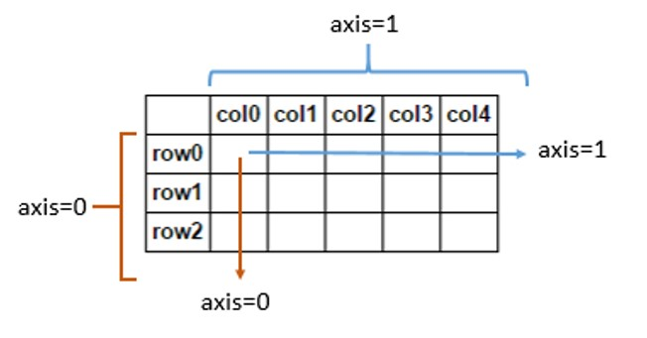
Removing rows/columns
print(frame)
c1 c2 c3
r1 0 1 2
r2 3 4 5
r3 6 7 8
print(frame.drop(['r1']))
c1 c2 c3
r2 3 4 5
r3 6 7 8
print(frame.drop(['r1','r3']))
c1 c2 c3
r2 3 4 5
print(frame.drop(['c1'], axis=1))
c2 c3
r1 1 2
r2 4 5
r3 7 8
This returns a new object

Slide 66
Reindexing
Alter the order of rows/columns of a DataFrame or order of a series according to new index
frame2 = frame.reindex(columns=['c2', 'c3', 'c1'])
print(frame2)
c2 c3 c1
r1 1 2 0
r2 4 5 3
r3 7 8 6
frame2 = frame.reindex(['r1', 'r3', 'r2', 'r4'])
c1 c2 c3
r1 0.0 1.0 2.0
r3 6.0 7.0 8.0
r2 3.0 4.0 5.0
r4 NaN NaN NaN
This returns a new object

Slide 67
Function application and mapping
DataFrame.applymap(f) applies f to every entry
DataFrame.apply(f) applies f to every column (default) or row
print(frame)
c1 c2 c3
r1 0 1 2
r2 3 4 5
r3 6 7 8
def square(x):
return x**2
print(frame.applymap(square))
c1 c2 c3
r1 0 1 4
r2 9 16 25
r3 36 49 64
def max_minus_min(x):
return max(x)-min(x)
print(frame.apply(max_minus_min))
c1 6
c2 6
c3 6
dtype: int64
print(frame.apply(max_minus_min,axis=1))
r1 2
r2 2
r3 2
dtype: int64

Slide 68
Function application and mapping - 2
def max_min(x):
return Series([max(x), min(x)], index=['max', 'min'])
print(frame.apply(max_min))
c1 c2 c3
max 6 7 8
min 0 1 2

Slide 69
Other DataFrame functions
sort_values()
sort_index()
frame.index=['A', 'C', 'B']; frame.columns=['b','a','c'];
print(frame)
b a c
A 0 1 2
C 3 4 5
B 6 7 8
print(frame.sort_index())
b a c
A 0 1 2
B 6 7 8
C 3 4 5
print(frame.sort_index(axis=1))
a b c
A 1 0 2
C 4 3 5
B 7 6 8
frame = DataFrame(np.random.randint(0, 10, 9).reshape(3,-1), index=['r1', 'r2', 'r3'], columns=['c1', 'c2', 'c3'])
print(frame)
c1 c2 c3
r1 6 9 0
r2 8 2 9
r3 8 0 6
print(frame.sort_values(by='c1'))
c1 c2 c3
r1 6 9 0
r2 8 2 9
r3 8 0 6
print(frame.sort_values(axis=1,by=['r3','r1']))
c2 c3 c1
r1 9 0 6
r2 2 9 8
r3 0 6 8

Slide 70
Activity 7
Use the Data Frame created at the Activity 6
Apply a lambda function to calculate the square root of each value in the data frame
  import math math.sqrt()
Notes:
Obj = pd.read_csv(‘values.csv’)

Slide 71
Other DataFrame functions
mean()
  Mean(axis=0, skipna=True)
sum()
cumsum()
describe(): return summary statistics of each column
  for numeric data: mean, std, max, min, 25%, 50%, 75%, etc.
  For non-numeric data: count, uniq, most-frequent item, etc.
corr(): correlation between two Series, or between columns of a DataFrame
corr_with(): correlation between columns of DataFram and a series or between the columns of another DataFrame

Slide 72
Handling missing data
Filtering out missing values
from numpy import nan as NaN
data = Series([1, NaN, 2.5, NaN, 6])
print(data)
0 1.0
1 NaN
2 2.5
3 NaN
6.0
dtype: float64
print(data.notnull())
0 True
1 False
2 True
3 False
4 True
dtype: bool
print(data[data.notnull()])
0 1.0
2 2.5
4 6.0
dtype: float64
print(data.dropna())
0 1.0
2 2.5
4 6.0
dtype: float64
Notes:
s.dropna(inplace=True)

Slide 73
Handling missing data - 2
data = DataFrame([[1, 2, 3], [1, NaN, NaN], [NaN, NaN, NaN], [NaN, 4, 5]])
print(data)
0 1 2
0 1.0 2.0 3.0
1 1.0 NaN NaN
2 NaN NaN NaN
NaN 4.0 5.0
print(data.dropna())
0 1 2
0 1.0 2.0 3.0
print(data.dropna(how='all'))
0 1 2
0 1.0 2.0 3.0
1 1.0 NaN NaN
NaN 4.0 5.0
print(data.dropna(axis=1, how='all'))
0 1 2
0 1.0 2.0 3.0
1 1.0 NaN NaN
2 NaN NaN NaN
3 NaN 4.0 5.0
data[4]=NaN
print(data)
0 1 2 4
0 1.0 2.0 3.0 NaN
1 1.0 NaN NaN NaN
2 NaN NaN NaN NaN
NaN 4.0 5.0 NaN
print(data.dropna(axis=1, how='all'))
0 1 2
0 1.0 2.0 3.0
1 1.0 NaN NaN
2 NaN NaN NaN
3 NaN 4.0 5.0

Slide 74
Filling in missing data
print(data)
0 1 2 4
0 1.0 2.0 3.0 NaN
1 1.0 NaN NaN NaN
2 NaN NaN NaN NaN
NaN 4.0 5.0 NaN
print(data.fillna(0))
0 1 2 4
0 1.0 2.0 3.0 0.0
1 1.0 0.0 0.0 0.0
2 0.0 0.0 0.0 0.0
3 0.0 4.0 5.0 0.0
print(data)
0 1 2
0 1.0 2.0 3.0
1 1.0 NaN NaN
2 NaN NaN NaN
3 NaN 4.0 5.0
print(data.fillna(data.mean(skipna=True)))
0 1 2
0 1.0 2.0 3.0
1 1.0 3.0 4.0
2 1.0 3.0 4.0
3 1.0 4.0 5.0
print(data.fillna(0, inplace=True))
print(data)
0 1 2 4
0 1.0 2.0 3.0 0.0
1 1.0 0.0 0.0 0.0
2 0.0 0.0 0.0 0.0
3 0.0 4.0 5.0 0.0
replace nan with column mean
Modify the dataframe instead of returning a new object (default)

Slide 75
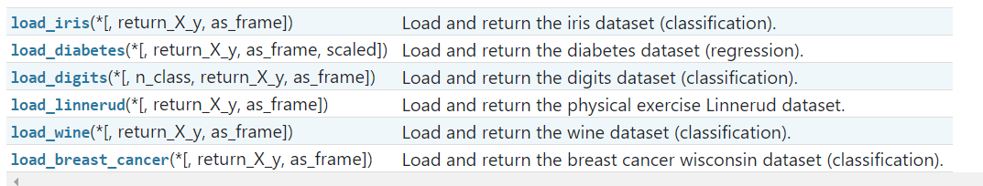
Toy Datasets in sklearn
scikit-learn comes with a few small standard datasets
They can be loaded using the following function
You can convert those to pandas dataframes
https://scikit-learn.org/stable/datasets/toy_dataset.html

Slide 76
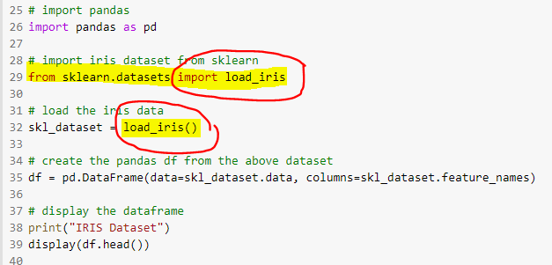
Loading sklearn datasets into pandas

Slide 77

Thank You.

