Slide 1
Course | ICS 352 Machine Learning
Term
Week
Date
Chapter. Topic
K Nearest Neighbors
Siva R Jasthi
Computer Science and Cybersecurity
Metropolitan State University

Slide 2
Supervised Learning
A training set of examples with the correct responses is provided
Based on this training set
  The algorithm generalizes to response correctly to all possible inputs
    Image recognition
Known as learning from exemplars

Slide 3
Nearest Neighbor Classifier
Basic idea:
  If it walks like a duck, quacks like a duck, then it’s probably a duck
Compute Distance
Test Record
Training Records
Choose k of the “nearest” records
K= 5
These are 5 nearest / closest neighbors to the new test sample.

Slide 4
K-NN is based on
Instance-based Learning
  Learning=storing all training instances
  Classification=assigning target function to a new instance
Also, referred to as
  Instance Based Learning
  Lazy Learning
  Case Based Reasoning
  Exemplar Based Learning

Slide 5
K-NN : Basic classification principle
k-NN classification rule is to assign to a test sample the majority category label of its k-nearest training samples
In practice, k is usually chosen to be odd, so as to avoid ties
The k = 1 rule is generally called the nearest-neighbor classification rule

Slide 6
K-NN : Nearest Neighbors? How many?
K-nearest neighbors of a record x are data points that have the k smallest distance to x

Slide 7
K-NN for Classification and Regression
In k-NN classification, the output is a class membership. An object is classified by a plurality vote of its neighbors, with the object being assigned to the class most common among its k nearest neighbors (k is a positive integer, typically small).
In k-NN regression, the output is the property value for the object. This value is the average of the values of k nearest neighbors.
Question: What happens if k = 1?
Question: What happens if k = 2 or 4 or 6?

Slide 8
Applications of KNN
Classification: KNN is often used for classification tasks, such as image recognition, document classification, and sentiment analysis. In these applications, KNN is trained on labeled data to predict the class of new, unseen data points.
Regression: KNN can also be used for regression tasks, such as predicting the price of a house based on its features or estimating the demand for a product based on historical sales data.
Anomaly (Outlier) detection: KNN can be used for anomaly detection, where the goal is to identify unusual or anomalous data points that deviate significantly from the normal behavior of the system.
Recommender systems: KNN can be used to build personalized recommender systems that suggest items or products based on the user's past behavior or preferences.
Image retrieval: KNN can be used for content-based image retrieval, where the goal is to find images in a database that are similar to a query image based on their visual features.
Natural language processing: KNN can be used for tasks such as text classification, document clustering, and word sense disambiguation in natural language processing.
imputation: KNN can be used for missing value imputation, where missing values in a dataset are replaced with the average of their k-nearest neighbors.

Slide 9
Features of KNN
Intuitive: KNN is easy to understand and implement. The algorithm is based on the idea that objects that are close to each other are more likely to belong to the same class.
Non-parametric: KNN is a non-parametric algorithm, which means it does not make any assumptions about the underlying data distribution. This makes it more flexible and able to handle a wide range of data types and structures.
Versatile: KNN can be used for both classification and regression tasks. For classification, the algorithm assigns a label to a new data point based on the labels of its k-nearest neighbors. For regression, the algorithm predicts a numerical value based on the values of its k-nearest neighbors.
Handles multi-class problems: KNN can handle multi-class classification problems, where there are more than two classes to predict.
Robust to noisy data: KNN is robust to noisy data, as outliers and noise tend to have less influence on the final decision due to the averaging effect of the algorithm.

Slide 10
Dealing with non-numerical data
Preprocess the data to label the non-numerical data
Use different distance measures that can operate on non-numerical data.

Slide 11
Hyper-parameter for KNN (K)
K = Number of nearest neighbors
Which K gives the best performance?
You can build the model with different K values and find the corresponding Accuracy.
Even values for K are avoided for obvious reasons.
We want the majority VOTE from the nearest neighbors.
So, we need to avoid any possible ties.
Choosing the value of k:
  If k is too small, sensitive to noise points
  If k is too large, neighborhood may include points from other classes
Rule of thumb:
K = sqrt(N)
N: number of training points

Slide 12
Hyper-parameter for KNN (Distance)
What distance measure is suitable?
1 1 1 1 1 1 1 1 1 1 1 0
1 0 0 0 0 0 0 0 0 0 0 0
vs
0 1 1 1 1 1 1 1 1 1 1 1
0 0 0 0 0 0 0 0 0 0 0 1
d = 1.4142
d = 1.4142

Slide 13
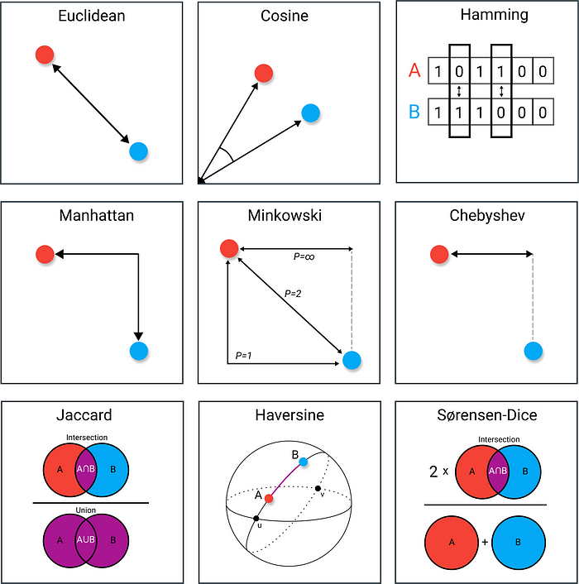
Hyper-parameter for KNN (Distance)
Distance Metric (default = Ecuclidean)
'euclidean', 'manhattan', 'minkowski’, ‘jaccard’, ‘hamming’
The choice of distance metric can have a significant impact on the performance of a KNN model, depending on the structure of the data and the problem bei
Euclidean distance is sensitive to scale. If you have data in different scales, using Manhattan distance or the Chebyshev distance may be more appropriate.
For categorical values, using Jaccard or Hamming distances may be more appropriate.
https://towardsdatascience.com/9-distance-measures-in-data-science-918109d069fa

Slide 14
K-NN : Computational Complexity
Suppose there are m instances and n features in the dataset
Nearest neighbor algorithm requires computing m distances
Each distance computation involves scanning through each feature value
Running time complexity is proportional to n * n

Slide 15
Summary
Very simple and intuitive ML algorithm
Useful for both Classification and Regression problems.
Two hyper parameters – K and Distance Metric

Slide 16
Any Questions?
Thank You.

