Slide 1
Course
Term
Week
Date
Chapter. Topic | Naïve Bayes Classification
Naïve Bayes Classificaiton
Siva R Jasthi
Computer Science and Cybersecurity
Metropolitan State University

Slide 2
Some classification problems
Email Spam Classification: This is a binary classification problem where the goal is to classify emails as spam or not spam. The input features are usually the text of the email and some metadata.
Image Classification: In this problem, the goal is to classify images into different categories. For example, identifying whether an image contains a cat or a dog. The input features are usually the pixel values of the image.
Sentiment Analysis: Sentiment analysis is the task of predicting the sentiment of a given text. This could be positive, negative, or neutral. The input features are usually the text itself.
Fraud Detection: Fraud detection is a binary classification problem where the goal is to detect fraudulent transactions in a dataset of credit card transactions. The input features could include the transaction amount, location, and other transaction metadata.
Medical Diagnosis: Medical diagnosis is a classification problem where the goal is to predict the presence or absence of a disease based on patient data such as symptoms, medical history, and test results.

Slide 3
Some classification problems (contd.)
6. Handwriting Recognition: Handwriting recognition is the task of classifying handwritten characters (pixel values) into their corresponding letters or numbers.
7. Customer Churn Prediction: In this problem, the goal is to predict whether a customer will stop using a service or product. The input features could include customer demographics, usage history, and satisfaction ratings.
8. Toxic Comment Classification: This is a text classification problem where the goal is to identify toxic comments in online forums or social media platforms.
9. Credit Risk Assessment: Credit risk assessment is a classification problem where the goal is to predict whether a loan applicant is likely to default on their loan payments. The input features could include the applicant's credit history, income, and employment status.
10. Traffic Sign Recognition: Traffic sign recognition is the task of classifying traffic signs in images captured by a camera installed in a vehicle. The input features are usually the pixel values of the image of the traffic sign.

Slide 4
Naïve Bayes Classifier
Problem statement:
  Given features X₁,X₂,…,X_{n}
  Predict a label Y
The Naïve Bayes Assumption: Assume that all features are independent given the class label Y

Slide 5
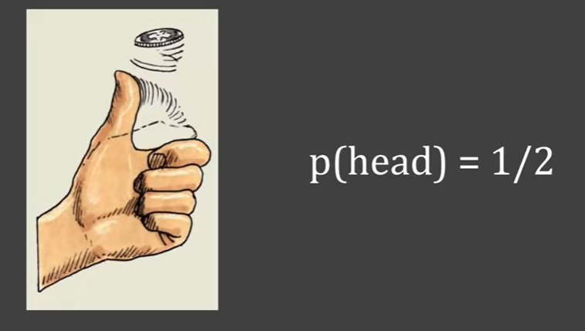
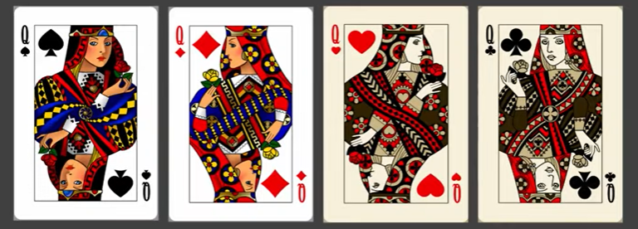
Probability Basics
What is the probability of getting a Head in a coin toss?
Number of Possibilities = 2
P(head) = 1/2
What is the probability of getting a Queen?
Total Cards = 52
Number of Queens = 4
P(Queen) = 4 / 52 = 1/13

Slide 6
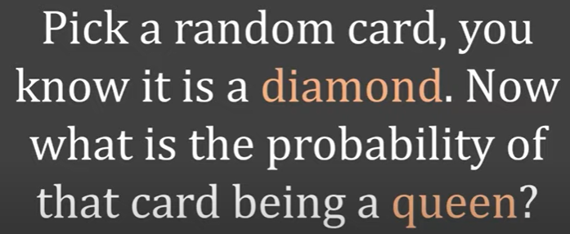
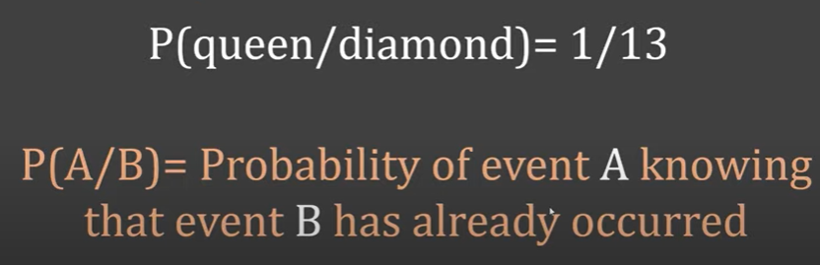
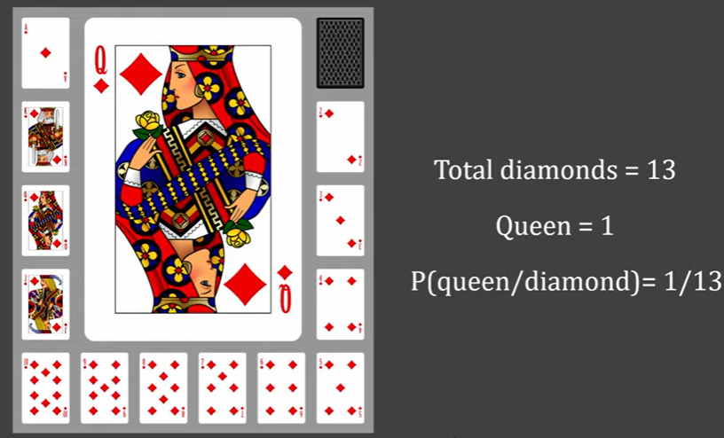
Conditional Probability

Slide 7
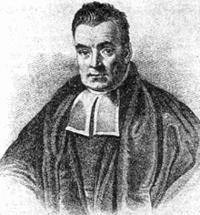
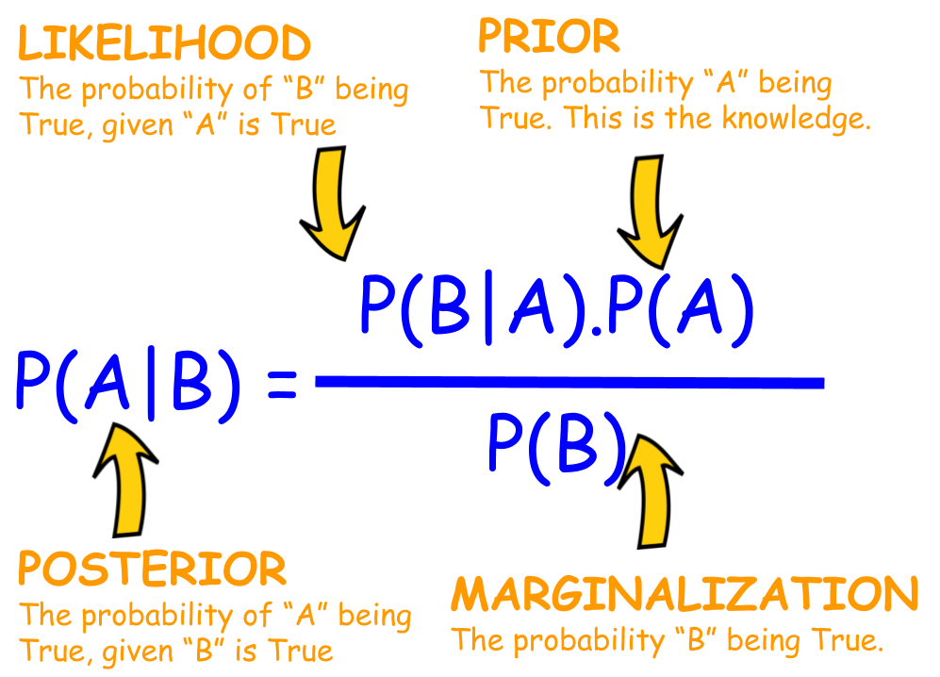
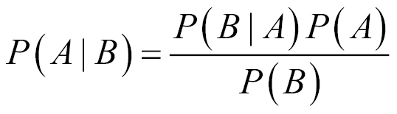
Bayes Theoram
Thomas Bayes
https://aman.ai/primers/ai/bayes-theorem/

Slide 8
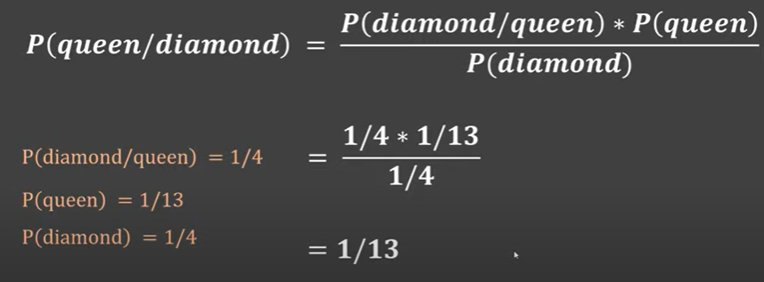
Conditional Probability

Slide 9
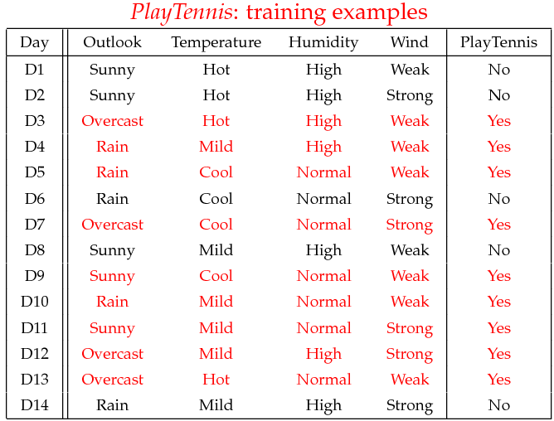
Example: Play Tennis
Training Examples

Slide 10
Example: Play Tennis: Learning Phase
Learning Phase
Outlook | Play=Yes | Play=No
Sunny | 2/9 | 3/5
Overcast | 4/9 | 0/5
Rain | 3/9 | 2/5
Temperature | Play=Yes | Play=No
Hot | 2/9 | 2/5
Mild | 4/9 | 2/5
Cool | 3/9 | 1/5
P(Play=Yes) = 9/14
Wind | Play=Yes | Play=No
Strong | 3/9 | 3/5
Weak | 6/9 | 2/5
Humidity | Play=Yes | Play=No
High | 3/9 | 4/5
Normal | 6/9 | 1/5
P(Play=No) = 5/14

Slide 11
Example: Play Tennis: Test Phase
Test Phase
  Given a new instance,
  x’=(Outlook=Sunny, Temperature=Cool, Humidity=High, Wind=Strong)
  Look up tables
  MAP rule
P(Outlook=Sunny|Play=Yes) = 2/9
P(Temperature=Cool|Play=Yes) = 3/9
P(Huminity=High|Play=Yes) = 3/9
P(Wind=Strong|Play=Yes) = 3/9
P(Play=Yes) = 9/14
P(Outlook=Sunny|Play=No) = 3/5
P(Temperature=Cool|Play==No) = 1/5
P(Huminity=High|Play=No) = 4/5
P(Wind=Strong|Play=No) = 3/5
P(Play=No) = 5/14
P(Yes|x’): [P(Sunny|Yes)P(Cool|Yes)P(High|Yes)P(Strong|Yes)]P(Play=Yes) = 0.0053
P(No|x’): [P(Sunny|No) P(Cool|No)P(High|No)P(Strong|No)]P(Play=No) = 0.0206
Given the fact P(Yes|x’) < P(No|x’), we label x’ to be “No”.

Slide 12
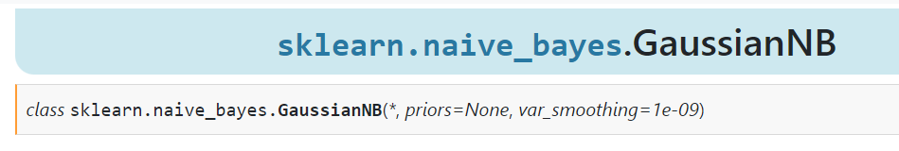
Gaussian Naive Bayes Model
This model assumes that the features are normally distributed and estimates the mean and variance of each feature for each class. It is suitable for continuous numerical data.
https://scikit-learn.org/stable/modules/generated/sklearn.naive_bayes.GaussianNB.html

Slide 13
Hyper Parameters for NB Classifier
priors: This is an optional parameter that allows you to specify prior probabilities for each class. The default is None, which means the prior probabilities are calculated from the training data.
var_smoothing: This is a smoothing parameter that is added to the variance of each feature. The default value is 1e-9, which is a small number to ensure numerical stability.

Slide 14
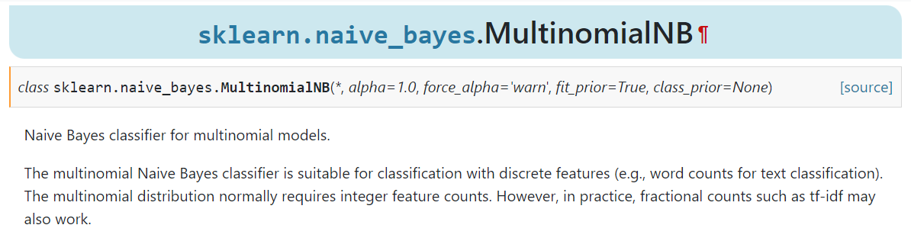
Multinomial Naive Bayes Model
Multinomial Naive Bayes: This model assumes that the features are generated from a multinomial distribution and counts the number of occurrences of each feature for each class. It is suitable for discrete count data, such as text data represented as word frequency counts.
https://scikit-learn.org/stable/modules/generated/sklearn.naive_bayes.MultinomialNB.html#sklearn.naive_bayes.MultinomialNB

Slide 15
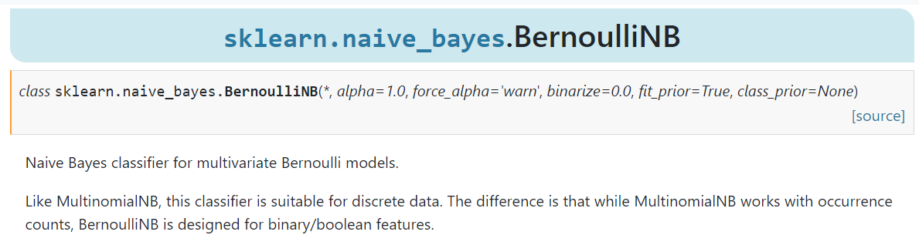
Bernoulli Naive Bayes Model
Bernoulli Naive Bayes: This model is similar to Multinomial Naive Bayes, but instead of counting the number of occurrences of each feature, it only considers whether a feature is present or not. It is suitable for binary data, such as text data represented as binary indicators of the presence or absence of words.
https://scikit-learn.org/stable/modules/generated/sklearn.naive_bayes.BernoulliNB.html#sklearn.naive_bayes.BernoulliNB

Slide 16
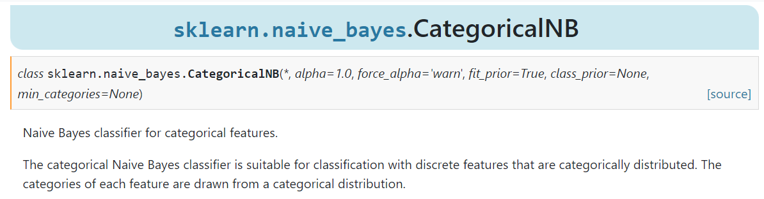
Categorical Naive Bayes Model
Categorical Naive Bayes: This is a variation of the Naive Bayes classifier that is specifically designed for categorical data, i.e., data that consists of discrete categories or labels. This classifier works by calculating the probability of each category given the input features, and then choosing the category with the highest probability as the predicted output.
https://scikit-learn.org/stable/modules/generated/sklearn.naive_bayes.CategoricalNB.html#sklearn.naive_bayes.CategoricalNB

Slide 17
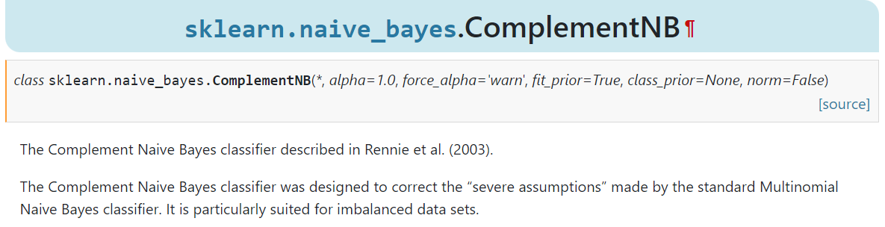
Complement Naive Bayes Model
Complement Naive Bayes: This is another variation of the Naive Bayes classifier that is designed to address the problem of imbalanced datasets. In many real-world scenarios, the dataset may contain significantly more examples of one class than another, leading to a biased classifier. The complement Naive Bayes classifier aims to correct this bias by reweighting the features of the minority class..
https://scikit-learn.org/stable/modules/generated/sklearn.naive_bayes.ComplementNB.html#sklearn.naive_bayes.ComplementNB

Slide 18
Summary
The Naïve Bayes Assumption: Assume that all features are independent given the class label Y
Despite this assumption, Naïve Bayes classifiers perform well in practice.
Depending on the nature of data (nominal vs categorical), the number of labels (two vs more), and the distribution of data, variations of NB Classifier are deployed.

Slide 19
References
See ML_Naive_Bayes_Classifier.ipynb for references

Slide 20
Any Questions?
Thank You.

