Slide 1
Course | Python ML (Python for Machine Learning)
Term
Week
Date
Topic | Decision Trees aka Classification and Regression Trees (CART)
Decision Trees
Classification and Regression Trees
Siva R Jasthi
Computer Science and Cybersecurity
Metropolitan State University

Slide 2
Classification and Regression Trees (CART)
Build a tree by splitting on independent variables
  To predict the outcome for an observation, follow the splits, making a prediction based on the final node n CART models can be applied to predict:
  A continuous outcome – called a regression tree
  A discrete (classification) outcome – called a classification tree
Hence the name “Classification And Regression Tree”
https://medium.com/geekculture/applying-7-classification-algorithms-on-the-titanic-dataset-278ef222b53c

Slide 3
Some sample data
NO | Interview | GPA | Experience
1 | 0 | 3.27 | 1.93
2 | 0 | 3.37 | 0.07
3 | 0 | 3.57 | 1.91
4 | 0 | 3.91 | 4.35
5 | 0 | 3.2 | 1.7
6 | 1 | 3.9 | 2.41
7 | 1 | 3.94 | 3
8 | 0 | 3.66 | 2.47
9 | 0 | 3.63 | 0.93
10 | 0 | 3.06 | 4.14
11 | 0 | 3.21 | 3.34
12 | 0 | 3.18 | 3.97
13 | 0 | 3.69 | 0.54
14 | 0 | 3.38 | 3.62
15 | 1 | 3.77 | 2.06
16 | 0 | 3.5 | 4.1
... | ... | ... | ...
17 | 1 | 3.31 | 3.46
26 | 0 | 3.78 | 0.29
27 | 0 | 3.87 | 1.21
28 | 0 | 4 | 0.49
29 | 1 | 3.87 | 2.11
GPA, Experience: are independent variables
Interview: Whether a candidate gets an interview or not depends on GPA and Experience.
3.2 (exp) GPA 3.8

Slide 4
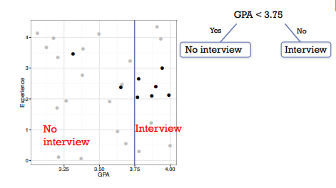
Decision Tree based on GPA

Slide 5

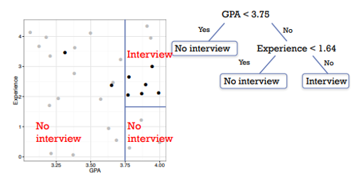
Decision Tree based on GPA and some Experience

Slide 6
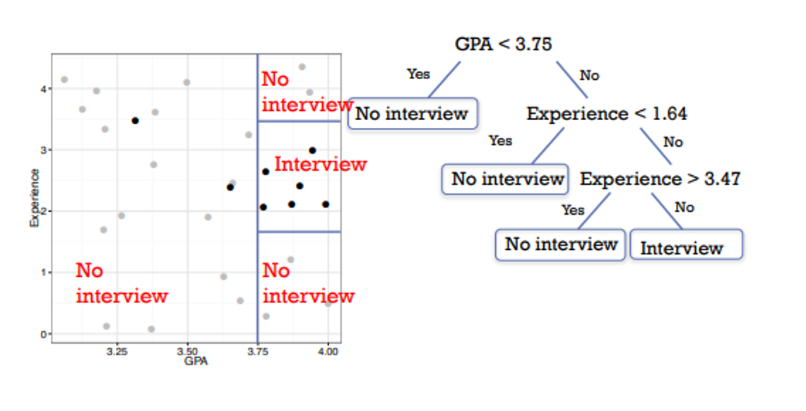

Decision Tree based on GPA and Experience

Slide 7
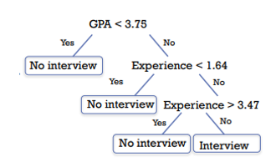
Decision Tree : Model Summary
Model predicts a student will get an interview if they have GPA of 3.75+ and 1.65- 3.47 years of experience
Others are predicted not to get interviews

Slide 8
Predictions follow a simple path
NO | Interview | GPA | Experience
1 | 0 | 3.27 | 1.93
2 | 0 | 3.37 | 0.07
3 | 0 | 3.57 | 1.91
4 | 0 | 3.91 | 4.35
5 | 0 | 3.2 | 1.7
6 | 1 | 3.9 | 2.41
7 | 1 | 3.94 | 3
8 | 0 | 3.66 | 2.47
9 | 0 | 3.63 | 0.93
10 | 0 | 3.06 | 4.14
11 | 0 | 3.21 | 3.34
12 | 0 | 3.18 | 3.97
13 | 0 | 3.69 | 0.54
14 | 0 | 3.38 | 3.62
15 | 1 | 3.77 | 2.06
16 | 0 | 3.5 | 4.1
... | ... | ... | ...
17 | 1 | 3.31 | 3.46
26 | 0 | 3.78 | 0.29
27 | 0 | 3.87 | 1.21
28 | 0 | 4 | 0.49
29 | 1 | 3.87 | 2.11
Consider Stephanie, who has a 3.91 GPA and 0.8 years of experience
Is she predicted by the model to get an interview?
3.2 (exp) GPA 3.8

Slide 9
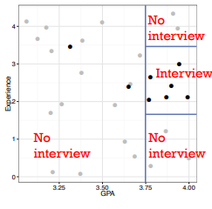
Some sample data
Trees divide the feature space (the space of possible features) into k distinct regions R1, R2,…, Rk
The same prediction is made for every X that falls into a particular region Rj

Slide 10
Predictions (regression and classification)
For regression trees, make a prediction based on the mean response value (w.r.t. to the training data) in the corresponding bucket
For classification trees, make a prediction based on the most commonly occurring class in the corresponding bucket n Class proportions also informative

Slide 11
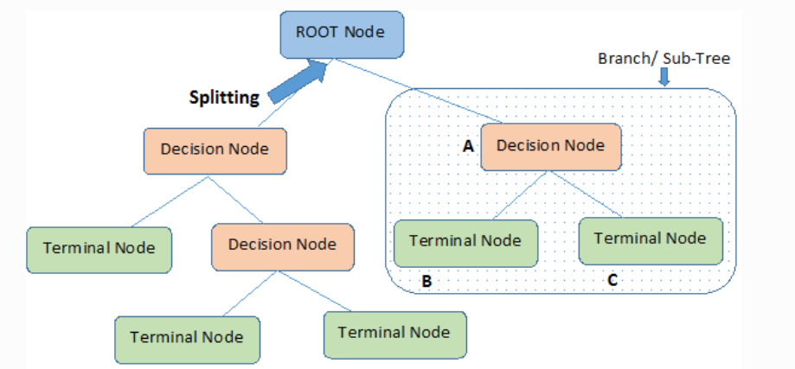
Decision Nodes, Leaf Nodes
https://www.kdnuggets.com/2020/01/decision-tree-algorithm-explained.html

Slide 12
Splitting Decisions and Model Performance
Gini impurity: This is a measure of the probability of misclassifying a randomly chosen element from the node. It is defined as the sum of the probabilities of each class label squared, subtracted from one. The Gini impurity is minimized when all the elements in the node belong to the same class.
Entropy: This is a measure of the amount of information needed to describe the distribution of the target variable in the node. It is defined as the negative sum of the probabilities of each class label multiplied by the logarithm of the probabilities. Entropy is minimized when all the elements in the node belong to the same class.
Classification error: This is a measure of the error rate of the most frequent class in the node. It is defined as one minus the maximum probability of any class label in the node. Classification error is minimized when all the elements in the node belong to the same class.
Let us refer to “ML_Basic_Concepts_Glossary.pdf” (slides 32 – 44)

Slide 13
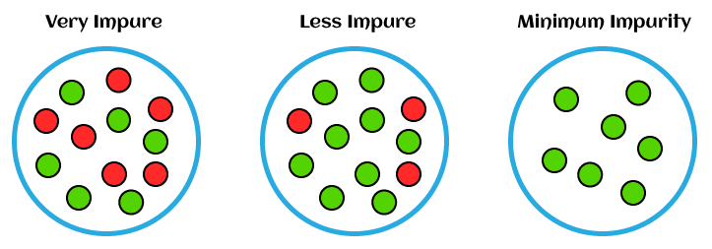
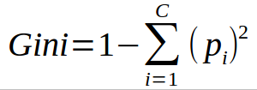
Gini Index
The Gini index is a measure of impurity or diversity commonly used to evaluate the quality of a split in a decision tree.
It measures how often a randomly chosen element from a set would be incorrectly labeled.
The Gini index ranges from 0 to 1, with 0 indicating perfect purity (all elements have the same label) and 1 indicating maximum impurity (an equal number of elements have each possible label).
The attribute with the lowest Gini index after the split is chosen as the root node of the next subtree, and the process is repeated recursively until a stopping criterion is met.
https://www.learnbymarketing.com/481/decision-tree-flavors-gini-info-gain/

Slide 14
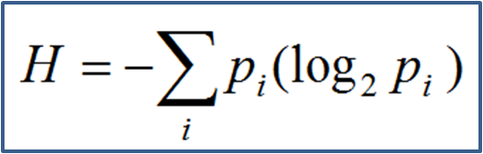
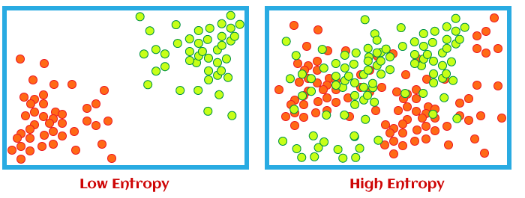
Entropy
Entropy is a measure of the impurity or disorder of a set of examples or data points.
It is commonly used in decision trees and other classification algorithms to determine the optimal splitting criteria for a given set of data.
When all the data points in a set belong to the same class, the entropy is zero, indicating perfect purity. On the other hand, if the data points are evenly distributed among all the classes, the entropy is maximum, indicating complete disorder or randomness.
where p(x) is the probability of a data point belonging to a particular class.
https://www.learnbymarketing.com/481/decision-tree-flavors-gini-info-gain/

Slide 15
Advantages of CART
A CART model is more easily interpretable than a linear regression or logistic regression model
  Simple rules to determine a prediction
  Provides transparency to decision process
  Graphical display
CART selects the significant variables for us
CART can deliver nonlinear predictions

Slide 16
References
https://www.kdnuggets.com/2020/01/decision-tree-algorithm-explained.html
https://medium.com/geekculture/applying-7-classification-algorithms-on-the-titanic-dataset-278ef222b53c

Slide 17
Any Questions?
Thank You.

