Slide 1
Course | Python for Machine Learning
Term
Week
Date
Chapter. Topic | K-Fold Cross Validation
K-Fold Cross Validation
Siva R Jasthi
Computer Science and Cybersecurity
Metropolitan State University

Slide 2
Machine Learning Process
Data Collection and Preparation
Feature Selection
Algorithm Choice
Parameter and Model Selection
Training
Evaluation

Slide 3
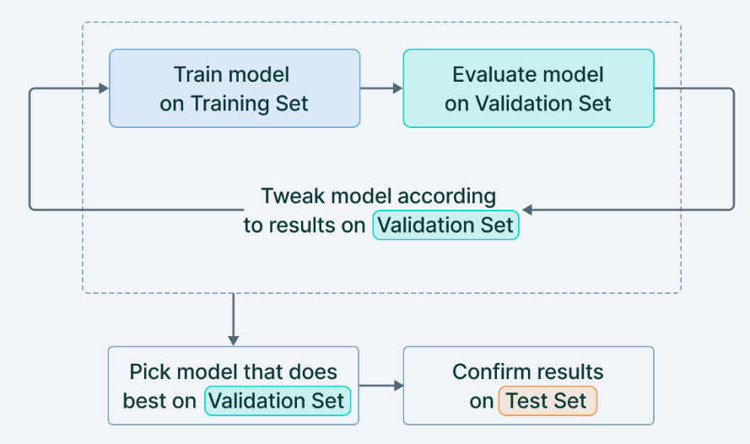
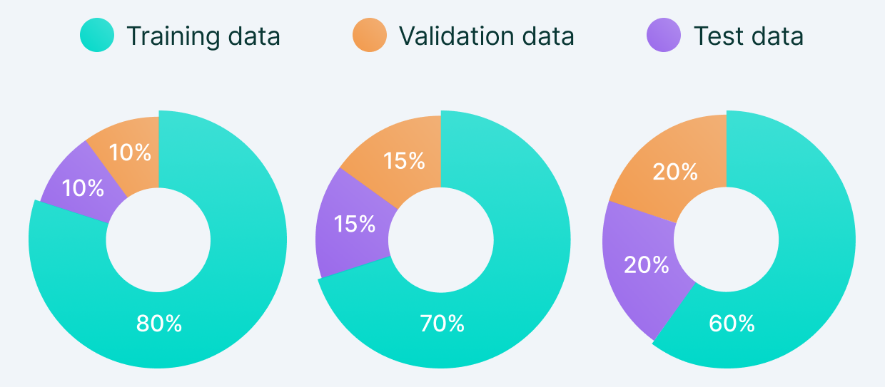
Training vs Test vs Validation Sets
Train the model using “training set”
Evaluate the model on “validation set”. Tweak the model as needed.
Finally, test your model with “Test set”
https://www.v7labs.com/blog/train-validation-test-set

Slide 4
Model Performance Assessment
Model evaluation is the process of assessing the performance of a machine learning model on a given dataset.
Depending on the type of problem (classification, regression, clustering) and the model (Linear Regression, Market Basket Analysis,etc. ), various metrics/measures come into play.
Some examples of metrics are:
Accuracy
Precision
Recall or Sensitivity
Specificity
F1 Score
AUC-ROC Curve
Confusion matrix
Mean Squared Error (MSR)
Mean absolute error (MAE)
R-SQuared (R2)
Log Loss
Jaccard Index
Kolomogorov Smirnov Chart
Gain and Lift Charts
Gini Coefficient
And many more…
https://www.kdnuggets.com/2020/05/model-evaluation-metrics-machine-learning.html

Slide 5
Model Performance Assessment: Examples #1
Accuracy: The percentage of correctly classified instances out of all the instances in the dataset.
Precision: The ratio of true positives (correctly predicted positive instances) to the total number of predicted positive instances.
Recall: The ratio of true positives to the total number of actual positive instances.
F1 score: The harmonic mean of precision and recall, which provides a balance between the two metrics.
AUC-ROC curve: The area under the receiver operating characteristic (ROC) curve, which is a plot of true positive rate against false positive rate for different threshold values.
Confusion matrix: A matrix that shows the number of true positives, true negatives, false positives, and false negatives in a binary classification problem. classification problem.

Slide 6
Model Performance Assessment: Examples #2
Mean squared error (MSE): A measure of the average squared difference between the predicted and actual values in a regression problem.
Mean absolute error (MAE): A measure of the average absolute difference between the predicted and actual values in a regression problem.
R-squared (R2): A metric that measures how well the model fits the data by comparing the variance of the predicted values to the variance of the actual values.
Log loss: A metric that measures the performance of a classifier where the predicted output is a probability value between 0 and 1.
Mean absolute percentage error (MAPE): A measure of the average absolute percentage difference between the predicted and actual values in a regression problem.

Slide 7
Model Performance Assessment: Examples #3
Root mean squared error (RMSE): A measure of the average squared difference between the predicted and actual values in a regression problem, with the square root taken.
Cohen's Kappa: A metric that measures the agreement between two raters or classifiers. It is commonly used in text classification problems.
Area under the precision-recall curve (AUC-PR): A metric that measures the trade-off between precision and recall for different threshold values in a binary classification problem.

Slide 8
Model Performance Assessment: Examples #4
Mean per class accuracy: A metric that calculates the average accuracy for each class in a multi-class classification problem.
Matthew's correlation coefficient (MCC): A metric that measures the correlation between the predicted and actual values in a binary classification problem.
Receiver Operating Characteristic (ROC) curve: A plot of the true positive rate against the false positive rate for different threshold values in a binary classification problem.
Mean IoU (Intersection over Union): A metric commonly used in object detection and segmentation tasks that measures the overlap between predicted and actual bounding boxes or masks.
Top-N accuracy: A metric that measures the percentage of times the correct answer is in the top N predicted answers in a multi-class classification problem.

Slide 9
Model Performance Assessment: Examples #5
Balanced accuracy: A metric that calculates the average of recall rates for each class in a multi-class classification problem, taking into account imbalanced class distributions.
F-beta score: A generalized version of the F1 score that allows tuning the balance between precision and recall by setting a parameter beta.
Gini coefficient: A metric that measures the inequality among values of a probability distribution, commonly used in evaluating binary classification models.
Precision at K: A metric that measures the precision of the top K predicted instances in a recommendation system.
Spearman rank correlation coefficient: A metric that measures the correlation between two variables by calculating the rank order of each variable.

Slide 10
Model Performance Assessment: Examples #6
Weighted F1 score: A metric that calculates the F1 score for each class in a multi-class classification problem, weighted by the number of instances in each class.
Coverage: A metric that measures the percentage of unique items in a recommendation system that are covered by the top N recommendations.
Multi-class logarithmic loss: A metric that measures the performance of a classifier that outputs probability estimates for each class
Kullback-Leibler divergence (KL-divergence): A metric that measures the difference between two probability distributions.
Mean Average Precision (MAP): A metric that evaluates the performance of a ranking system by measuring the average precision over different levels of recall.
Spearman-Brown correlation coefficient: A metric that measures the correlation between two halves of a test, used in evaluating the reliability of a test or measurement.

Slide 11
What is the problem we are trying to solve?
Cross Validation address the problem of Over-fitting.
Overfitting happens when a model is too complex and captures the noise or random fluctuations in the training data, instead of the underlying patterns that generalize to new data.
This can lead to poor performance on the test set and can cause the model to be less useful in practice.
Cross-validation helps to address this problem by partitioning the available data into several subsets, or folds, and using each fold as a validation set while the other folds are used for training.
This way, the model is tested on data it has not seen during training, and the performance on the validation set can be used as an estimate of the model's generalization performance.

Slide 12
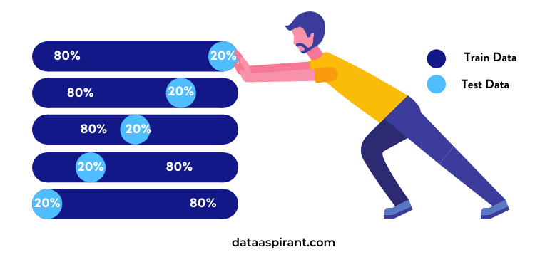
Cross Validation
https://dataaspirant.com/cross-validation/

Slide 13
Types of Cross-Validation
Cross-Validation
Non-Exhaustive
Methods
Exhaustive
Methods
Rolling
Cross-Validation
Holdout
Method
K-Fold
CV
Stratified
K-Fold CV
Leave
N Out
Leave
One Out
https://www.mygreatlearning.com/blog/cross-validation/

Slide 14
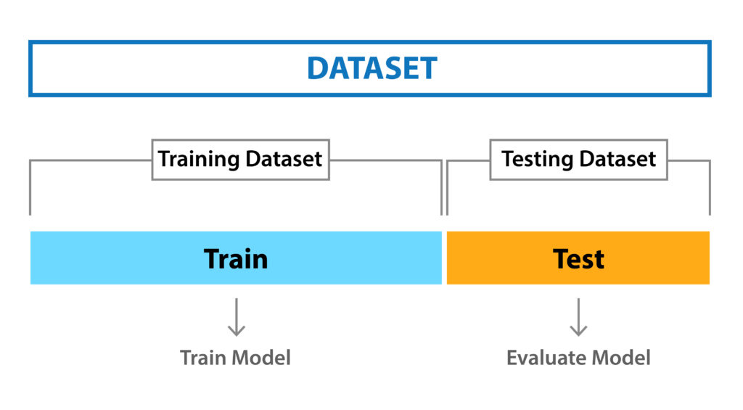
Holdout Cross Validation
Traditional Splits
70% - 30%
75% - 25%
80% - 20%
Basic and simple approach where we split the data.
Data is shuffled randomly before splitting.
The model can give different results every time we train it.
Hold-out method works well when you have a very large dataset.
This is also good to build an initial model.
https://www.researchgate.net/figure/k-fold-cross-validation-example_fig1_335074407

Slide 15
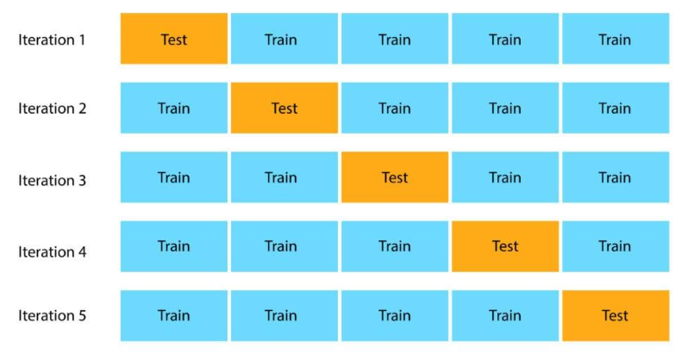
K-Fold Cross Validation
https://www.section.io/engineering-education/how-to-implement-k-fold-cross-validation/

Slide 16
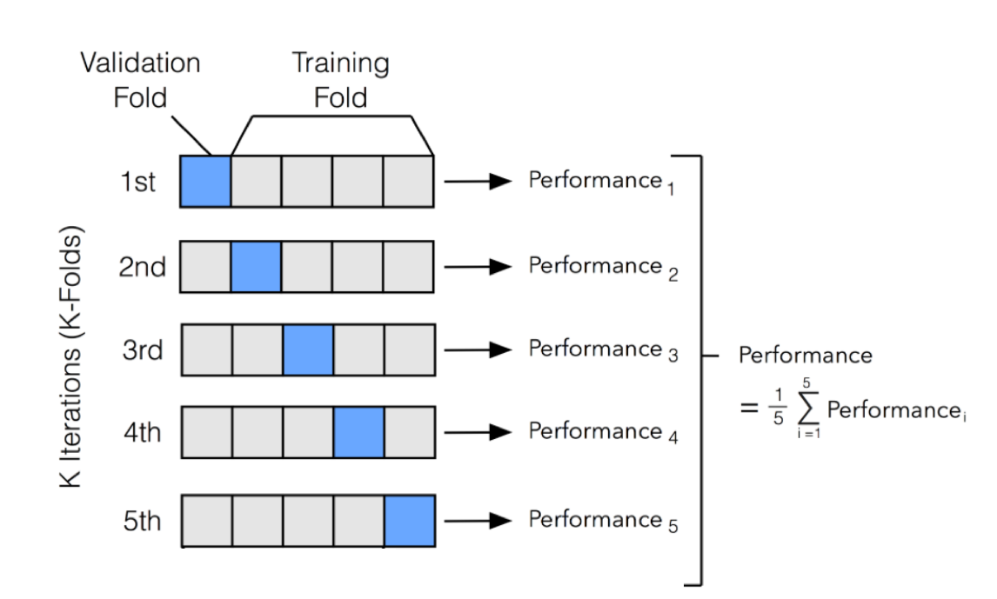
K-Fold Cross Validation
https://www.analyticsvidhya.com/blog/2021/05/importance-of-cross-validation-are-evaluation-metrics-enough/

Slide 17
K-Fold Cross Validation
K-fold CV guarantees that the score of our model does not depend on the way we picked the training and testing dataset.
The data set is divided into k number of subsets and the holdout method is repeated k number of times.
Algorithm:
  Randomly split your entire dataset into k number of folds (subsets)
  Pick K-1 folds to build the model and the use Kth fold to test the model.
  Repeat (Step 2) K times and record the accuracy of the model.
  Average accuracy of K runs will serve as the performance metric for the model.
Advantage: Results in less biased model. Works best when we have limited set of data.
Disadvantage: Takes K times as much computation to make an evaluation.

Slide 18
Stratified K-Fold Cross Validation
Using K Fold CV can be tricky as it involves random shuffling.
Some folds may cause in highly imbalanced folds, resulting in highly biased model.
That is... a fold has majority belonging to one class (say +ve), and only a few negaive classes.
Stratification is the process of rearranging the data so as to ensure that each fold is a good representative of the whole.
For example, in a binary classification problem where each class comprises of 50% of the data, it is best to arrange the data such that in every fold, each class comprises of about half the instances.

Slide 19
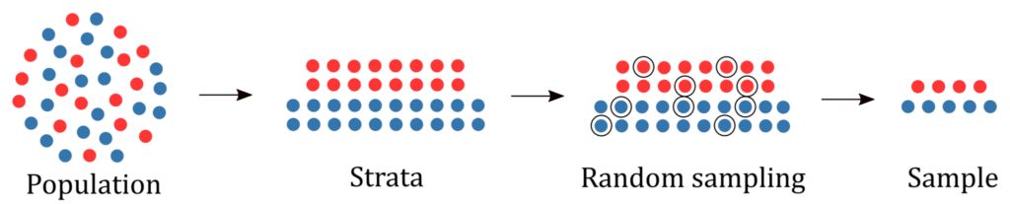
Stratified K-Fold Cross Validation
https://www.baeldung.com/cs/ml-stratified-sampling

Slide 20
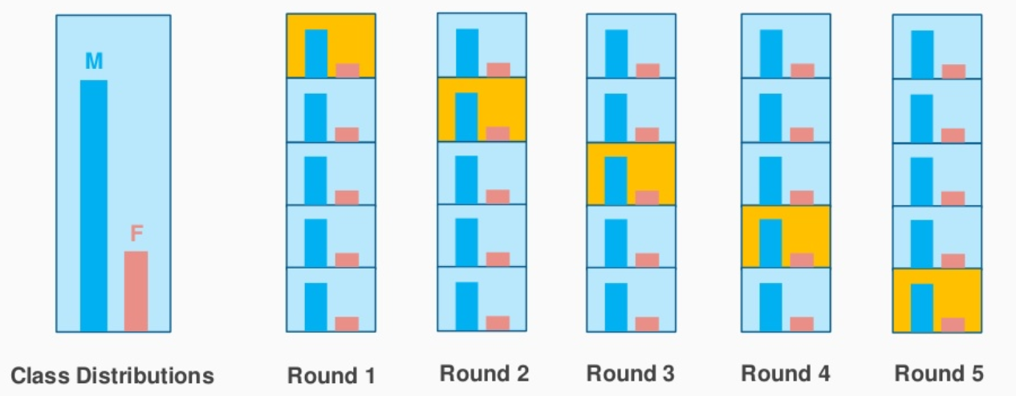
Stratified K-Fold Cross Validation
https://www.analyticsvidhya.com/blog/2021/05/importance-of-cross-validation-are-evaluation-metrics-enough/

Slide 21
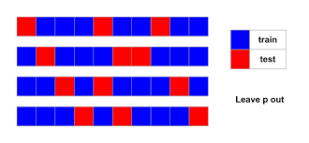
Leave P Out Cross-Validation
When using this exhaustive method, we take p number of points out from the total number of data points in the dataset(say n).
While training the model we train it on these (n – p) data points and test the model on p data points.
We repeat this process for all the possible combinations of p from the original dataset.
Then to get the final accuracy, we average the accuracies from all these iterations.

Slide 22
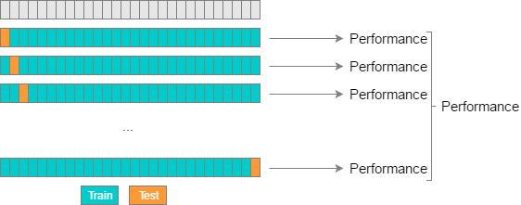
Leave One Out Cross-Validation (LOOCV)
Leave P Out Cross-Validation when P is 1
In each iteration, model is built using (N-1) instances leaving 1 out. The Nth instance is used to test the model.
Computationally very expensive.
https://www.analyticsvidhya.com/blog/2021/05/importance-of-cross-validation-are-evaluation-metrics-enough/

Slide 23
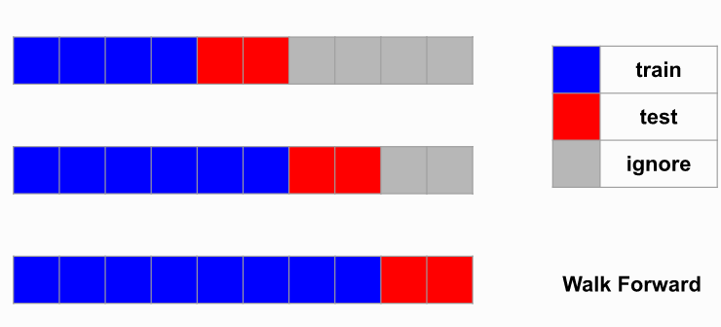
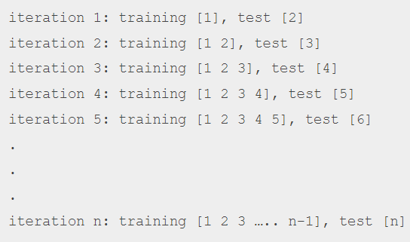
Rolling Cross-Validation for Time Series
Rolling Forward = Walk Forward = Rolling Cross Validation
Applicale only for the Time Series data
https://tscv.readthedocs.io/en/latest/tutorial/roll_forward.html
https://www.mygreatlearning.com/blog/cross-validation/

Slide 24
Summary
Cross-Validation techniques to address Overfitting.
Cross-Validation to measure the accuracy (performance measure) of a model.
Let us explore the colab notebook for Cross-Validation

Slide 25
Summary
StatQuest: Cross-Validation Video
https://www.youtube.com/watch?v=fSytzGwwBVw

Slide 26
Any Questions?
Thank You.

