Slide 1

Seven Little Words (phase 2.0)
Enhancements
Siva R Jasthi
Computer Science and Cyber Security
Metropolitan State University

Slide 2
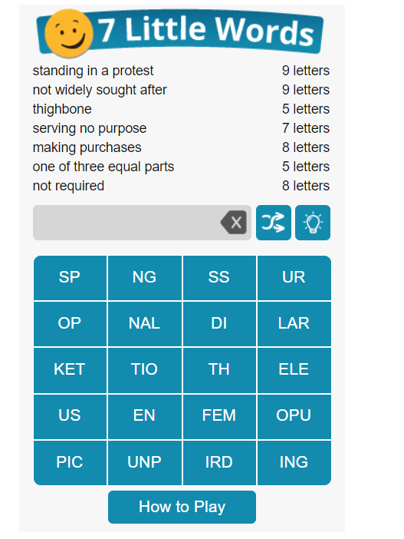
Background
https://www.7littlewords.com/ is a word puzzle.
In similar lines, we will be building Seven Little Words puzzle generation application with a twist. It should work for languages whose characters occupy multiple-bytes.
GITHUB Link:
http://www.github.com/sjasthi/sevenlittlewords

Slide 3
Enhancements (Phase 2)
[1] Refactor the application so that it makes use of indic-wp application (www.github.com/sjasthi/indic-wp)
[2] Support the CRUD support in two modes
[1] Q & A mode
[2] CSV import mode / CSV copy n paste mode
[3] Support Dual Mode
* Classic Mode (Title, 7 Clues, 7 Words)
* Title Mode (Title, 7 Words)
[4] Support the puzzle generation
[5] Support the persistence of the puzzles.
[6] Simulate the admin/user access (as is shown in the quotes application).
[7] Enable playing of the puzzle by the visitors.
[8] Provide the database persistence support for saving the puzzles and solutions.
[9] Provide a web-service that can split 7 words into 20 titles.

Slide 4

Any questions?

