Slide 1
ICS370: Software Design Models Tile 9 (Generating the tiles and configurations for 9 character words)
Siva Jasthi
Summer 2021

Slide 2
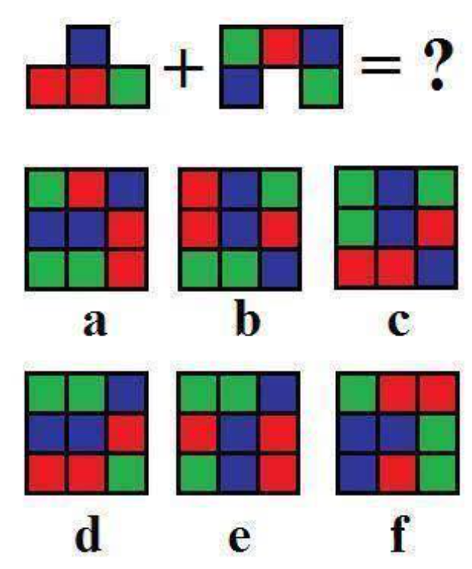
9 Letter Words
Consider this puzzle.
[1] A tile equation is given at the top
[2] A set of 6 possible answers are given at the bottom.
[3] Puzzlers are required to guess the correct answer.

Slide 3
Tile Nine App
In this project, we will be building a java application “TileNineApp”.
“TileNineApp” helps the users to create such puzzles:
[1] Either with colors
[2] OR with the characters (9 letter words – without any repeating letters)
[3] OR a combination of colors and characters.
The application can generate the puzzles based on
* input characters (9 characters)
* configuration [1] or [2] or [3]
The application also persists the generated puzzles in a database for later retrieval.
The application will also generate this puzzle in HTML and PPT formats.

Slide 4
Questions

