Slide 1

indic-wp
Siva R Jasthi
Computer Science and Cyber Security
Metropolitan State University

Slide 2
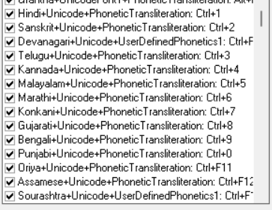

ਅ
అ अ
A অ
അ
અ
అ अ
A অ

Slide 3
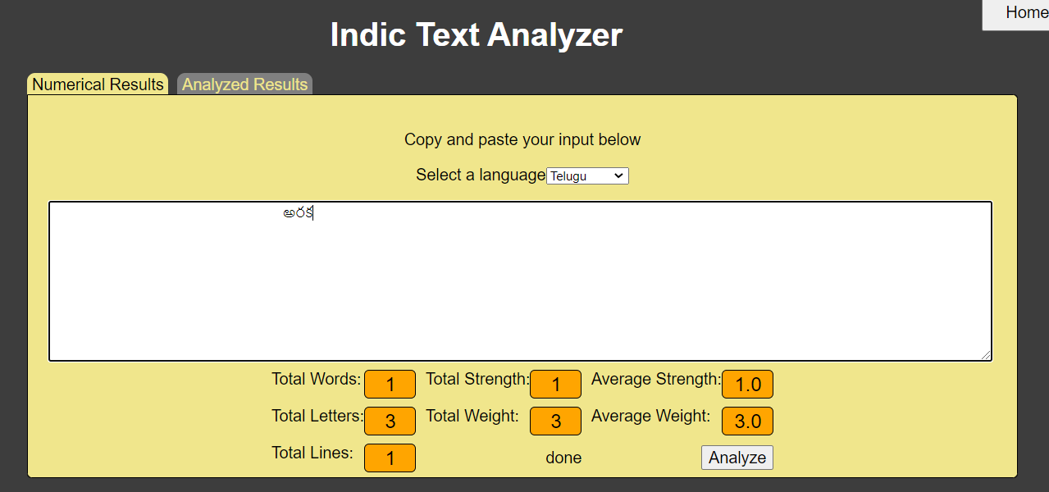
Background
Indic-wp is an application for processing Strings in Indian Languages.
By default, this application can also process “English” Strings.
As of now, only one other language “Telugu” is supported in indic-wp

Slide 4

What is the problem indic-wp trying to solve?
Most of the algorithms and software applications assume that each character occupies one byte.
This may be valid for English language and some western European langauges.
However, this does not hold true for many languages that require multiple bytes to represent one logical character.
For example, consider this word. స్త్రీ
It is only one logical character in Telugu language.
However, Microsoft Word says it is 6 characters long.
I need to press BACKSPACE 6 times to remove that character.
Indic-wp has logic to parse the individual Unicode characters of the string and convert that to a logical character.
If you are not seeing the above character on this slide, it may be because you do not have the required FONT to display it.

Slide 5
Goals of indic-wp (V3.0)
As of now, indic-wp application is being used only by PHP applications.
We want to convert the current application into a set of web-service APIs (using REST APIs).
It helps to empower other technologies (java client, python clients, etc.) to make use of these Web Services.

Slide 6
Goals of indic-wp (V3.0)
[1] Enable the current PHP methods (APIs) as Web Services
[2] Provide additional methods (Web services) in indic-wp
[3] Provide/Fix/Enhance the documentation of these APIs; Refactor the current implementation for supportability and maintainability
[4] Host the indic-wp application on bluehost (Hosting site) and perform the testing of these APIs from different tools (postman.com) and/or (reqbin.com)
[5] Develop a summary page (API test page) showing the execution status
  With some default value
  With the values entered by the user
[6] Develop a Java Client that shows the summary page (API test page)
[7] Develop a Python Client that shows the summary page (API test page)
[8] Develop a mini PHP application called (Lengther) that makes use of the refactored Web Services. This application takes a set of strings and returns the length of each string in the GUI; OR if a CSV file is given, it produces a new CSV file for the download; OR it can update a “length” column of a table for the corresponding “word” (string) column)

Slide 7
Typical use cases / Web Services
[1] Given a string, parse that into LOGICAL characters
[2] Given a string, give me its length

Slide 8
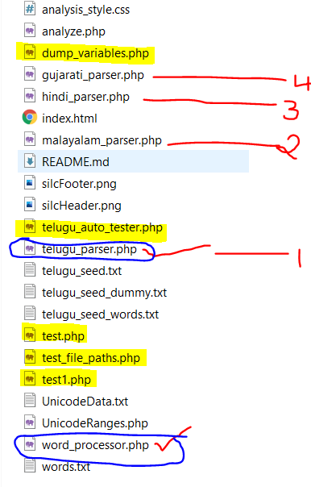
Walkthrough of the Code Base
[1] Though the code mentions 4 indic-languages, only “telugu_parser” is functional.
All others are not in the scope and are placeholders for future expansion.
[2] All the yellow high-lighted files are test files and tools. These do not contribute to the functionality.
[3] The two circled ones are the key files.
Word_processor: All the APIs are here. Based on the language, it delegates the responsibility to different parsers for parsing a given string into logical characters.
telugu_parser.php is one of the parsers that is functional now for processing “Telugu” language strings

Slide 9
SOAP vs REST API: Some Resources
SOAP Vs. REST: Difference between Web API Services
https://www.guru99.com/comparison-between-web-services.html
SOAP vs REST?
https://www.youtube.com/watch?v=bPNfu0IZhoE
REST API Concepts
https://www.youtube.com/watch?v=7YcW25PHnAA
Programmable Web (API Directory)
https://www.programmableweb.com/category/all/apis

Slide 10
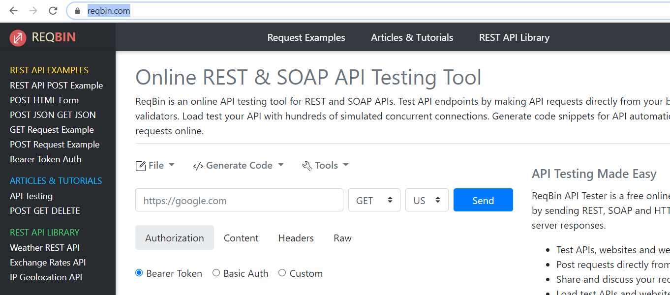
API Testing through reqbin.com

Slide 11
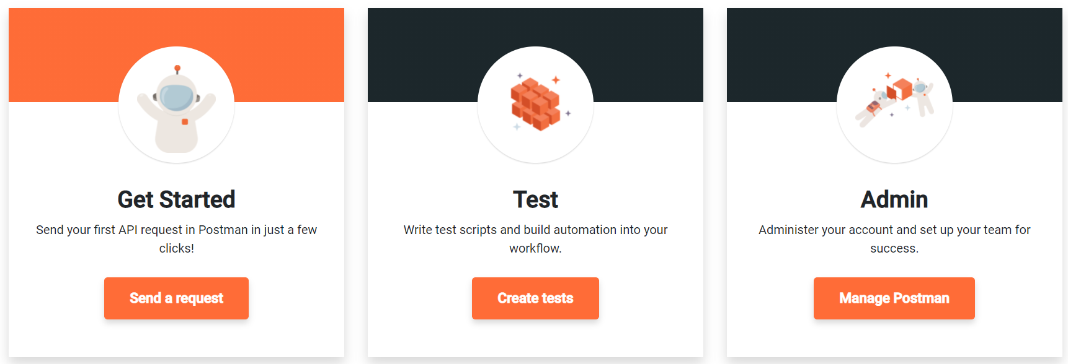
API Testing through postman.com
https://www.postman.com/

Slide 12
Lengther application
[8] Develop a mini PHP application called (Lengther) that makes use of the refactored Web Services.
(Case 1) This application takes a set of strings and returns the length of each string in the GUI;
(Case 2) a CSV file is given, it produces a new CSV file for the download
(Case 3) It can update a “length” column of a table for the corresponding “word” (string) column)

Slide 13

Any questions?

