Slide 1
CS1 - Introduction to Programming in Java
Assignment 1
(Chapter 5, Programming Challenge 8. Conversion Program)
Siva.Jasthi@nhcc.com

Slide 2
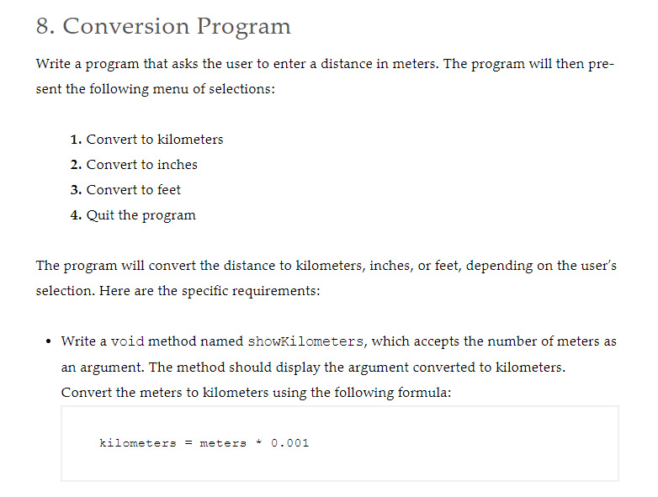

Slide 3
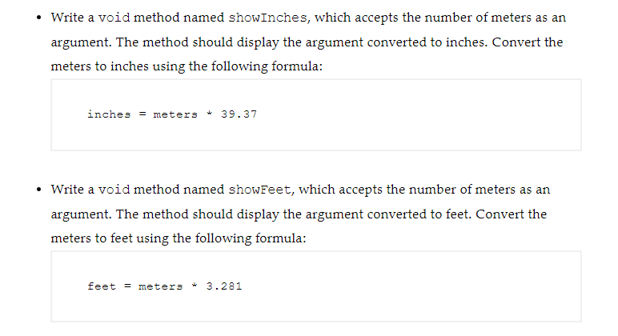

Slide 4
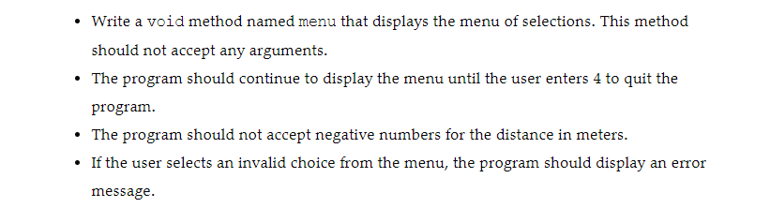

Slide 5
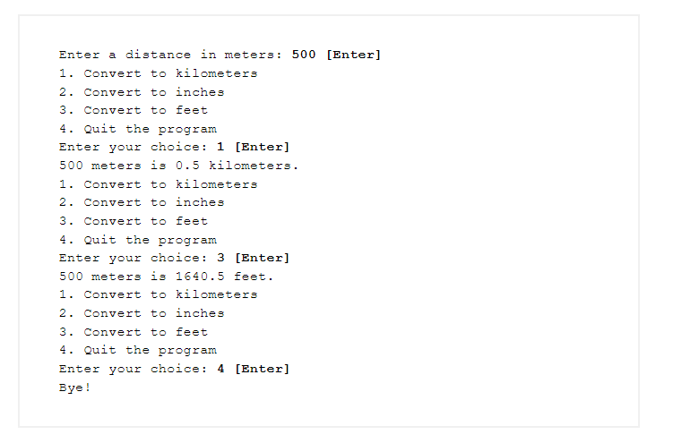
Sample Output
Note:
[1] In the sample output shown here, the option 2 is missing.
Make sure that your testing includes all 4 choices.
[2] Ensure that you display a valid error message if the users makes an incorrect choice.
[3] Ensure that the program does not accept the negative numbers for the distance in meters.
[4] Make sure that the program continues to display the menu option till the user choses the option 4

Slide 6
Testing and sample output
tbd
Select Option 2 as additional test case.
5
Error: Invalid Choice. Try again!
Convert to kilometers
Convert to inches
Convert to feet
Quit the program
Enter your choice:

Slide 7
What to submit?
Submit these two files separately. Do not submit the zip files. And do not submit the whole project folder.
I just need these two files – java file and output text file.
A1_Conversion.java
A1_Conversion_output.txt
Evaluation:
showKilometers method is implemented
showInches method is implemented
showFeet method is implemented
menu method is implemented
main( ) method is implemented meeting the requirements.

