Slide 1

ICS141 Programming with Objects
Lecture Notes (pdf)
Week 5 (Chapter 5)
Spring 2021
Iterations (for loop)
Siva R Jasthi
Information and Computer Sciences
Metropolitan State University

Slide 2
Iterations (loops)
Iterations help in executing a block of code several times.
You can execute a block of code
  A fixed number of times
  Or till some condition is met.
You can also have nested loops (loops inside loops).
continue – will help to suspend the loop temporarily and restart the execution from beginning
break– will help in stopping the loop and exiting out of the loop.

Slide 3
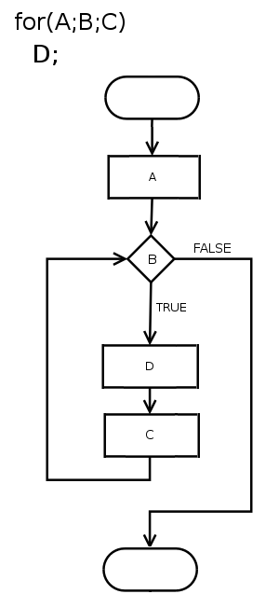
Flow of “for” loops
for (A;B;C)
  D;
Remember
Two semi-colons in the loop
ABDC → BDC → BDC → BDC

Slide 4
The for Structure: Semantics
A for loop consists of the following:
  Loop index (or control variable):
    int counter
    Index of the loop MUST be of type int
  Initial value for the loop index:
    counter = 1
  Loop continuation condition:
    counter <=10
    As long as the condition counter<=10 is TRUE, the code inside the loop is re-executed
  Step:
    counter = counter + 1
    Increment counter by 1 after each time of execution
4

Slide 5
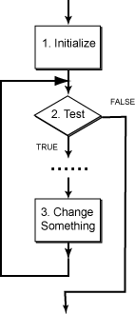
Execution steps of the for loop
1) The index of the loop is set to the initial value
2) The loop continuation condition is tested:
  2.1) If FALSE, the loop is terminated and execution proceeds with the next statement after the for structure
  2.2) if TRUE:
    a) The body of the loop is executed
    b) The step is updated to change the value of the index variable
    c) Go back to step 2

Slide 6
Some typical errors
[1] Off by one errors
Are you using > or >=?
Are you using < or <=?
6

Slide 7
Some typical errors
[2] misplaced semi-colon
for (int x = 0; x < 5; x++);
{
System.out.println(x);
}
7

Slide 8
Some typical errors
[3] Infinite loops
for (int x = 1; x >0; x++)
{
System.out.println(x);
}
8

Slide 9
continue
Sometimes, we want to skip some lines of code when some condition is met. However, we want to run the for loop for the next value of the counter variable.
In such cases, “continue” will help.
For example: Print numbers from 1 to 100. However, all the multiples of 13 should not be printed.
9

Slide 10
break
Sometimes, we want to stop the execution of the loop when some condition is met.
That is.. Condition inside the for loop takes the precedence over the loop condition.
In such cases, “break” will help.
For example: Print 100 random numbers (whose values are between 1 and 200). However, if the random number is 13, then we do not want to print any more numbers.
10

Slide 11
Nested Loops
A nested loop is a loop inside a loop
Example: What is printed on the screen by the following pieces of code:
for ( int i =1; i <= 5; i++ ) {
System.out.println("Outside loop i: "+i);
for (int j=1;j <= 5; j++)
System.out.print("Inside j: "+j +", ");
System.out.println();
}
for ( int i =1; i <= 5; i++ ) {
System.out.println("Outside i: "+i);
for (int j=1;j <= i; j++)
System.out.print("Inside j: "+j + ", ");
System.out.println();
}

Slide 12
Types of Loops
type | description
counting loop | Uses a loop control variable to count upwards or downwards (usually by an integer increment.)
sentinel-controlled loop | Loop keeps going until a special value is encountered in the data.
result-controlled loop | Loop keeps going until a test determines that the desired result has been achieved.
Exit-controlled loop | A block of statements are executed at least once. Then the condition is checked to determine whether to iterate over the block of statements.

