Slide 1
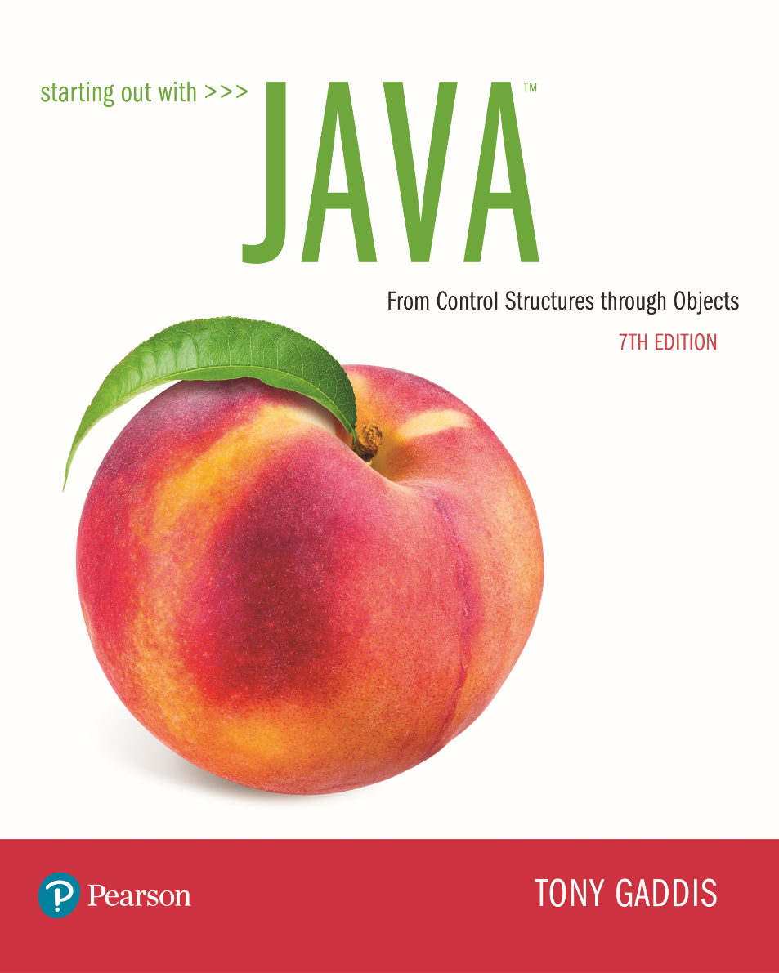
STARTING OUT WITH JAVATM
7th Edition
Chapter 4
Loops and Files

Slide 2
Chapter Topics (1 of 2)
Chapter 4 discusses the following main topics:
  The Increment and Decrement Operators
  The while Loop
  Using the while Loop for Input Validation
  The do-while Loop
  The for Loop
  Running Totals and Sentinel Values

Slide 3
Chapter Topics (2 of 2)
Chapter 4 discusses the following main topics:
  Nested Loops
  The break and continue Statements
  Deciding Which Loop to Use
  Introduction to File Input and Output
  Generating Random Numbers with the Random class

Slide 4
The Increment and Decrement Operators
There are numerous times where a variable must simply be incremented or decremented.
  number = number + 1;
  number = number – 1;
Java provide shortened ways to increment and decrement a variable’s value.
Using the ++ or -- unary operators, this task can be completed quickly.
  number++; or ++number;
  number--; or --number;
Example: IncrementDecrement.java

Slide 5
Differences Between Prefix and Postfix
When an increment or decrement are the only operations in a statement, there is no difference between prefix and postfix notation.
When used in an expression:
  prefix notation indicates that the variable will be incremented or decremented prior to the rest of the equation being evaluated.
  postfix notation indicates that the variable will be incremented or decremented after the rest of the equation has been evaluated.
Example: Prefix.java

Slide 6
The while Loop (1 of 2)
Java provides three different looping structures.
The while loop has the form:
  while(condition)
  {
    statements;
  }
While the condition is true, the statements will execute repeatedly.
The while loop is a pretest loop, which means that it will test the value of the condition prior to executing the loop.

Slide 7
The while Loop (2 of 2)
Care must be taken to set the condition to false somewhere in the loop so the loop will end.
Loops that do not end are called infinite loops.
A while loop executes 0 or more times. If the condition is false, the loop will not execute.
Example: WhileLoop.java

Slide 8
The while loop Flowchart
true
boolean
expression?
statement(s)
false

Slide 9
Infinite Loops (1 of 2)
In order for a while loop to end, the condition must become false. The following loop will not end:
  int x = 20;
  while(x > 0)
  {
    System.out.println("x is greater than 0");
  }
The variable x never gets decremented so it will always be greater than 0.
Adding the x-- above fixes the problem.

Slide 10
Infinite Loops (2 of 2)
This version of the loop decrements x during each iteration:
  int x = 20;
  while(x > 0)
  {
  System.out.println("x is greater than 0");
  x--;
  }

Slide 11
Block Statements in Loops
Curly braces are required to enclose block statement while loops. (like block if statements)
  while (condition)
  {
  statement;
  statement;
  statement;
  }

Slide 12
The while Loop for Input Validation
Input validation is the process of ensuring that user input is valid.
  System.out.print("Enter a number in the " +
  "range of 1 through 100: ");
  number = keyboard.nextInt();
  // Validate the input.
  while (number < 1 || number > 100)
  {
  System.out.println("That number is invalid.");
  System.out.print("Enter a number in the " +
  "range of 1 through 100: ");
  number = keyboard.nextInt();
  }
Example: SoccerTeams.java

Slide 13
The do-while Loop
The do-while loop is a post-test loop, which means it will execute the loop prior to testing the condition.
The do-while loop (sometimes called called a do loop) takes the form:
  do
  {
  statement(s);
  }while (condition);
Example: TestAverage1.java

Slide 14
The do-while Loop Flowchart
statement(s)
true
boolean
expression?
false

Slide 15
The for Loop
The for loop is a pre-test loop.
The for loop allows the programmer to initialize a control variable, test a condition, and modify the control variable all in one line of code.
The for loop takes the form:
  for(initialization; test; update)
  {
    statement(s);
  }
See example: Squares.java

Slide 16
The for Loop Flowchart
boolean
expression?
true
statement(s)
update
false

Slide 17
The Sections of The for Loop
The initialization section of the for loop allows the loop to initialize its own control variable.
The test section of the for statement acts in the same manner as the condition section of a while loop.
The update section of the for loop is the last thing to execute at the end of each loop.
Example: UserSquares.java

Slide 18
The for Loop Initialization
The initialization section of a for loop is optional; however, it is usually provided.
Typically, for loops initialize a counter variable that will be tested by the test section of the loop and updated by the update section.
The initialization section can initialize multiple variables.
Variables declared in this section have scope only for the for loop.

Slide 19
The Update Expression
The update expression is usually used to increment or decrement the counter variable(s) declared in the initialization section of the for loop.
The update section of the loop executes last in the loop.
The update section may update multiple variables.
Each variable updated is executed as if it were on a line by itself.

Slide 20
Modifying The Control Variable
You should avoid updating the control variable of a for loop within the body of the loop.
The update section should be used to update the control variable.
Updating the control variable in the for loop body leads to hard to maintain code and difficult debugging.

Slide 21
Multiple Initializations and Updates
The for loop may initialize and update multiple variables.
  for(int i = 5, int j = 0; i < 10 || j < 20; i++, j+=2)
  {
  statement(s);
  }
Note that the only parts of a for loop that are mandatory are the semicolons.
  for(;;)
  {
  statement(s);
  } // infinite loop
If left out, the test section defaults to true.

Slide 22
Running Totals
Loops allow the program to keep running totals while evaluating data.
Imagine needing to keep a running total of user input.
Example: TotalSales.java

Slide 23
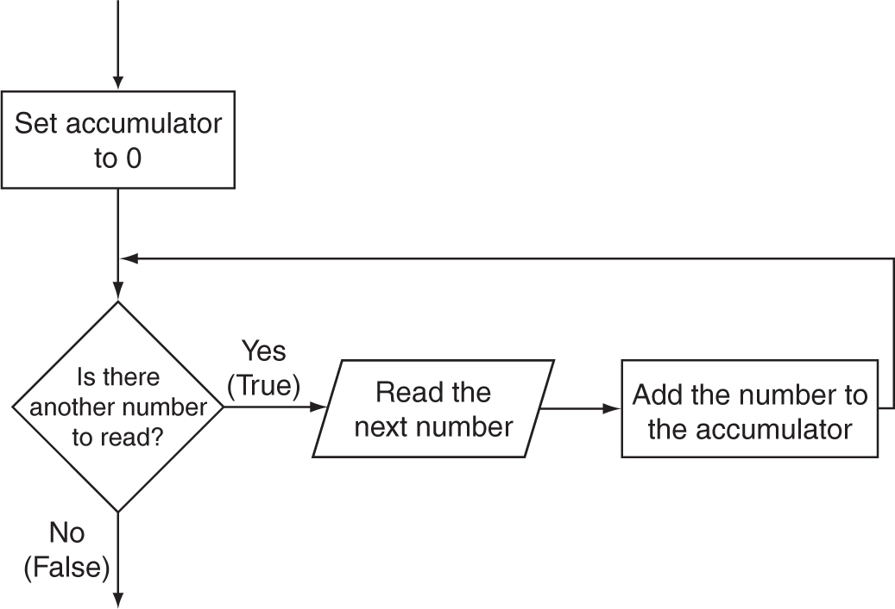
Logic for Calculating a Running Total

Slide 24
Sentinel Values
Sometimes the end point of input data is not known.
A sentinel value can be used to notify the program to stop acquiring input.
If it is a user input, the user could be prompted to input data that is not normally in the input data range (i.e. –1 where normal input would be positive.)
Programs that get file input typically use the end-of-file marker to stop acquiring input data.
Example: SoccerPoints.java

Slide 25
Nested Loops
Like if statements, loops can be nested.
If a loop is nested, the inner loop will execute all of its iterations for each time the outer loop executes once.
  for(int i = 0; i < 10; i++)
    for(int j = 0; j < 10; j++)
      loop statements;
The loop statements in this example will execute 100 times.
Example: Clock.java

Slide 26
The break Statement
The break statement can be used to abnormally terminate a loop.
The use of the break statement in loops bypasses the normal mechanisms and makes the code hard to read and maintain.
It is considered bad form to use the break statement in this manner.

Slide 27
The continue Statement
The continue statement will cause the currently executing iteration of a loop to terminate and the next iteration will begin.
The continue statement will cause the evaluation of the condition in while and for loops.
Like the break statement, the continue statement should be avoided because it makes the code hard to read and debug.

Slide 28
Deciding Which Loops to Use
The while loop:
  Pretest loop
  Use it where you do not want the statements to execute if the condition is false in the beginning.
The do-while loop:
  Post-test loop
  Use it where you want the statements to execute at least one time.
The for loop:
  Pretest loop
  Use it where there is some type of counting variable that can be evaluated.

Slide 29
File Input and Output
Reentering data all the time could get tedious for the user.
The data can be saved to a file.
  Files can be input files or output files.
Files:
  Files have to be opened.
  Data is then written to the file.
  The file must be closed prior to program termination.
In general, there are two types of files:
  binary
  text

Slide 30
Writing Text To a File
To open a file for text output you create an instance of the PrintWriter class.
PrintWriter outputFile = new PrintWriter("StudentData.txt");
Pass the name of the file that you wish to open as an argument to the PrintWriter constructor.
Warning: if the file already exists, it will be erased and replaced with a new file.

Slide 31
The PrintWriter Class (1 of 3)
The PrintWriter class allows you to write data to a file using the print and println methods, as you have been using to display data on the screen.
Just as with the System.out object, the println method of the PrintWriter class will place a newline character after the written data.
The print method writes data without writing the newline character.

Slide 32
The PrintWriter Class (2 of 3)
Open the file.
PrintWriter outputFile = new PrintWriter("Names.txt");
outputFile.println("Chris");
outputFile.println("Kathryn");
outputFile.println("Jean");
outputFile.close();
Close the file.
Write data to the file.

Slide 33
The PrintWriter Class (3 of 3)
To use the PrintWriter class, put the following import statement at the top of the source file:
import java.io.*;
See example: FileWriteDemo.java

Slide 34
Exceptions (1 of 2)
When something unexpected happens in a Java program, an exception is thrown.
The method that is executing when the exception is thrown must either handle the exception or pass it up the line.
Handling the exception will be discussed later.
To pass it up the line, the method needs a throws clause in the method header.

Slide 35
Exceptions (2 of 2)
To insert a throws clause in a method header, simply add the word throws and the name of the expected exception.
PrintWriter objects can throw an IOException, so we write the throws clause like this:
  public static void main(String[] args) throws IOException

Slide 36
Appending Text to a File
To avoid erasing a file that already exists, create a FileWriter object in this manner:
FileWriter fw =
new FileWriter("names.txt", true);
Then, create a PrintWriter object in this manner:
PrintWriter fw = new PrintWriter(fw);

Slide 37
Specifying a File Location (1 of 2)
On a Windows computer, paths contain backslash (\) characters.
Remember, if the backslash is used in a string literal, it is the escape character so you must use two of them:
  PrintWriter outFile = new PrintWriter("A:\\PriceList.txt");

Slide 38
Specifying a File Location (2 of 2)
This is only necessary if the backslash is in a string literal.
If the backslash is in a String object then it will be handled properly.
Fortunately, Java allows Unix style filenames using the forward slash (/) to separate directories:
  PrintWriter outFile = new
  PrintWriter("/home/rharrison/names.txt");

Slide 39
Reading Data From a File (1 of 3)
You use the File class and the Scanner class to read data from a file:
Pass the name of the file as an argument to the File class constructor.
File myFile = new File("Customers.txt");
Scanner inputFile = new Scanner(myFile);
Pass the File object as an argument to the Scanner class constructor.

Slide 40
Reading Data From a File (2 of 3)
  Scanner keyboard = new Scanner(System.in);
  System.out.print("Enter the filename: ");
  String filename = keyboard.nextLine();
  File file = new File(filename);
  Scanner inputFile = new Scanner(file);
The lines above:
  Creates an instance of the Scanner class to read from the keyboard
  Prompt the user for a filename
  Get the filename from the user
  Create an instance of the File class to represent the file
  Create an instance of the Scanner class that reads from the file

Slide 41
Reading Data From a File (3 of 3)
Once an instance of Scanner is created, data can be read using the same methods that you have used to read keyboard input (nextLine, nextInt, nextDouble, etc).
  // Open the file.
  File file = new File("Names.txt");
  Scanner inputFile = new Scanner(file);
  // Read a line from the file.
  String str = inputFile.nextLine();
  // Close the file.
  inputFile.close();

Slide 42
Exceptions
The Scanner class can throw an IOException when a File object is passed to its constructor.
So, we put a throws IOException clause in the header of the method that instantiates the Scanner class.
See Example: ReadFirstLine.java

Slide 43
Detecting The End of a File
The Scanner class’s hasNext() method will return true if another item can be read from the file.
  // Open the file.
  File file = new File(filename);
  Scanner inputFile = new Scanner(file);
  // Read until the end of the file.
  while (inputFile.hasNext())
  {
  String str = inputFile.nextLine();
  System.out.println(str);
  }
  inputFile.close();// close the file when done.

Slide 44
Detecting the End of a File
See example: FileReadDemo.java

Slide 45
Generating Random Numbers with the Random Class
Some applications, such as games and simulations, require the use of randomly generated numbers.
The Java API has a class, Random, for this purpose. To use the Random class, use the following import statement and create an instance of the class.
  import java.util.Random;
  Random randomNumbers = new Random();

Slide 46
Some Methods of the
Random Class
Method | Description
nextDouble() | Returns the next random number as a double. The number will be within the range of 0.0 and 1.0.
nextFloat() | Returns the next random number as a float. The number will be within the range of 0.0 and 1.0.
nextInt() | Returns the next random number as an int. The number will be within the range of an int, which is –2,147,483,648 to +2,147,483,648.
nextInt(int n) | This method accepts an integer argument, n. It returns a random number as an int. The number will be within the range of 0 to n.
See example: RollDice.java

Slide 47
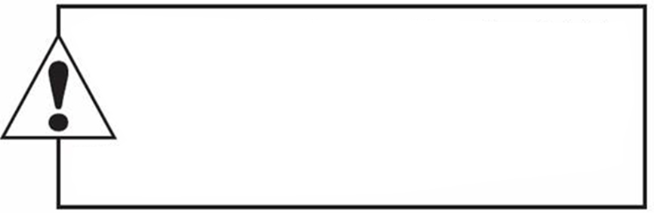
Copyright
This work is protected by United States copyright laws and is provided solely
for the use of instructions in teaching their courses and assessing student
learning. dissemination or sale of any part of this work (including on the
World Wide Web) will destroy the integrity of the work and is not permit-
ted. The work and materials from it should never be made available to
students except by instructors using the accompanying text in their
classes. All recipients of this work are expected to abide by these
restrictions and to honor the intended pedagogical purposes and the needs of
other instructors who rely on these materials.

