Slide 1
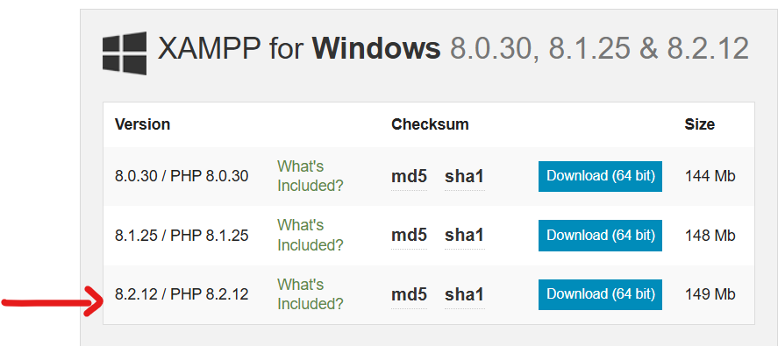
1. Install XAMPP 8.2.12
1. Download XAMPP 8.2.12 from
https://www.apachefriends.org/download.html
of what you see on the browser on the next slide.

Slide 2
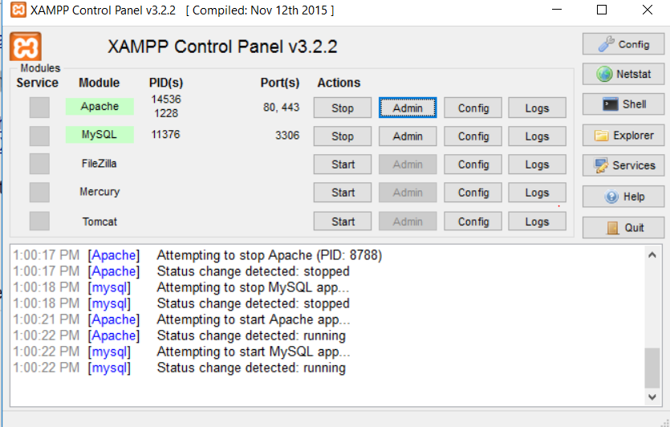
1. Install XAMPP 8.2.12 (Contd.)
2. For installation issues and trouble shooting, please refer to
(Video) https://www.youtube.com/watch?v=CGhzCOOEUJU
(Wiki) https://www.wikihow.com/Install-XAMPP-for-Windows
3. After successful installation and starting Apache, access this link on your browser to see the PHP configuration.
http://localhost/dashboard/phpinfo.php
Install XAMPP
Start XAMPP
Click “Start” for Apache
Access http://localhost

Slide 3
XAMPP Deployment Issues
(Windows and Mac Users) You may get Port conflict issues. Search StackOverFlow or google the error message to figure out how to resolve those issues.
(MAC Users) There were two issues:
1. Site returning an access privilege denial
To solve this make sure rebus file has at least "read" privileges for everyone on your computer. Right click on file, get info, and at bottom give everyone "read" access.
2. When entering link in URL, site downloads files and does not display them.
Try copying all files inside your deployment directory (do not just duplicate the directory) and create a new directory with the copied files. The issue may be coming from hidden files.

Slide 4
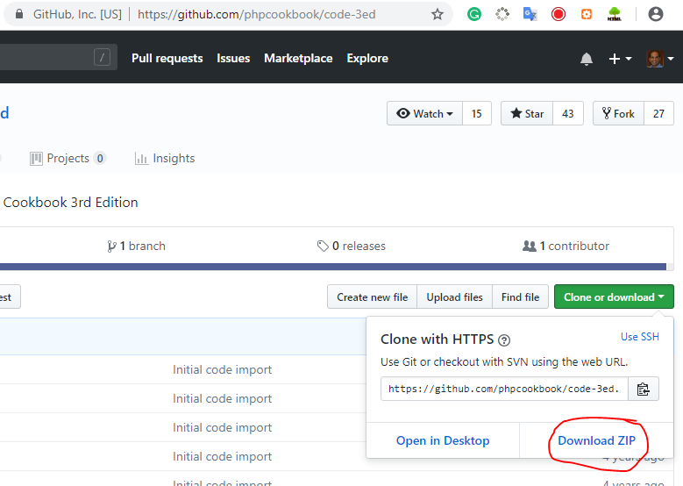
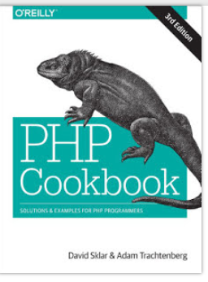
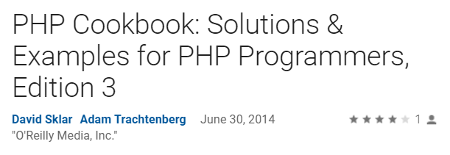
PHP Cookbook 3rd Edition
Download PHP Cookbook from this link
https://github.com/phpcookbook/code-3ed
Extract the contents of this ZIP file to <XAMPP/htdocs> directory.

Slide 5
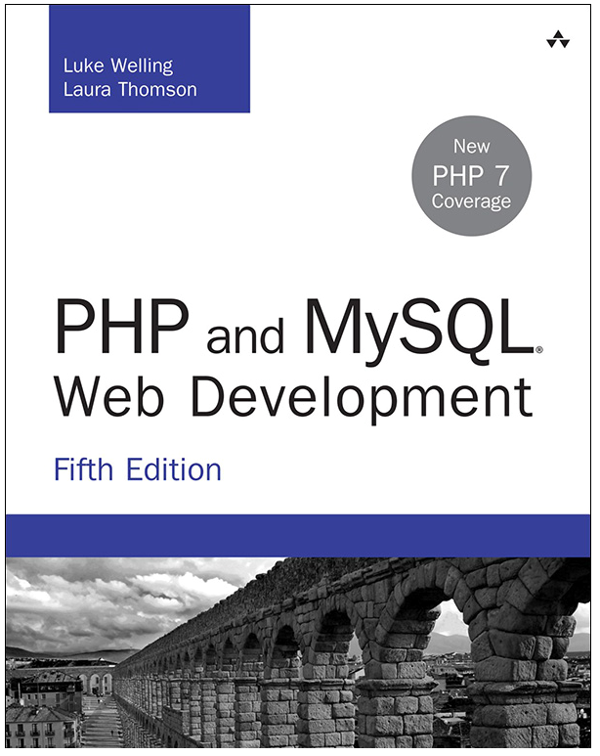
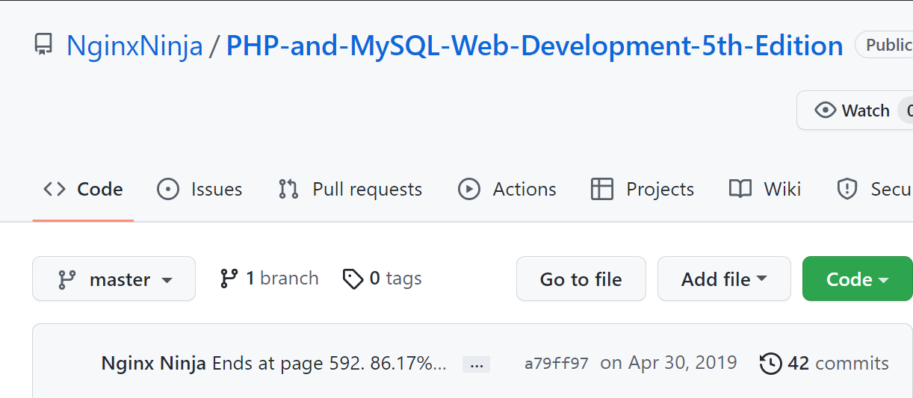
Download the source code (for the book)
from GitHub
https://github.com/NginxNinja/PHP-and-MySQL-Web-Development-5th-Edition

