Slide 1

ICS499 – Software Engineering and Capstone Project
Introduction to SCM
(GitHub)
Siva R Jasthi
Information and Computer Sciences
Metropolitan State University

Slide 2
Outline
[1] Introduction to SCM
[2] What is GIT?
[2] What is GitHub?
[3] Wat is GitHub For Desktop?

Slide 3
Real Scenario
SOLO: 1 person – writing code
Team: 10 to 12 people – writing code
Organization: 100 teams (1000 people)
Locations: 5 continents
Goal: All are contributing to the same product
Windows 3,Windows XP, Windows NT, Windows 2000, Windows 11 Professional

Slide 4
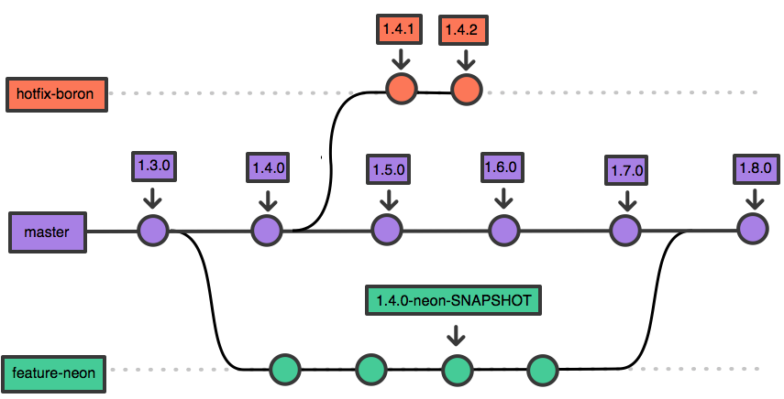
Software Branches or Versions

Slide 5
Software Configuration Management
Let us review
https://en.wikipedia.org/wiki/Software_configuration_management

Slide 6

[1] What is Git?
Git
Git is a Version Control System (VCS).
We use it to track and control changes to source code, configuration files, and documentation.
You can check the history of changes over time.
You can revert back to a previous version if needed.
You can use it solo, but it is particularly useful when working in a team.
Git stores the history of changes in a database called repository.
(repository = folder of source files + .git subdirectory created by Git to story the history)

Slide 7
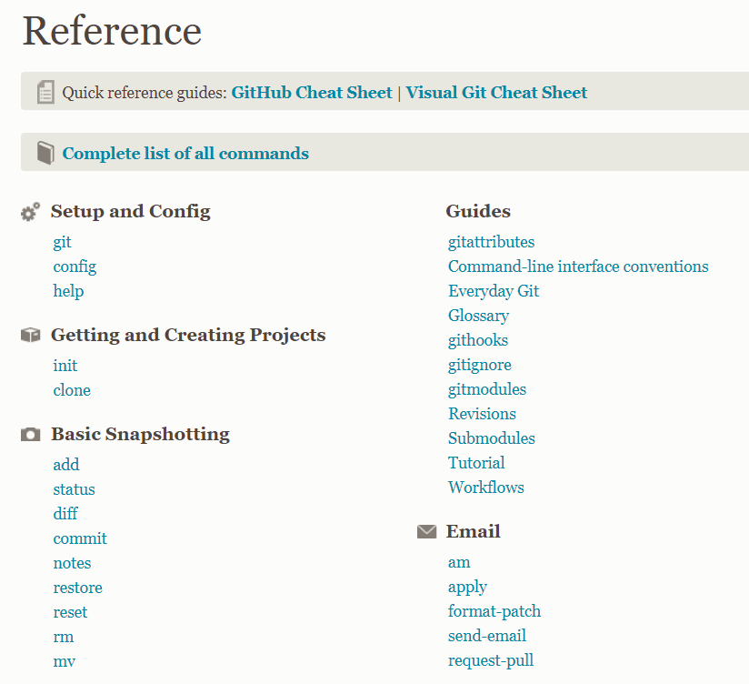
Git - Reference
Git Reference
https://git-scm.com/docs
Visual Git
https://ndpsoftware.com/git-cheatsheet.html

Slide 8
[2] What is GitHub?
GitHub
Don’t we need a place to host our local repositories to collaborate with others?
GitHub is such a place: it is a hosting service for Git repositories on the internet.
And it is free to use for open source projects (which are public. All others can see your code).
GitHub is also social networking site for developers.

Slide 9
[3] What is GitHub Desktop?
GitHub Desktop
The client application provides a GUI (Graphical User Interface) front-end to the most common git commands.
GitHub Desktop simplifies the development workflows and tasks.

Slide 10
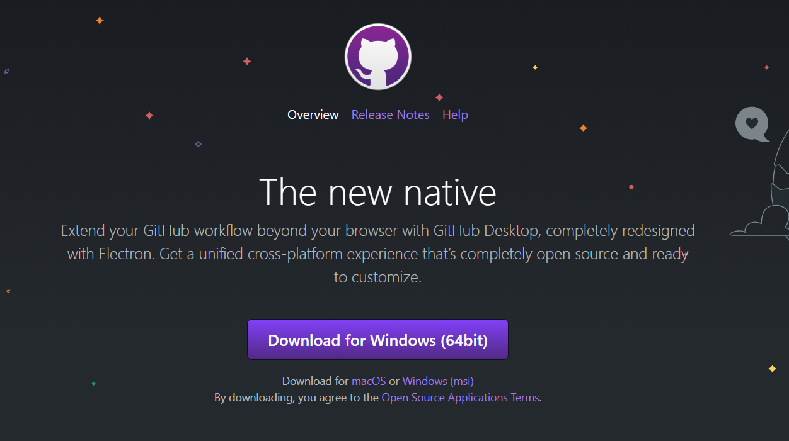
Download GitHub Desktop Client from this link
https://desktop.github.com/

Slide 11
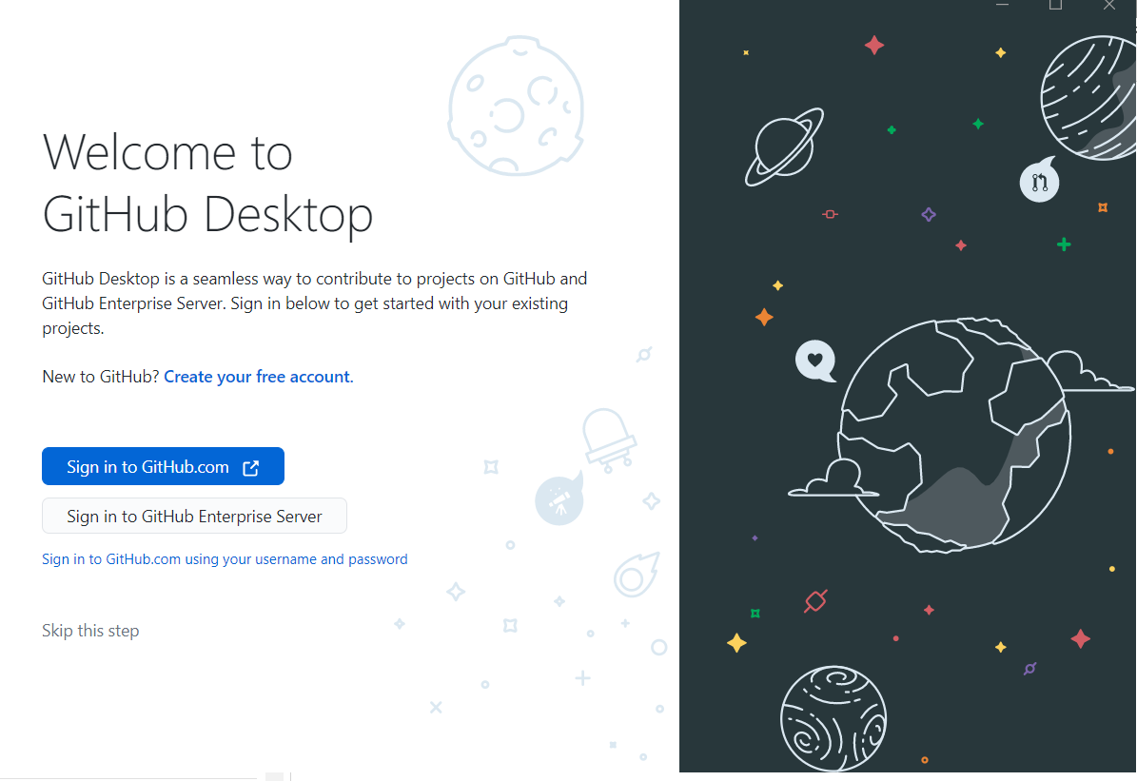

Slide 12

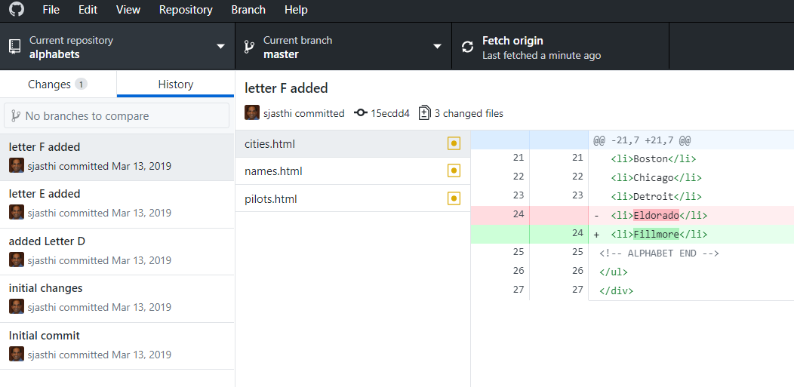
GitHub for Desktop
Learn Git in 20 minutes
https://www.youtube.com/watch?v=IHaTbJPdB-s
GitHub for Desktop
http://desktop.github.com (download)
https://www.youtube.com/watch?v=77W2JSL7-r8

Slide 13
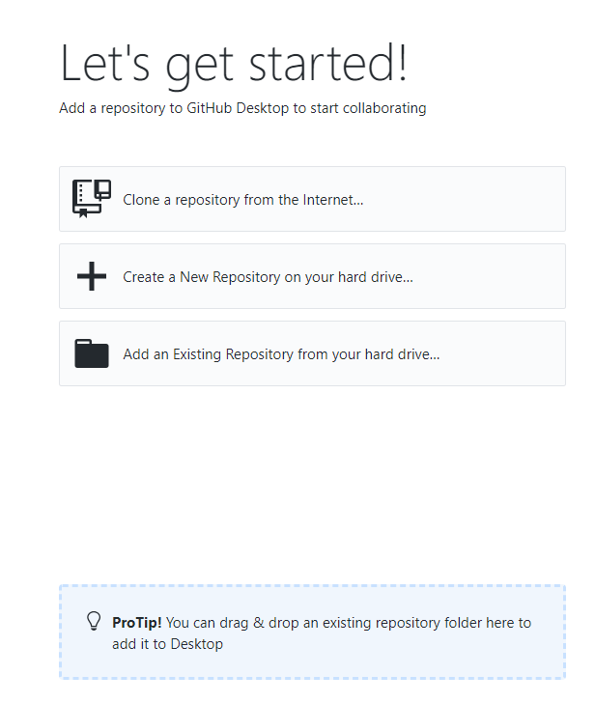
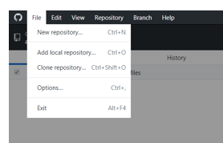
Three ways of creating a Repository

Slide 14
Three ways of creating a Repository
What to do? | Option
You already have a repository on github.com You want to clone that to a local directory on your desktop | Clone a Repository from the internet..
You have an application (or directory) on your local machine. And you want to make it as a git repository. You will also get an opportunity to push it to github.com once you make it as a git repository. | Create new repository on your hard drive..
If you already have a repository locally (*), then you can add it to make it visible in GitHub Desktop. * You may have temporarily removed it from GitHub Desktop to reduce the clutter. | Add an existing repository from your hard drive..

Slide 15
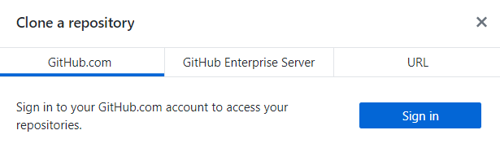
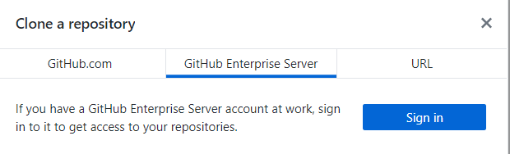
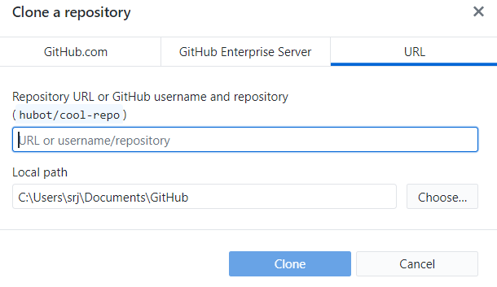
[1] Create a Repository from Internet
For PHP applications, your local directory will be in your “xampp/htdocs” directory

Slide 16
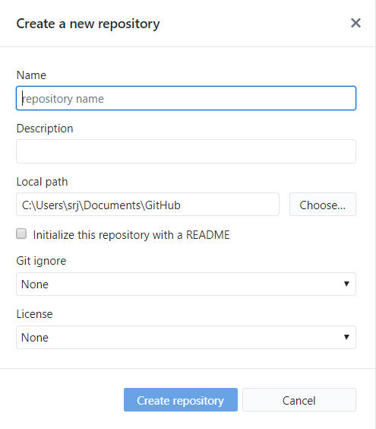
[2] Create a new Repository on your Hard Drive

Slide 17
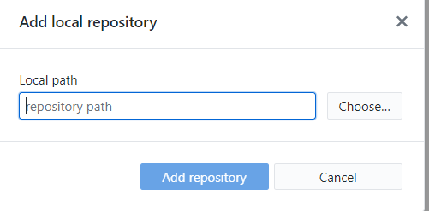
[3] Add an existing Repository from your Hard Drive

Slide 18
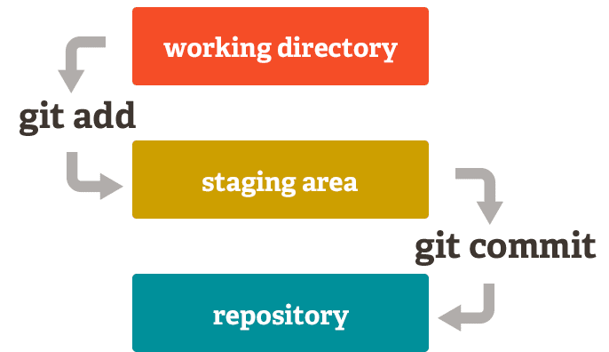
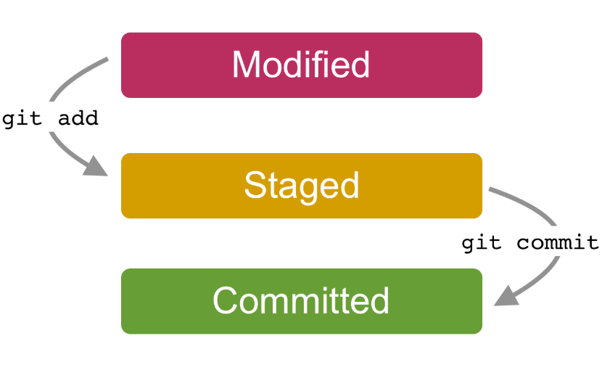
Concept: Staging vs Committing

Slide 19
Recap
What is…
Git
GitHub
GitHub Desktop
Fork
Clone
Staging (Add)
Commit
Push
Pull Request
Fetch
Merge
Pull (fetch + merge)
Sync

