Slide 1

ICS499 – Software Engineering and Capstone Project
Deployment of Web Applications
Siva R Jasthi
Computer Sciences and Cybersecurity
Metropolitan State University

Slide 2
Deployment of Web Applications
Hosting Providers
CPANEL
Subdomains, Databases, FTP Accounts
FileZilla
  (Client to Server)
  (Server to Client

Slide 3









Hosting Providers
https://www.top10.com/hosting/comparison
For example, all my projects are on bluehost

Slide 4
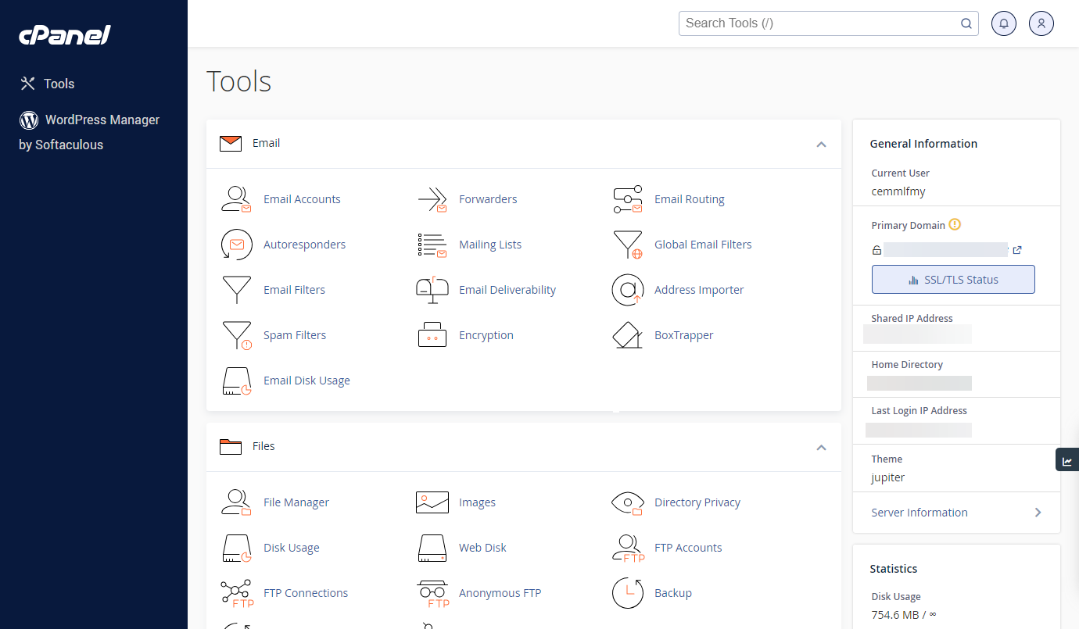
What is cPanel?
cPanel is a web-based control panel used by many hosting providers to manage website hosting accounts.
It provides a graphical interface and automation tools designed to simplify the process of website management for both hosting providers and website owners.

Slide 5
What is Cpanel? (Contd.)
File Management: Users can upload, download, and manage files directly through the control panel using a File Manager.
Email Management: cPanel allows users to create and manage email accounts associated with their domain, set up email forwarding, autoresponders, and spam filters.
Domain Management: Users can add, remove, and manage domain names associated with their hosting account. They can also set up subdomains, addon domains, and parked domains.
Database Management: cPanel provides tools for creating and managing MySQL and PostgreSQL databases, including phpMyAdmin for database administration.
Website Statistics: Users can view various statistics about their website's performance, including traffic, visitor demographics, and bandwidth usage.
One-click Installs: cPanel often includes a feature called Softaculous or Installatron, which allows users to quickly install popular web applications like WordPress, Joomla, and Drupal with just a few clicks.
Security Features: cPanel offers various security features such as password-protected directories, SSL/TLS certificate management, IP address blocking, and more.

Slide 6
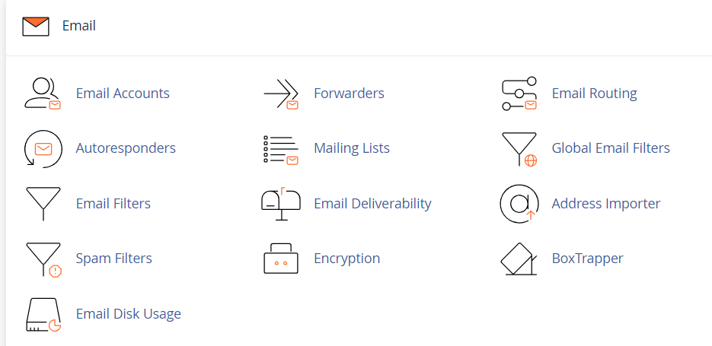
What is Cpanel? (Contd.)

Slide 7
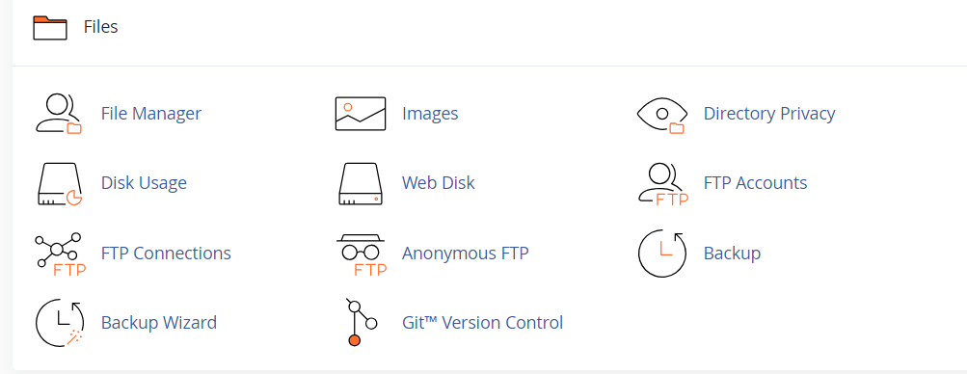
What is Cpanel? (Contd.)

Slide 8
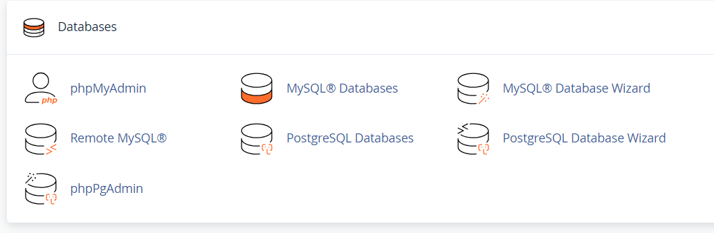
What is Cpanel? (Contd.)

Slide 9
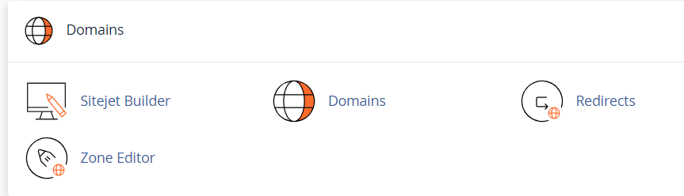
What is Cpanel? (Contd.)

Slide 10
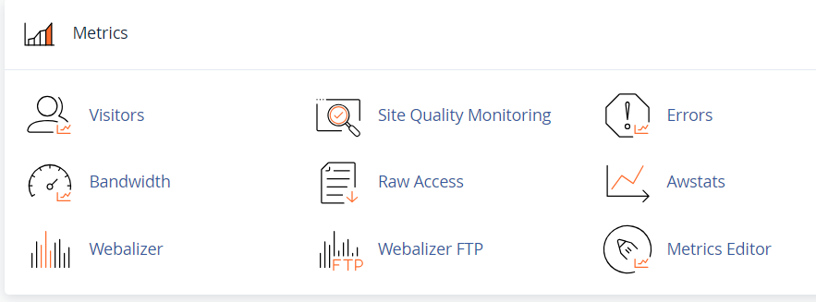
What is Cpanel? (Contd.)

Slide 11
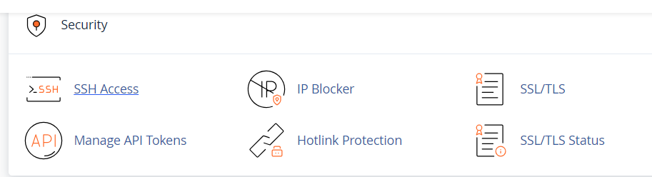
What is Cpanel? (Contd.)

Slide 12
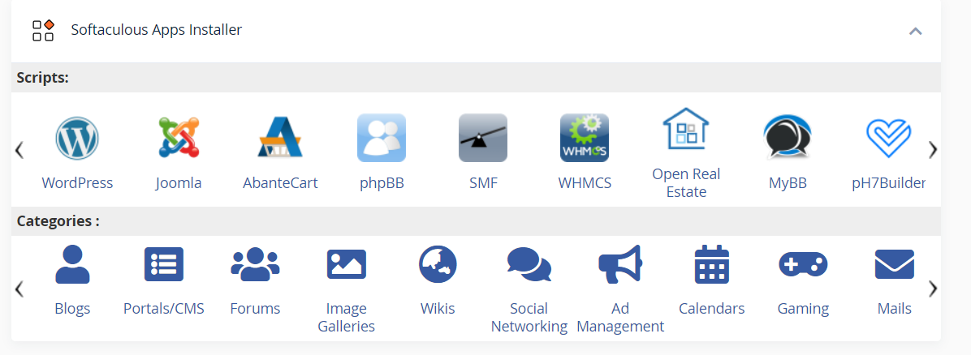
What is Cpanel? (Contd.)

Slide 13
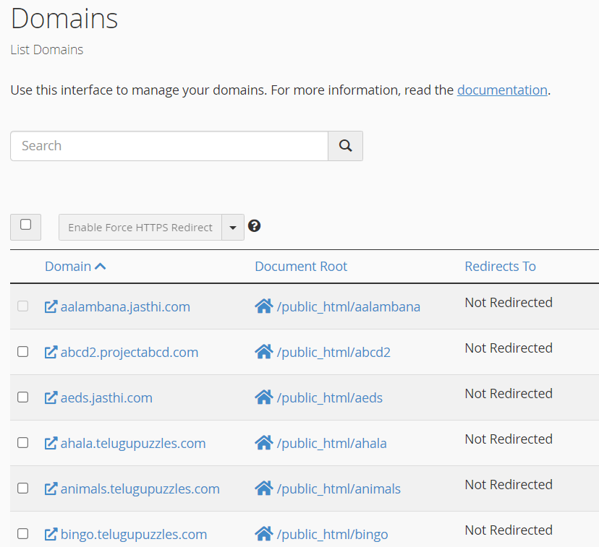
Subdomains

Slide 14
FTP Accounts
Each FTP Account has access to one of the public_html folders on the remote host
You need to use a file transfer client (such as FileZilla) to move the content from the client to server.
Each project is provided with a FTP account (which will be active for the semester).
The FTP account will be disabled at the end of the semester.

Slide 15
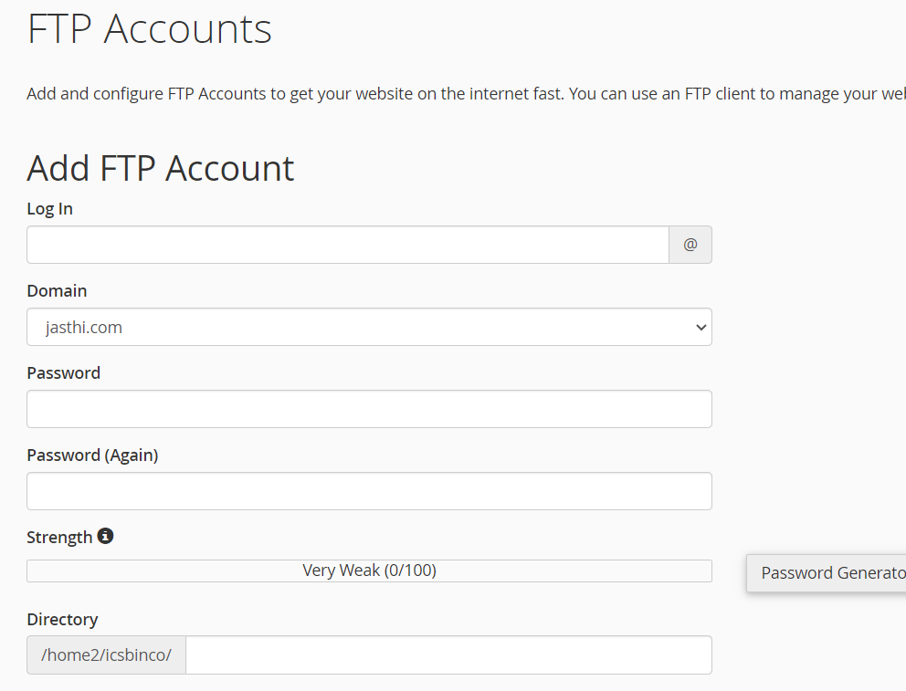
Creation of FTP Accounts

Slide 16
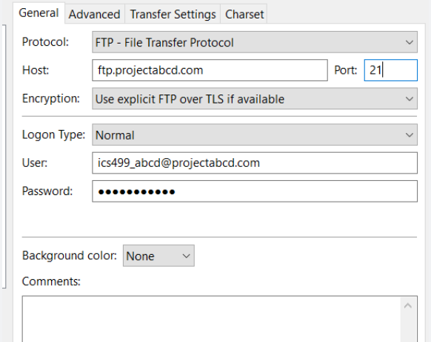
Filezilla (Example 1)
DevOps Engineer: is promoting the code from the FORK to UPSTREAM
Password will be given to the DEVOPS engineer.
They host the code on remote host.
And the DEMO happens on the remote host.

Slide 17
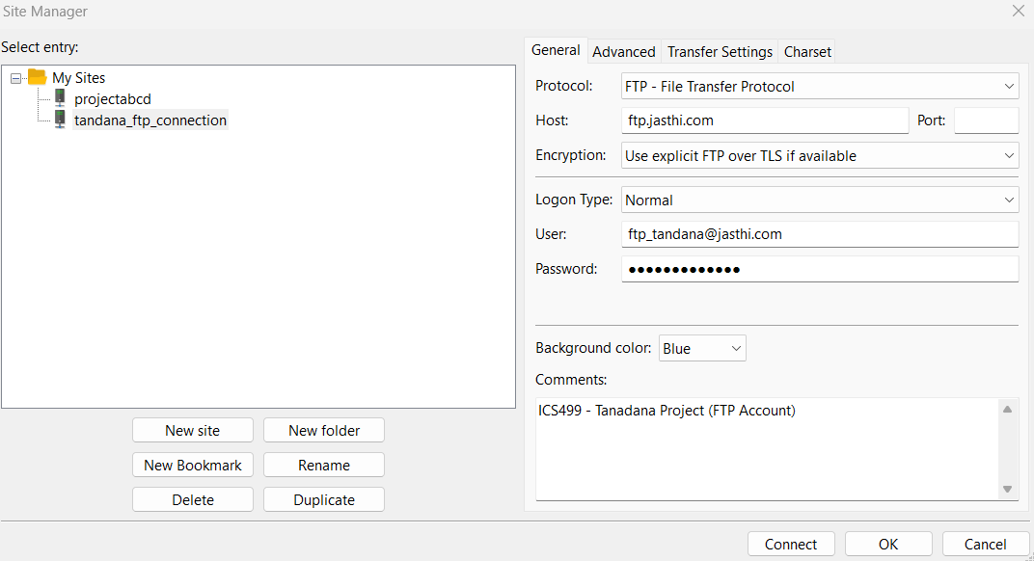
Filezilla (You can save the configuration in FileZilla Client)

Slide 18
Filezilla – File Transfer Considerations
Any file you move from the client to the server will overwrite the existing file on the server.
It is very very important to ensure that you do not cause regressions on the remote host. We should always be making progress.
Do NOT host / move / transfer the db_configuration.php file. It will overwrite the connection information and your system will not work.

Slide 19
Deployment Cheat Sheet
Onetime activity (to be done by Jasthi)
Create a subdomain
Identify a public_html folder to hold the content
Create a database and import the data (eg: icsbinco_tandana_db)
Create a db user and assign the user to the database (eg: isbinco_admin)
Set the configuration in a configuration file (change the db name, db user and password in the *.php file)
Create FTP account and give access to the respective project/folder
Do this every week (by the Project Team)
Move the content from the client (desktop) to the remote host
Perform the testing on the remove host

Slide 20
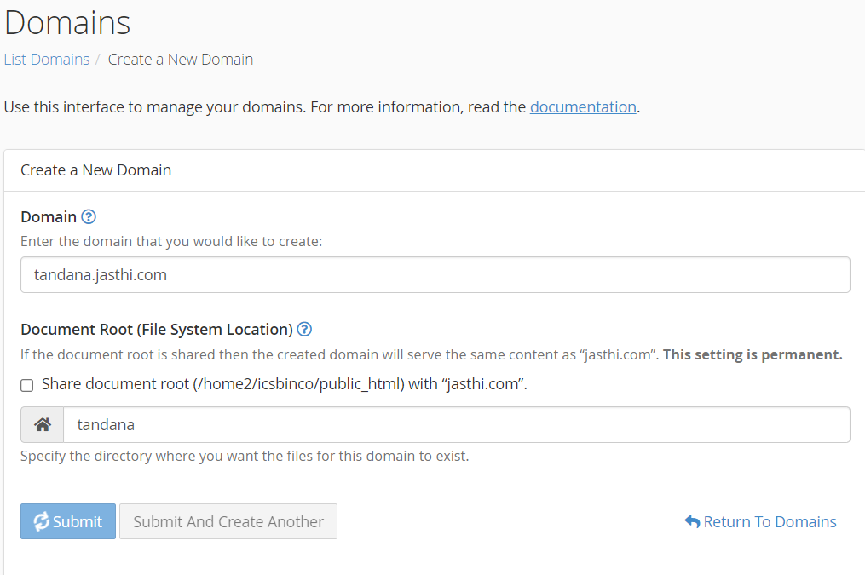
Create a subdomain

Slide 21
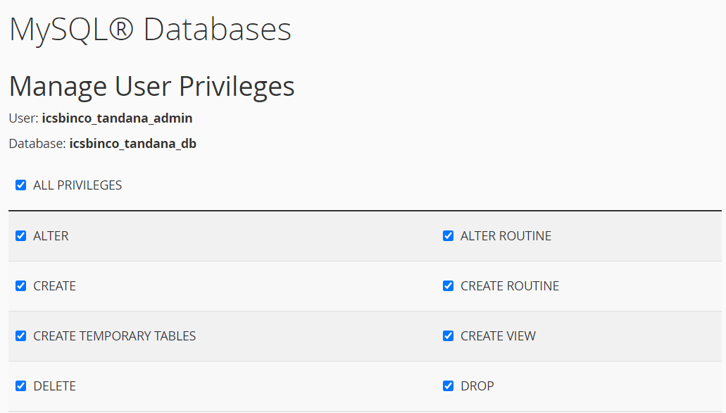
Assigning a user to a database with privileges

Slide 22
Deployment Checklist (Bluehost)
Checklist for Deployment:
Team Info:
Team Name: Dolphins
Team Membership:
DevOps Engineer:
Project Info:
GitHub Link (upstream):
Trello Link:
Localhost Links:
Domain/URL:
Database Name:
Database User Name:
Database User Password:
BlueHost Links (to be provided by instructor)
Domain/URL: version4.projectabcd.com
Database Name: icsbinco_version4abcd_db
Database User Name: icsbinco_version4_user
Database User Password: ICS325_version4
FTP User Name: version4@jasthi.com
FTP User Password: ICS325_version4
FTP home directory: public_html/version4
Deployment Instructions:
Received the instructions from the instructor: ( ) yes ( ) not yet
Team able to deploy changes using FileZilla: ( ) yes ( ) not yet

Slide 23
Summary
Create a subdomain
Identify a public_html folder to hold the content
Create a database and import the data
Set the configuration in a configuration file
Create FTP account and give access to the respective project/folder
Move the content from the client (desktop) to the remote host
Perform the testing on the remove host

Slide 24

Q&A
Notes:
24

