Slide 1

ICS499 – Software Engineering and Capstone Project
Agile Scrum Methodology
Siva Jasthi
Computer Science and Cybersecurity
Metropolitan State University

Slide 2
Outline
Agile Scrum Methodology
Roles
Artifacts
Ceremonies
Tools
References

Slide 3
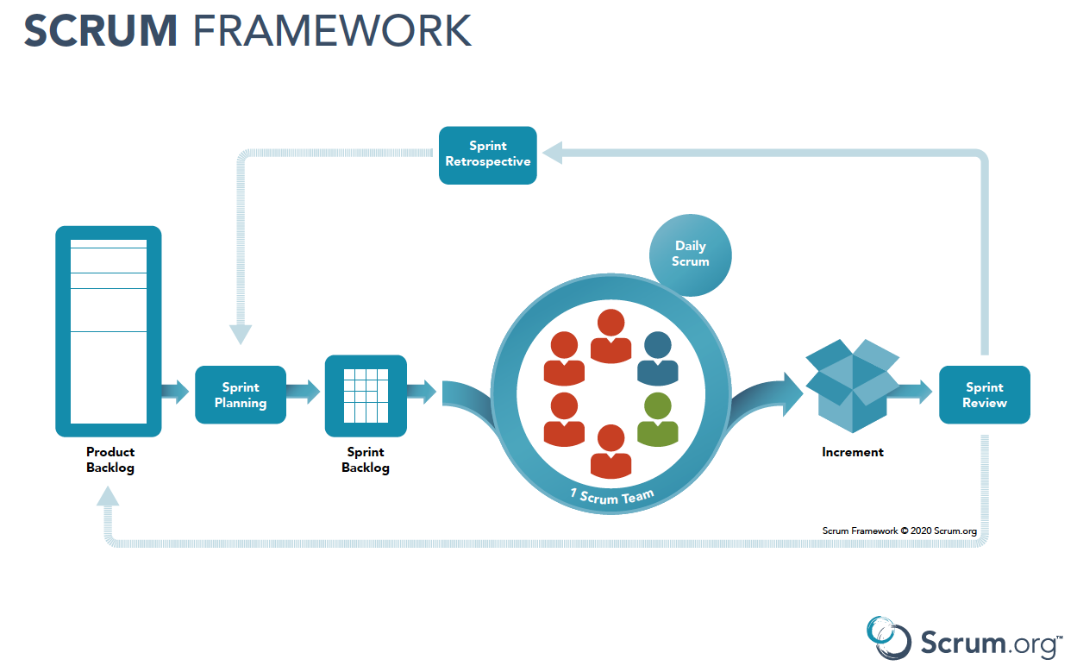
Agile Scrum Methodology
-
https://www.scrum.org/resources/scrum-framework-poster

Slide 4
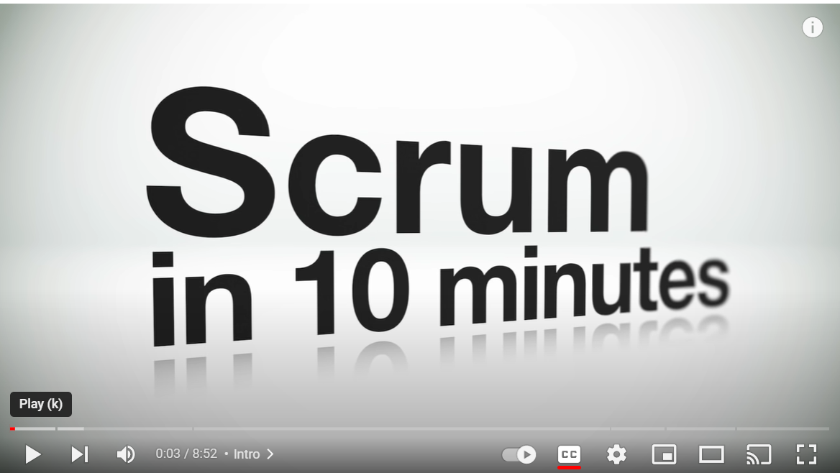
Srum in 10 minutes
-
https://www.youtube.com/watch?v=XU0llRltyFM

Slide 5
Roles
Product Owner
Scrum Master
Development Team

Slide 6
Artifacts
Product Backlog
Release Backlog
Iteration Backlog

Slide 7
Ceremonies
Sprint Planning
Daily Standup meeting
Sprint Planning
Sprint Retrospective

Slide 8
Reports / Monitoring
Burnup Chart
Burndown Chart
User Stories
Story Points

Slide 9
Tools
Numerous tools available (See https://www.ntaskmanager.com/blog/best-scrum-tools/
We will use GITHUB projects in this course.
GitHub Projects
Jira
Trello
Monday.com
Trackit

Slide 10
References
https://www.atlassian.com/agile/scrum
https://www.scrum.org/resources/what-is-scrum
https://www.cprime.com/resources/what-is-agile-what-is-scrum/

Slide 11

Q&A
Notes:
11

