Slide 1
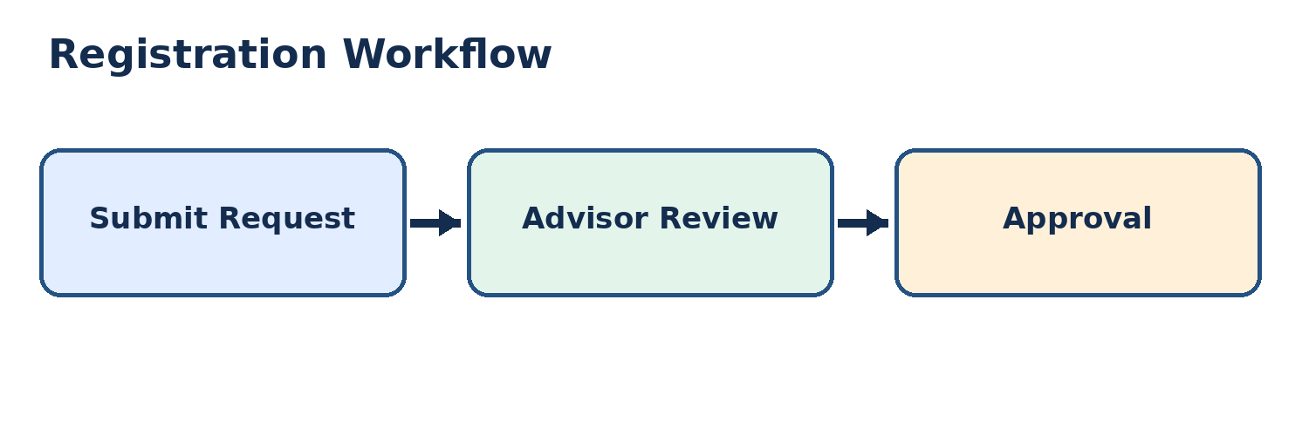
Student Registration: Fall registration requests must be submitted by November 12, 2026. Reference code REG-482. (Fictional test data.)
Registration Task | Processing Time | Responsible Office
Registration Review | 2 business days | Advising
Enrollment Verification | 3 business days | Registrar

Slide 2
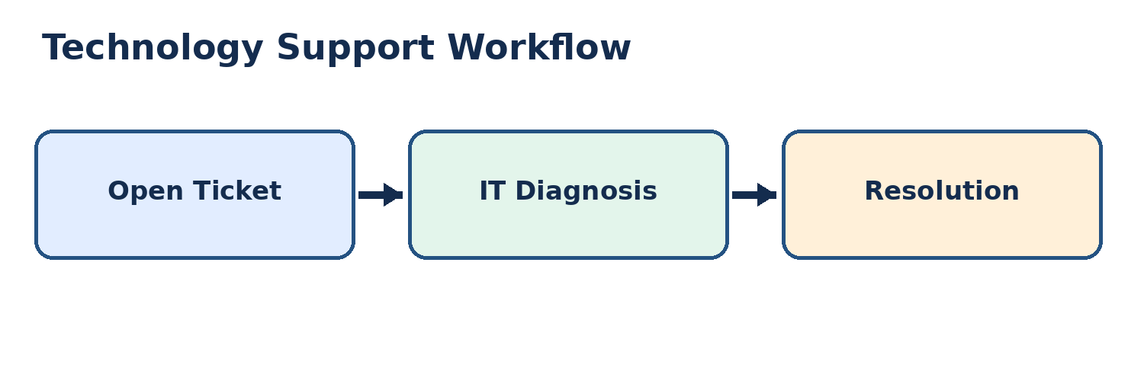
Technology Support: Use reference code TECH-739 for campus technology requests. Priority support reviews occur on Thursdays. (Fictional test data.)
Support Request | Priority | Responsible Team
Password Reset | High | Identity Services
Software Installation | Normal | Desktop Support

