Slide 1
Python 101 Auto Grader
Design of the program

Slide 2
Representing a Student Data
(dictionary containing a dictionary)
KEY | VALUE
Quiz1 | None
Quiz2 | None
Quiz3 | 10.0
lab1 | 10.0
 | 10.0
 | …
 | ..
 | …
 | None
Final_project | None
KEY | VALUE
last | ln1
first | fn1
email | fn1.ln1@learnandhelp.com
scores

Slide 3
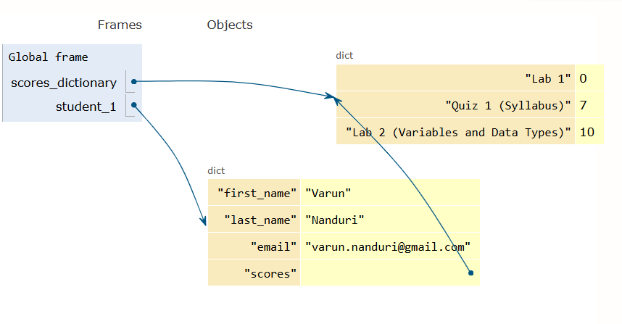
Representing a Student Data
(dictionary containing a dictionary)

Slide 4
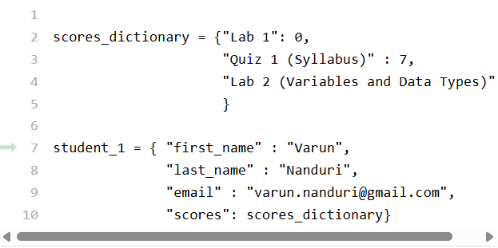
Representing a Student Data
(dictionary containing a dictionary)

Slide 5
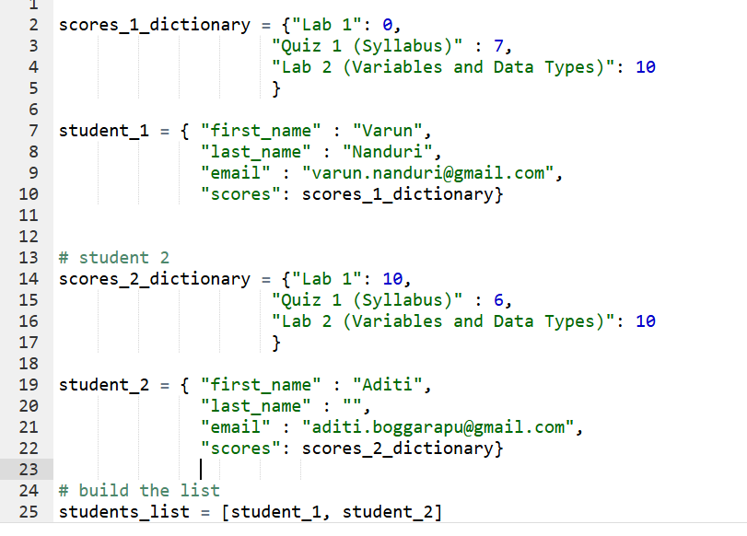
Representing two Students
(dictionary containing a dictionary)

Slide 6
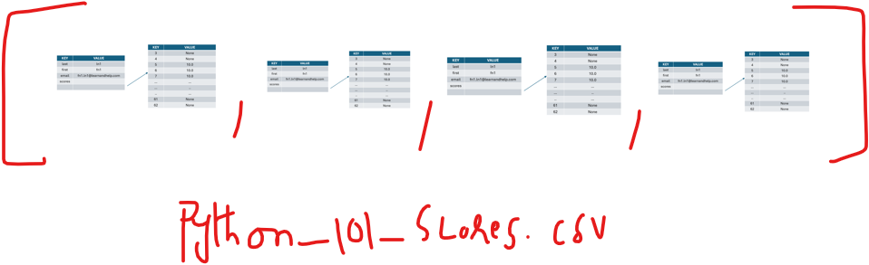
Representing all Students
(list of student dictionaries)

Slide 7
To be continued

Slide 8
email_lookup: {'fn1.ln1@learnandhelp.com': {'p1_name': 'P2FNameln1fn1 P1LName ln1fn1', 'p1_email': 'P1_.fn1.ln1@learnandhelp.com', 'p2_name': 'P2FNameln1fn1 P2LName ln1fn1', 'p2_email': 'P2_.fn1.ln1@learnandhelp.com'}, 'fn2.ln2@learnandhelp.com': {'p1_name': 'P2FNameln2fn2 P1LName ln2fn2', 'p1_email': 'P1_.fn2.ln2@learnandhelp.com', 'p2_name': 'P2FNameln2fn2 P2LName ln2fn2', 'p2_email': 'P2_.fn2.ln2@learnandhelp.com'}, 'fn3.ln3@learnandhelp.com': {'p1_name': 'P2FNameln3fn3 P1LName ln3fn3', 'p1_email': 'P1_.fn3.ln3@learnandhelp.com', 'p2_name': 'P2FNameln3fn3 P2LName ln3fn3', 'p2_email': 'P2_.fn3.ln3@learnandhelp.com'}, 'fn4.ln4@learnandhelp.com': {'p1_name': 'P2FNameln4fn4 P1LName ln4fn4', 'p1_email': 'P1_.fn4.ln4@learnandhelp.com', 'p2_name': 'P2FNameln4fn4 P2LName ln4fn4', 'p2_email': 'P2_.fn4.ln4@learnandhelp.com'}, 'fn5.ln5@learnandhelp.com': {'p1_name': 'P2FNameln5fn5 P1LName ln5fn5', 'p1_email': 'P1_.fn5.ln5@learnandhelp.com', 'p2_name': 'P2FNameln5fn5 P2LName ln5fn5', 'p2_email': 'P2_.fn5.ln5@learnandhelp.com'}, 'fn6.ln6@learnandhelp.com': {'p1_name': 'P2FNameln6fn6 P1LName ln6fn6', 'p1_email': 'P1_.fn6.ln6@learnandhelp.com', 'p2_name': 'P2FNameln6fn6 P2LName ln6fn6', 'p2_email': 'P2_.fn6.ln6@learnandhelp.com'}, 'fn7.ln7@learnandhelp.com': {'p1_name': 'P2FNameln7fn7 P1LName ln7fn7', 'p1_email': 'P1_.fn7.ln7@learnandhelp.com', 'p2_name': 'P2FNameln7fn7 P2LName ln7fn7', 'p2_email': 'P2_.fn7.ln7@learnandhelp.com'}, 'fn8.ln8@learnandhelp.com': {'p1_name': 'P2FNameln8fn8 P1LName ln8fn8', 'p1_email': 'P1_.fn8.ln8@learnandhelp.com', 'p2_name': '', 'p2_email': ''}, 'fn9.ln9@learnandhelp.com': {'p1_name': 'P2FNameln9fn9 P1LName ln9fn9', 'p1_email': 'P1_.fn9.ln9@learnandhelp.com', 'p2_name': '', 'p2_email': ''}, 'fn10.ln10@learnandhelp.com': {'p1_name': 'P2FNameln10fn10 P1LName ln10fn10', 'p1_email': 'P1_.fn10.ln10@learnandhelp.com', 'p2_name': '', 'p2_email': ''}, 'fn11.ln11@learnandhelp.com': {'p1_name': 'P2FNameln11fn11 P1LName ln11fn11', 'p1_email': 'P1_.fn11.ln11@learnandhelp.com', 'p2_name': '', 'p2_email': ''}, 'fn12.ln12@learnandhelp.com': {'p1_name': 'P2FNameln12fn12 P1LName ln12fn12', 'p1_email': 'P1_.fn12.ln12@learnandhelp.com', 'p2_name': '', 'p2_email': ''}, 'fn13.ln13@learnandhelp.com': {'p1_name': 'P2FNameln13fn13 P1LName ln13fn13', 'p1_email': 'P1_.fn13.ln13@learnandhelp.com', 'p2_name': '', 'p2_email': ''}, 'fn14.ln14@learnandhelp.com': {'p1_name': 'P2FNameln14fn14', 'p1_email': 'P1_.fn14.ln14@learnandhelp.com', 'p2_name': 'P2FNameln14fn14 P2LName ln14fn14', 'p2_email': 'P2_.fn14.ln14@learnandhelp.com'}, 'fn15.ln15@learnandhelp.com': {'p1_name': 'P2FNameln15fn15', 'p1_email': 'P1_.fn15.ln15@learnandhelp.com', 'p2_name': 'P2FNameln15fn15 P2LName ln15fn15', 'p2_email': 'P2_.fn15.ln15@learnandhelp.com'}, 'fn16.ln16@learnandhelp.com': {'p1_name': 'P2FNameln16fn16 P1LName ln16fn16', 'p1_email': 'P1_.fn16.ln16@learnandhelp.com', 'p2_name': 'P2FNameln16fn16 P2LName ln16fn16', 'p2_email': 'P2_.fn16.ln16@learnandhelp.com'}, 'fn17.ln17@learnandhelp.com': {'p1_name': 'P2FNameln17fn17 P1LName ln17fn17', 'p1_email': 'P1_.fn17.ln17@learnandhelp.com', 'p2_name': 'P2FNameln17fn17 P2LName ln17fn17', 'p2_email': 'P2_.fn17.ln17@learnandhelp.com'}, 'fn18.ln18@learnandhelp.com': {'p1_name': 'P2FNameln18fn18 P1LName ln18fn18', 'p1_email': 'P1_.fn18.ln18@learnandhelp.com', 'p2_name': 'P2FNameln18fn18 P2LName ln18fn18', 'p2_email': ''}, 'fn19.ln19@learnandhelp.com': {'p1_name': 'P2FNameln19fn19 P1LName ln19fn19', 'p1_email': 'P1_.fn19.ln19@learnandhelp.com', 'p2_name': 'P2FNameln19fn19 P2LName ln19fn19', 'p2_email': ''}, 'fn20.ln20@learnandhelp.com': {'p1_name': 'P2FNameln20fn20', 'p1_email': 'P1_.fn20.ln20@learnandhelp.com', 'p2_name': '', 'p2_email': ''}, 'fn21.ln21@learnandhelp.com': {'p1_name': 'P2FNameln21fn21', 'p1_email': 'P1_.fn21.ln21@learnandhelp.com', 'p2_name': 'P2FNameln21fn21 P2LName ln21fn21', 'p2_email': 'P2_.fn21.ln21@learnandhelp.com'}, 'fn22.ln22@learnandhelp.com': {'p1_name': 'P2FNameln22fn22', 'p1_email': 'P1_.fn22.ln22@learnandhelp.com', 'p2_name': 'P2FNameln22fn22 P2LName ln22fn22', 'p2_email': 'P2_.fn22.ln22@learnandhelp.com'}, 'fn23.ln23@learnandhelp.com': {'p1_name': 'P2FNameln23fn23 P1LName ln23fn23', 'p1_email': 'P1_.fn23.ln23@learnandhelp.com', 'p2_name': 'P2FNameln23fn23 P2LName ln23fn23', 'p2_email': 'P2_.fn23.ln23@learnandhelp.com'}, 'fn24.ln24@learnandhelp.com': {'p1_name': 'P2FNameln24fn24 P1LName ln24fn24', 'p1_email': 'P1_.fn24.ln24@learnandhelp.com', 'p2_name': 'P2FNameln24fn24 P2LName ln24fn24', 'p2_email': 'P2_.fn24.ln24@learnandhelp.com'}, 'fn25.ln25@learnandhelp.com': {'p1_name': 'P2FNameln25fn25 P1LName ln25fn25', 'p1_email': 'P1_.fn25.ln25@learnandhelp.com', 'p2_name': 'P2FNameln25fn25 P2LName ln25fn25', 'p2_email': 'P2_.fn25.ln25@learnandhelp.com'}, 'fn26.ln26@learnandhelp.com': {'p1_name': 'P2FNameln26fn26 P1LName ln26fn26', 'p1_email': 'P1_.fn26.ln26@learnandhelp.com', 'p2_name': 'P2FNameln26fn26 P2LName ln26fn26', 'p2_email': 'P2_.fn26.ln26@learnandhelp.com'}, 'fn27.ln27@learnandhelp.com': {'p1_name': 'P2FNameln27fn27 P1LName ln27fn27', 'p1_email': 'P1_.fn27.ln27@learnandhelp.com', 'p2_name': 'P2FNameln27fn27 P2LName ln27fn27', 'p2_email': 'P2_.fn27.ln27@learnandhelp.com'}, 'fn28.ln28@learnandhelp.com': {'p1_name': 'P2FNameln28fn28 P1LName ln28fn28', 'p1_email': 'P1_.fn28.ln28@learnandhelp.com', 'p2_name': 'P2FNameln28fn28 P2LName ln28fn28', 'p2_email': 'P2_.fn28.ln28@learnandhelp.com'}, 'fn29.ln29@learnandhelp.com': {'p1_name': 'P2FNameln29fn29 P1LName ln29fn29', 'p1_email': 'P1_.fn29.ln29@learnandhelp.com', 'p2_name': 'P2FNameln29fn29 P2LName ln29fn29', 'p2_email': 'P2_.fn29.ln29@learnandhelp.com'}, 'fn30.ln30@learnandhelp.com': {'p1_name': 'P2FNameln30fn30 P1LName ln30fn30', 'p1_email': 'P1_.fn30.ln30@learnandhelp.com', 'p2_name': 'P2FNameln30fn30 P2LName ln30fn30', 'p2_email': 'P2_.fn30.ln30@learnandhelp.com'}}

Slide 9
'fn28.ln28@learnandhelp.com': {'p1_name': 'P2FNameln28fn28 P1LName ln28fn28', 'p1_email': 'P1_.fn28.ln28@learnandhelp.com', 'p2_name': 'P2FNameln28fn28 P2LName ln28fn28', 'p2_email': 'P2_.fn28.ln28@learnandhelp.com}
KEY | VALUE
p1_name | 'P2FNameln28fn28 P1LName ln28fn28
p1_email | P1_.fn28.ln28@learnandhelp.com
p2_name | 'P2FNameln28fn28 P2LName ln28fn28
p2_email | 'P2_.fn28.ln28@learnandhelp.com
KEY | VALUE
Fn28.ln28@learnandhelp.com

Slide 10
